Slide 1

Change as Opportunity: Re-Vamping LibGuides to Better Engage Students
Jennifer Bazeley & Jennifer Natale

Slide 2

Overview
Review our migration process to 2.0
Share our revised standards and best practices that we learned through the process
Only subscribe to LibGuides
Notes:
JN

Slide 3
Preparing to Migrate to 2.0
Established working group
Review of literature and other sites
Examined Springshare’s resources and timelines
Evaluation of our own sites
Notes:
JB
Established working group
Literature Review - reviewed literature available as well as looked at other institution’s guides.
Review documentation provided by Springshare including estimated timelines
Analyze and revise existing standards by critically evaluating our own guides

Slide 4
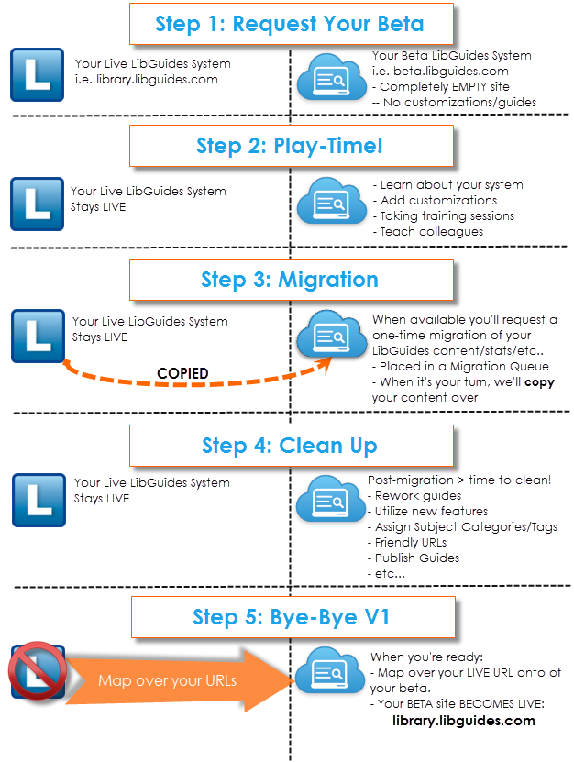
Notes:
JB
Springshare chart

Slide 5
Before Migration
Current state lacked consistency and uniformity
ADA Compliance concerns
Usability low, not engaging
Increase in online learning
Notes:
JB
Loose standards were created when LibGuides v.1 was implemented in 2009 but no enforcement
Over time, lack of consistency & uniformity on subject guides both in structure and content choices
Issues
ADA compliance problems; university focus on online learning means we need to be more conscientious about this
lack of friendly URLs
clutter, especially on subject guides intended for undergrads
inconsistency in fonts, layout, formatting, box colors, use of images (especially link resolver button & librarian photos)
Look to usage statistics from LibGuides v.1 to guide content decisions for v.2
Increase in online learning

Slide 6
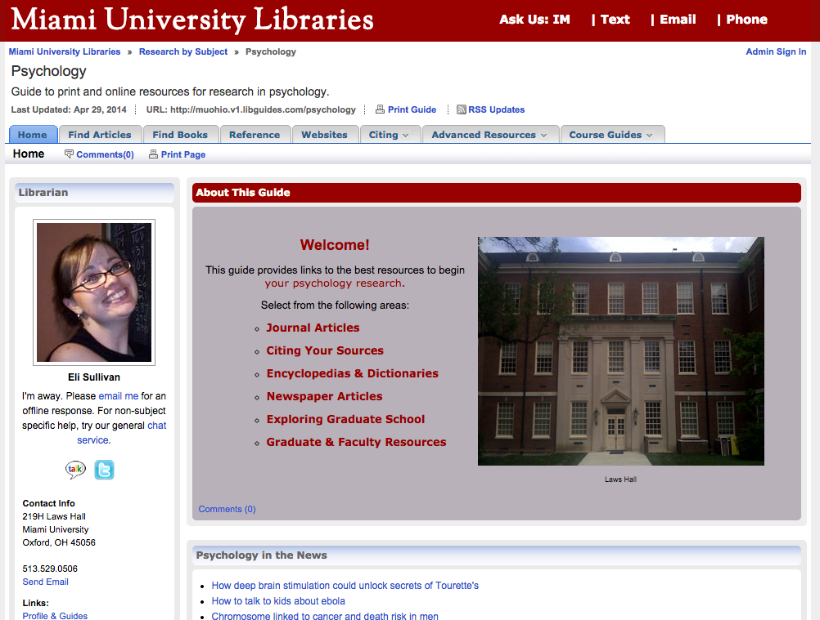
Notes:
JB
color/font
informal photos
photos of buildings
many tabs

Slide 7
Migration Planning Process
Basecamp & Google Docs
Springshare documentation & lounge
Pre-migration clean-up checklist from Springshare
Setting a schedule
Notes:
JB
Basecamp & Google docs
Springshare documentation & Springshare Lounge
http://support.springshare.com/libguides
http://springsharelounge.com/groups/group/show?groupUrl=libguides-2
Pre-Migration Clean-Up Checklists from Springshare
http://support.springshare.com/libguides/migration
http://support.springshare.com/libguides/migration/v1cleanup
Setting a schedule: Conscious choice to migrate over the summer when staff would have more time to make improvements; also lined up with library website re-design at same time

Slide 8
Our Timeline
September 2013 (Springshare announces upgrade)
Access to v.2 beta site available on 3/24/14
Librarian LibGuides meeting 5/21/14
Migration to v. 2 production 5/24/14
Librarian access to v. 2 production 6/3/14
  Clean-up begins
V. 2 goes live 8/3/14
Notes:
JB
September 2013 (Springshare announcement of upgrade)
Access to v.2 beta site available on 3/24/14
Librarian LibGuides meeting 5/21/14
Migration to v. 2 production 5/24/14
Librarian access to v. 2 production 6/3/14
Clean-up begins (DEADLINES!)
V. 2 goes live 8/3/14

Slide 9
Usability Testing
Originally done Spring 2011
With access to beta site, mock up of 2.0 site with our initial ideas for improvement
Compared usability of 1.0 to 2.0
Captured with Camtasia
Notes:
JN

Slide 10
Usability Results
2.0 preferred, more modern
“Cleaner”, less cluttered
Tended to choose the first link they saw
Used search boxes like Google
Notes:
JN

Slide 11
New Standards
Standardized look and feel for subject guides
Improve accessibility
Thoughtfully consider topic, purpose and intended audience
“Less is more” approach
Notes:
JN

Slide 12
Home Page of Subject Guides
Profile box with professional photo
Quick links
Best bets
Friendly URL
Concise content
Notes:
JN

Slide 13
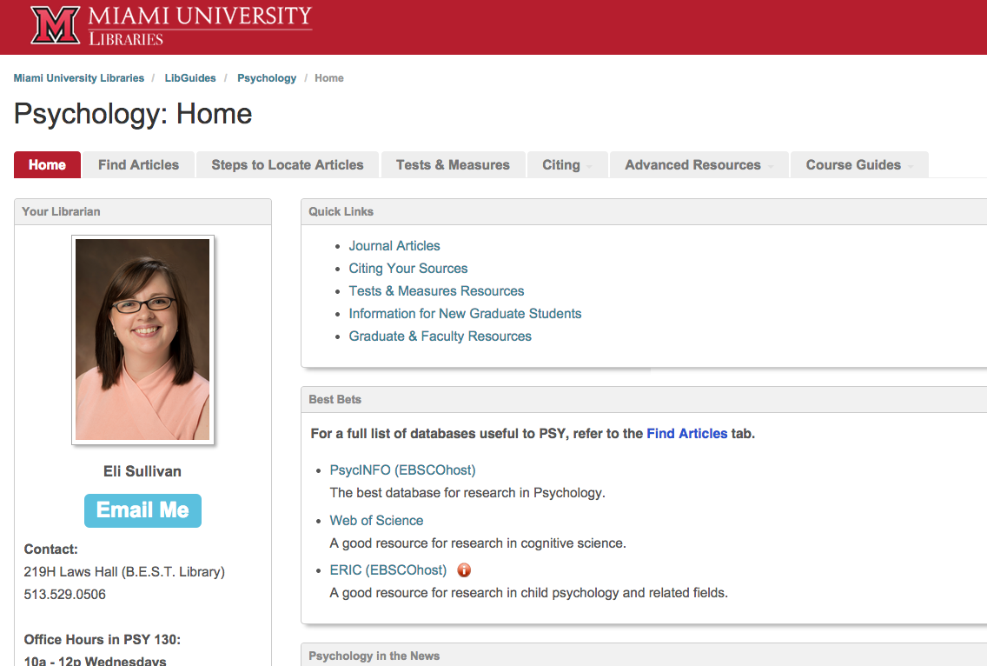
Notes:
JN

Slide 14
Notes:
JN

Slide 15
Engage Colleagues
Outlined our timeline
Shared usability results
Previewed 2.0
Encouraged pre-migration cleanup
“We’re here to help!” mentality
Notes:
JN

Slide 16
Working Group Responsibilities
Behind the scenes clean-up
Troubleshooting
Division of labor
Notes:
JB
Guide cleanup: in some cases it was easier for the working group to clean up behind the scenes.
Division of labor
Working Group members
Division of guides among us for basic post-migration check in August
did all content migrate from old guide? check for missing pages, drop-down menus, boxes
did links/descriptions migrate from old guide?
RSS errors for those who had RSS feeds
Subject assignments: working group cleaned up existing subjects, added new, and made initial assignments of subjects to subject libguides
E-Resources librarians
Links (proxy, etc.): many broken links, many incorrect uses of the proxy prefix; abuse of proxy prefix; 3 prefixes mean confusion for users
Databases A to Z: checked all database links for currency; some had not been updated to match links in our catalog/website. Assigned subjects to databases.
Images: uploading standard images for link resolver icon and OhioLINK consortia icon (used in many guides)
Content that didn’t migrate: in some cases, Springshare developers were able to move missing content; some content had to be manually re-created

Slide 17
Surprises, Frustrations, Improvements
Ownership
CSS customization
Link migration
Links to other LibGuides
Improvements in 2.0
Notes:
JB
Ownership (editors versus admins, etc.)
Guides that were previously co-owned became 1 owner, 1 editor. Initially, only the owner of the guide could update content that he/she created; editors could not edit that content.
CSS customization
The ability to customize was not available immediately but was added by Springshare in small increments over time.
Link migration (or lack thereof)
Duplicate links that matched links in Databases A to Z did not get mapped to A to Z due to a misunderstanding on my part of the documentation.
Links to other LibGuides
Links within libguides that go to other libguides did not update automatically with migration; had to be done manually.
Improvements in LibGuides 2.0 - What Made Migration Easier
Assets / Databases A-Z
Image Manager
Link Checker
Search and Replace

Slide 18
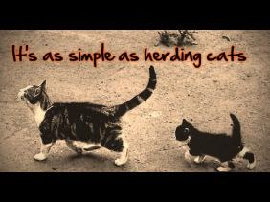
From SLCC Digital Archives
Notes:
JB

Slide 19
Staff Training
Workshops as soon as “live”
Step by step to meet new standards
Checklist
LibGuide Standards & How-to’s
Drop-in sessions for help
Notes:
JN

Slide 20
Next Steps
Additional customization
Improving topic guides
Training on statistics
Creating re-usable info lit content
Template for online courses
Usability testing
Notes:
JB - Additional customization, improving topic guides, training on stats
Additional customization of templates for public interface to match library website re-design (custom colors and layouts) (Bazeley)
Improving topic & course guides - planning for Summer 2015 (Bazeley)
Training on stats - using information to make to decisions/usability (Bazeley) - planning for January 2015
JN - Creating re-usable info lit content, template for online courses, usability testing

Slide 21
Questions?
Handout has the link to our LibGuide Standards & How-to’s which contains:
Literature review
Standards & Checklist
Slides from training
FAQ’s, tips

