Slide 1
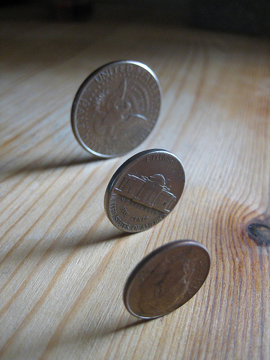
Privacy and Sharing:
Two Sides of the Same Coin?
Notes:
Thanks, XXX. And hi everyone. I’m happy to be here.
So I was asked to give this presentation way back last December, and that seems like a very long time ago. For one, William and Kate had only just announced they were pregnant with the Royal Baby.

Slide 2
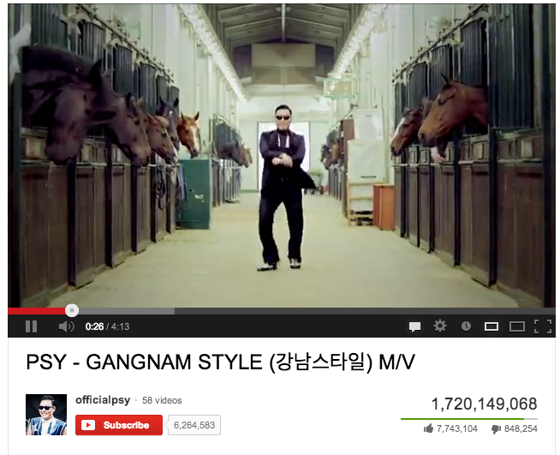
Notes:
In the online world, Gangnam Style became the first YouTube video to hit one billion views

Slide 3

Notes:
Syria had entered its third day of its government blocking the Internet and telephone communications from its citizens

Slide 4
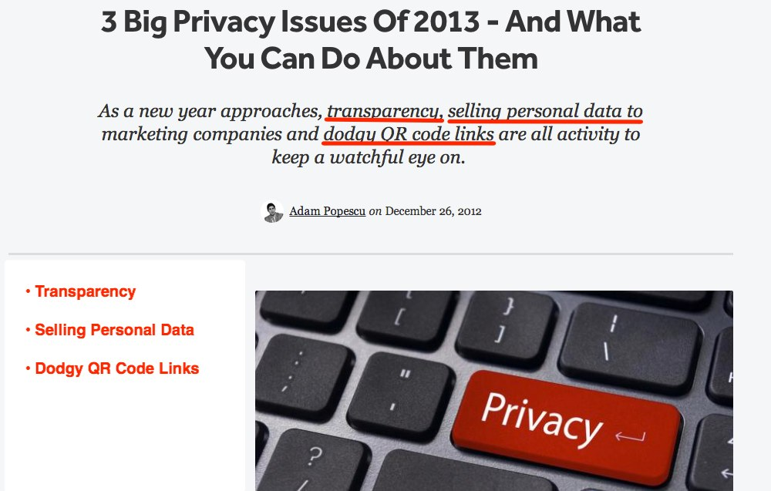
Notes:
And Read Write Web identified the three biggest privacy issues for 2013 as transparency, selling personal data to marketing companies, and dodgy QR code links. All these things, except for maybe the Royal Baby, were pertinent to my talk today.

Slide 5
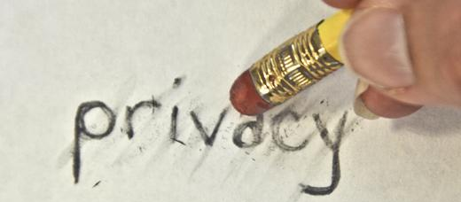

Notes:
I also teach a class here at Miami, “Information in the Digital World.” During that class I generally spend a week or so on privacy and sharing

Slide 6
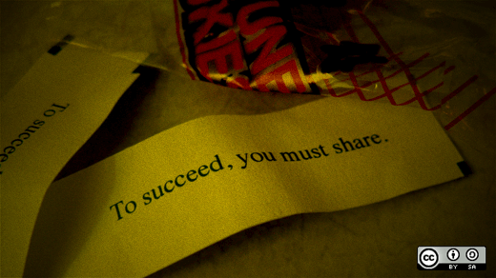
Notes:
And much of my work as a librarian here involves me talking with librarians and faculty about sharing their work by providing open access to their scholarly articles. And - also as a librarian - I spend a fair amount of time thinking about – and talking about – privacy.

Slide 7
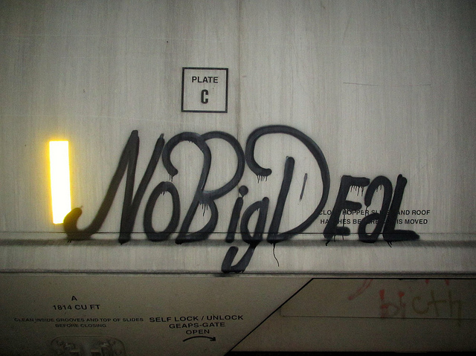
Notes:
So back in December, being asked to give this presentation was kind of a no-brainer. It was going to be no big deal. I figured I had the material, and I and I keep fairly current with new developments. I would just need to re-package it and re-tailor it to fit this audience instead of an audience of college students. No big deal, right?

Slide 8

Notes:
Well, there have been two major developments that have happened since last December that have made me rethink my entire presentation. In fact, both of them have happened in the last two months.

Slide 9

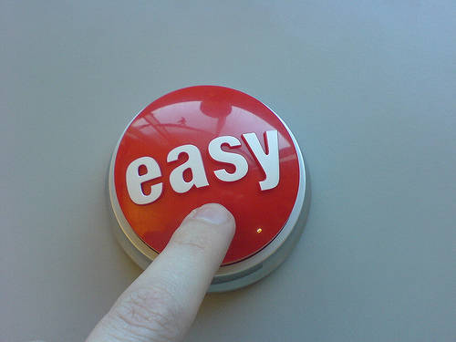
Notes:
The first one is pretty easy to guess.

Slide 10
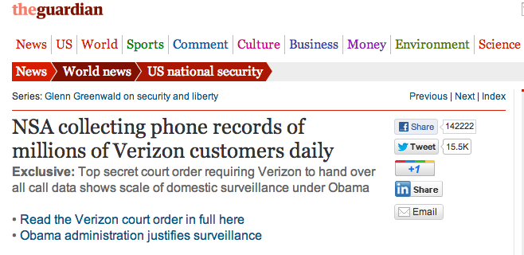

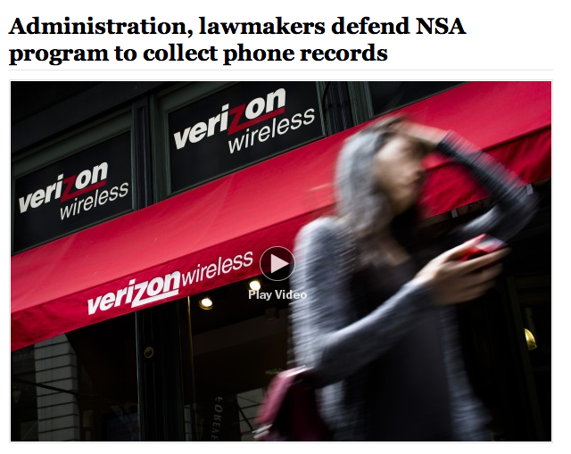
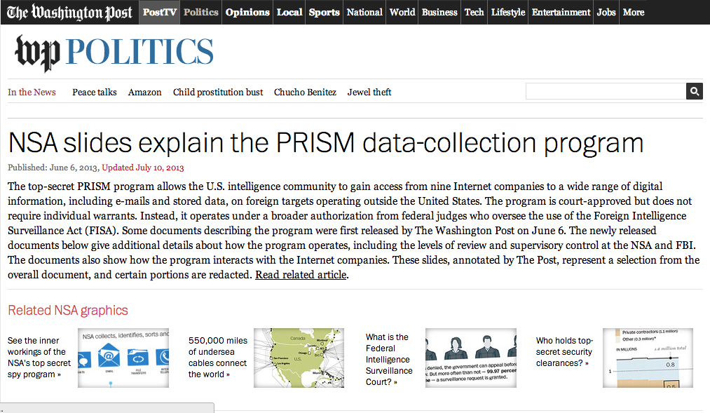
Notes:
On June 6 both The Guardian and the Washington Post disclosed details about the United States National Security Agency’s Prism Program.

Slide 11
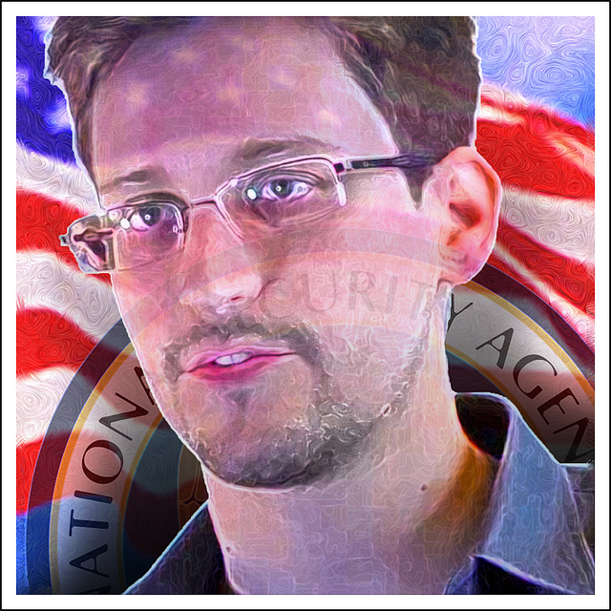
Notes:
A few days later, Edward Snowden became recognizable and a household name for being the person to blow the whistle on the NSA.
The Guardian is still releasing information about the NSA’s programs,

Slide 12
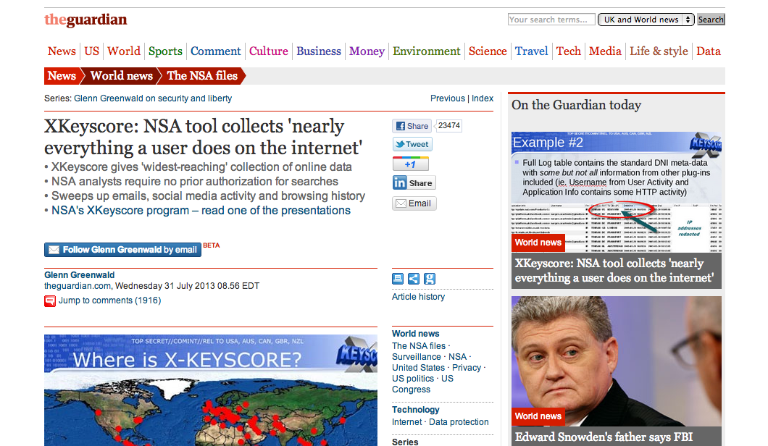
Notes:
and just this week they released information about the NSA’s “X-Keyscore” program which “collects nearly everything a user does on the Internet.”

Slide 13
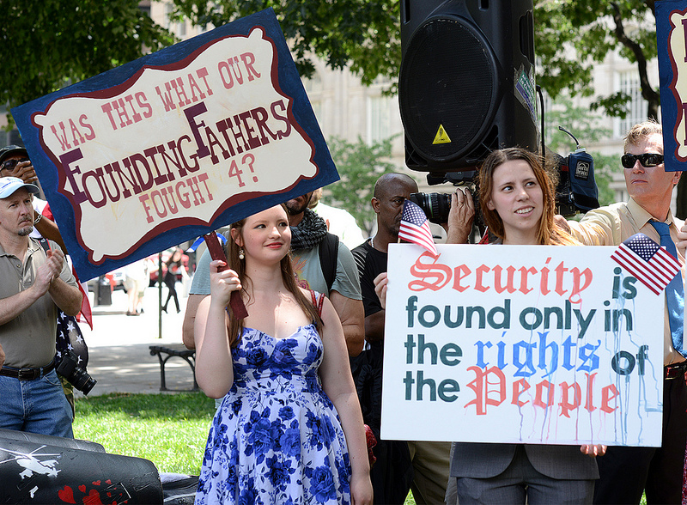
Notes:
This development is huge, and it has greatly increased the worldwide conversation about privacy and the Internet.
There are some big issues here – issues about laws keeping up with technology, the role of the U.S. government both nationally and internationally, the ways in which people – again, both nationally and internationally – use the web, our liberties and rights, and even Obama’s presidency. I’m thinking and hoping that some of those issues will be covered in much more depth during this afternoon’s digital ethics track with Jonathan Peters. Frankly, it has been beyond my ability to keep up with every nuance of these developments.

Slide 14
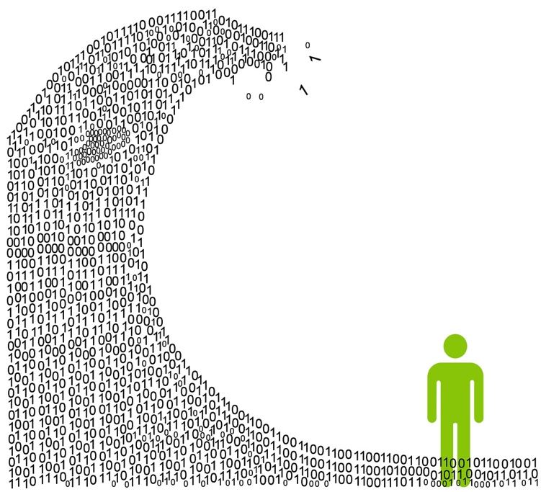
Notes:
But even prior to Edward Snowden’s whistleblowing we had thoughts about privacy. For example, we knew that there’s a tremendous amount of information on the Internet, both information that we put out there and information that is collected by others. We’re all familiar with the term information overload. So this deluge of information is not a surprise.

Slide 15
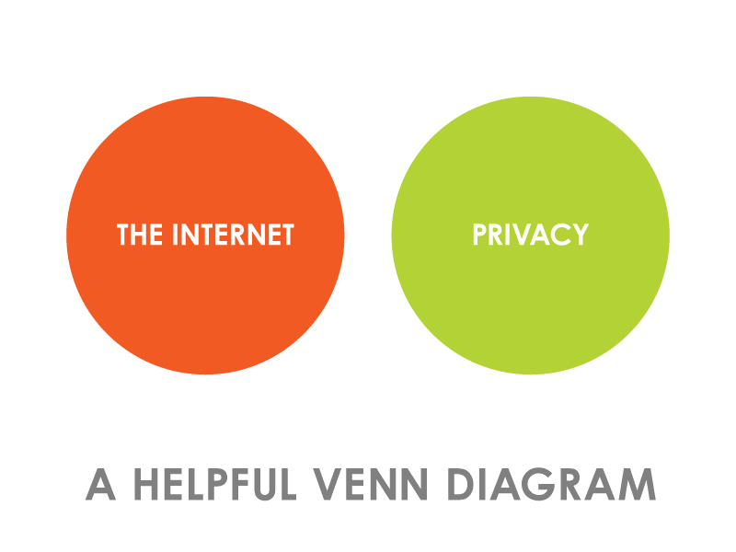
Notes:
We also knew that information we put online is not private. At least, this is what we’ve been teaching students for years. We know that there’s no “delete” button once we’ve uploaded a photo or commented on something on Facebook. We’ve showed them the Wayback Machine Internet Archive. We’ve been telling them to be careful what they put there and that it can be seen by anybody and everybody. Over and over we’ve been telling students that the Internet isn’t private.

Slide 16
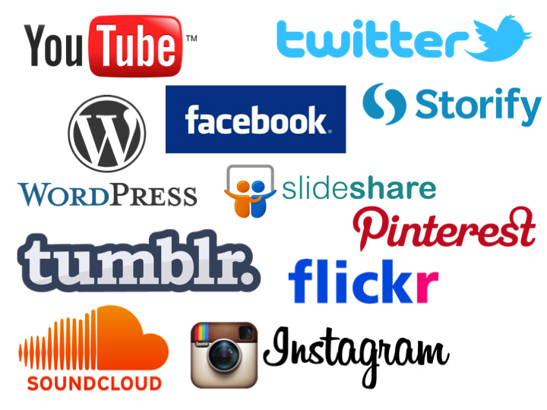
Notes:
Yet everyday we upload information to social media sites like, Facebook, Twitter, Flickr, Pinterest, Instragram, and loads of others.

Slide 17
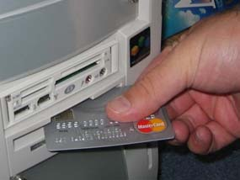
Notes:
Of course, we upload information to online retailers like Amazon, eBay, and Overstock.com. But it’s not just specifically online retailers; nearly all retailers have an online presence now. Costco, Walmart, Pottery Barn, Restoration Hardware, ModCloth, Macy’s, Bloomingdales, Best Buy. We increasingly shop online, and therefore hand over our personal information and our purchasing record to these sites. And they’ve become social too! People visiting these sites share reviews about what they’ve purchased.

Slide 18
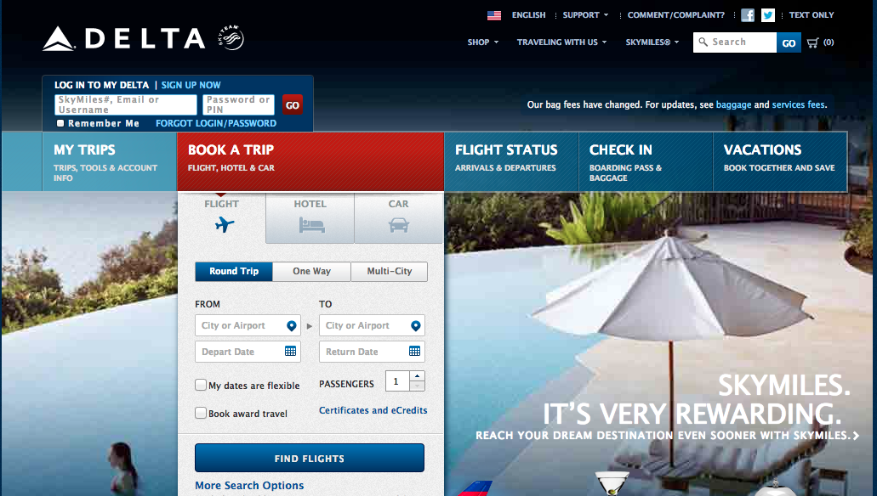
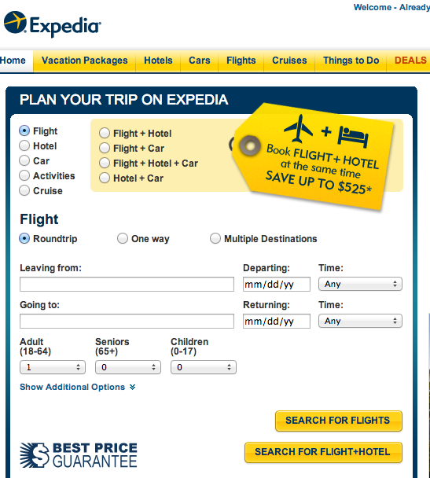
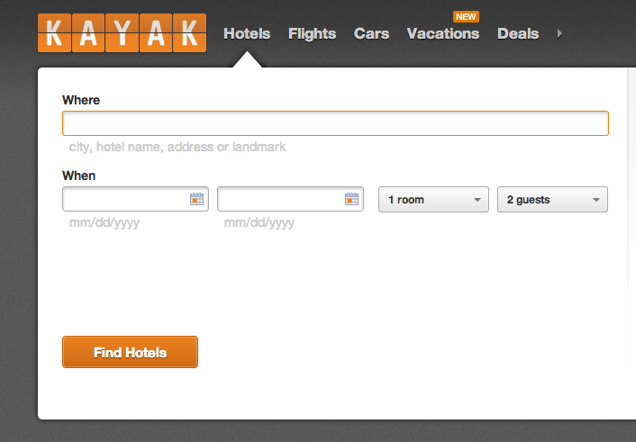
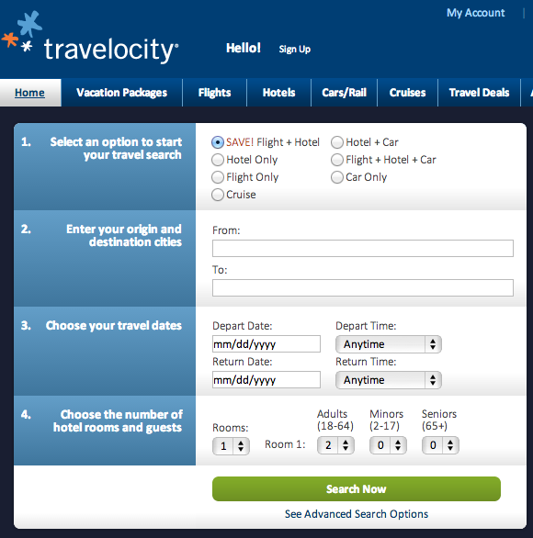
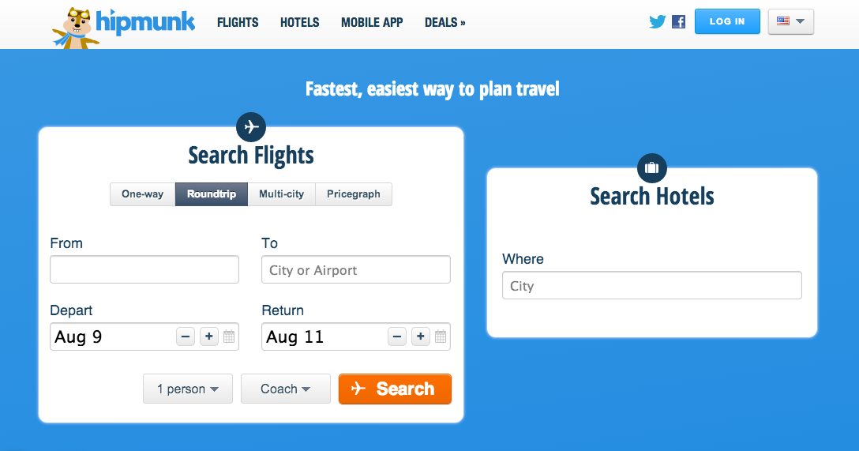
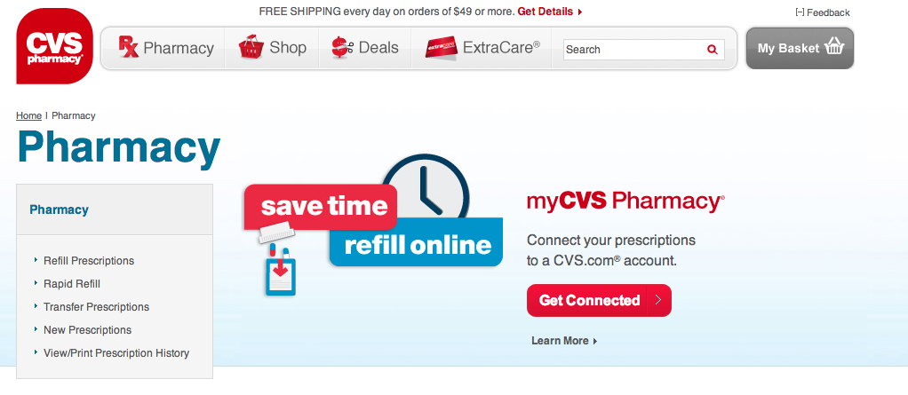
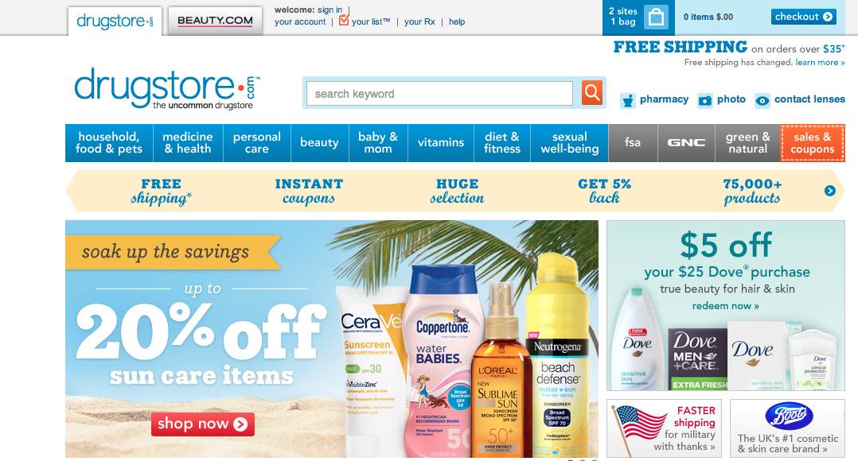
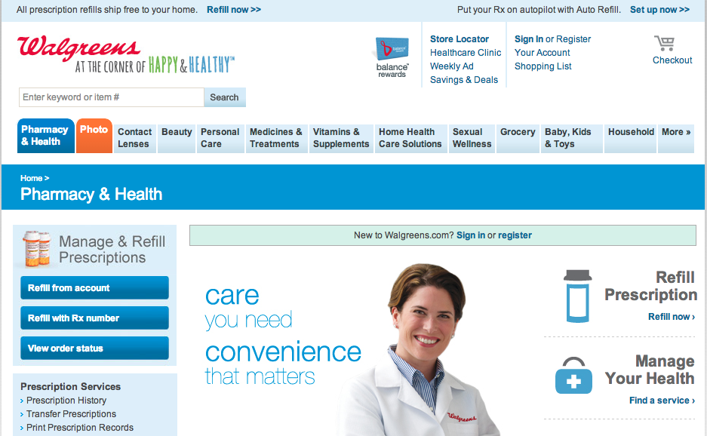
Notes:
We make travel reservations and purchase them online. We increasingly buy prescription drugs online.

Slide 19
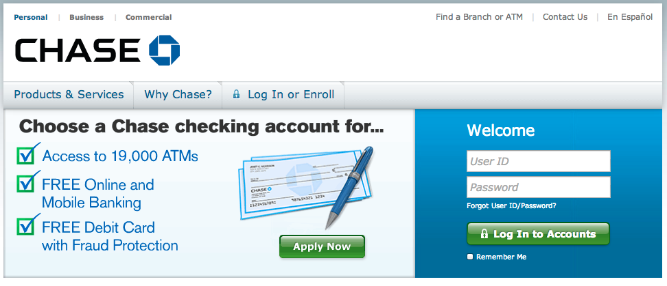
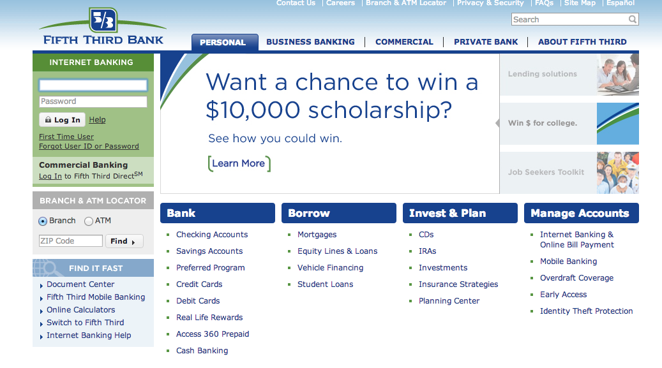
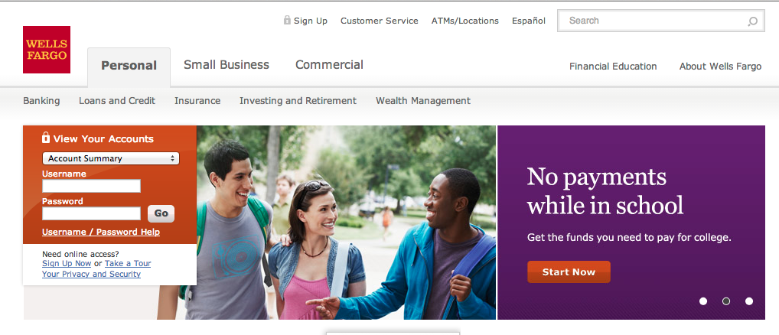
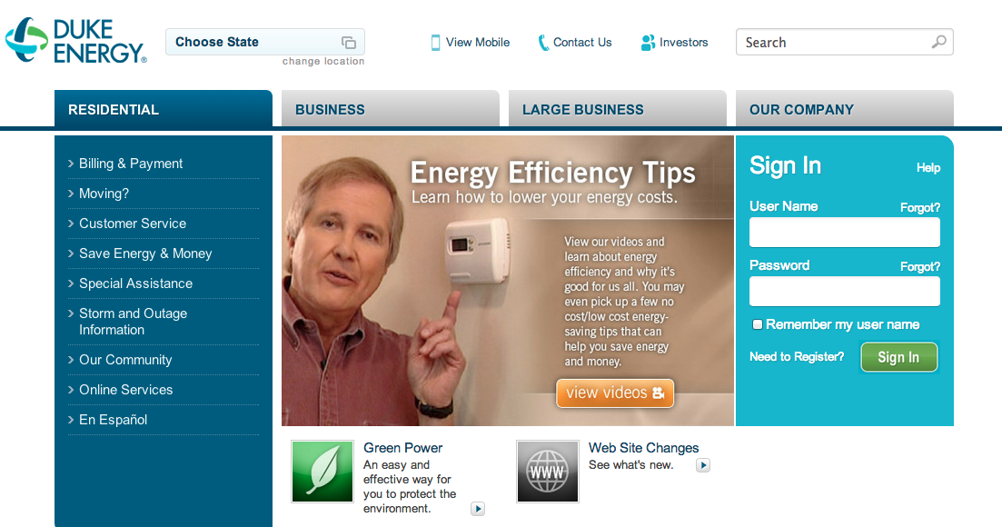
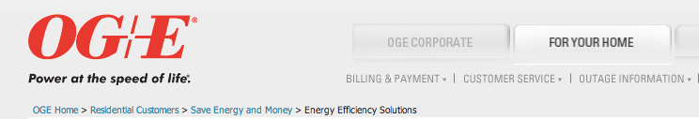
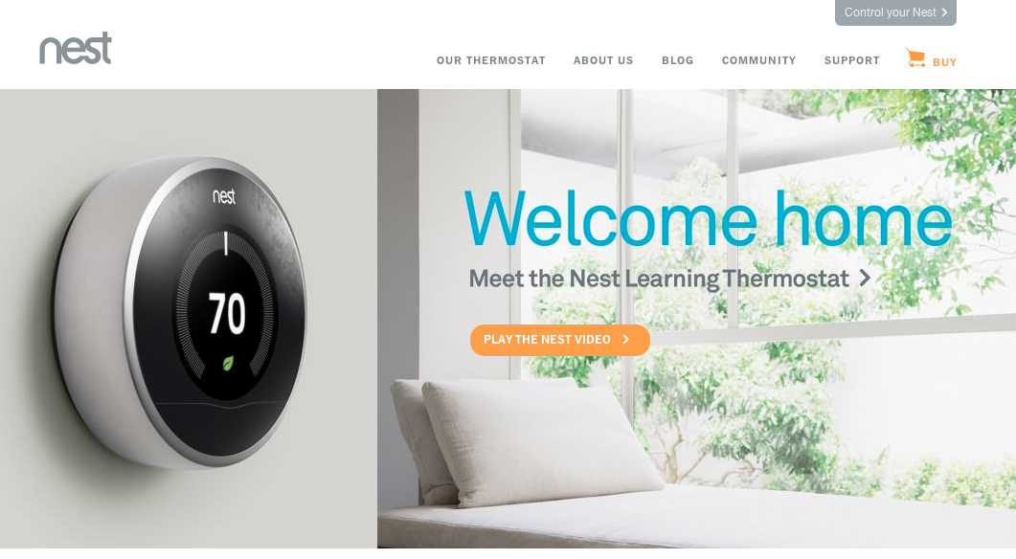
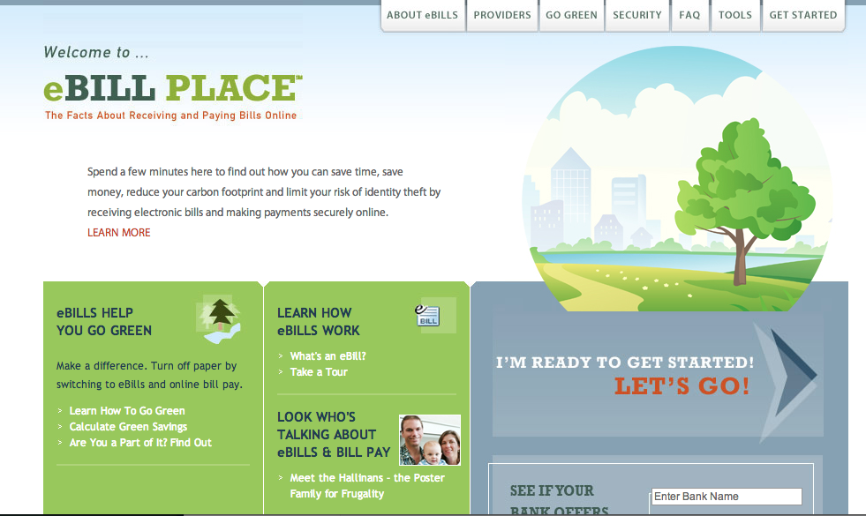
Notes:
Your banking information is most likely online, and you pay most of your bills online. Increasingly, our home energy usage is online through “smart” thermostats and through our utility companies.

Slide 20

Notes:
We generally file our taxes online.

Slide 21
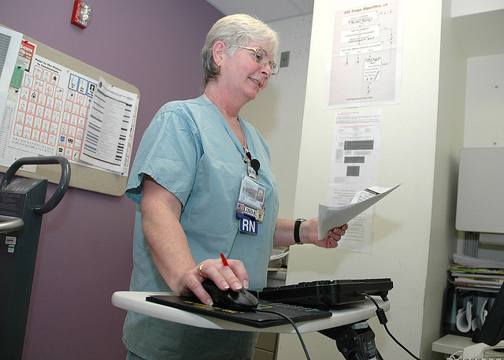
Notes:
Increasingly, our medical information is moving online

Slide 22
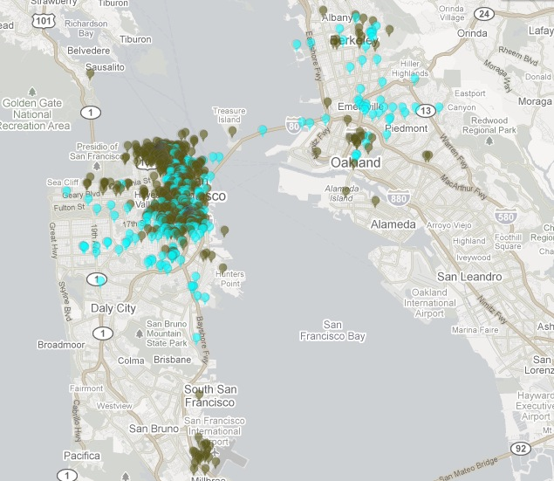
Notes:
We willingly announce our whereabouts when we use apps like Foursquare and Yelp. Facebook and Twitter ask you to share your location too. There’s often no reason for you to check in though, because many of these apps already know where you are based on the GPS in your smartphone.

Slide 23
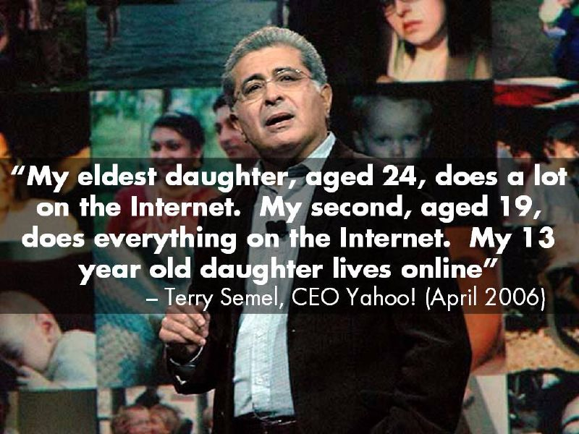
Notes:
We are all aware that our lives are moving online, but I don’t think we realize the breadth and depth to which we’re living online.

Slide 24

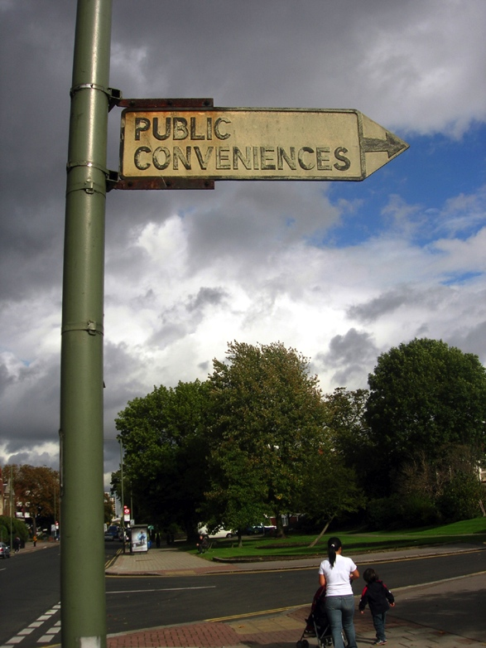
Notes:
We decide to trade privacy for convenience. We are vaguely aware of these companies’ privacy policies and their Terms of Service agreements. We don’t read them, but we know they’re there. We want the product, the service, the tool. We knowingly sign up for the service and provide our information, even though we might not be aware of how that information will be used.

Slide 25
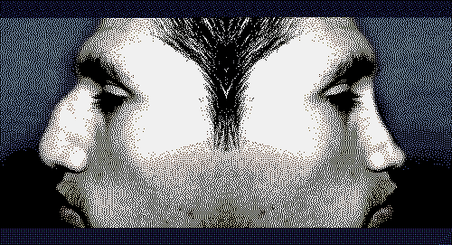
Notes:
And I’m pretty sure we don’t understand the full, long term consequences. Many of us spend a lot of time grooming our “online persona.” We choose our images and words to create a portrait of ourselves online. We want to control our images. But what is going on behind the scenes? Your persona is also being created by others on the other side of your screen. This is the persona you can’t control.

Slide 26

Notes:
I think that privacy correlates with trust and that we somehow trust that these companies – and let’s be honest, that’s what the web has become – will use our information in responsible ways. But what about when people make decisions and judgments about you based on this information and based on this “behind the scenes” persona? Maybe someone will decide you’re not a good credit risk, and you’ll be denied a home loan. Or maybe you’ll get the home loan, but you’ll get a higher interest rate. Or what if a surveillance camera picks up your image in a legal demonstration, the government decides to start building a case against you?

Slide 27
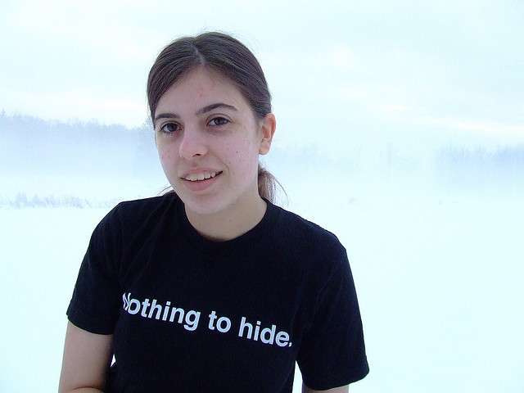
Notes:
And this, for me, is where the “if you don’t have anything to hide, you have nothing to worry about” argument falls short for me. I’m not doing anything wrong; I’m simply sharing thoughts and images. I’m paying my bills, and I’m buying books and groceries. I’m hopefully booking trips to fun, faraway places. None of this is wrong, nor does it need to be particularly secretive. However, is the “behind the scenes” persona that’s being created accurate? How is this information being used?

Slide 28

Notes:
So now after I’ve raised the troubling and darker side of privacy, I want to flip the coin so to speak. I wanted to acknowledge the issues of privacy, but now I want to talk about the value of sharing and how important the Internet has become with regards to sharing.

Slide 29
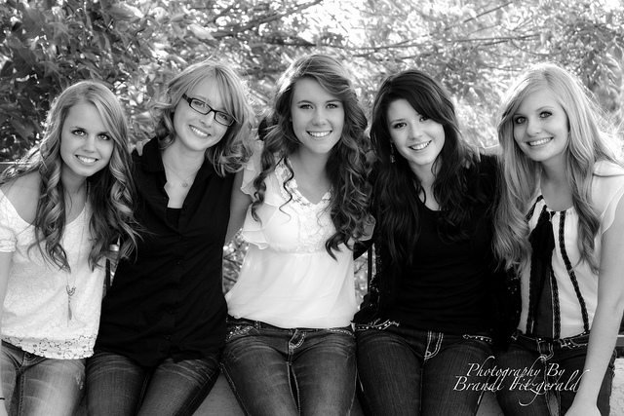
Notes:
I think most of us have enjoyed personal benefits of sharing online. Although I’m no longer on Facebook, while I was there I re-connected with my college housemates. These were five women who I lived with all throughout my time as an undergrad. Some of us kept in touch sporadically, but we had mostly fallen out of touch. But through social media we reconnected. Last year we had a reunion in Connecticut, and this year we’re meeting up in Napa. My life is richer and fuller from my connections with these women. I’m guessing you have similar experiences.

Slide 30

Notes:
Earlier today you may have heard Bo Brinkman’s presentation on sharing work through Creative Commons licenses. This starts to get closer to the type of sharing I advocate for in my work here – that is, making your work available immediately, online, for free, and licensing it in such a way that others can re-use it. I drew nearly every image for this presentation from Creative Commons licensed works on Flickr, a huge photo sharing site. I also upload and share my photos on Flickr, and I allow others to use them with a CC license.

Slide 31
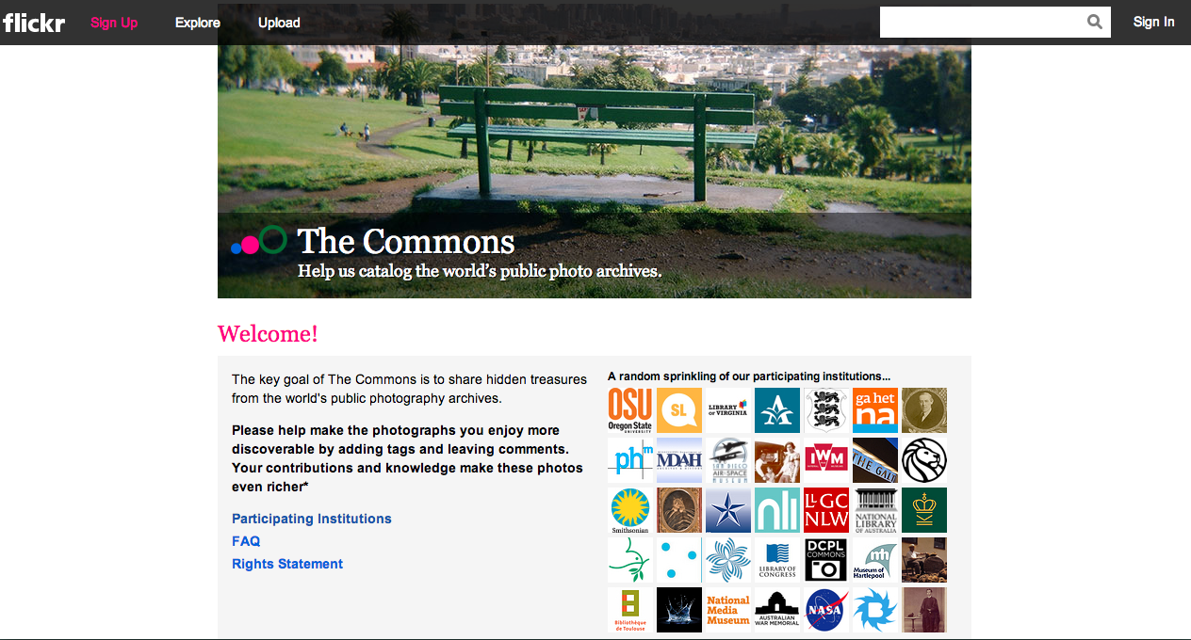
Notes:
When we put our work out there for people to use and comment on, some great collaboration and problem solving can occur. Flickr began proving this with their “Commons” project. The goal of The Commons is to share hidden treasures from the world’s public photography archives. Just a few of the participants in the Commons includes NASA, the Library of Congress, the Smithsonian, New York Public Library, and many others. One way users help added value was by making these photos more discoverable. They say on their site, “Your contributions and knowledge make these photos even richer.” And it’s true. Flickr partnered with these institutions and shared their images,

Slide 32
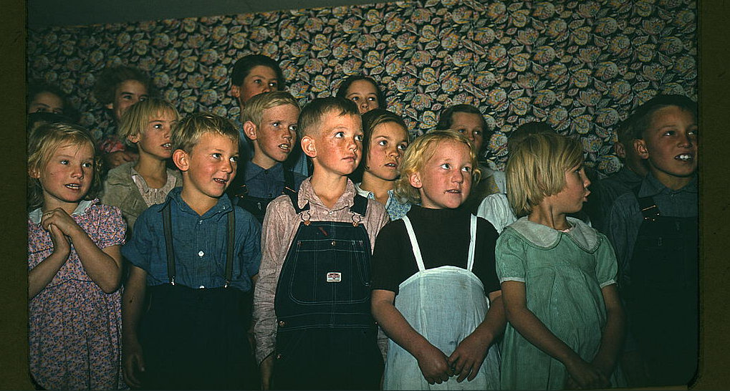
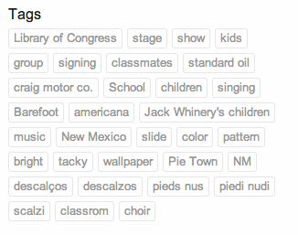
Notes:
but it's the users who continue to add value. People are encouraged to tag images and comment on them, thereby helping them to become more findable.

Slide 33
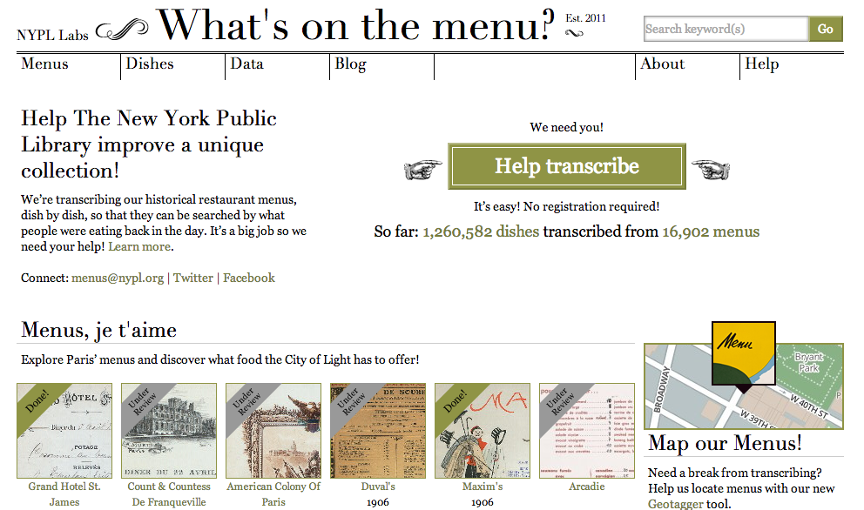
Notes:
The New York Public Library has done something similar with their vast menu collection. Several years ago, they began scanning their collection of historic menus from restaurants in Manhattan. They did it in such a way that brought so much more value to the project though. They created the “What’s on the Menu” project so that the menus could be transcribed and be searchable. Researchers are then able to search across time to see how our tastes have changed, how menus have changed, and even possibly how agriculture has changed.

Slide 34
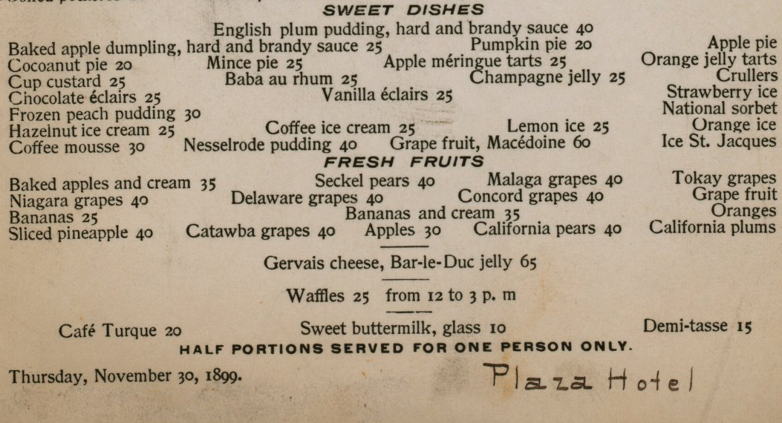
Notes:
I remember looking at a menu in person and seeing five different varieties of fresh grapes on a dessert menu. Making these things public and allowing the public to comment on them provides public value. But it goes deeper than “just” food or history.

Slide 35
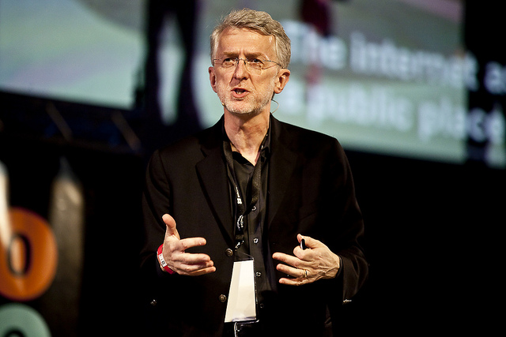
Notes:
Jeff Jarvis is a journalism professor and an author living in New York, and one of the things he speaks about is his experience with prostate cancer. Jarvis says, “Nothing more private than medical data, and even more so – the penis.” But Jarvis publicly blogged about his experience with prostate cancer. He shared publicly things that are generally kept private such as impotence and incontinence. There are people who told him he was oversharing, to which he responded they were underfiltering.

Slide 36
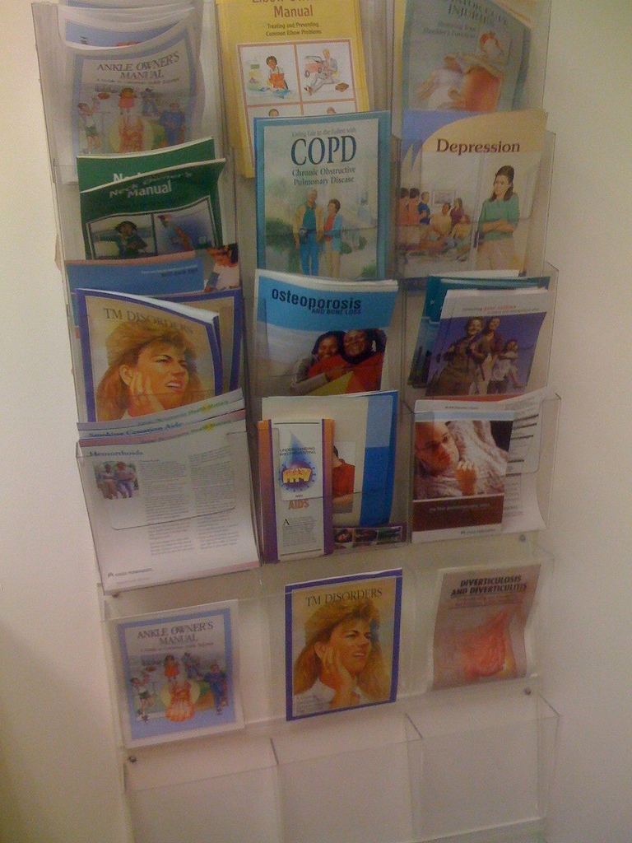
Notes:
Jarvis gained tremendous personal value from sharing this information publicly. He got links to information and connections with people. People who had undergone the same experience began sharing back with him, because they had gone through it too. They sent him detailed information about things he might anticipate in a way that no pamphlet could do. And then all this sharing that Jarvis was doing inspired people to share their own stories. Men wrote about their experiences, and then women began writing about how they felt about their husbands’ experiences. So now when people search for information about prostate cancer, they will find much more information – and information of value – than they would have before.

Slide 37
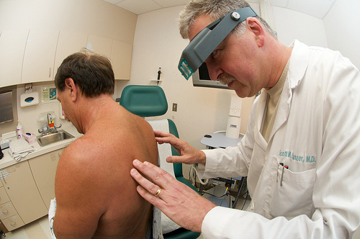
Notes:
Even better, Jarvis heard the stories of people who chose to get tested because of reading his work. So there’s this tremendous value that came from publicly talking about what’s typically an extremely private thing.

Slide 38
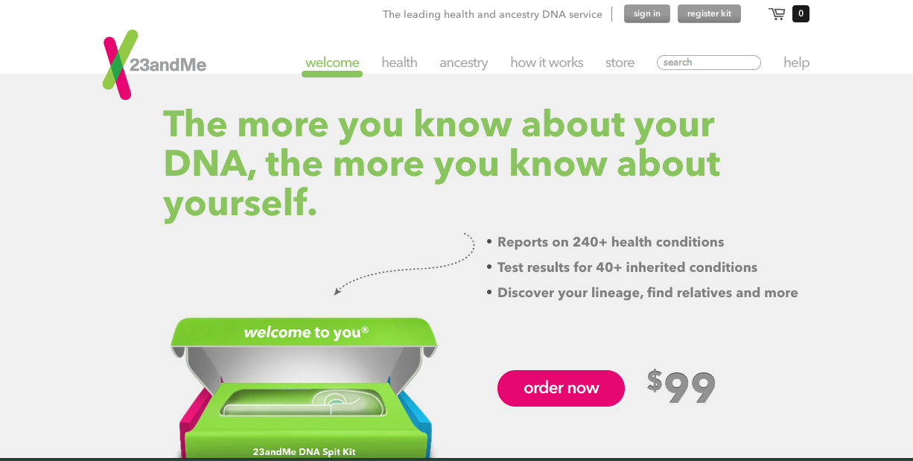
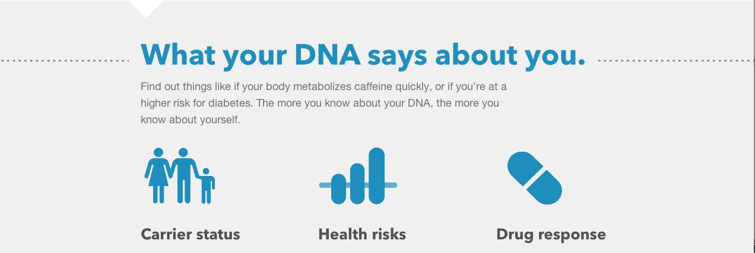
Notes:
A different example of how sharing can benefit society is with the website 23 & Me. 23 & Me is somewhat controversial, and it’s not for everyone. Essentially, you send a spit sample to 23 & Me, they analyze it, and tell you about your heritage and your genetics. They are able to tell you if you’re at a greater risk for many kinds of diseases and inherited conditions. You might ask, why is this about sharing?

Slide 39
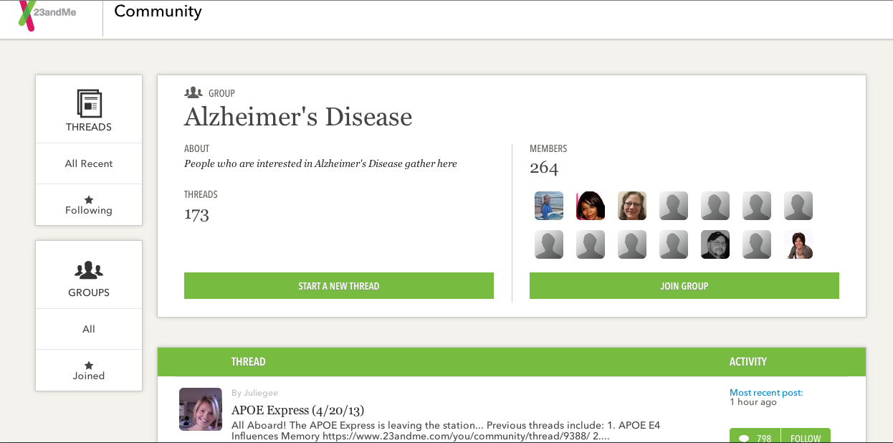
Notes:
Well, one of the things that has happened is that entire communities have sprouted up to talk about health. People who have to make difficult choices, such as whether to get a mastectomy if they’re at a high risk for breast cancer, now have hundreds and thousands of other people they can “talk” to.

Slide 40

Notes:
But it goes deeper than that. One of the things 23 & Me now has is millions of spit samples. This allows them to help researchers run clinical trials to help find treatments and cures for all kinds of diseases such as Parkinson’s.
“Over 10,000 people with Parkinson’s have come together to form what is now the largest Parkinson’s community for genetic research in the world. This group is already powering research breakthroughs – we’ve found two new genes associated with Parkinson’s. With over 10,000 participants, the odds of finding a cure are even better.”

Slide 41

Notes:
When we open ourselves up to hearing others’ ideas and sharing our own our work gets better. For the Internet to work you need to say something. You need to share instead of consume.

Slide 42

Notes:
So in addition to talking about privacy, I think it’s important that we also defend the public. When you take away from the public, you take away from all of us. When everything is private we give up value, and we encourage opacity. What we want is transparency.

Slide 43
Notes:
Way back in the beginning of this presentation, I referred to a second thing that changed how I would deliver my thoughts today. I want to make sure to get back to that, because it also has spurred conversations about privacy and openness.

Slide 44

Notes:
In late June I got notification from Google that I had been chosen as a “Glass Explorer.” That is, one of about 7000 people who have the opportunity to use Google’s latest consumer technology, Google Glass. I’m interested in how people perceive new technology; I’m interested in library services and education methods using new technology. So I jumped at the chance to be involved, and about a month ago I went to New York to pick up my pair. As is the case with all new technology, reactions to Glass have been mixed. There are people who gush over it and think it’s going to solve all kinds of problems, and there are people who are very concerned about the privacy aspects. I’m going to give those who want to time to wear it and try it out, but let me first talk about the way it operates.

Slide 45






Notes:
You could say Google’s inspiration came from all those people who have their head buried in their cell phone. We see a lot of this these days. People texting or searching or using a map or quickly checking email while they’re walking down the street. And I think Google is very right in this regard – “hands free” is going to become increasingly important. A colleague recently told me how amazing it would be to be pushing his daughter on a swing at the playground while simultaneously shooting a video or – even better – having a video chat with him mother who could see the joy in his daughter’s face and hear her laughter. This is possible with a cell phone, but it’s difficult precisely because it’s not hands free.

Slide 46

Notes:
On the flip side, there is a whole lot of concern about people taking photos or videos without others’ knowledge or consent. I might argue that this is the kneejerk reaction that occurs whenever there is new technology – people are fearful about the “what ifs.” It’s important to think through those things, but I’m not sure the photo argument is the best one. Currently, people can take pictures of you without your knowledge. They can use a cell phone when you’re in a public place. What’s worse, in my mind, isn’t about the latest technology at all. They can use a telephoto lens when you’re in a private place. So it’s not really about the photography. Instead, I think it’s really about:

Slide 47

instantaneous dissemination
Notes:
instantaneous dissemination

Slide 48

persistence of data
Notes:
persistence of data

Slide 49

ease of search
Notes:
ease of search

Slide 50

Notes:
When facial recognition software becomes more ubiquitous, this is problematic too. Although those problems aren’t specific to Glass.

Slide 51

Notes:
A less concerning, but nevertheless knee jerk reaction, is just how they look. A new moniker, “Glassholes,” has emerged. I think the form factor will change though. I think these are the beta version, and in seven years we’ll all have something that makes these look archaic.

Slide 52

Notes:
My objections about Glass, so far, revolve primarily around platform. I like to break up my social media; I don’t like putting all my eggs in one basket. I don’t use Facebook at all, and I spread my digital life around. I use Twitter, Flickr, Apple and Windows, Firefox and Chrome. Glass requires you to have a Google+ account, which I already had. But I do have an iPhone, and Glass works much better with an Android phone. Connecting to a wireless network is challenging with Glass and an iPhone. It pretty much requires that you have a laptop with you. Connecting Glass to a wifi signal with an Android phone is pretty seamless. So when you’re not connected to wifi, Glass is really just a head-mounted camera. There is no additional information delivery.

Slide 53

Notes:
Glass also automatically uploads your photos and videos to your Google+ account. You aren’t required to share your photos, and you can “delete” them. But you’re also not given a choice. I would prefer to share my photos on Flickr, but in order for me to do that I need to download them from G+ and then re-upload them to Flickr.

Slide 54

Notes:
Google is working with developers to create Glass apps, so I right now I can choose to get content from CNN delivered to me on Glass. Their other partners right now include Gmail, Google Now, Evernote, Tumblr, Twitter, Facebook, Path, The New York Times, Elle Magazine. I have not connected most of these apps, although I may in the future.

Slide 55

Notes:
One of the things Glass can’t do is connect to a closed network – essentially, one that requires that you accept an agreement and log in with a unique I.D. and password. Therefore, Glass doesn’t work here at Miami yet, because I can’t connect it to Miami’s wireless. I did find out a way to get an exception to this, but unfortunately I didn’t learn about it soon enough to implement the work-around.

Slide 56


Notes:
I should be able to connect it to my iPhone using Bluetooth and tether it. However, I can’t do that either. I’m grandfathered in for unlimited data on ATT, and I would need to change plans in order to tether Glass. While Miami has an exception to connecting, ATT so far has no exception. So with all those limitations in mind, I’d like to give anyone who wants to try it a chance, and I’ll stick around for a bit.

Slide 57


Notes:
But before that, I’d like to hear your thoughts on privacy, openness, anything I’ve said, or about Glass. People often refer to this as Q&A time, but I’d prefer to be the facilitator of a discussion among all of us. So who’s going to share first?

Slide 58
Photo Credits
http://www.flickr.com/photos/coolmikeol/5046644462/
"Coins Standing" by coolmikeol
Used under a CC BY 2.0 license
http://www.flickr.com/photos/notionscapital/6718228941/
"SOPA Blackout" by Mike Licht, NotionsCapital.com
Used under a CC BY 2.0 license
http://www.flickr.com/photos/opensourceway/4638981545/
"Facebook: The privacy saga continues" by opensourceway
Used under a CC BY-SA 2.0 license
http://www.flickr.com/photos/niklaswikstrom/5214708665/
"Sharing Is Caring - Fotosöndag" by Niklas Wikström
Used under a CC BY-NC 2.0 license
http://www.flickr.com/photos/opensourceway/4812651268/
"Fortune cookie says: To succeed, you must share." by opensourceway
Used under a CC BY-SA 2.9 license
http://www.flickr.com/photos/getoffmyspasip/6842521939/
"No Big Deal (NBD)" by The.Handicapped.Stall
Used under a CC BY-NC-SA 2.9 license
http://www.flickr.com/photos/lwr/3250170468/
"number 2" by Leo Reynolds
Used under a CC BY-NC-SA 2.0 license
http://www.flickr.com/photos/lwr/5212320961/
"number 1" by Leo Reynolds
Used under a CC BY-NC-SA license
http://www.flickr.com/photos/spackletoe/90811910/
"THAT WAS EASY!" by spackletoe
Used under a CC BY-NC-ND 2.0 license
http://www.flickr.com/photos/donkeyhotey/9247530743/
"Edward Snowden" by DonkeyHotey
Used under a CC BY 2.0 license

Slide 59
Photo Credits
http://www.flickr.com/photos/stephenmelkisethian/9210548067/
"RestoreTheFourth14" by Stephen D. Melkisethian
Used under a CC BY-NC-ND 2.0 license
http://www.flickr.com/photos/intersectionconsulting/7537238368/
"Social Media Information Overload by Intersection Consulting
Used under a CC BY-NC 2.0 license
http://www.flickr.com/photos/buriednexttoyou/5095255302/
"Internet VS Privacy - A Helpful Venn Diagram" by Dave Makes
Used under a CC BY-NC 2.0 license
http://www.flickr.com/photos/macloo/8102783925/
"Social media logos by macloo
Used under a CC BY-NC-ND 2.0 license
http://www.flickr.com/photos/garethjmsaunders/2065891945/
"RAOK Suggestion #15 Buy something on the internet" by garethjmsaunders
Used under a CC BY-SA 2.0 license
http://www.flickr.com/photos/teegardin/5512347305/
"IRS 1040 Tax Form Being Filled Out" by kenteegardin
Used under a CC BY-SA 2.0 license
http://www.flickr.com/photos/mc4army/4406919358/
"VA Nurse Accessing Electronic Medical Records" by MC4 Army
Used under a CC BY 2.0 license
http://www.flickr.com/photos/benchun/5709886371/
"Day and Night" by Benjamin Chun
Used under a CC BY-SA 2.0 license
http://www.flickr.com/photos/lynetter/148843299/
"terry semel quote about living online" by lynetter
Used under a CC BY-NC 2.0 license
http://www.flickr.com/photos/alancleaver/4105726930/
"privacy" by Alan Cleaver
Used under a CC BY 2.0 license

Slide 60
Photo Credits
http://www.flickr.com/photos/malias/261406666/
"Public Conveniences" by malias
Used under a CC BY 2.0 license
http://www.flickr.com/photos/mushon/296437369/
"Reputation-Job" by mushon
Used under a CC BY-NC-SA 2.0 license
http://www.flickr.com/photos/_nijoker_/3478765392/
"wwe Judgment Day 2009" by ♠NiJoKeR♣
Used under a CC BY-NC-ND 2.0 license
http://www.flickr.com/photos/andrea_r/2179236154/
"Sarah has nothing to hide." by Andrea_R,
Used under a CC BY-NC-SA 2.0 license
http://www.flickr.com/photos/pauliantero/4685925036/
"113/365: Flippin' coins" by Pauli Antero
Used under a CC BY-NC-ND 2.0 license
http://www.flickr.com/photos/brandifitzgerald/6926969904/
"Best Friends" by BrandiFitzgerald
Used under a CC BY-NC-SA 2.0 license
http://www.openaccessweek.org
Open Access Week logo by SPARC
Used under a CC BY 2.0 license
http://www.flickr.com/photos/library_of_congress/2179143282/
"School children singing, Pie Town, New Mexico (LOC)" by The Library of Congress
Used by public domain
http://www.flickr.com/photos/re-publica/4520685058/
"Jeff Jarvis auf der re:publica10" by re:publica 2013
Used under a CC BY 2.0 license
http://www.flickr.com/photos/52183006@N00/3586655800/
"photo" by Juiceboy
Used under a CC BY-NC-SA 2.0 license

Slide 61
Photo Credits
http://www.flickr.com/photos/christianacare/5890531549/
"Dr. Scott Panzer examines Philip Gawel for skin cancer" by Christiana Care
Used under a CC BY-NC-SA 2.0 license
http://www.flickr.com/photos/91194757@N08/8275164873/
"CONSUME !" by Rubix_Color
Used under a CC BY-NC 2.9 license
http://www.flickr.com/photos/cambodia4kidsorg/6479244489/
"Transparency and Effectiveness" by cambodia4kidsorg
Used under a CC BY 2.0 license
http://www.flickr.com/photos/stuckincustoms/7350510542/
"Google Glass" by Stuck in Customs
Used under a CC BY-NC-SA 2.0 license
http://www.flickr.com/photos/cabreraluengocom/8553476261/
"Prohibited Google Glass" by cabreraluengo.com
Used under a CC BY-NC-SA 2.0 license
http://www.flickr.com/photos/58847482@N03/5597906430/
"Texting - (Day 4 of Holiday 2011)" by Matthew Kenwrick
Used under a CC BY-ND 2.0 license
http://www.flickr.com/photos/sea-turtle/7647691828/
"Texting While Walking" by sea turtle
Used under a CC BY-NC-ND 2.0 license
http://www.flickr.com/photos/opacity/4107198594/
"texting" by opacity
Used under a CC BY-NC-ND 2.0 license
http://www.flickr.com/photos/pieceoplastic/8293895852/
"Texting while walking #paris" by pieceoplastic
Used under a CC BY-NC 2.0 license
http://www.flickr.com/photos/12810816@N08/7424015658/
"Texting while walking" by JuhaOnTheRoad
Used under a CC BY-NC-SA 2.0 license

Slide 62
Photo Credits
http://www.flickr.com/photos/mean-machine/6078011142/
"texting" by meanmachine_ie
Used under a CC BY-NC-ND 2.0 license
http://www.flickr.com/photos/eole/380316678/
"Entering Hyperspace" by Éole
Used under a CC BY-NC-SA 2.0 license
http://www.flickr.com/photos/stevenerat/156905030/
"Persistence" by StevenErat
Used under a CC BY-NC-SA 2.0 license
http://www.flickr.com/photos/keso/108805307/
"google_logo" by keso
Used under a CC BY-NC-ND 2.0 license
http://www.flickr.com/photos/31290193@N06/6131827350/
"Illegible wallpaper" by justinpickard
Used under a CC BY-SA 2.0 license
http://www.flickr.com/photos/seanaes/8683585843/
"so I'm a glasshole now I guess" by seanaes
Used under a CC BY-NC 2.0 license
http://www.flickr.com/photos/jackjack/5658307403/
"Jack has all his eggs in one basket!" by laughograms
Used under a CC BY-NC-ND 2.0 license
http://www.flickr.com/photos/lgallardo/8119881851/
SIP Authentication" by Luis M. Gallardo D.
Used under a CC BY-NC-ND 2.0 license
http://www.flickr.com/photos/seanbonner/3636651317/
"iPhone tethering" by seanbonner
Used under a CC BY-NC-SA 2.0 license
http://www.flickr.com/photos/simpleskye/9190409373/
"Nazarene General Assembly 2013" by SimpleSkye
Used under a CC BY 2.0 license
http://www.flickr.com/photos/shareconference/5599787188/
"Share By Night" by SHAREconference
Used under a CC BY-NC-SA license

Slide 63
Et Cetera
This work was created by Jen Waller for the GeoGebra Dynamic Mathematics North American Conference held at Miami University in Oxford, Ohio on August 3-4, 2013. The presentation was part of the “Digital Ethics” track and was presented on August 4, 2013.
This work is licensed under a Creative Commons Attribution – Share Alike 3.0 Unported (CC BY-SA 3.0) license. For more information about this license, please see:
http://creativecommons.org/licenses/by-sa/3.0/deed.en_US
You can reach Jen at jenwaller@miamioh.edu or @jenniferwaller on Twitter.

