Slide 1
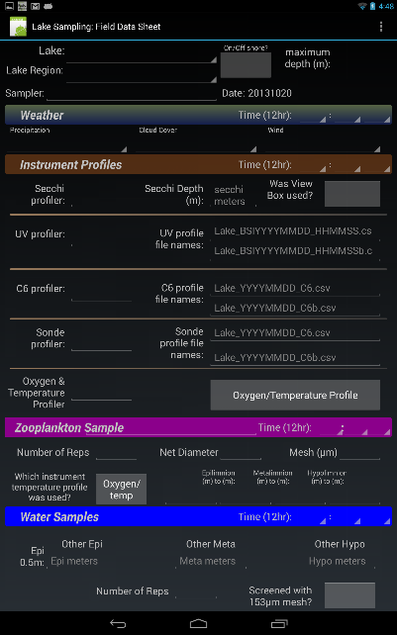
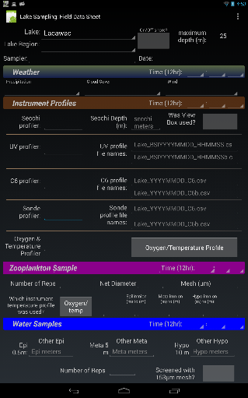
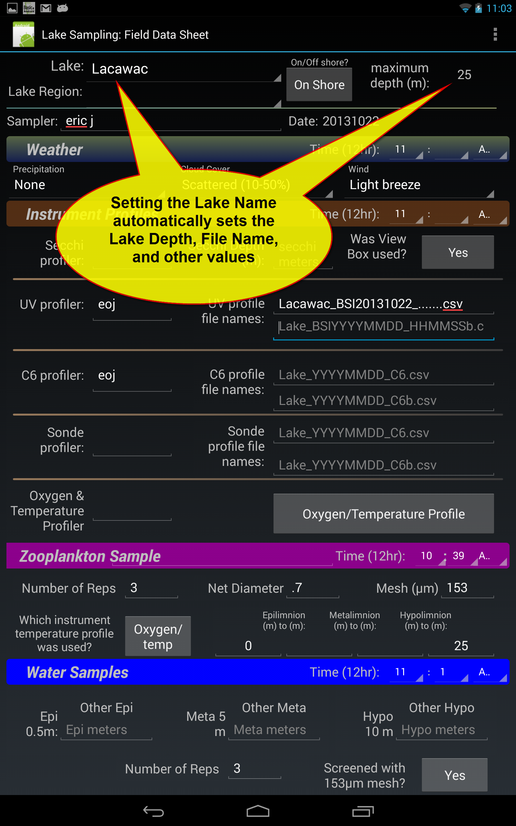
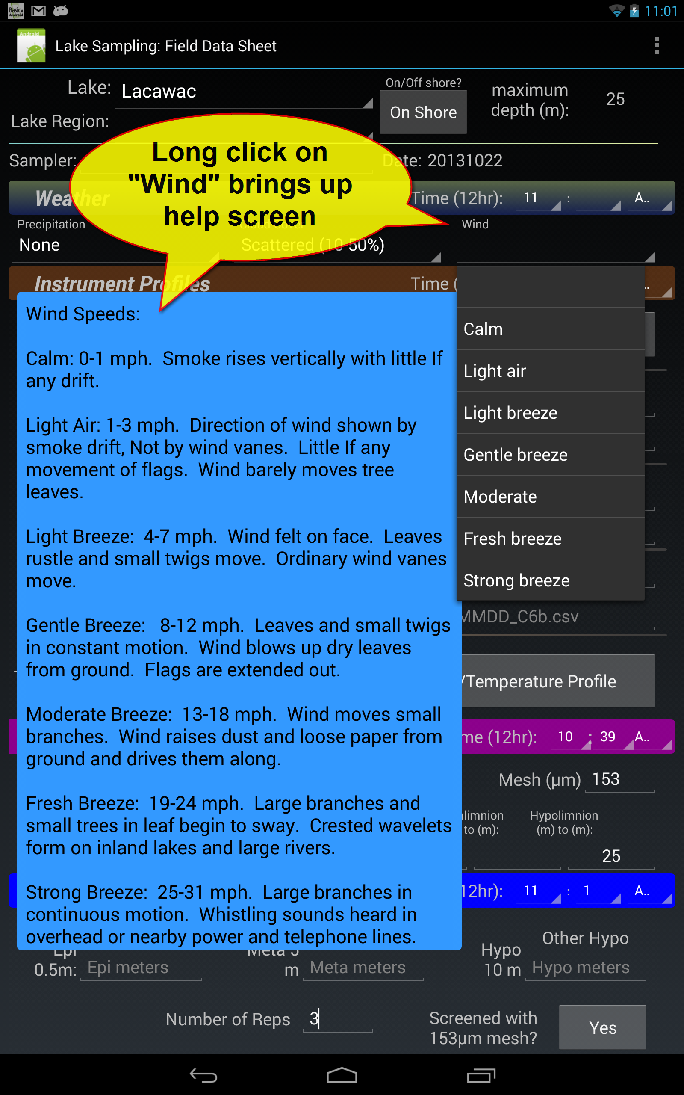
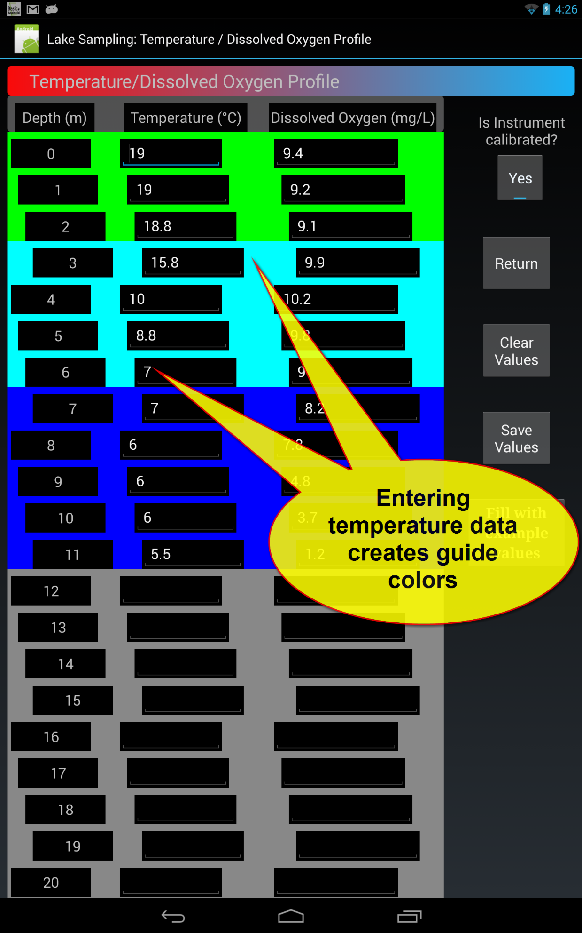
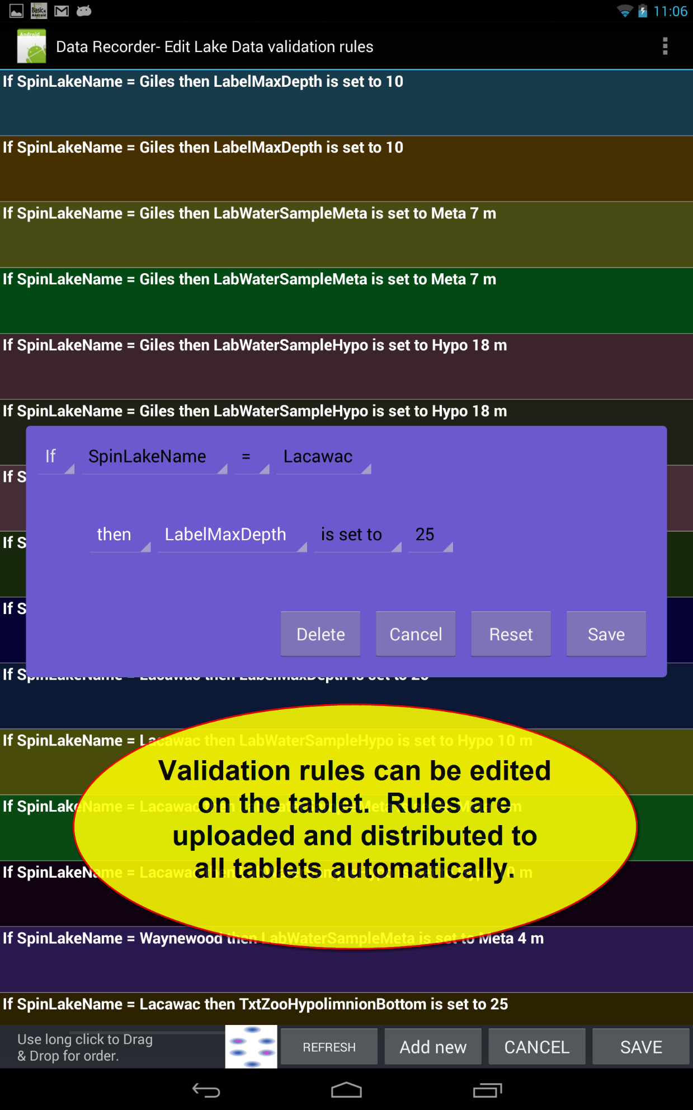
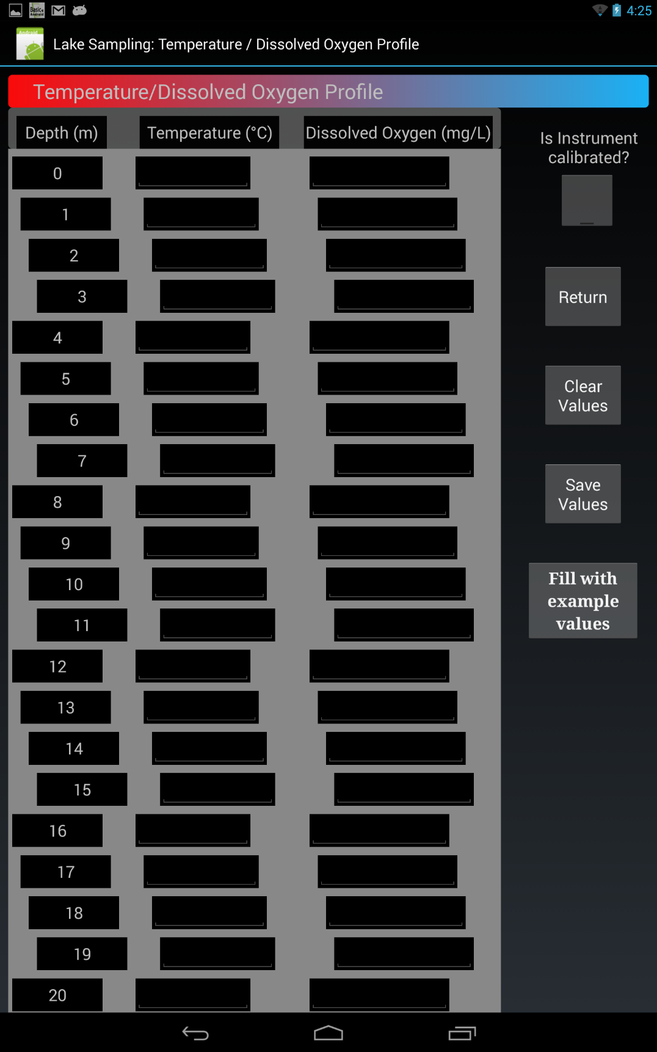

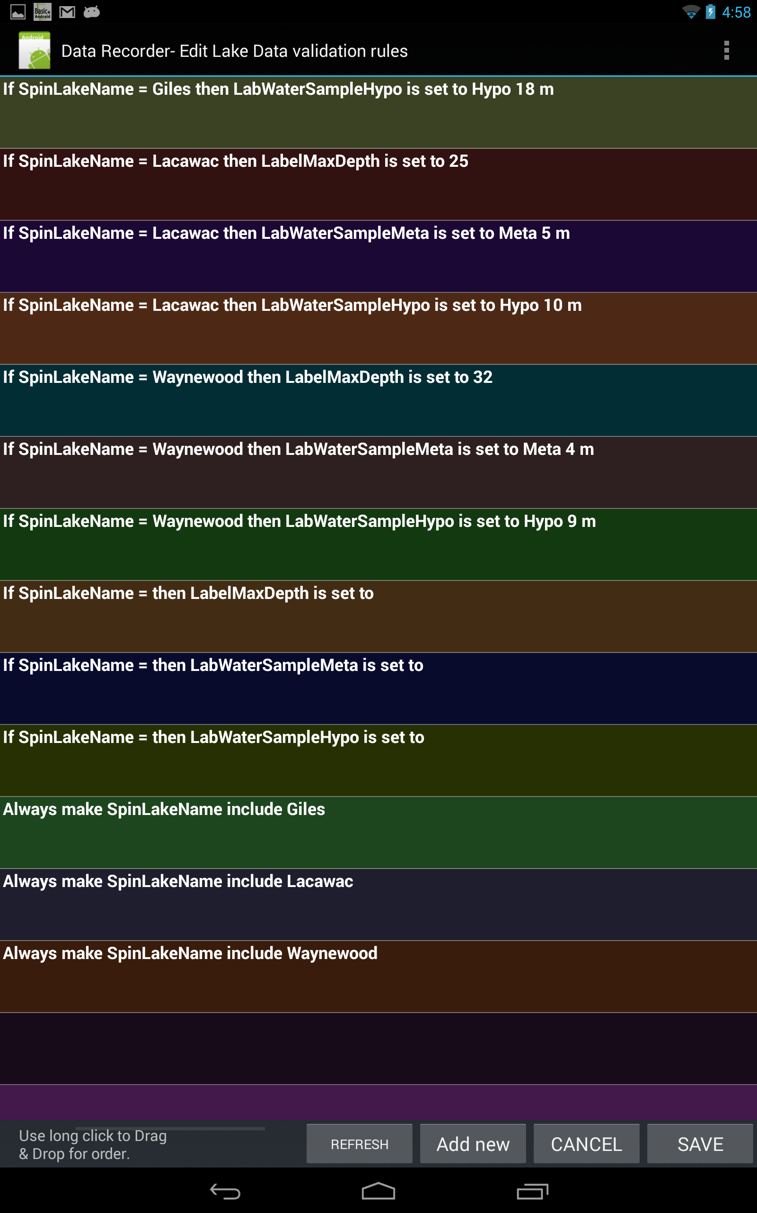

"Tablet Based Data Recorder for Librarians and Researchers“
Librarians & Information Professionals helping Faculty:
Data collection and Validation
Eric Johnson, Miami University 2013, johnsoeo@miamioh.edu
Improving Paper data collection sheets:
Put elements in order of activity
Give guidance in light gray text
Checkboxes and circle items are fast and limit errors
Typeface indicates type of information
Use a single sheet if possible
Limit redundant or unnecessary entries
Put Identification info on each page
Tablet data collection software:
Builds on paper data collection techniques
Has Active Validation to catch typos
Uploads data immediately
Data upload is in the background
Automatically fills out information as needed
Gives guidance screens
Color codes sections
Captures the time and date for every entry
Benefits:
Errors can be fixed instantly while the correct data is still known
Typewriting eliminates errors in reading handwriting
Data is automatically and immediately stored off-site and ready for analysis
More involved guidance can be given
Validation rules can be updated remotely

