Slide 1
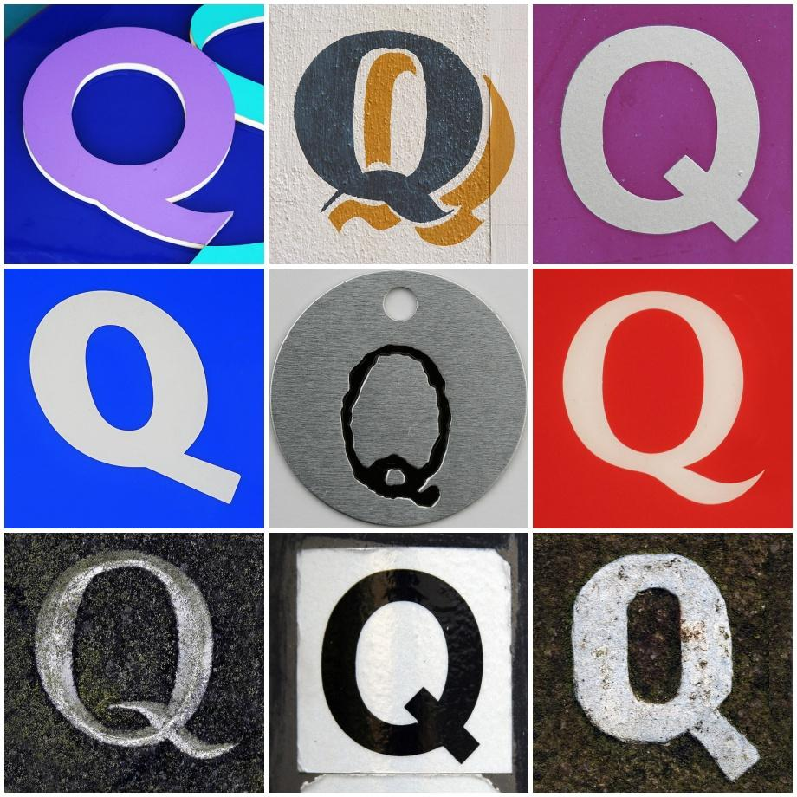

Minding Your Ps & Qs:
A Q Methodology Workshop
Stacy Brinkman
Kevin Messner
Aaron Shrimplin
Jen Waller

Slide 2
Introductions
Stacy Brinkman
  Art & Architecture Librarian
  brinkmsm@miamioh.edu
Jen Waller
Interdisciplinary Librarian & Scholarly Communication Liaison
wallerjl@miamioh.edu
Kevin Messner
  Interim Head, B.E.S.T. Library
  messnekr@miamioh.edu
Aaron Shrimplin
  Associate Dean of Libraries
  shrimpak@miamioh.edu

Slide 3
Workshop Overview
1:30 – 1:40: Introduction
1:40 - 2:10: Hands-on Q icebreaker
2:10 - 2:40: How Q Works
2:40 - 3:20: Hands-on activity
          Q Concourse
          P-set
          Sort
3:20 - 3:35: Break
3:35 - 4:10: Hands-on activity: Analysis & Interpretation
4:10 - 4:30: Q&A, Wrap up

Slide 4
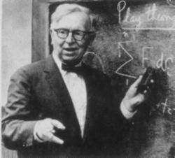
History of Q Methodology
William Stephenson, 1902 – 1989
Notes:
Q-methodology was developed in the 1930s by William Stephenson. Stephenson was a protégé of Charles Spearman, who pioneered factor analytic methods that are still commonly used in more traditional quantitative studies today. Spearman’s factor analysis is used to account for associations between variables captured in a correlation matrix. In other words, it reflects by-variable differences and correlations. The factor analysis Stephenson developed was an inversion of Spearman’s method, and it is designed to produce a person-by-person correlation matrix (as opposed to variable-by-variable matrix).

Slide 5

Subjectivity is Everywhere
“Self-archiving takes too much time.”
“Open access journals are not less pretentious than subscription based journals.”
?
“Front loading the open access costs to academics is really problematic for me.”
“Putting my work out there will just invite rip-offs.”
“Information should be as widely and freely available as possible.”
“I think open access to data is a wonderful idea.”
“My promotion and tenure committee would never give weight to a journal charging author-side fees.”
“Open access articles will be more frequently cited.”
Notes:
Subjectivity is everywhere. For any given topic, people have different viewpoints and opinions. Ask a question – what do faculty on our campus think about open access? – and you are likely to get a multitude of opinion statements about it.

Slide 6

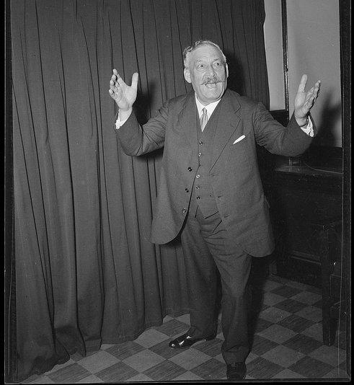
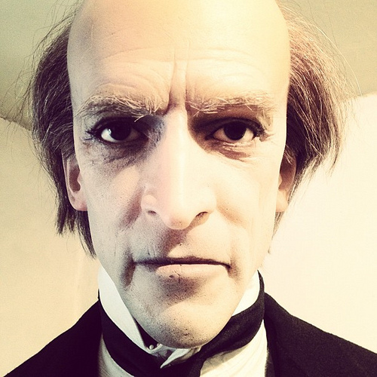
What does Q Methodology Do?
Pragmatist
Evangelist
Traditionalist
Notes:
Q is a mixed-methods technique that stands kind of in between qualitative and “R” techniques of analysis. Unlike R, it does not chop up a person into traits. It preserves the whole viewpoint of each individual, and then uses statistical techniques to run a by-person correlation of viewpoints, rather than a by-variable correlation.
When we conducted a Q-analysis of the various viewpoints on open access help by faculty at Miami University, we might find that there exist at least three dominant viewpoints on this topic in general, and that these viewpoints are not determined by demographic variables.
The faculty who we called “evangelists” were faculty members who were supportive of open access principles.
The faculty members we called traditionalists generally saw no problems with the current system, and they had strong reservations about open access
And the faculty members we called pragmatists would support open access if all other things were equal, but they weren’t willing to support it at all costs. In particular, they had concerns about how publishing open access might affect their tenure and promotion.
Once we knew that we had these three distinct, dominant viewpoints, we could develop marketing plans to each viewpoint rather than to demographic categories. You could also follow up with a survey to determine whether the types of viewpoints correlate with specific demographic traits, or you could find out what percentage of people fall into each category.
In a nutshell, Q is a way that we can talk about subjectivity in a systematic and measureable way. In other words, it is designed to research viewpoints, perceptions, and understandings using techniques that are both qualitative and quantitative.

Slide 7
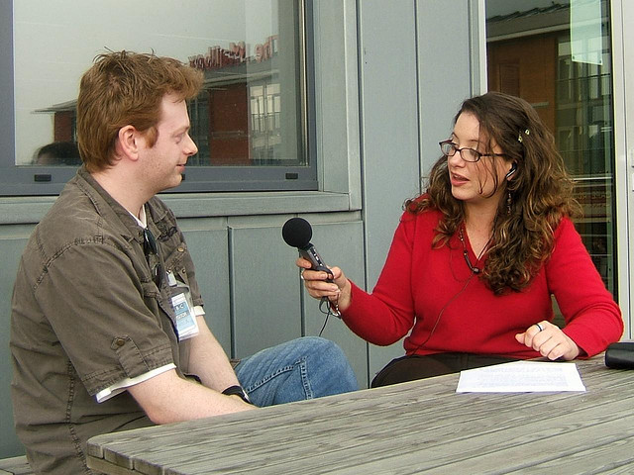
Qualitative Methods
Interviews
Focus Groups
Ethnography
Observation
Narrative
Analysis
Notes:
How do we make sense of those opinions? One method commonly used in libraries is to conduct interviews or focus groups. These are qualitative research methods that often involve recording, transcribing, and coding the collected data, and then deriving themes or making inferences about how to interpret the data. Qualitative research seeks to explain or explore phenomena in context.
Qualitative methods are great for teasing out why a person might have a particular viewpoint, or the degree to which a person might be passionate about a particular opinion.
But you would not be able to make generalizations about the data, and you would always have to understand that the analysis is coming from the subjective lens of the researcher, and that “objective,” or mathematical, analyses are not usually used.

Slide 8
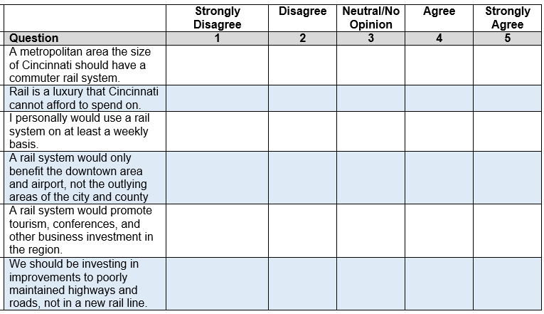
Quantitative (“R”) Methods
Notes:
Another common research method is to create and analyze surveys. The researcher uses statistical tests to determine averages, correlations, and in some instances, to make predictions or other generalizations. However, these traditional qualitative methods, which we will refer to as “R” methods after Pearson’s R, tend to flatten out individual viewpoints in order to make generalizations about the whole sample.
In our example with open access, we might find that the average person in the sample is supportive of open access. We might find that more women like the idea than men. Maybe faculty rank or department is positively correlated with support of open access. We might find other patterns across demographic variables (all of which depends on which variables we chose to collect).
However, in this process of finding correlations between traits of people, we lose the holistic viewpoint of an individual. In a sense, R method chops up a person into demographic parts – female, white, married, college-educated, income of X – and so forth, and calculates correlations across those variables instead of looking at each whole person with their full opinion intact.

Slide 9
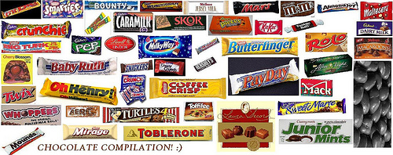

Ice Breaker Activity:
Candy Q-Sort

Slide 10
Q sorts
Procedure in Q methodology which generates primary data for quantitative analysis
Subject assigns value to opinion statements (or other objects)

Slide 11
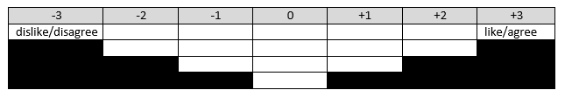
Candy sort
16 statements in this sort (relatively small number, 40-60 more typical)
Detailed sorting instructions on pink sheet
Briefly, put the one you like best on the far right, one you like the least on the far left, and work toward the middle

Slide 12
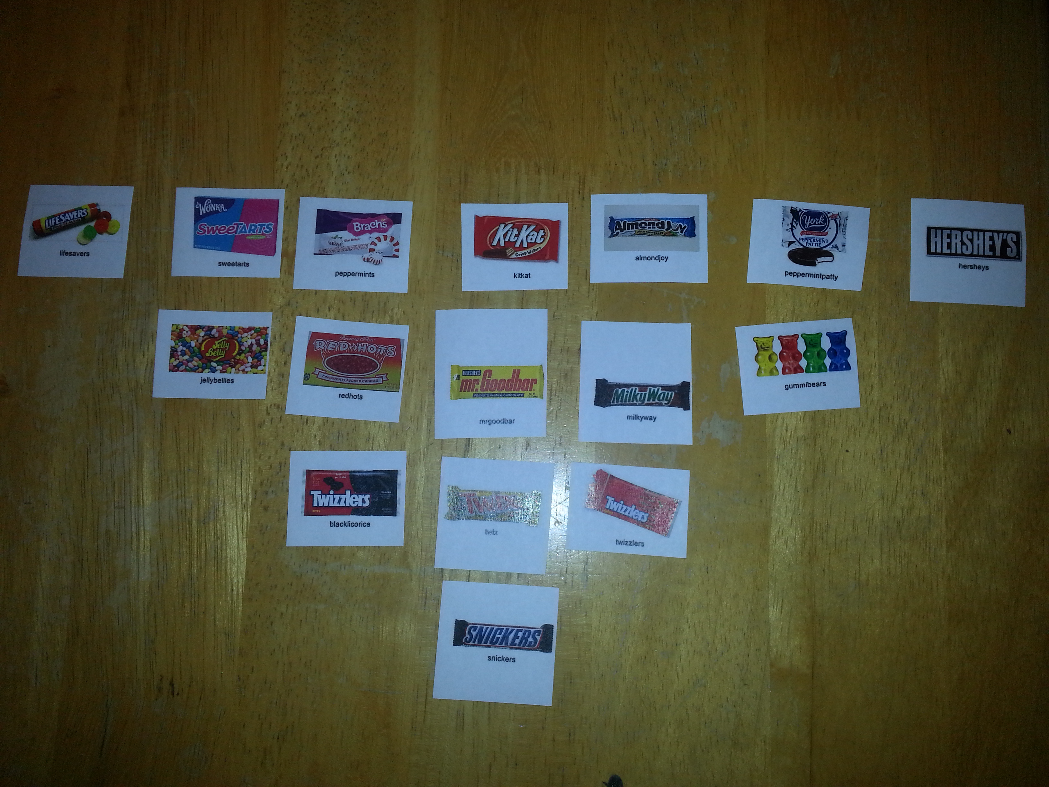

Slide 13
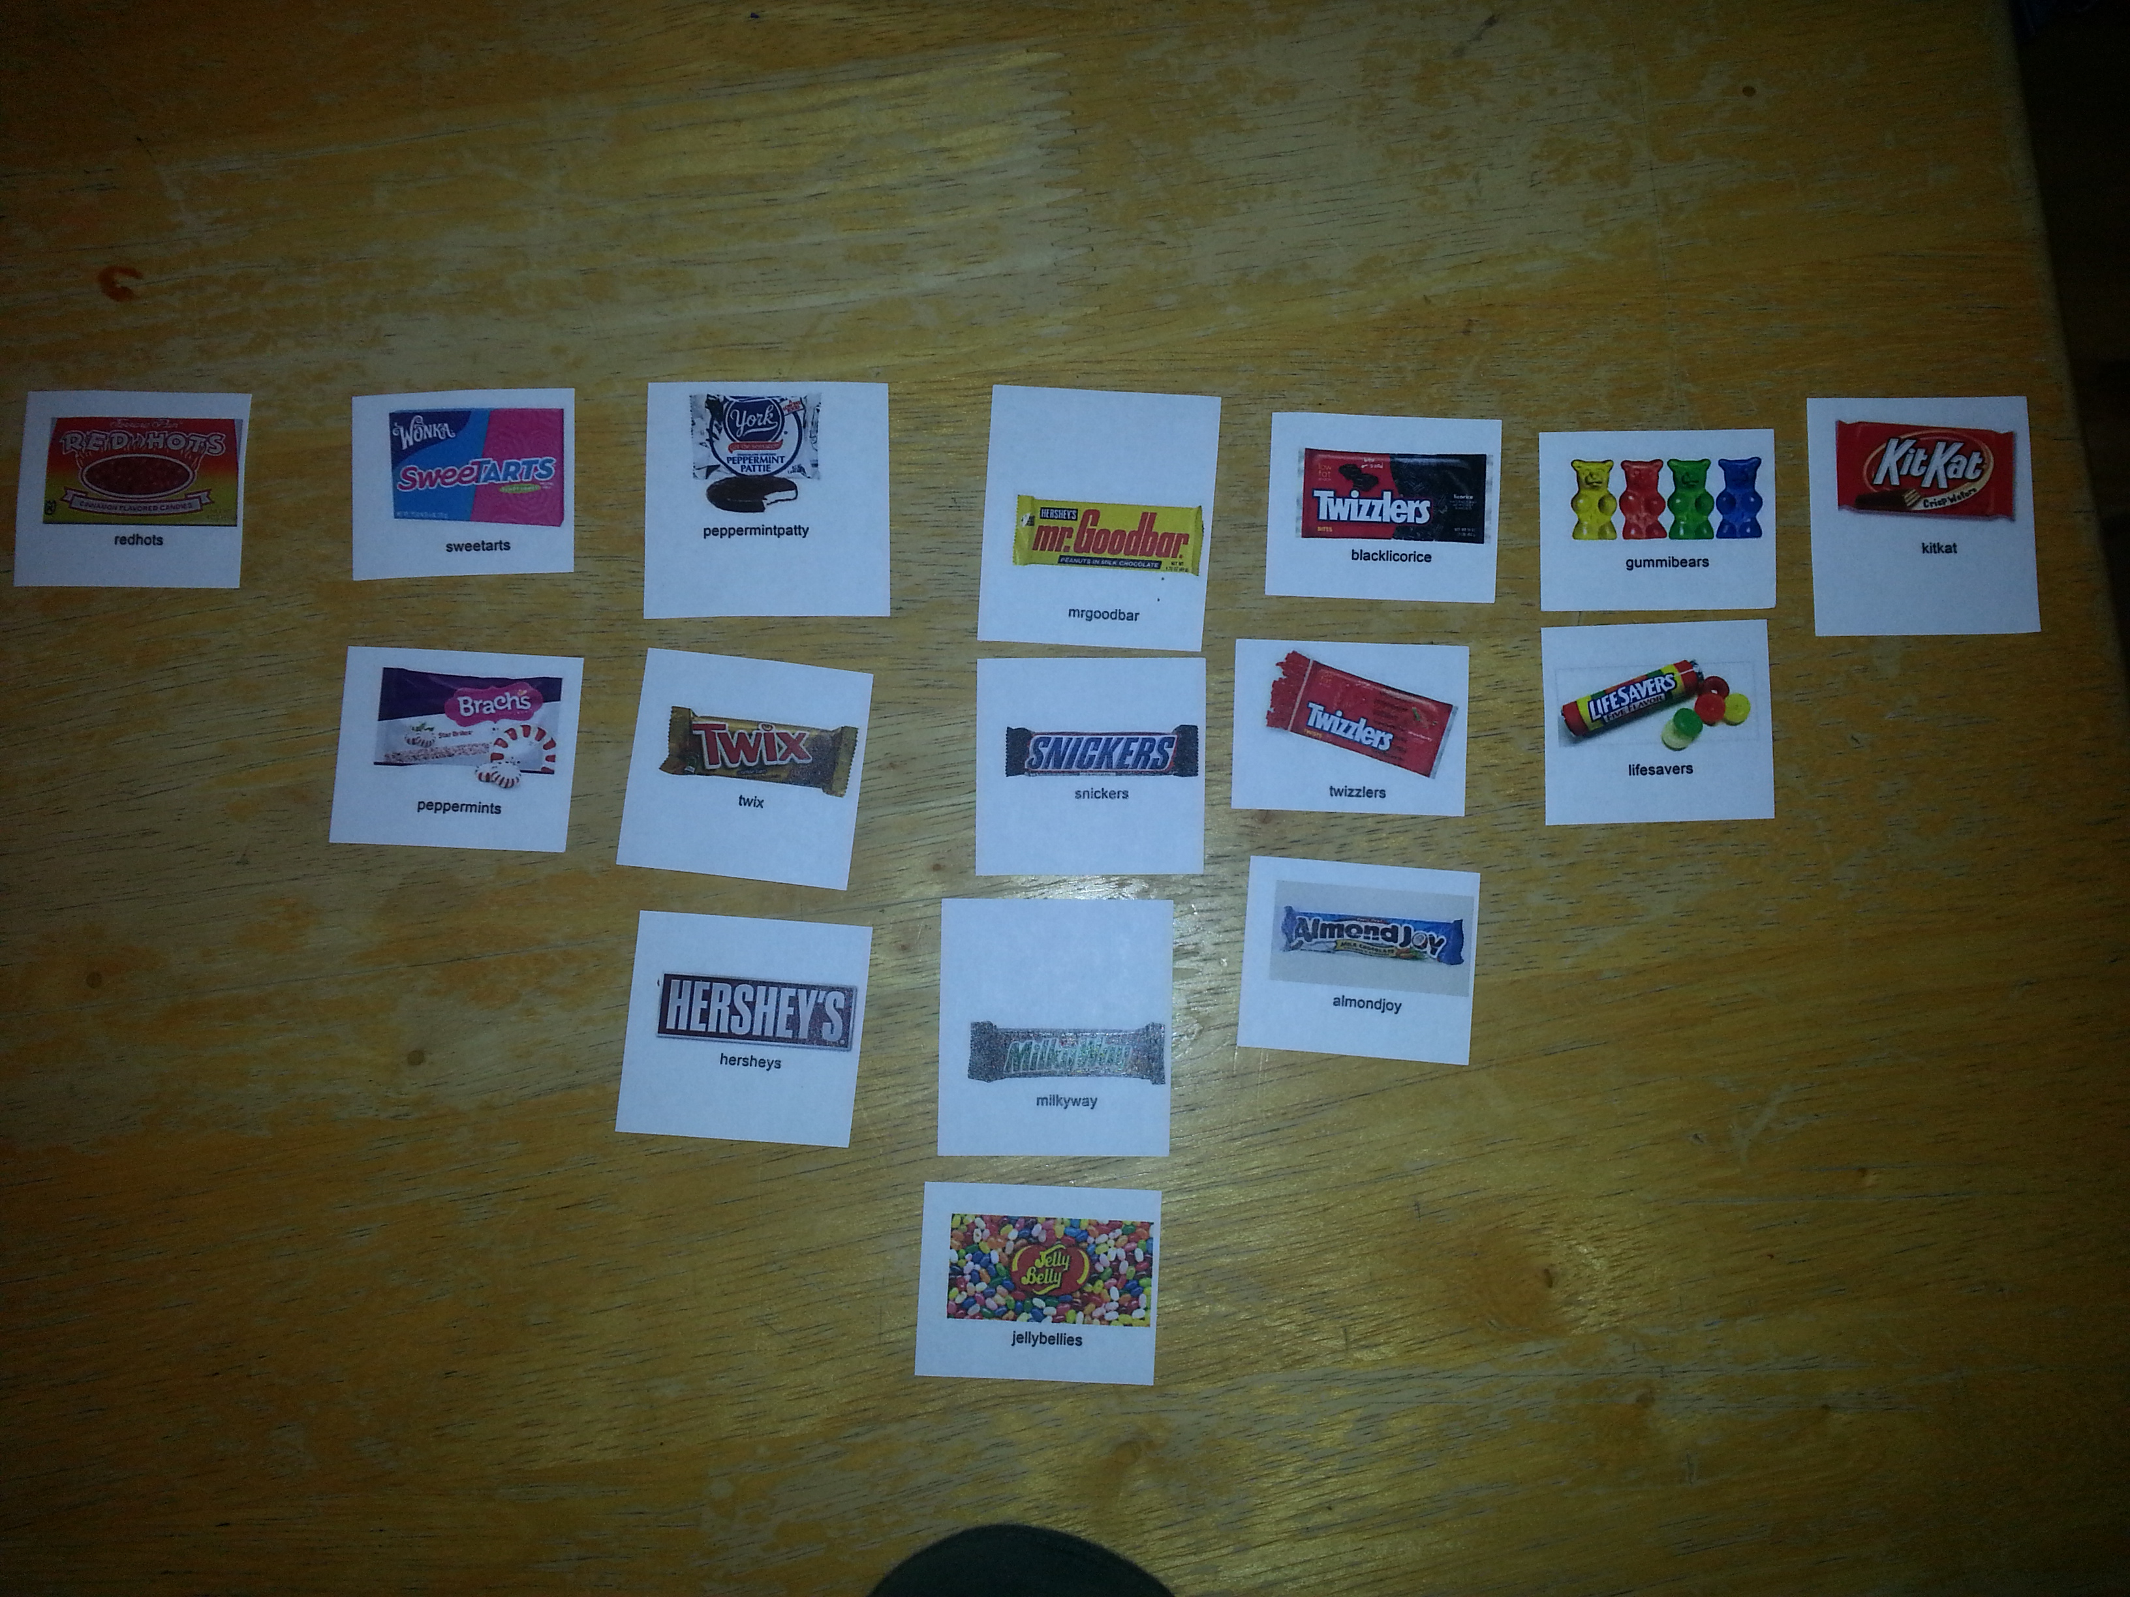

Slide 14
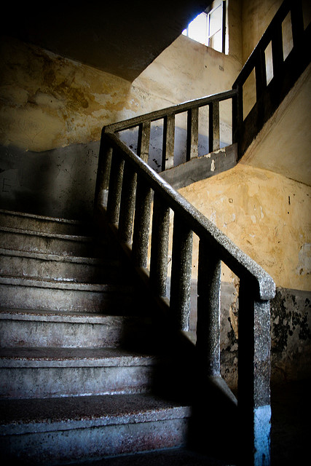
Five Steps in Q Methodology
Concourse Building
P-Set
Q Sort
Analysis
Interpretation
Notes:
Walking through the five steps very broadly. We’ll get into specifics when we do that hands-on activity later on.

Slide 15

Step 1: Concourse Building
CONCOURSE:
The entire conversation surrounding the topic
Gather a “concourse” of communication surrounding your topic
Notes:
The first step in Q is to build the concourse. Quite simply, the concourse is the entire conversation surrounding the topic.
So we want to gather a very wide range of opinion statements about a particular topic. There are several ways to do this, and you can use them in combination, or you can use just one.

Slide 16
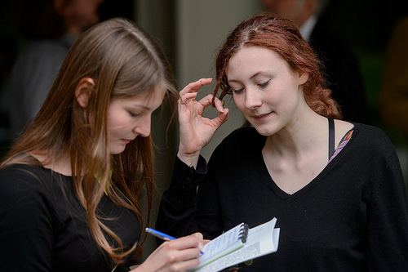
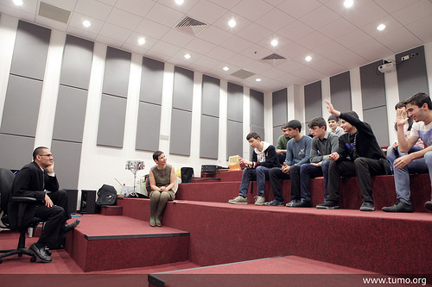
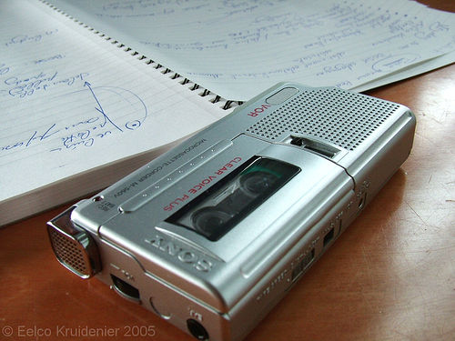
Step 1: Concourse Building
in-person interviews
focus groups
Notes:
A traditional way to do this is to conduct in-person interviews or focus groups. So for our faculty perceptions of open access study, we talked to faculty from different departments and faculty holding different tenure ranks – assistant, associate, and full. Your goal is to get a wide range of opinions, and in order to do that you’ll want to talk to a wide range of people – no matter what your topic is.
When you do this, you’ll want to make sure you record the interviews, because you will want to pull strong statements from the interviews afterwards. You may not need to transcribe them entirely, but you will want to listen for opinions.

Slide 17

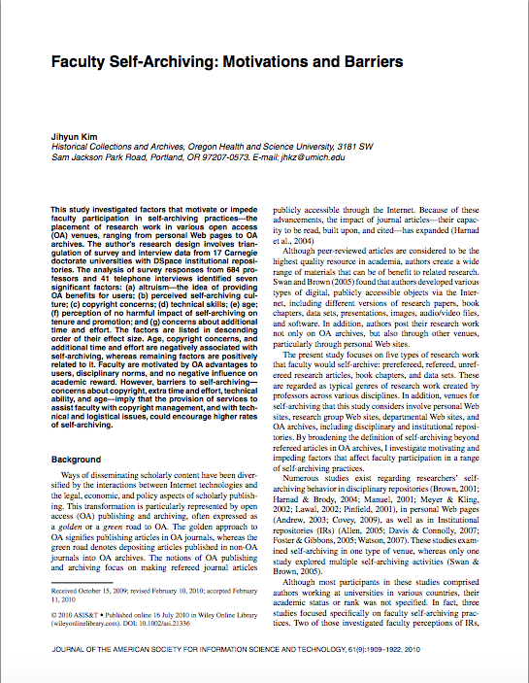
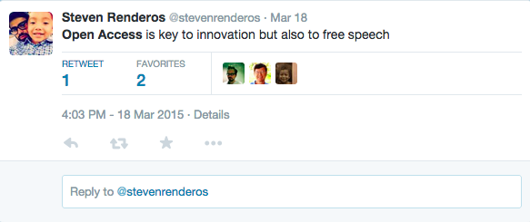
Step 1: Concourse Building
scanning the literature
includes tweets, blogs, listservs, comments
Notes:
You can also gather opinion statements by scanning the literature. You’ll want to look at some of the scholarly literature. But we’d also want to look at more informal communication channels such as tweets, blogs, and listservs, etc.
Don’t forget about comments on blogs and newspaper articles as well. As much as we hate to look at them, there are some strongly worded opinions there.
And just like you would with any literature review, keep track of your sources. If you end up publishing the study, you’ll need to cite them.

Slide 18

Step 1: Concourse Building
statements
and the full range of opinions
Notes:
The two goals of Concourse building is to gather as many different types of opinions as possible and to gather strong statements. We’ll talk about strong statements a little bit later, but essentially you want strong opinions. You want to find opinions that are strongly worded and that people can generally agree with or disagree with.

Slide 19
Step 2: P-set
Develop a “P-set” of statements from the concourse
Concourse of 150+ statements
Coding, cleaning up, ensuring representation
P-set of
40-60 statements
Notes:
The next step is to select what is called a “P-set” of statements from the concourse.
The goal of the P-set is to be a representative sample of all of the concourse statements, containing only opinion statements. It is important that all statements that make it into the p-set are statements that a person could agree with or disagree with. The statements can be cleaned up to some degree, but it is best to try to retain as much of the natural language and context of the original statement as possible. It is also important to ensure that the p-set itself is balanced – that there is a good mix of statements for and against particular themes that might emerge from the initial coding process.
The final number of statements in a P-set depends on a number of factors, including how many statements were originally in the concourse. There should be enough statements in the p-set that cover the range of opinions captured in the concourse. However, there shouldn’t be so many statements that a person could not put them in order. In general, many studies have a p-set of between 40-60 statements.

Slide 20
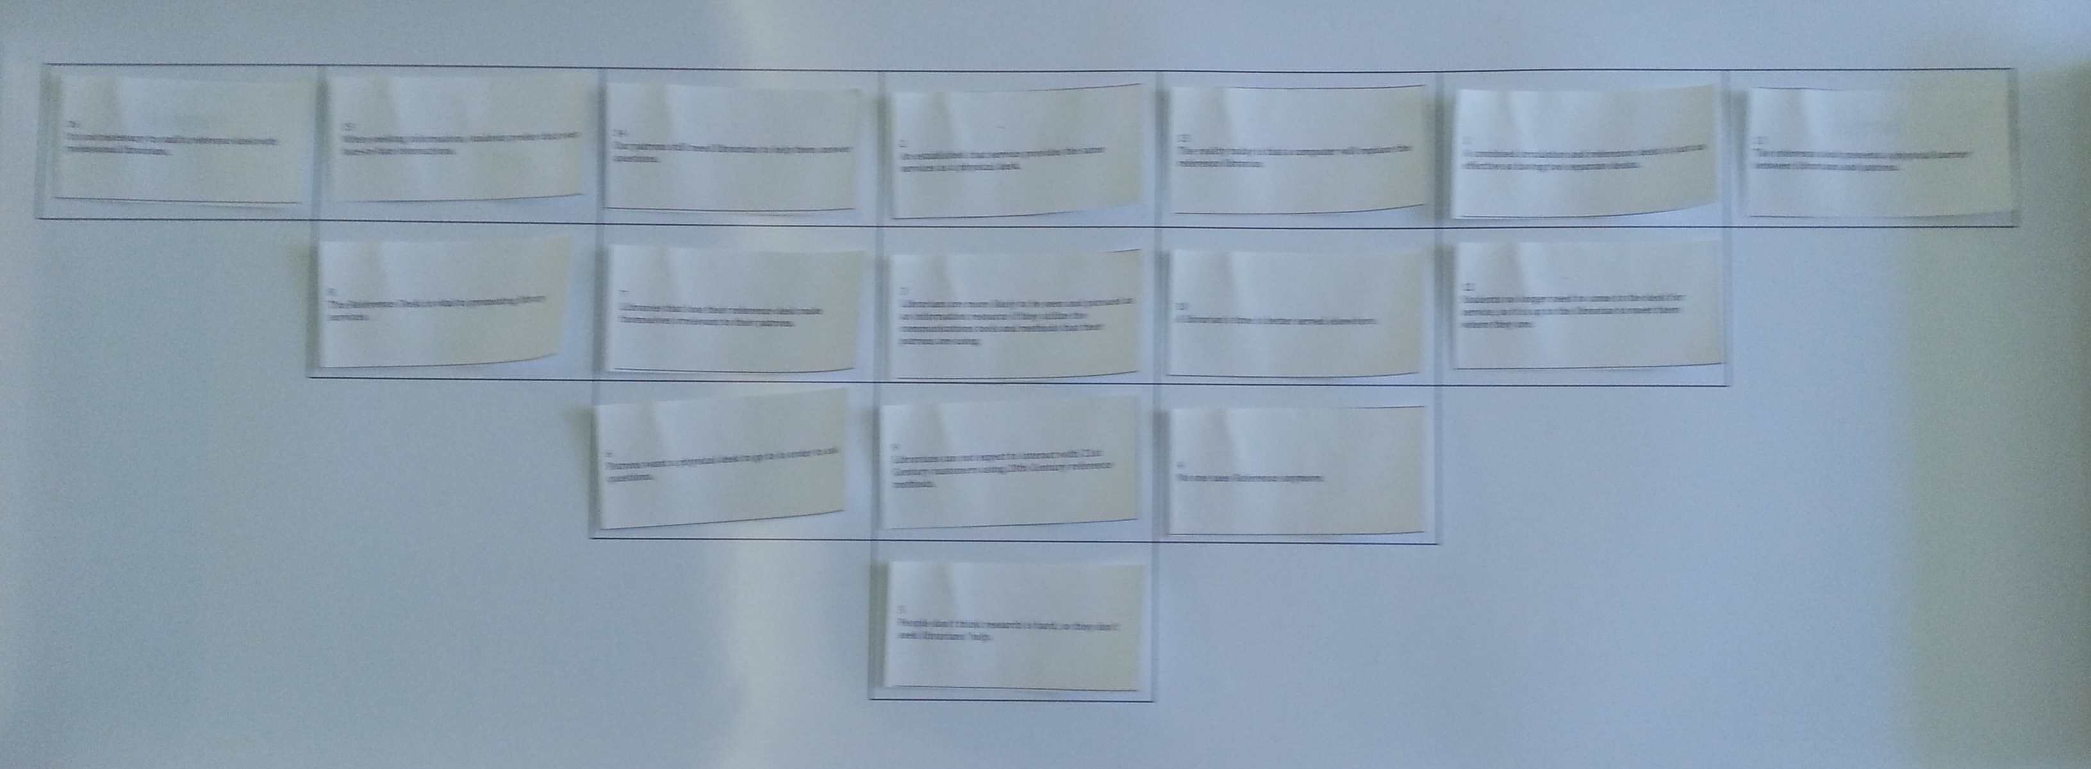
Step 3: Q-sort
P-set statements are put on cards and are then sorted by participants onto a grid
Notes:
Next, the P-set statements are then put on cards. Another group of participants then sort these cards onto a grid that indicates levels of agreements with a statement.
The grid is usually an inverted triangle, with the left hand tip representing “most disagree” and the right hand tip representing “most agree.”
Typically, after the participant sorts the cards, they are asked why they sorted the cards the way they did. These post-hoc interviews allow for additional viewpoints to arise, but will actually often confirm what quantitative analysis will show.

Slide 21
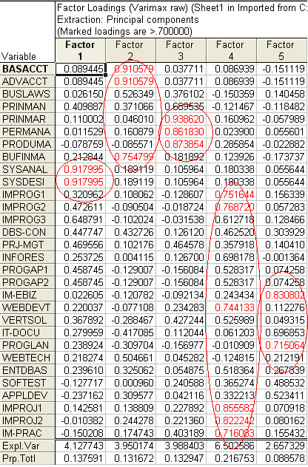
Step 4: Factor analysis of sorting
Q-sort results are analyzed
Q-analysis as an inversion of Spearman’s factor analysis
Produces a person-by-person correlation matrix (instead of a variable-by-variable matrix)
Notes:
The next step is a statistical one. In layman’s terms, we will be using math to derive “factors,” or idealized, archetypical viewpoints, based on the data collected.
As we mentioned previously, Q-methodology was developed in the 1930s by William Stephenson. Stephenson was a protégé of Charles Spearman, who pioneered factor analytic methods that are still commonly used in more traditional quantitative studies today. Spearman’s factor analysis is used to account for associations between variables captured in a correlation matrix. In other words, it reflects by-variable differences and correlations. The factor analysis Stephenson developed was an inversion of Spearman’s method, and it is designed to produce a person-by-person correlation matrix (as opposed to variable-by-variable matrix).
Although it is possible to calculate these by hand, most researchers using Q will rely on a software package called PQ Method. We will work with PQ Method later in the workshop, so you’ll be able to see it in action.

Slide 22

Factors vs. individual viewpoints (sorts)
Factor 1
√
1
Each dot = one Q-sort
Line = Factor = common ground between viewpoints
Factor 2
√
-1
1
-1
Notes:
In this visualization, let’s imagine the red Y-axis as a factor. Let’s imagine that the teal X-axis is another factor, or viewpoint.
We’ve added eyes with a square root sign to remind you that this is an idealized viewpoint, mathematically derived. Each factor “looks” towards the origin of the factor axes. Again, in this very simplified 2-D representation, that origin is the center point where the axes meet.

Slide 23
Factors vs. individual viewpoints (sorts)
Factor 1
√
1
Each dot = one Q-sort
Line = Factor = common ground between viewpoints
Q-sort 16
0.57 (F1)
-0.54 (F2)
Q-sort 1
0.63 (F1)
0.35 (F2)
Factor 2
√
-1
1
-1
Notes:
Now, let’s add another viewpoint. Let’s say Q-sort #16 correlates ..57 with Factor 1 and -.54 with Factor 2.

Slide 24
Rotating the factors
Factor 1
√
1
Dotted lines = rotated factors
Rotated factors intersect clusters of actual viewpoints from individuals
Rotated factor = archetypical viewpoint that describes the entire cluster of viewpoints
Factor 2
√
-1
1
-1
Notes:
This is the reason why an additional step is taken to ROTATE the factors. The rotation doesn’t change any of the data. It simply shifts the perspective of a factor, so that the factor focuses on the data itself. The purpose of extracting factors in the first place was to identify the number of unique perspectives, represented by opinion clusters, in the data. By rotating the factors so that they align with the data points themselves, you can describe the factor and know that you are describing a cluster of opinions. In this manner, the factor represents an archetypical viewpoint.
You can also determine how much any individual opinion correlates to that archetypical viewpoint. You may find that one person’s q-sort correlates 85% with the factor. That person would be described as “loading very highly onto the factor.” You may also see individual opinions that don’t load that highly onto a factor, but still help to define it.

Slide 25
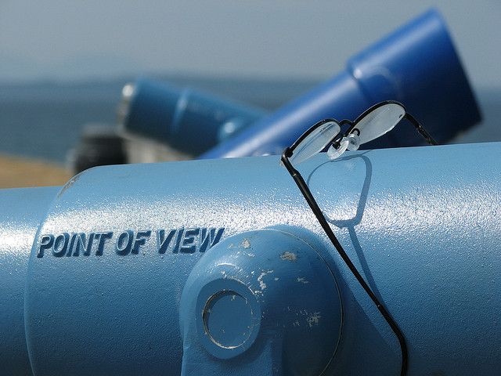
Step 5: Interpretation
Identify and name the perspectives that represent shared viewpoints.
Pragmatist
Traditionalist
Evangelist
Notes:
So, after the analysis you end up with a set of factors – discrete perspectives that represent shared viewpoints or subjectivity. Then researcher then has to describe what that factor actually looks like. Sometimes you may want to “name” the opinion type, and you will want to describe what makes this opinion type unique or different from the others. In our open access study, we named them pragmatists, traditionalists, and evangelists. You will come up with different names and descriptions based on what and who you’re studying.

Slide 26
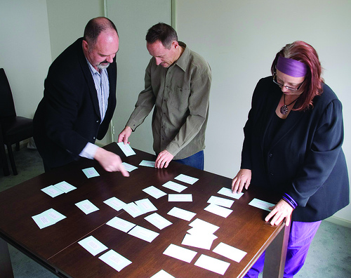
Hands-on Activity
How do academic librarians think about the Reference Desk?
Concourse
P-Set
Q-Sort
Analysis
Interpretation
Notes:
Get into packet.
Purple gray = concourse
Coral/Salmon = p set
Blue = sorting grid worksheet
Pink = sorting instructions
Cards – should be 16, may have slipped out of the envelope

Slide 27

Review: Concourse
Gather as many opinion statements as possible
Review literature, interviews, social media, etc.
Seek out people with strong opinions
OK to ask pointed or leading questions
Notes:
Purple-gray one worksheet is the Concourse that we have gathered. For this workshop, you will not be gathering a concourse; we have supplied one for you.
We gathered the concourse a little differently, because our goal wasn’t to do a study – it was to conduct a workshop. So we didn’t conduct interviews, and we did a very abbreviated search of the literature.
There’s no “set number” of opinions you need. Similar to other types of research, you’ll know you’re done when you start running into the same opinions and aren’t finding anything new. “Research saturation,” “echo chamber,”
Strong statements are unambiguous, and sometimes you need to draw them out of people. This is a skill you’ll develop, but it may mean asking a number of follow up questions, asking pointed questions or leading questions.
IRBs sometimes want to see interview/focus group questions. You’ll need to have a structure that includes leading questions and questions in case you get stalled. But skill becomes in drawing people’s opinions out of them. No need to stay impartial in these interviews. Be prepared to go “off script.”

Slide 28
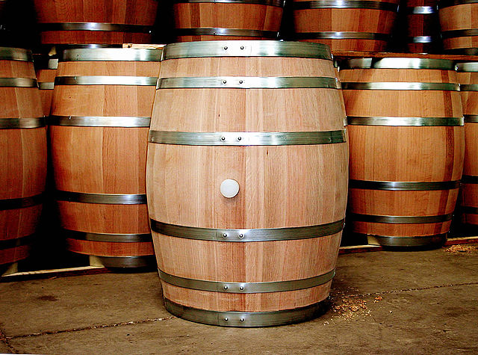
Concourse P-Set
Clean up
  Eliminate double-barreled statements
  Clear up ambiguous statements
Notes:
Once you’ve gathered the Concourse, you’re going to need to start looking at patterns in the Concourse.
Don’t look at the P-set yet we’ve provided you yet. Just look at the Concourse and think about how you might start turning it into the P-Set. What do you see? You might come up with a different p-set than we did.
Where are the double-barreled statements?
Where are the ambiguous statements?

Slide 29
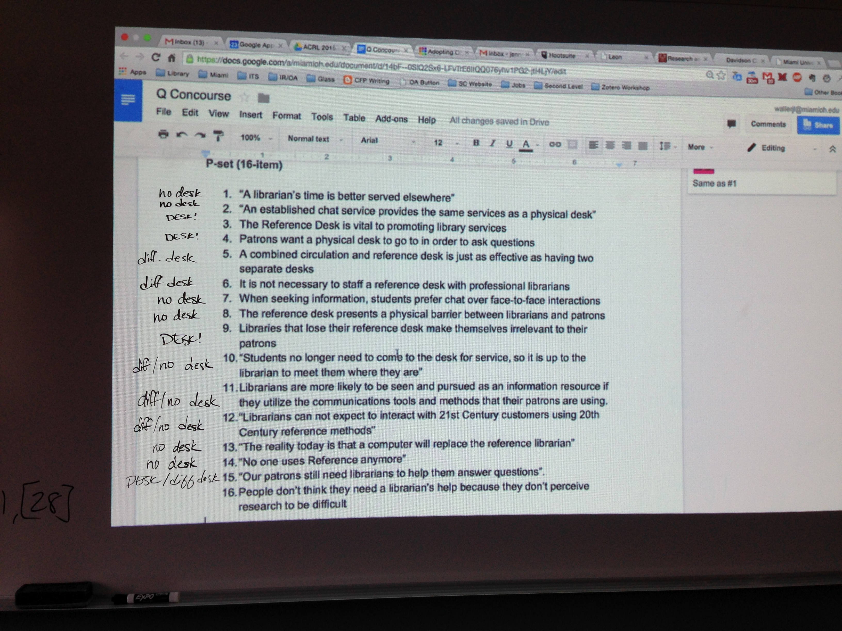
P-set
Code statements in the concourse
Determine categories of codes
Ensure that the p-set is representative of the range of statements in the concourse

Slide 30

What’s in a Q Packet?
P-set turned into cards
  randomize and number
“How to sort” instruction sheet
Sorting Grid
  Permission to follow up
  Additional demographic questions
IRB/Informed consent form (2-copies)
Notes:
Reminder – In the sorting grid – can ask questions. Ask if they are willing to do follow up.

Slide 31

Q-sort, Grid, and BREAK
Each person does one sort.
Complete the grid and submit.
BREAK!

Slide 32
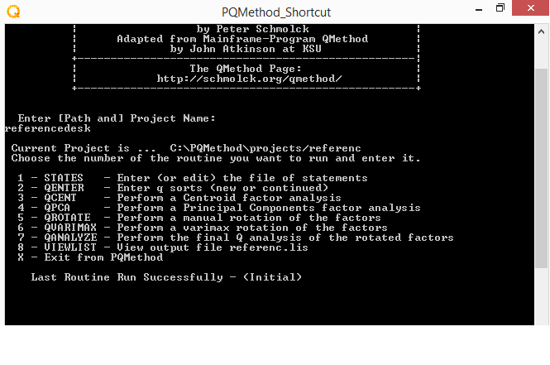

Slide 33
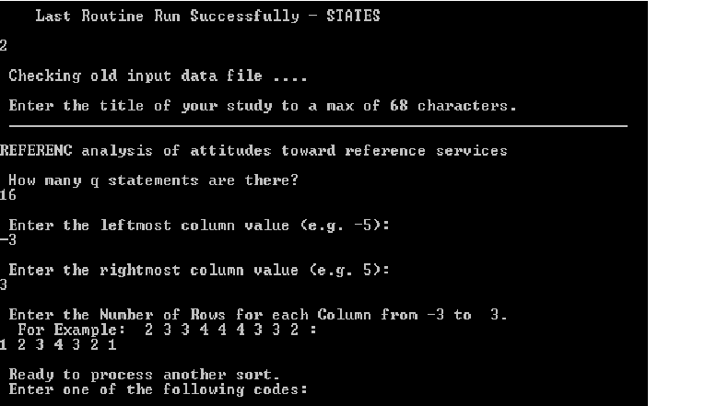

Slide 34
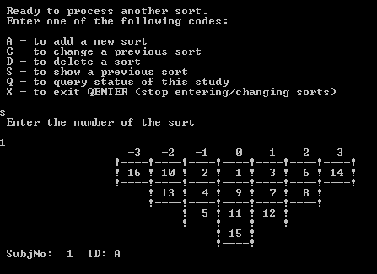

Slide 35
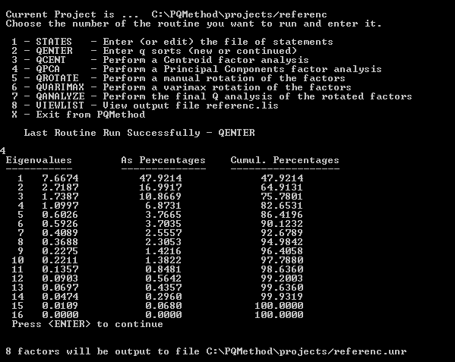

Slide 36
Path and Project Name: C:\PQMethod\projects/referenc Mar 23 15
Unrotated Factor Matrix
Factors
1 2 3 4 5 6 7 8
SORTS
1 A 0.6843 -0.4711 0.1309 -0.3529 -0.1239 0.3012 0.1160 0.0247
2 B 0.8133 0.2416 0.1616 0.0075 0.2468 0.1437 -0.1452 -0.2754
3 C 0.6659 0.5075 -0.1763 -0.2301 -0.1017 -0.2549 -0.3094 -0.0166
4 D 0.8568 0.1585 -0.1238 0.0162 0.1267 -0.0218 -0.2220 0.1189
5 E 0.8918 -0.0108 -0.1459 0.0683 0.1999 -0.1609 0.0543 0.2791
6 F 0.7979 0.3051 -0.3352 0.0180 -0.1923 -0.2005 0.0343 -0.2082
7 G 0.7582 0.3452 0.3467 0.1353 -0.1417 0.0381 0.1688 0.2601
8 H 0.8943 -0.2814 0.1464 0.2074 0.0556 -0.0627 0.0071 -0.0872
9 I 0.1637 0.8316 -0.0370 -0.3417 0.2671 0.0708 0.2052 -0.0221
10 J 0.5156 -0.7016 -0.2725 0.0484 -0.0892 -0.2455 -0.0450 -0.0452
11 K 0.5330 0.0181 0.6253 0.3006 0.0048 -0.2718 0.3241 -0.1729
12 L 0.6140 0.3068 0.6244 -0.1750 -0.1231 0.1473 -0.1646 0.0042
13 M 0.5307 0.2404 -0.6133 -0.0624 -0.3819 0.2078 0.2512 -0.1129
14 N 0.7042 -0.4413 -0.0180 0.2625 0.1351 0.3345 -0.1398 -0.0976
15 O 0.8862 -0.2284 0.0210 -0.0472 -0.2806 0.0261 -0.0229 0.1559
16 P 0.0358 0.5121 -0.3417 0.7233 0.0470 0.1876 -0.0160 0.0726
17 Q 0.6452 -0.3052 -0.3599 -0.2266 0.4742 -0.0159 0.1997 0.0291
Eigenvalues 8.0481 2.7930 1.8445 1.1338 0.7671 0.6003 0.5118 0.3725
% expl.Var. 47 16 11 7 5 4 3 2

Slide 37
Factor Matrix with an X Indicating a Defining Sort
Loadings
QSORT 1 2 3 4
1 A 0.1973 0.6351 0.3062 -0.5440
2 B 0.5150 0.2463 0.6481X -0.0087
3 C 0.8226X -0.0088 0.3275 -0.0327
4 D 0.6457X 0.4047 0.4373 0.0526
5 E 0.5728 0.5689 0.4087 0.0501
6 F 0.7995X 0.3126 0.2797 0.1651
7 G 0.3981 0.1207 0.8072X 0.0891
8 H 0.2333 0.7338X 0.5919 0.0052
9 I 0.6593X -0.5983 0.2051 -0.0423
10 J 0.0644 0.8988X -0.0765 -0.1296
11 K -0.1054 0.2069 0.8411X 0.0665
12 L 0.2447 -0.0694 0.8668X -0.2748
13 M 0.7821X 0.2576 -0.1153 0.1673
14 N 0.1080 0.7974X 0.3297 0.0621
15 O 0.4038 0.6630X 0.4565 -0.1709
16 P 0.2404 -0.1202 0.0260 0.9113X
17 Q 0.4815 0.6350X -0.0237 -0.2337
% expl.Var. 24 26 23 8
Notes:
Green handout

Slide 38
Factor Q-Sort Values for Each Statement
Factor Arrays
No. Statement No. 1 2 3 4
1 A combined circulation and reference desk is just as effecti 1 1 1 1 0
2 An established chat service provides the same services as a 2 0 0 -2 -1
3 Librarians are more likely to be seen and pursued as an info 3 2 0 3 -1
4 No one uses Reference anymore. 4 -1 -3 -3 -1
5 People don’t think research is hard, so they don't seek libr 5 -1 -1 1 0
6 Patrons want a physical desk to go to in order to ask questi 6 -1 2 0 0
7 Libraries that lose their reference desk make themselves irr 7 -2 1 0 -3
8 The Reference Desk is vital to promoting library services. 8 -2 2 0 -2
9 Librarians can not expect to interact with 21st Century cust 9 2 -1 2 1
10 A librarian’s time is better served elsewhere. 10 0 -2 -1 2
11 The reference desk presents a physical barrier between libra 11 0 -1 -1 -2
12 Students no longer need to come to the desk for service, so 12 1 0 1 1
13 The reality today is that a computer will replace the refere 13 -3 -2 0 1
14 Our patrons still need librarians to help them answer questi 14 3 3 2 0
15 When seeking information, students prefer chat over face-to- 15 0 0 -1 3
16 It is not necessary to staff a reference desk with professio 16 1 1 -2 2
Variance = 2.500 St. Dev. = 1.581
Notes:
Instruction for for hands on,
What does this factor look like?
Name the type, use flip charts.

Slide 39
Resources
Q Methodology Website: http://qmethod.org/about
Information about ISSSS, the Q Listserv, conferences, tutorials, etc.
Operant Subjectivity: http://www.operantsubjectivity.org/
Scholarly, peer reviewed journal for ISSSS
Download PQ Method: http://schmolck.userweb.mwn.de/qmethod/#PQMethod
Software tailored to the requirements of Q Method
“Links” page on the Q Methodology Website: http://qmethod.org/links
Contains links to software for conducting online Q Sorts
William Stephenson, The Study of Behavior: Q Technique and its Methodology (Chicago: University of Chicago Press, 1953).
Steven Brown, “Primer on Q Methodology,” Operant Subjectivity 16, no.3 (1993): 91-138.
Simon Watts and Paul Stenner, Doing Q Methodological Research: Theory, Method and Interpretation (Los Angeles: Sage, 2012).
Steven Brown, Political Subjectivity: Applications of Q Methodology in Political Science (New Haven: Yale University Press, 1980), http://qmethod.org/papers/Brown-1980-PoliticalSubjectivity.pdf

Slide 40
Miami University Q Studies
Stacy Brinkman
  Brinkman, S., Krivickas, J. (2015) Attitudes Towards E-Books Among Visual Arts Faculty and Students. Art Documentation, 34(1), 1-18.
Jen Waller
Waller, J., Revelle, A., & Shrimplin, A.K. (2013) Keep the Change: Clusters of Faculty Opinions on Open Access. Imagine, Innovate, Inspire: The Proceedings of the ACRL 2013 Conference, (pp 360-372). http://sc.lib.miamioh.edu/handle/2374.MIA/4964
Kevin Messner
  Messner, K., Revelle, A., Shrimplin, A. Hurst, S. (2011, March) Book Lovers, Technophiles, Printers and Pragmatists: The Social and Demographic Structure of User Attitudes Toward E-Books. College & Research Libraries, 73(5), 420-429. http://sc.lib.miamioh.edu/handle/2374.MIA/5191
Aaron Shrimplin
  Shrimplin, A., Revelle, A., Hurst, S., & Messner, K. (2011). Contradictions and Consensus – Clusters of Opinions on E-books. College & Research Libraries, 72(2), 181-190. http://sc.lib.miamioh.edu/handle/2374.MIA/5192
  Shrimplin, A., Hurst, S. (2007). A Virtual Standoff – Using Q Methodology to Analyze Virtual Reference. Evidence Based Library and Information Practice, 2(4), 3-21.

Slide 41
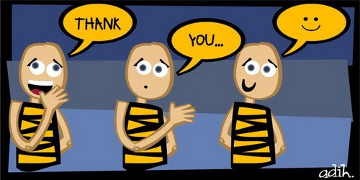

Wrap Up, Questions, Thank You!

Slide 42
Et Cetera
This work was created by Stacy Brinkman, Kevin Messner, Aaron Shrimplin, and Jen Waller for the Association of College and Research Libraries (ACRL) 2015 national conference and presented on March 27, 2015 in Portland, Oregon.
This work is licensed under a Creative Commons Attribution-NonCommercial-Share Alike 4.0 International license (CC BY-NC-SA 4.0) license. For more information about this license, please see:
http://creativecommons.org/licenses/by-nc-sa/4.0/
You may reach the presenters at the following email addresses:
Stacy Brinkman: brinkmsn@miamioh.edu
Kevin Messner: messnekr@miamioh.edu
Aaron Shrimplin: shrimpak@miamioh.edu
Jen Waller: wallerjl@miamioh.edu

Slide 43
Image Credits
“Q Mosaic” © Leo Reynolds
Used under a CC BY-NC-SA 2.0 license
https://www.flickr.com/photos/lwr/101562372/
Stephenson.jpg © unknown
Used by permission from ISSSS
http://qmethod.org/images/Stephenson.jpg
“BBC WM skin cancer interview” © Lee Jordan
Used under a CC BY-SA 2.0 license
https://www.flickr.com/photos/leejordan/536286331/
“Berit Brogaard” © August Jennewein
Used under a CC BY 3.0 license
http://en.wikipedia.org/wiki/Berit_Brogaard#/media/File:Berit_Brogaard.jpg
“Gipsy Smith, evangelist, in action in the Boston Arena © Boston Public Library, Leslie Jones Collection.
Used under a CC BY-NC-ND 2.0 license
https://www.flickr.com/photos/boston_public_library/8094123894
“Professor Moriarty said to remind you to eat your vegetables © Steven Gray
Used under a CC BY-NC 2.0 license
https://www.flickr.com/photos/stevengrayphotograpy/8025722664
“Chocolate bar compilation” © captcreate
Used under a CC BY-NC-SA 2.0 license
https://www.flickr.com/photos/27845211@N02/2808511517/
“Stairs” © M.G. Kafkas
Used under a CC BY-NC-ND 2.0 license
https://www.flickr.com/photos/thecaucas/3551765419
“Graphic Conversation” © Marc Wathieu
Used under a CC BY-NC 2.0 license
https://www.flickr.com/photos/marcwathieu/2979581445
“IMG_5879” © raffik
Used under a CC BY-NC-SA 2.0 license
https://www.flickr.com/photos/raffik/13929883634
“Interviews” © Stephan Roehl
Used under a CC BY-SA 2.0 license
https://www.flickr.com/photos/boellstiftung/13981256424
“Interview” © Eelco
Used under a CC BY-NC 2.0 license
https://www.flickr.com/photos/smiling_da_vinci/14785644/
“Open Access” book cover © MIT Press
Used under a CC BY license
http://mitpress.mit.edu/sites/default/files/9780262517638_Open_Access_PDF_Version.pdf

Slide 44
Image Credits
“Most Americans Do Not Want Google Glasses, Drones, Or Lab-Grown Meat” © wackystuff
Used under a CC BY-SA 2.0 license
https://www.flickr.com/photos/wackystuff/13997991255/
“Q-Sort grid” © Kevin Messner
“IS_Survey_Varimax_Raw_Subjects_factors” © ThePageman
Used under a CC BY-SA 2.0 license
https://www.flickr.com/photos/the_pageman/3799744140
“Point of View binoculars in West Seattle” © Jonathon Colman
Used under a CC BY-NC-ND 2.0 license
https://www.flickr.com/photos/jcolman/2770526461
“CS 003: Figure 1.3 © Rosenfeld Media
Used under a CC BY 2.0 license
https://www.flickr.com/photos/rosenfeldmedia/3343498557
Job interview colleagues business
Public domain image thanks ”nuggety247”
http://pixabay.com/en/job-interview-colleagues-business-437026/
“Oak wine barrel at toneleria nacional chile” © Gerard Prins
Used under a CC BY-SA 3.0 license
http://en.wikipedia.org/wiki/Barrel#/media/File:Oak-wine-barrel-at-toneleria-nacional-chile.jpg
“paper work piles” © bourgeoisbee
Used under a CC BY-NC 2.0 license
https://www.flickr.com/photos/bourgeiosbee/2037138405
Blue Sky and Clouds © p.Gordon
Used under a CC BY 2.0 license
https://www.flickr.com/photos/pgordon/2531908489
“thank you” © adihrespati
Used under a CC BY 2.0 license
http://www.flickr.com/photos/29224712@N08/2755905578
“Questions” © Oberazzi
Used under a CC BY-NC-SA 2.0 license
http://www.flickr.com/photos/oberazzi/318947873

