Slide 1





Sustainably Supporting Assessment Work with Communities of Practice
Maryellen Allen
University of South Florida
Sarah Evelyn
Brown University
Lorraine Heffernan
University of Massachusetts Dartmouth
Jennifer Jarson
Muhlenberg College
Eric Resnis
Miami University
Notes:
JEN

Slide 2
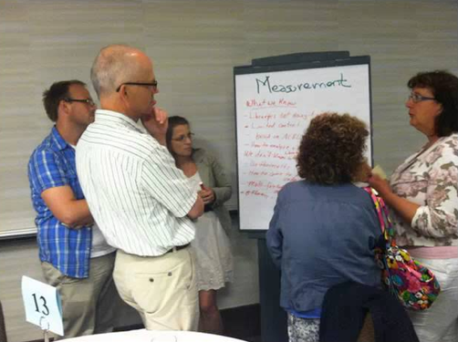
Communities of practice (COP)
Notes:
ERIC

Slide 3
What is a Community of Practice?
Mutual Engagement
Joint Enterprise
Shared Repertoire
“Groups of people who share a concern, a set of problems, or a passion about a topic, and who deepen their knowledge and expertise in this area by interacting on an ongoing basis.”
(Wenger, McDermott, and Snyder)
“Cross-Disciplinary Group...who engage in an active, collaborative program with a curriculum …that provides learning development, and community building.” (Cox)
Cox, M. D. (2004). Introduction to faculty learning communities. New Directions for Teaching and Learning , 2004 (97), 5–23. http://dx.doi.org/10.1002/tl.129
Wenger, E., McDermott, R. A., & Snyder, W. (2002). Cultivating communities of practice: A guide to managing knowledge. Boston, Mass: Harvard Business School Press
Notes:
ERIC
----- Meeting Notes (3/26/15 09:25) -----
SARAH

Slide 4
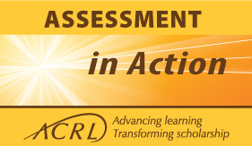
Team-based assessment projects
Library and campus partners supported by blended learning environment and peer-to-peer network
Cohort 1: 2013-2014 (75 teams)
Cohort 2: 2014-2015 (73 teams)
Cohort 3: 2015-2016
Notes:
SARAH
The AiA program has three broad goals:
GOAL 1: Develop the professional competencies of librarians to document and communicate the value of their academic libraries primarily in relation to their institution’s goals for student learning and success.
GOAL 2: Build and strengthen collaborative relationships with higher education stakeholders around the issue of library value.
GOAL 3: Contribute to higher education assessment work by creating approaches, strategies, and practices that document the contribution of academic libraries to the overall goals and missions of their institutions.

Slide 5
In this session, we will:
Share the benefits and value of external relationships and communities of practice
Help you identify ideas to improve current/future projects by building on external relationships
Encourage you to network and share strategies to create your own support communities
Notes:
LORRAINE

Slide 6
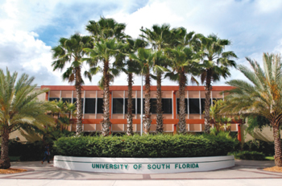
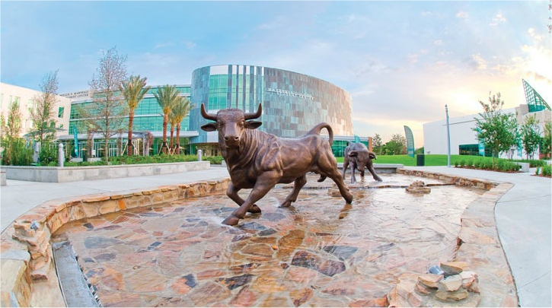
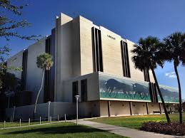
Assessment Project
Impact of Information Literacy Instruction on Student Success
University of South Florida
Research Question: Do First Year Composition students who attend information literacy instruction perform better in their course than those who do not?
Members of USF’s COP appointed by the Assistant Vice Provost, consisting of:
  2 Librarians
  Director of First Year Composition (FYC)
  Director of the Academy for Teaching and Learning Excellence
2 members left the University during the middle of the project
Notes:
MARYELLEN

Slide 7
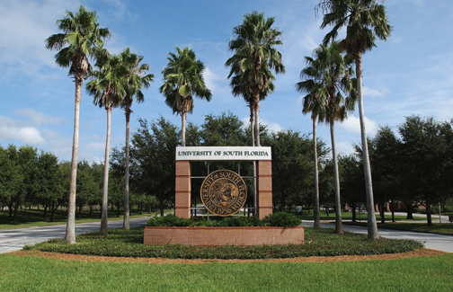

Assessment Project
Plugging into the process: Enhancing campus partnerships to provide robust student research support
Existing strong relationship with FYC.
  Provided invaluable data
  Very vested in information literacy and student success
Support from AiA cohort was vital.
Institutional support made library data collection of students possible
Notes:
MARYELLEN

Slide 8
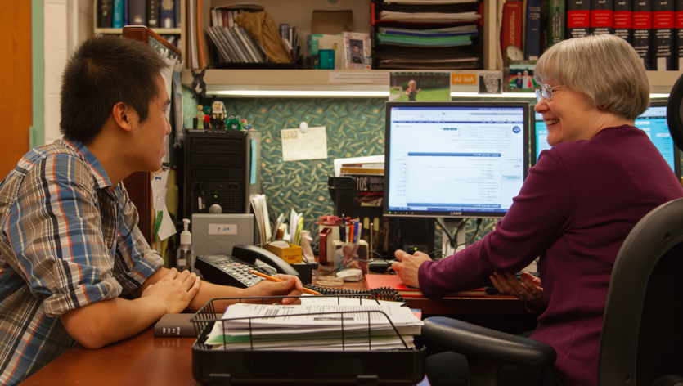
Assessment Project
Plugging into the process: Enhancing campus partnerships to provide robust student research support
Research Question
To what extent do students meet/exceed faculty expectations of student research needs
Notes:
SARAH

Slide 9
University Library Team
Head, Instructional Design
Director of Library Assessment and Planning
AUL of Research and Outreach
Subject Librarians
External COP of colleagues also doing assessment work
On Campus COP
Director, Center for Teaching & Learning
Dean of First Year Students and Sophomores
Academic Departments: Faculty of First Year Seminars
Notes:
SARAH

Slide 10
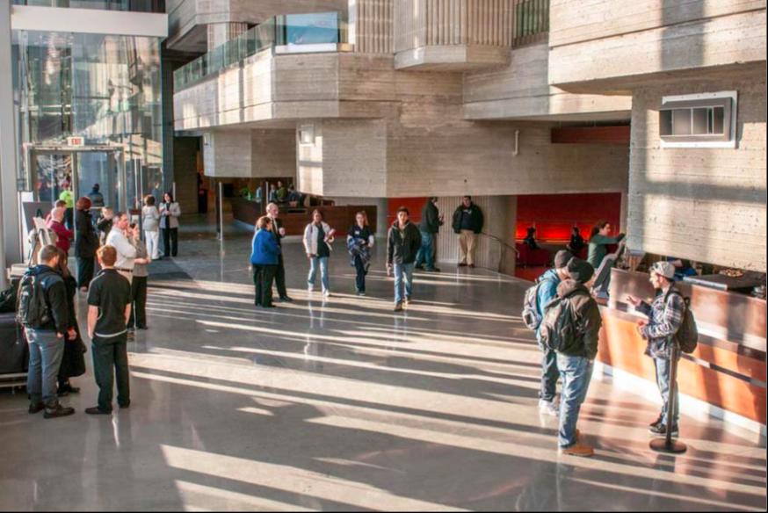
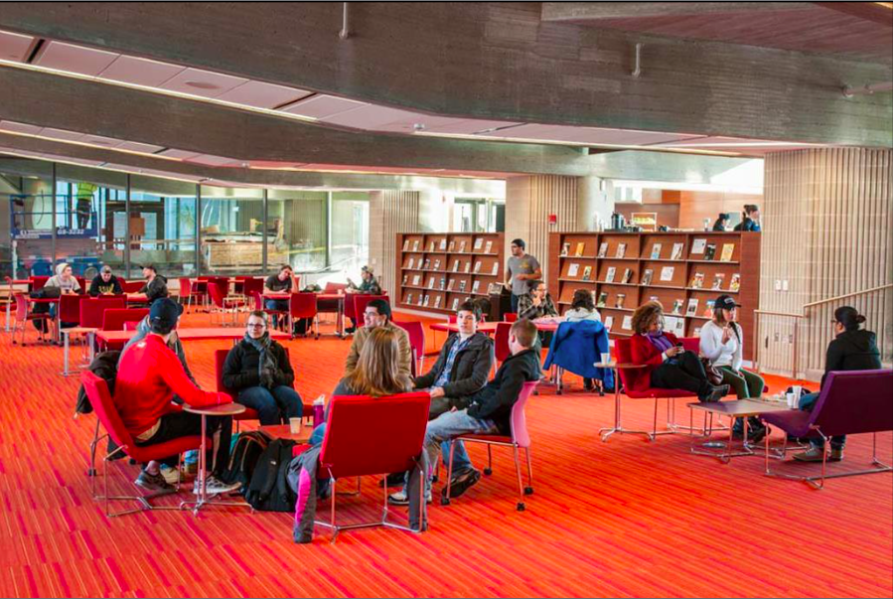
Assessment Project:
The Relationship between Library Usage and Student Success
Research Question:
Does time spent in the physical library impact GPA?
Communities of Practice:
The Project Team:
Institutional Researcher
Faculty Member
Two Librarians
Support and Oversight
Dean of the Library
Vice Provost
AiA Cohort
Notes:
LORRAINE

Slide 11
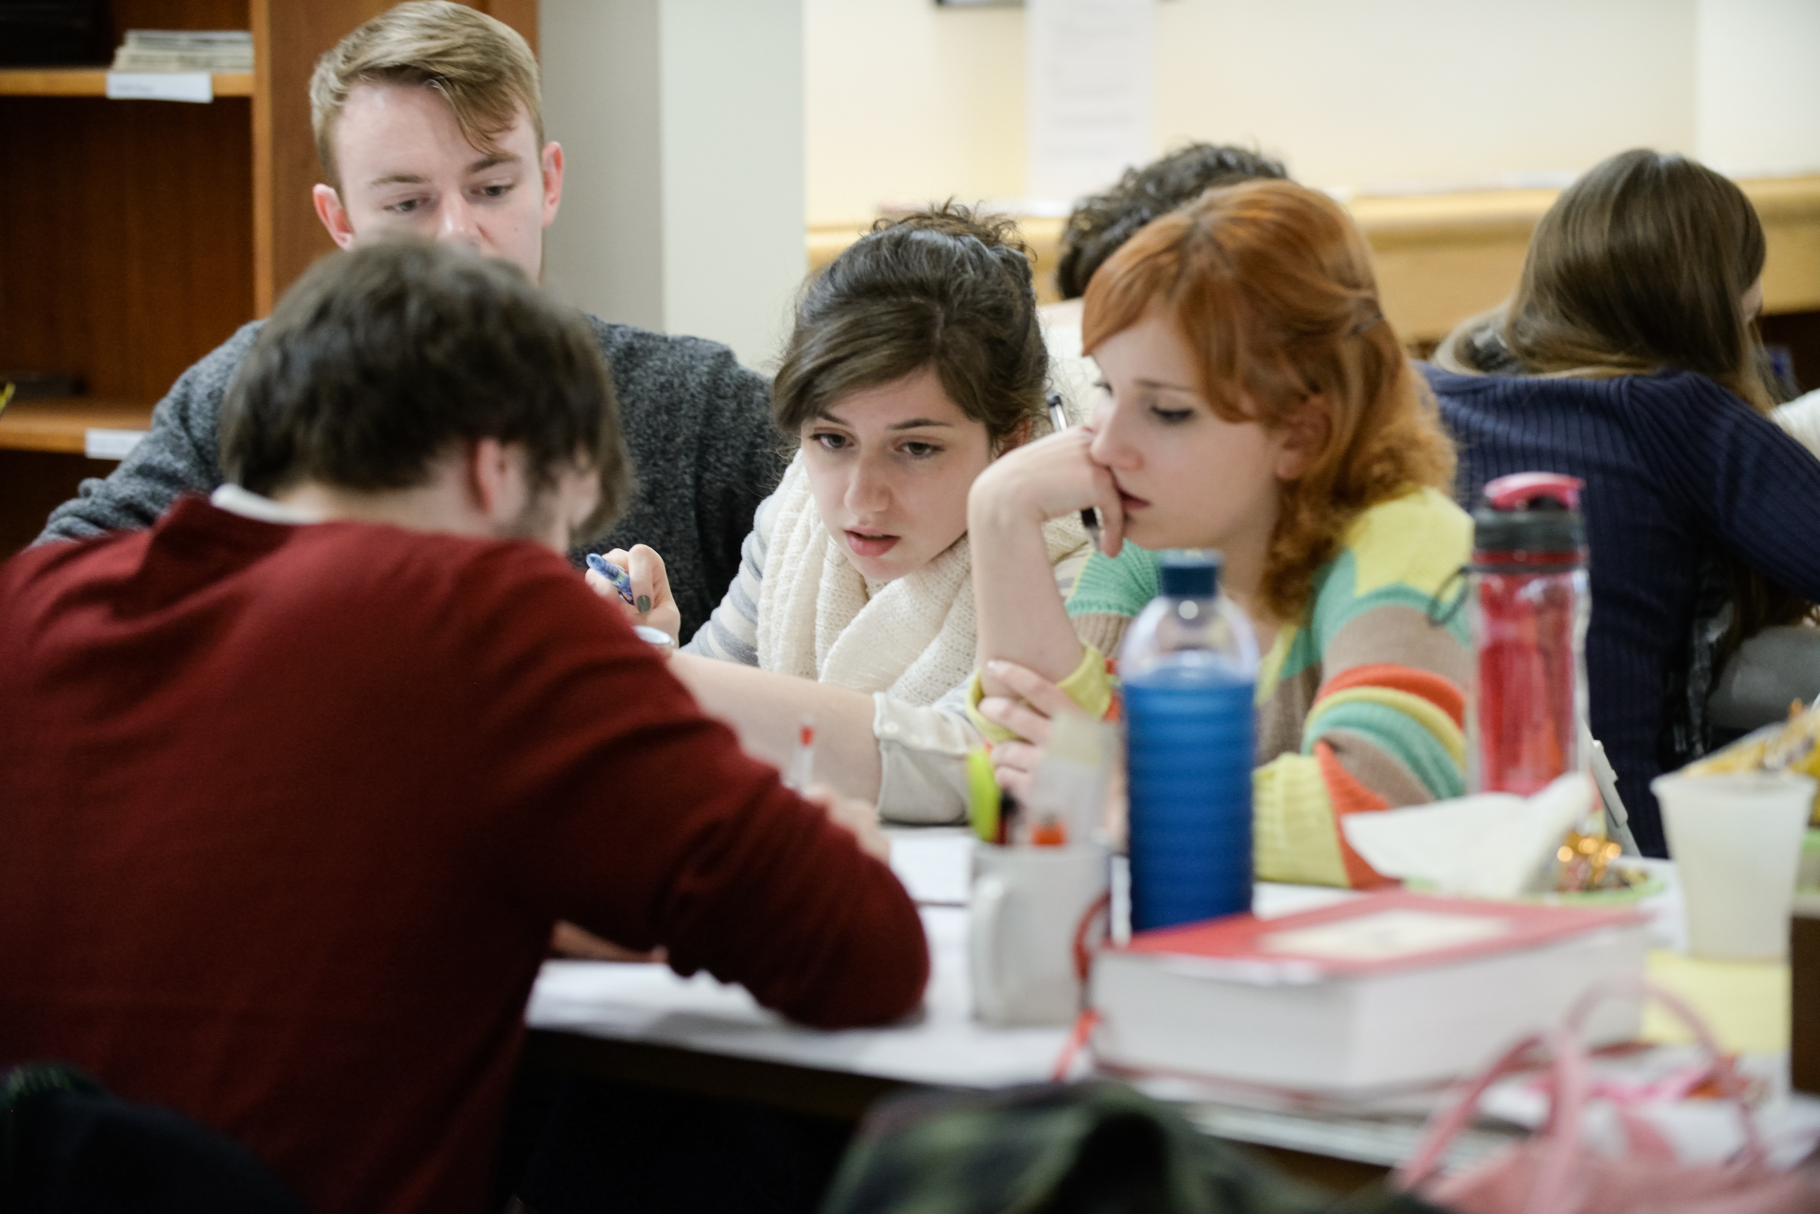
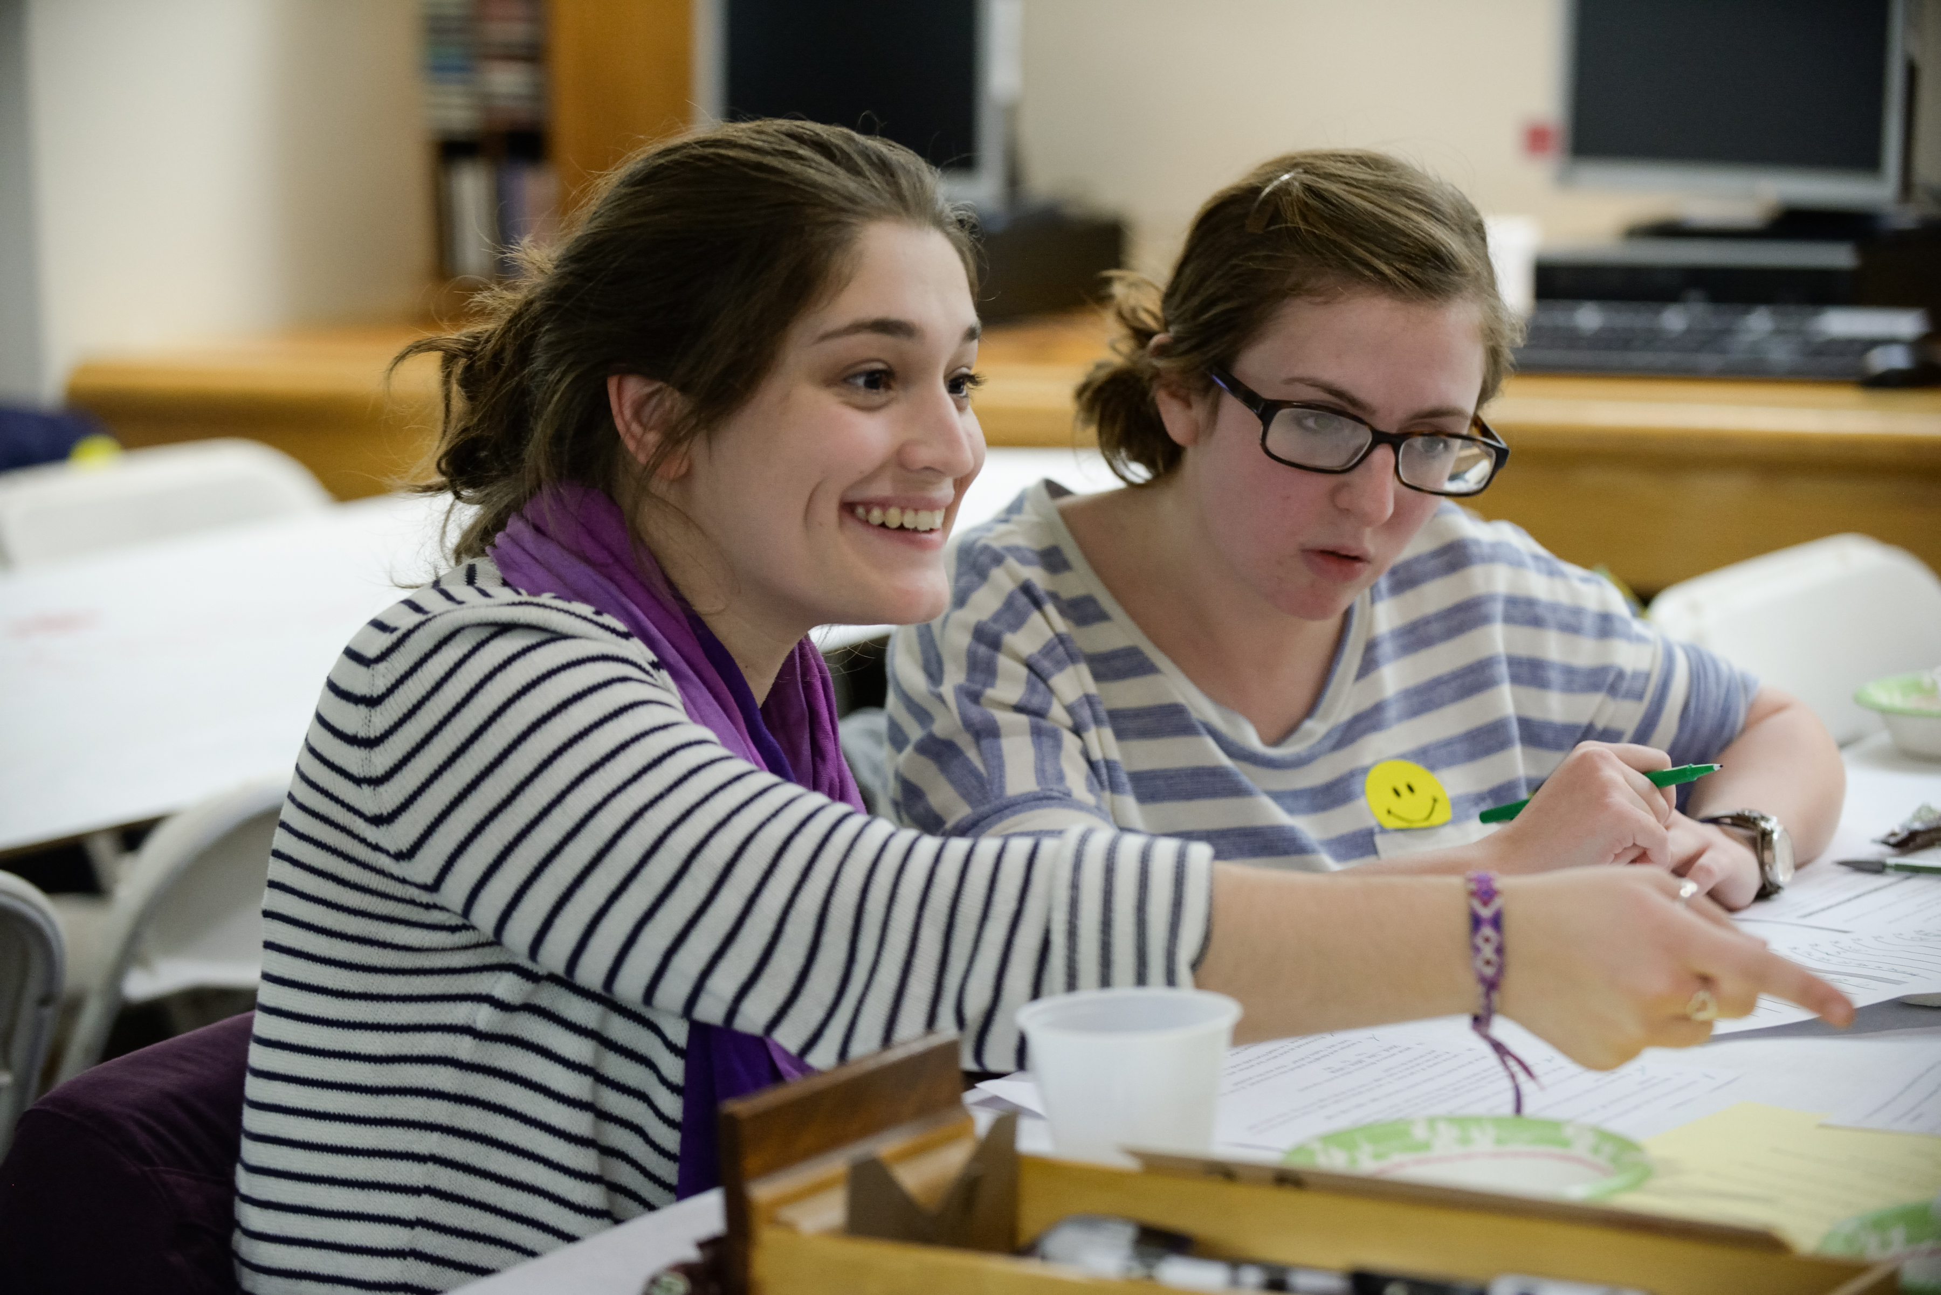
Assessment Project:
Information Literacy and Student Learning at a Liberal Arts College
Research Areas:
Students’ information literacy experiences & competencies
Faculty perspectives on
students’ information literacy competencies
Impact of information literacy instruction on student learning
Notes:
JEN

Slide 12
AiA Cohort
Campus Team
Library Colleagues
Faculty Participants
AiA Image: http://static1.squarespace.com/static/53713bf0e4b0297decd1ab8b/t/537540ebe4b020043377bcc9/1400193339701/icon_31671.png
Faculty Image: https://cdn3.iconfinder.com/data/icons/medcare/512/professor-512.png
Notes:
JEN

Slide 13
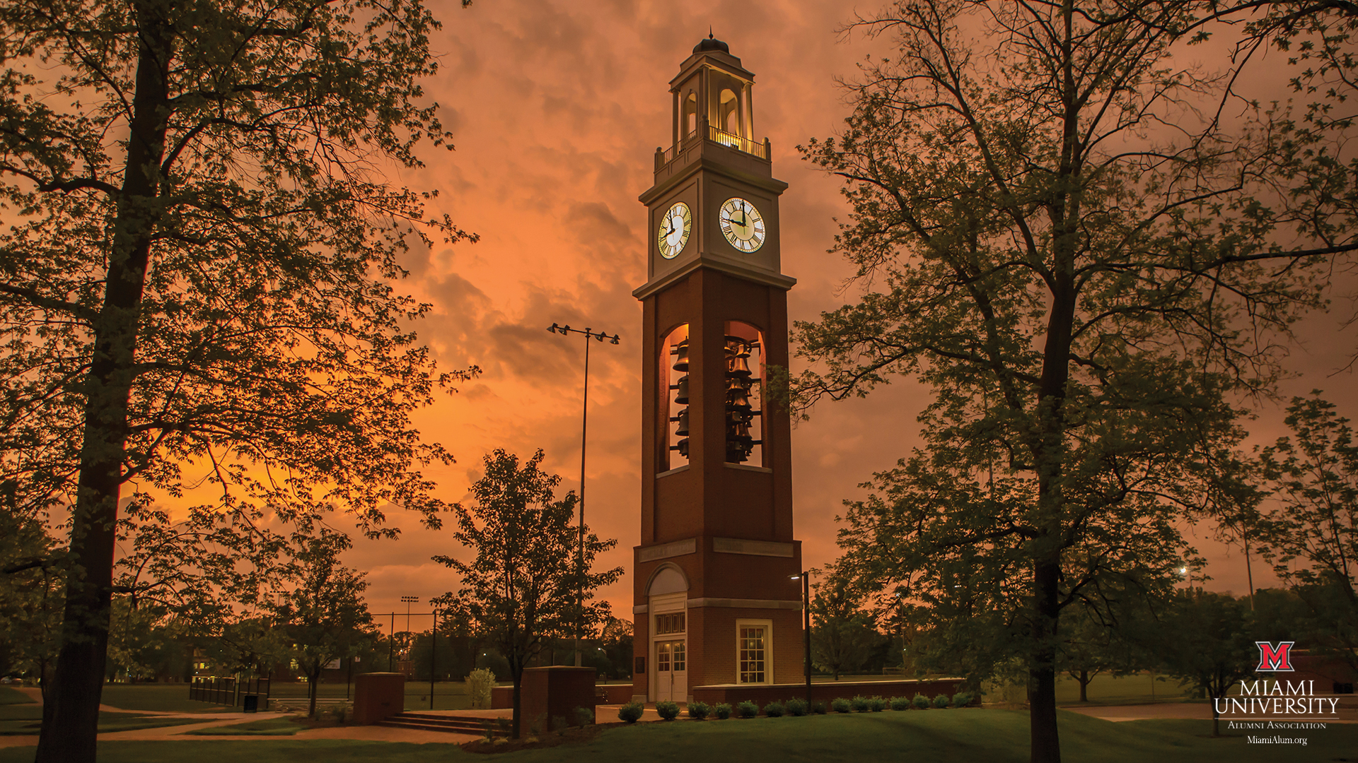
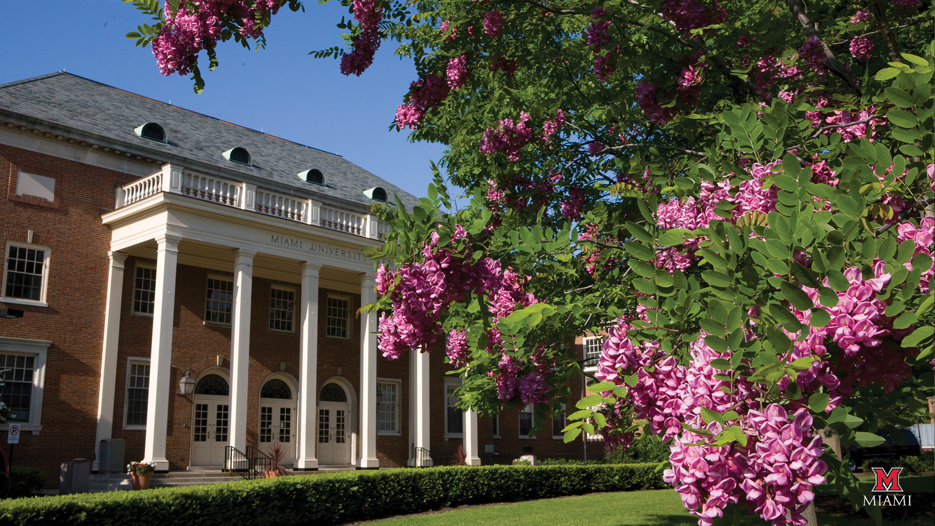

Assessment Project
Dedicated Technology Facilities: Impacts, Success, and Implications
Research Question: How does the usage of dedicated technology facilities contribute to the success of Miami student scholarship and research?
Team Composition:
  Associate Provost for Undergraduate Education
  Director, Teaching and Learning Center
  Assistant Director for Institutional Research
Notes:
ERIC

Slide 14
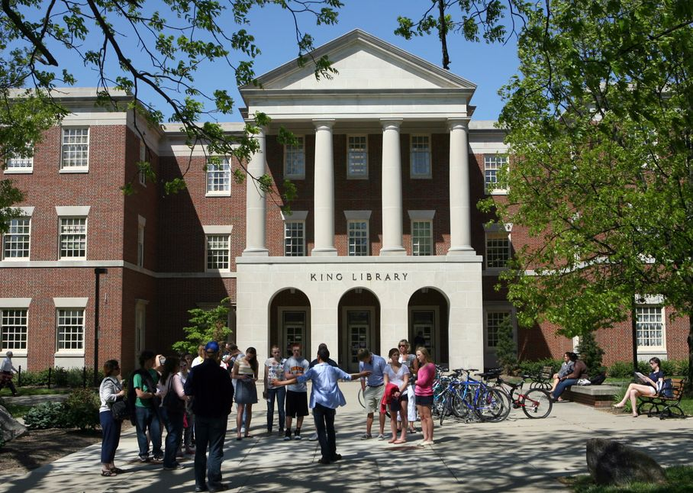
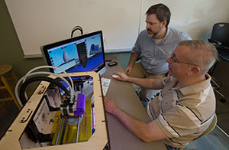
Assessment Project
Dedicated Technology Facilities: Impacts, Success, and Implications
Research Projects:
  Student Technological Self-Efficacy
  Digital Literacy exhibited in Undergraduate Research Posters
Notes:
ERIC

Slide 15
Think-Pair-Share
Notes:
MARYELLEN

Slide 16
What are the advantages of different types of COPs?
How is this different from my regular work?
Notes:
SARAH

Slide 17
How were your groups formed?
What would you do differently?
Notes:
SARAH

Slide 18
How did you define people’s roles within your COP?
How did you set and manage expectations?
How do you avoid inertia and maintain engagement in the project over time?
Notes:
SARAH

Slide 19
How can I do this?
Get in touch with someone on your campus. One partner is all it takes to get started.
Build external relationships. Start today.
Don’t underestimate the power of communication.
Talk, share, plan. Repeat.

Slide 20
Handout is available at the Speaker Center for download and also here:
http://bit.ly/1HNVEAb
Bibliography
Guiding questions
Contact information

Slide 21
Panel Discussion
What we set out to do and what we learned in the process
Communicate and then communicate again
Find members of the team
Build on what you have
Avoid inertia

