Slide 1
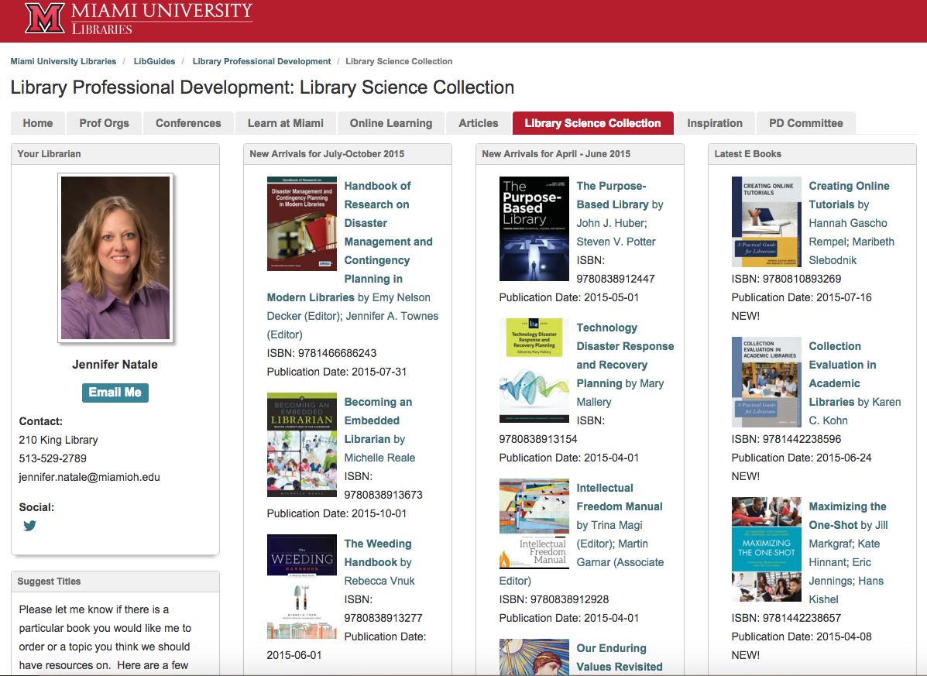

Promoting Use of the Library Science Collection for Professional Development
Create a digital display using LibGuides to:
Encourage professional development
Increase usage
Serve librarians in multiple locations
Promote browsing
Prompt discussion about new topics
Easily link to ebooks
Remind librarians to suggest new titles
Share your collection development policy
SUGGESTIONS:
Provide quarterly updates
Include new titles that came in on approval or were purchased
Offer a separate list of ebooks
Include your collection development policy and links to prominent suppliers of Library Science titles
Connect your LibGuide with other professional development resources for your library
Libguides.lib.miamioh.edu/ProfDev/LibSci
ZZZZZZZZZZZZZZZZZZZZZZZZZZZZZZ
ZZZZZZZZZZZZZZZZZZZZZZZZZZZZZZ

