Slide 1
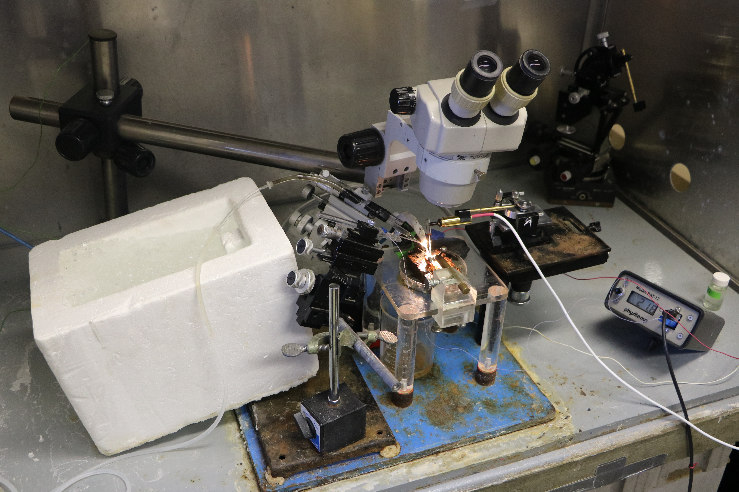
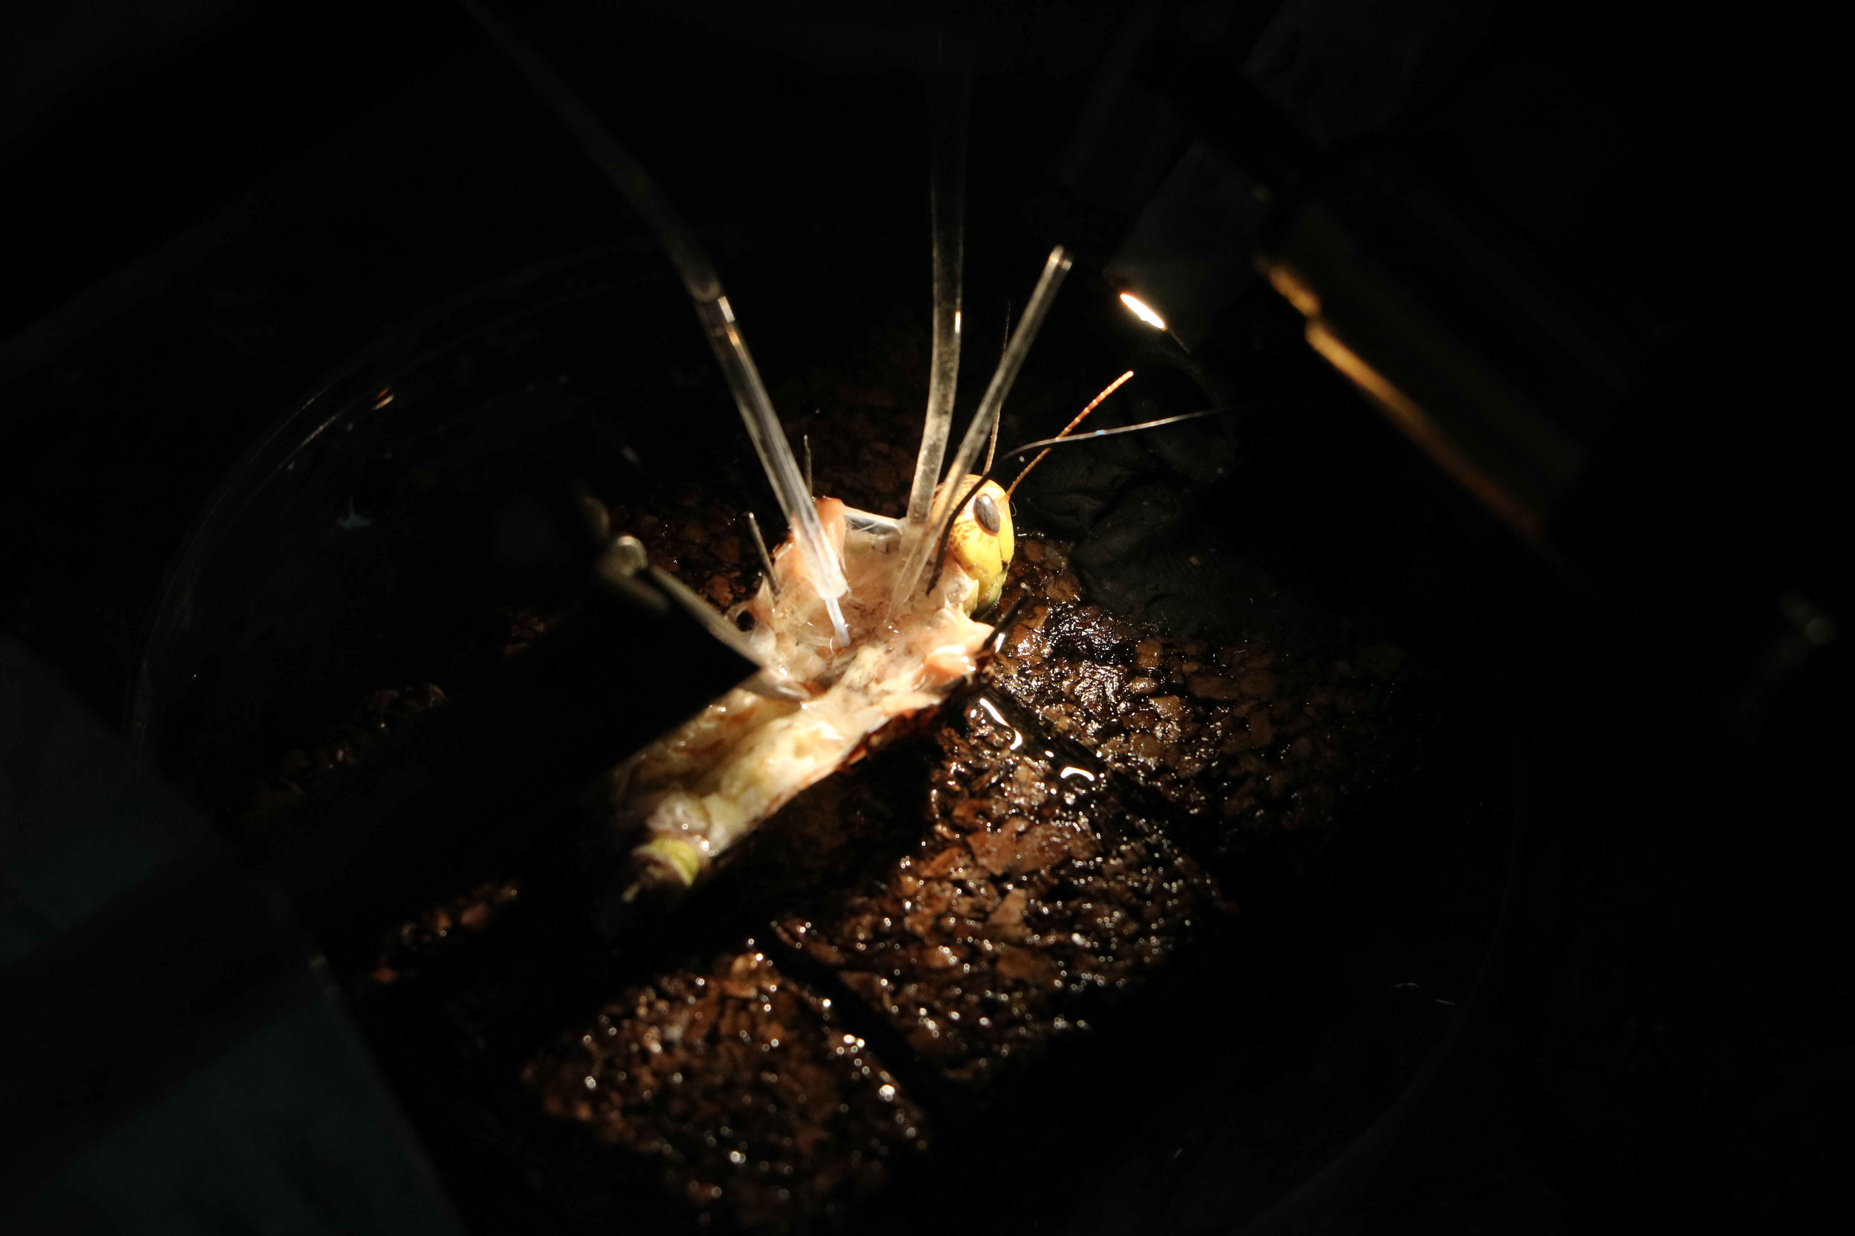
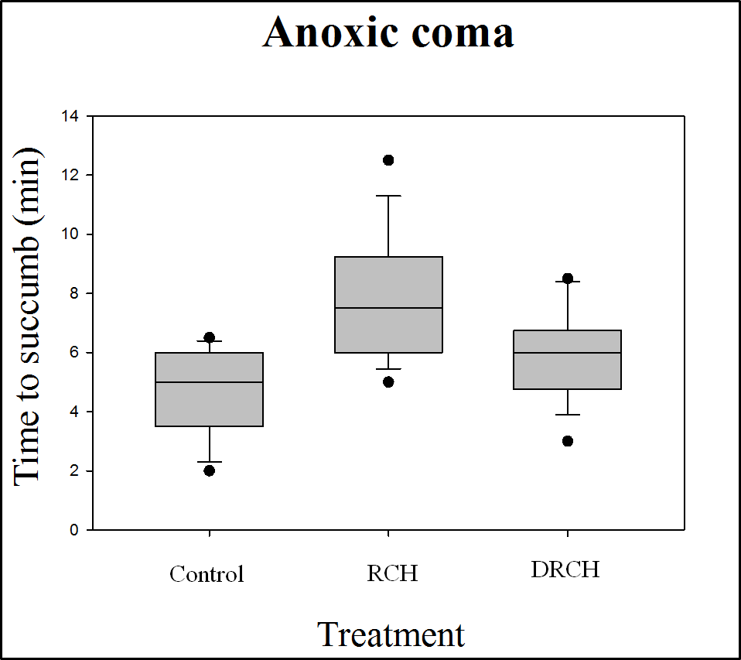
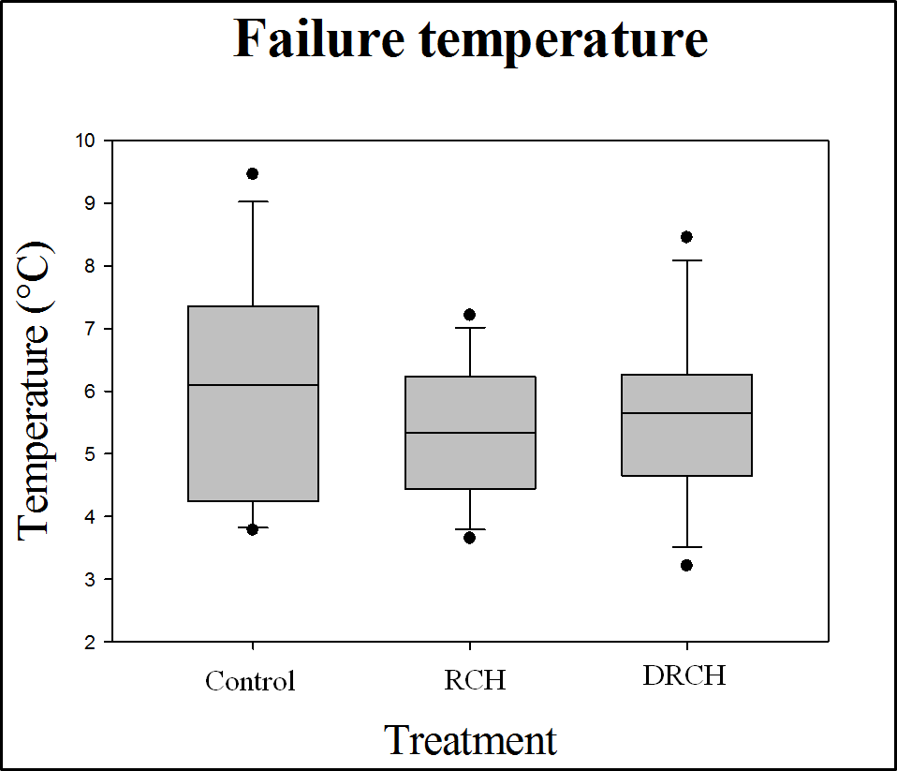

Neurophysiological Assessment of Rapid Cold-hardening-induced Resistance to the Disruption of Resting Neuronal Membrane Potential
Erik A. Seroogy, J. D. Gantz, and Richard E. Lee
Department of Biology, College of Arts and Sciences, Miami University of Oxford, Ohio
Introduction
Conclusions
Rapid cold-hardening (RCH) describes physiological adaptations made within minutes or hours that enhance stress tolerance in insects. RCH can be triggered by chilling, dehydration, and other environmental stressors. Recently, we found evidence that RCH responses triggered by different environmental cues use different physiological mechanisms. For example, brief chilling (cold-induced RCH) causes a distinct physiological response than dehydration (drought-induced RCH) does.
When insects are chilled to a critical temperature, they enter chill coma, a state where they are incapable of movement, which may result from potassium ion imbalance in neurons. RCH enhances resistance to chill coma, though the mechanism used is unknown. The effects of RCH have never been examined at the neuronal level.
• The anoxic coma data suggest that cold- and drought-induced RCH are distinct physiological responses.
• The absence of a significant trend in the chill coma assays may be due to large individual variation, a fast temperature ramp, or the absence of an effect on resistance to ion imbalance in neurons.
• Ongoing experiments are using ouabain-induced spreading depression, a more sensitive method of measuring neuronal resistance to ion imbalance.
• The mechanisms modulating RCH hold significant implications for understanding how insects overcome the challenges of large changes in temperature and hydration state in the course of a normal day. Further, understanding these mechanisms may enhance our ability to control pest species, such as L. migratoria.
Electrophysiology rig used to measure L. migratoria neuronal potential.
Dissected locust during measurements of neuronal electrical potential.
Results
1)
Objectives
• Begin investigating mechanisms used during cold- and drought-induced RCH that increase resistance to chill coma.
Acknowledgements
• The authors would like to thank Dr. Meldrum Robertson and Dr. Kristin Spong at Queen’s University in Kingston, Ontario for hosting us and helping with both the development and execution of this project.
• Miami University Doctoral Undergraduate Opportunity Scholarships (DUOS)
The effects of cold- and drought-induced RCH on resistance to anoxic coma. Drought-induced RCH enhanced resistance relative to controls and cold-induced RCH enhanced resistance relative to drought-induced RCH (p<0.05).
Methodology
2)
• Resistance to and recovery from anoxic coma were measured as a proxy for chill coma using a drowning assay.
• An electrical potential probe was inserted into the thoracic ganglion of locusts (Locusta migratoria), in order to measure the loss of neuronal potential during chilling.
The effects of cold- and drought-induced RCH on resistance to chill coma. There are no significant differences in chill coma temperatures between treatments.

