Slide 1

Source Notes: A collaboration between C.D.S., Faculty, campus I.T., and Humanities Center
Eric Johnson
Miami University
2016 August 15
IFLA

Slide 2
Collaboration
The Miami Libraries Center for Digital Scholarship
Department of History
Campus Research and Computing Support
Humanities Center

Slide 3
Background
Andrew Offenburger – New history faculty
  Dissertation used historic newspapers from the American South-West.
  While writing his dissertation, he used Microsoft Access and spreadsheets to organize his notes.
  He has dreams of a better system.
  Wants to teach students how to annotate
  Wants to create a system for other researchers to use.

Slide 4
Limitations
Not sufficient skills or time to write software.
Doesn’t have database design skills.
So, he contacted campus Computing Support for help.

Slide 5
Discuss the problem
Computing Support called on the Center for Digital Scholarship based on our previous work with them.
Group meeting – 5 people from different units
We heard Andrew’s dream.
Discussed the tasks needed to accomplish it.
Andrew wanted a downloadable piece of software that connects to a central database for research collaboration.

Slide 6
Build the team
Two of us volunteered to work with him: Greg Reese of Computing Support and myself.
Met with Andrew more to get a better understanding of the details of the project.
Greg and I met several times to divide the work between us.

Slide 7
Tackle the Problem
For decades people have been annotating for their dissertation using hand written notes or text documents.
Some even use card sorting.
Biographical, other information and metadata is written on the card.
Subjects are recorded using notches around the edge of the card.

Slide 8
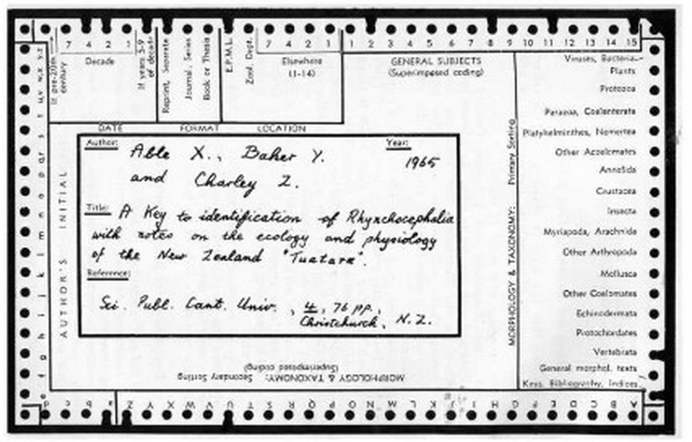
Sorting Card
Notes:
One corner is trimmed to aid in insuring correct card orientation. Also called needle cards, sorting cards or edge-notched cards.
Invented in the 1890’s - https://en.wikipedia.org/wiki/Index_card
Precursor to the IBM – Hollerith card.

Slide 9
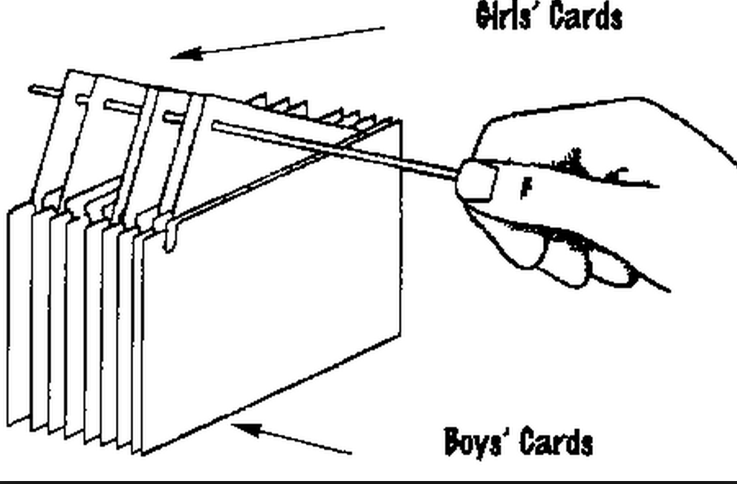
Needle Card sorting

Slide 10
Modern Era
Word processing documents – search for phrases.
Microsoft Access – easy to use database.
Still complex and requires additional work to extract the information.
Andrew wanted a system that didn’t require revisiting the source document.

Slide 11
Andrew’s Goal
“The system should be flexible enough for professional historians so they can use the system to develop their notes and then after publication make them available to others.”
Instead of the current system where, “Historians write notes that they donate to archives after they die.”
Notes:
The notes may be born digital, but if not preserved, they die just the same.

Slide 12
Design Goals
Easy to use interface.
Collects comments, direct quotes, subject key words, names of individuals in the document, metadata about the source document.
Usable by researchers worldwide.
Helpful for teaching students – group project.

Slide 13
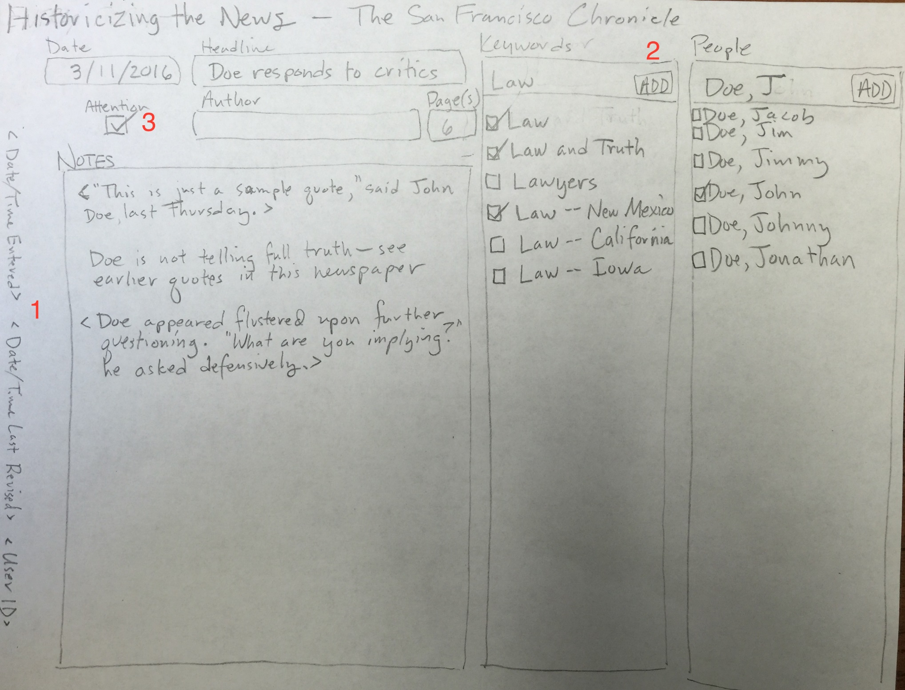

Slide 14
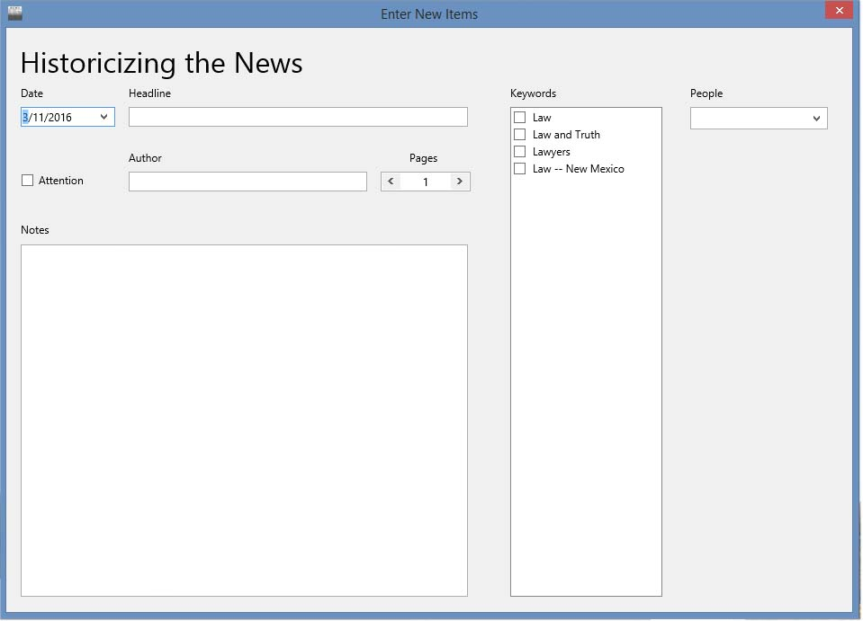

Slide 15
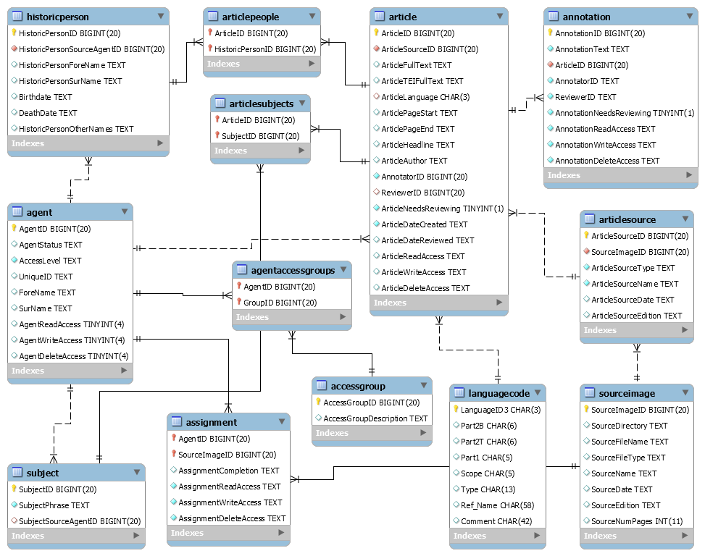
Database

Slide 16
Humanities Center
Digital Humanities Fellowship
  Award of $2000
    Used for student work and paying for the server
  Design time from the Center for Digital Scholarship

Slide 17
Refining other pieces
Navigation within the software
Display the source image or full text
Search and view people’s annotations
Manage users and their permissions

Slide 18
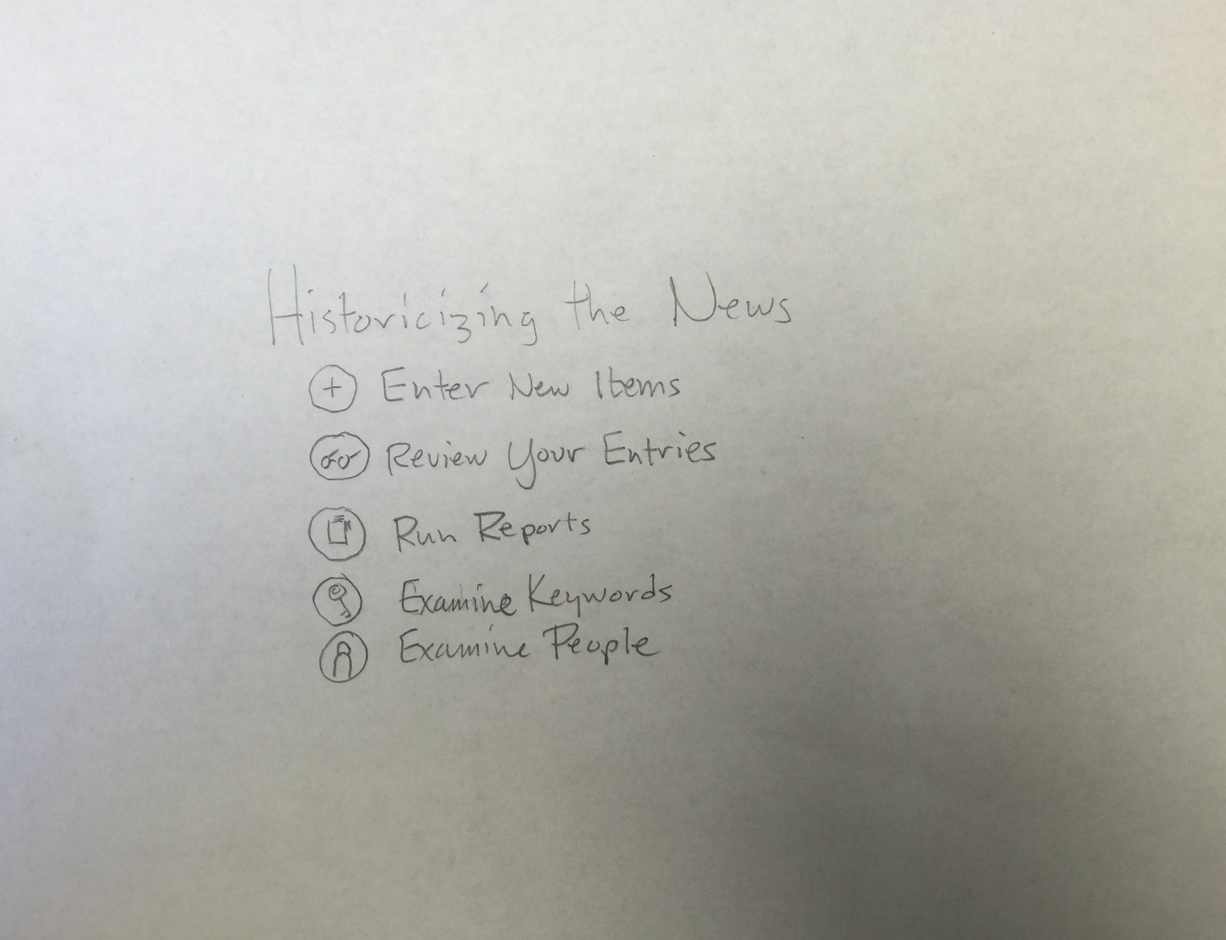

Slide 19
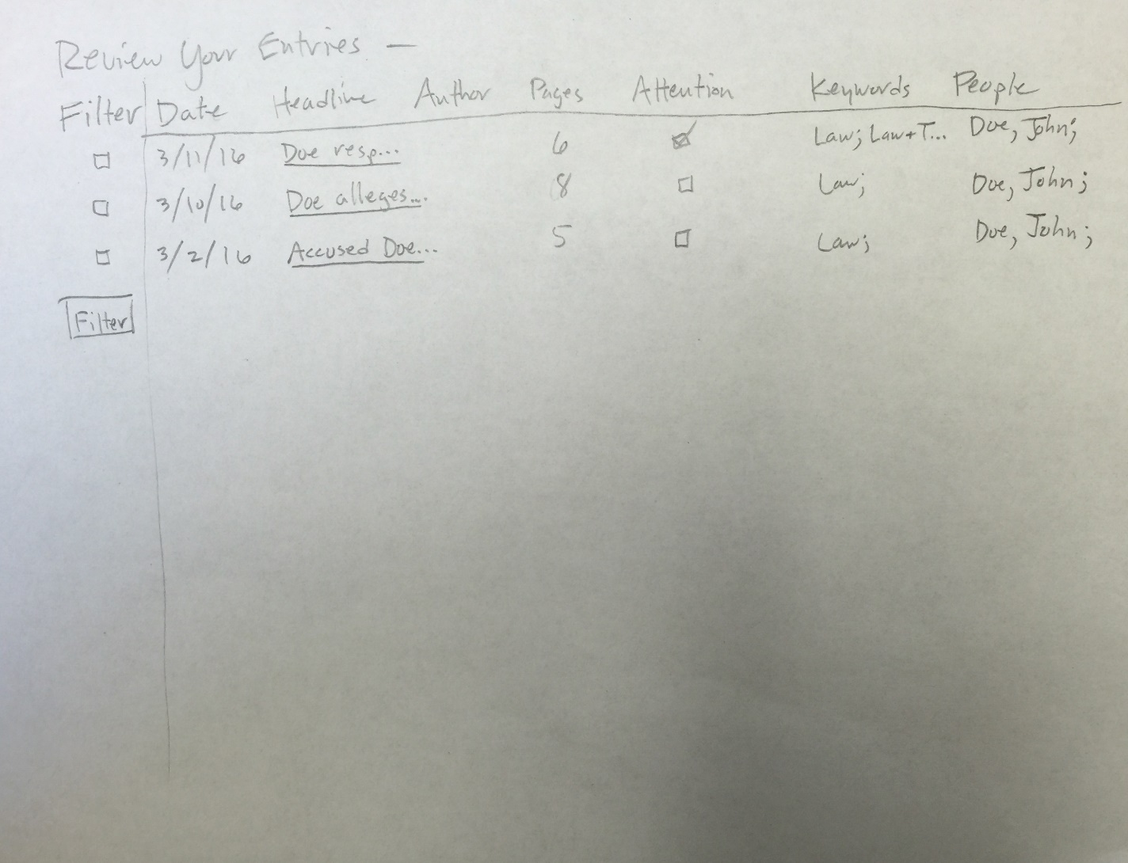

Slide 20
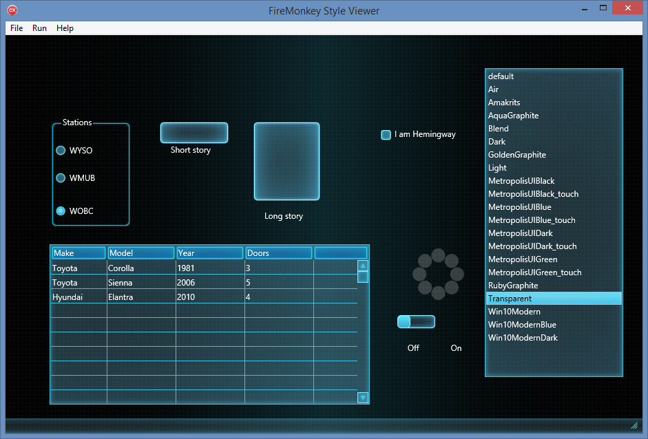
Style Viewer

Slide 21
Subjects
Controlled vocabulary
Drop down list – auto-search for entered string fragment.
Uses OCLC/LC FAST subject key phrases.
  (Faceted Application of Subject Terminology)
  http://www.oclc.org/research/themes/data-science/fast.html
Notes:
Auto suggest.

Slide 22
Historic People
Authority control is developed by reading of successive issues of the same newspaper.
News worthy people’s names, birth and death dates are recorded
Individuals are linked to all the articles in which they appear.
Alternative name are also recorded. (Buffalo Bill, William Cody)

Slide 23
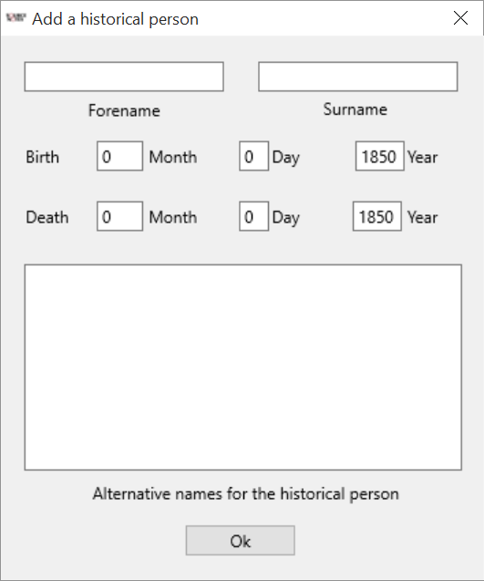

Slide 24
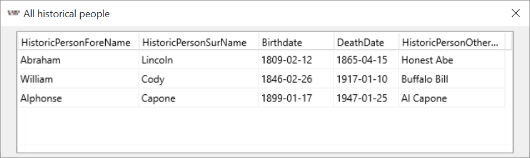

Slide 25
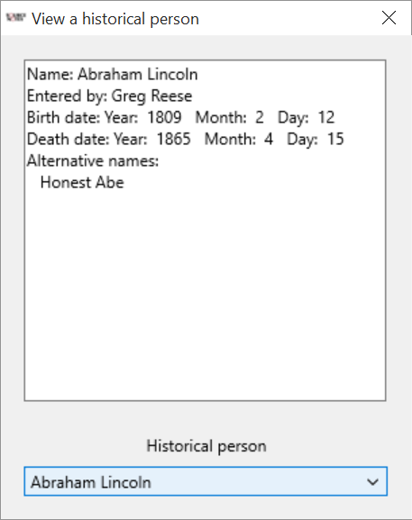

Slide 26
User access
Several types of users:
  Instructor
  Researcher
  Teaching assistant
  Student
Each with different access and edit rights
Record information about each person so that future researchers can know more about each annotator.
Notes:
Student – deadline. Can’t edit after the assignment is due.

Slide 27
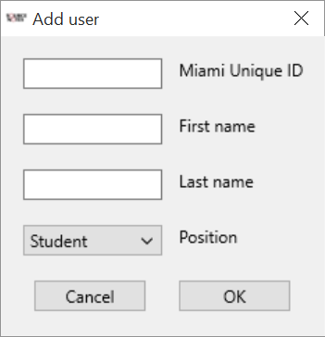
Notes:
A variety of tools to work with users.

Slide 28
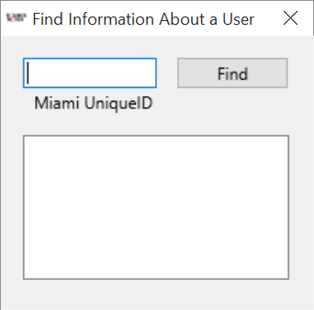
Notes:
Find information via the username. Other search methods are available.

Slide 29
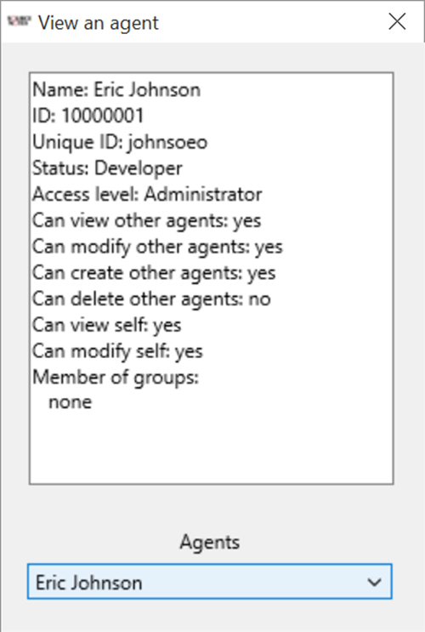

Slide 30
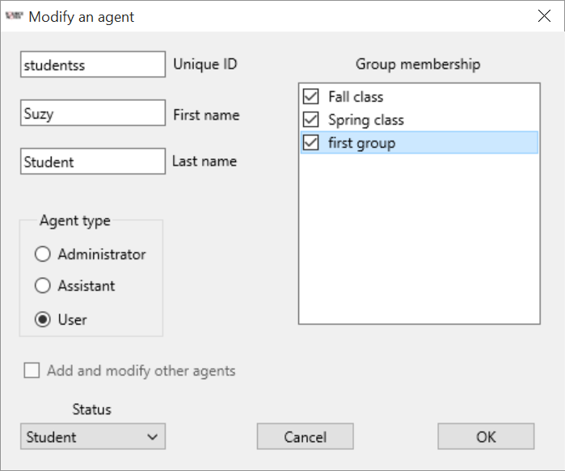

Slide 31
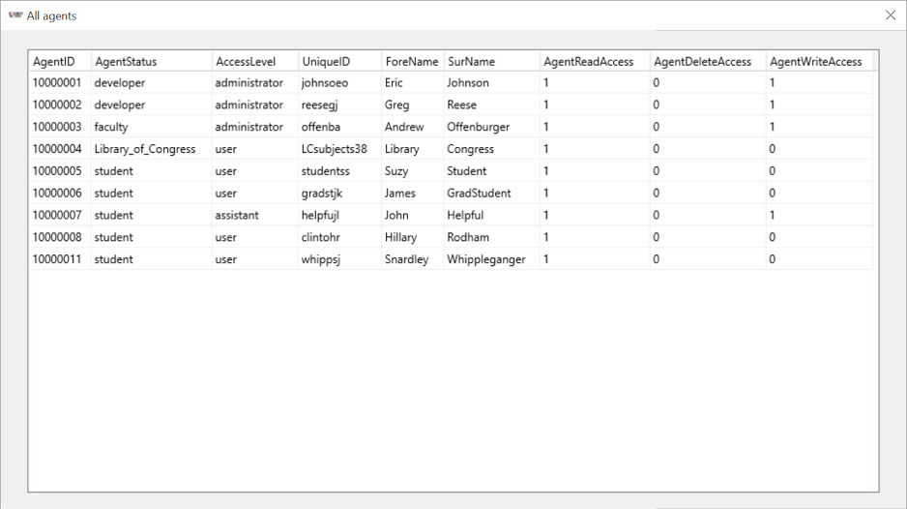

Slide 32
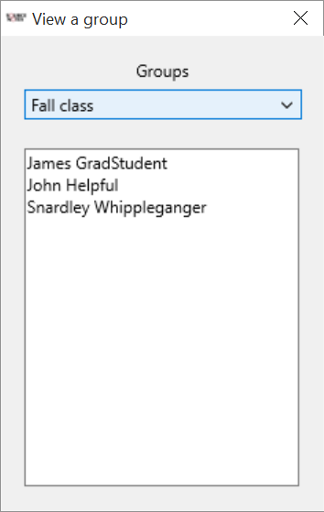

Slide 33
Search and Display
Search in the full text of the annotations
Sort by subjects and historic person terms
Display the full text and/or source image.
Filter by dates and source name

Slide 34
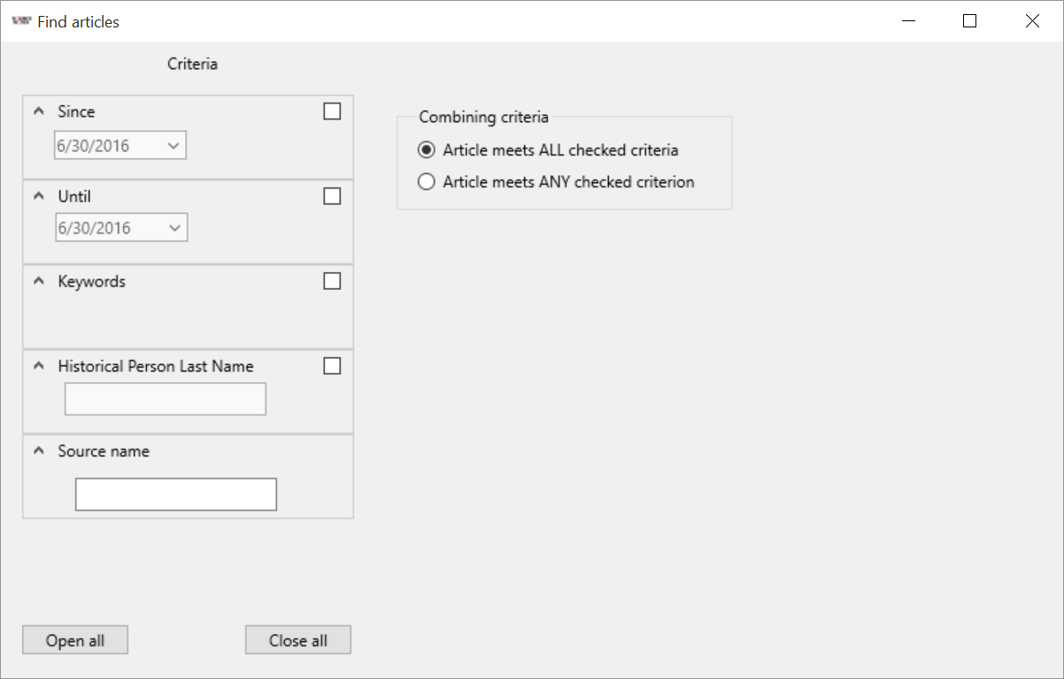

Slide 35
Future
Expand to more educational classes.
Expand to other institutions.
Global tool for researchers.
Web based (rather than downloaded software).

Slide 36

Questions
Comments

