Slide 1




The most beautiful campus that ever there was.
-Robert Frost

Slide 2
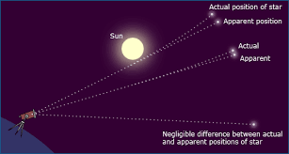

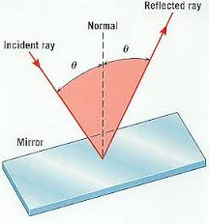
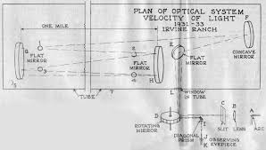
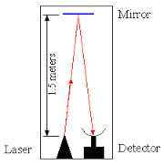

Slide 3
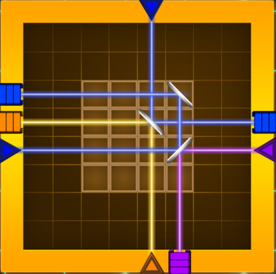

ERPs of Children Aged 6-12 during Optical Spatial Reasoning Video Game Play
Joseph E. Schroer
Miami University Ohio

Slide 4
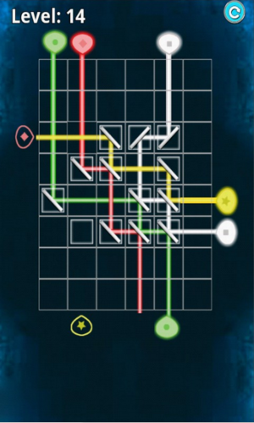
Agenda
Spatial Reasoning and the Brain
  Mental Rotation
  Animal Studies
  Gender
  Video games
  Naïve Optics
EEG & Spatial Reasoning
Current Study
Results
Discussion/Conclusion

Slide 5
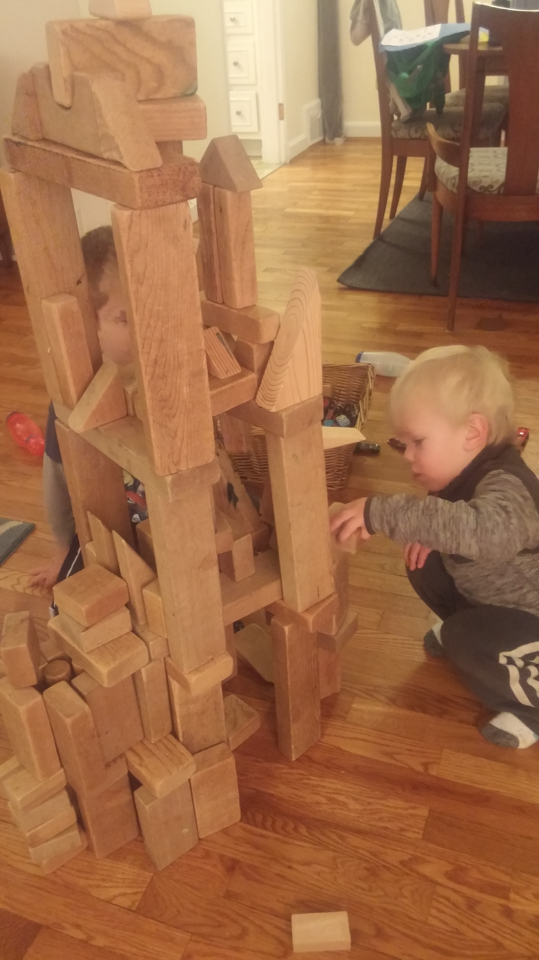
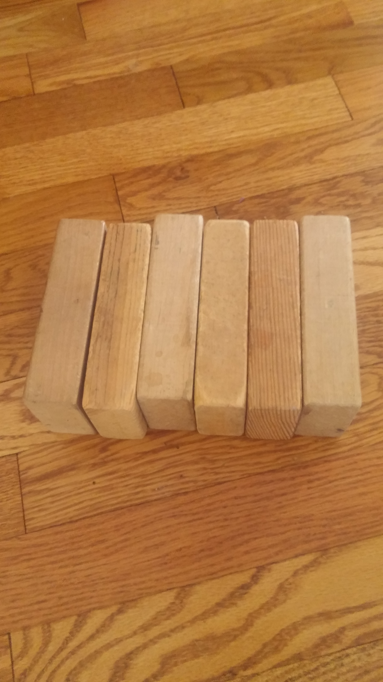
Relevance-Spatial Reasoning
Spatial Reasoning & Math
Davis and the Spatial Reasoning Study Group suggest using the terms spatial reasoning and embodied mathematics interchangeably (2015, p.81).
Similar areas are activated when people process both spatial and number tasks (see Hubbard, Piazza, Pinel, & Dehaene, 2005, and Umiltà, Priftis, & Zorzi, 2009, for reviews).
Notes:
split

Slide 6
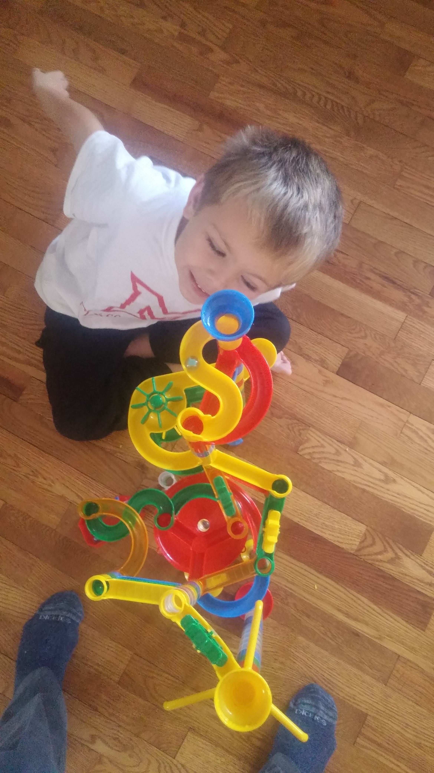
Relevance-Spatial Reasoning
Spatial Reasoning & Math
Mathematics achievement can be improved through spatial skill training specifically related to mental rotation abilities.
Improvements in VSWM should lead to very broad improvements in both space and math (Cheng & Mix, 2014; see also Bresgi & Seabi, 2016).
Notes:
split

Slide 7
Spatial Reasoning as Mental Rotation
Mental Rotation focus of neuroscientific research (Zacks et. al., 2008)
Gender differences (Feng, Spence, & Pratt, 2007; De Lisi & Cammarano, 1996; Subrahmanyam & Greenfield, 1994)
Positive significant effects of MR (Uttal et.al., 2013)
Tetris mediated gender differences and transferred new skills to other spatial tasks with long-lasting effects (Terlecki, Newcombe, and Little, 2008)

Slide 8
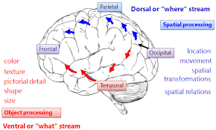
VSWM
Macaque monkeys activate the occipitoparietal pathway with the dorsal limbic and dorsal frontal cortex (Mishkin et. al., 1983, p. 414)
Goldman-Rakic (1990)- Memory Fields- PFC
VSWM activates the superior frontal
sulcus (Courtney et. al., 1998)
dorsolateral prefrontal cortex (DLPFC-
spatial) & ventrolateral prefrontal cortex
(VLPFC-objects) Activation
(Nakahachi et al., 2010)
manipulating objects and hand
movements in space as a means of
building spatial reasoning
abilities (Ehrlich, Levine, & Goldin-Meadow, 2006)
Eye Fields, PFC, & intraparietal sulcus all involved in VSWM
Notes:
Memory fields some neurons are associated with specific spatial locations 135* oriented item would not fire the same neuron as a 270* oriented item

Slide 9
Spatial Reasoning & Gender
Geary et al. (2000) found that the male advantage in mathematics is facilitated by the male advantages in both computational fluency and spatial cognition.
Meta-analysis of Purdue Spatial Visualization Tests males tend to outperform females, especially under time constraints (Maeda & Yoon, 2013).
A meta-analysis by Uttal et. al. (2013 ) male advantage yet both genders improve equally well with training.

Slide 10
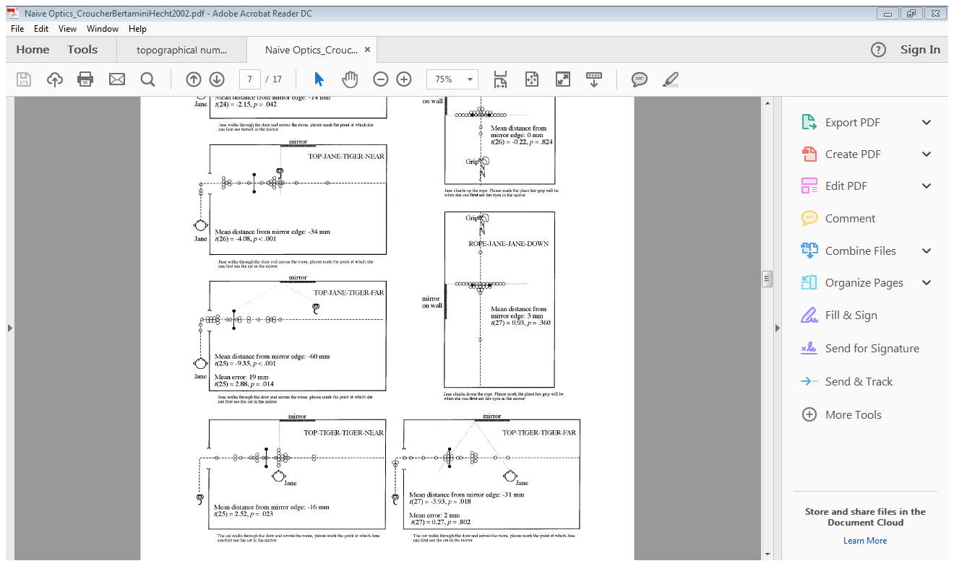
Spatial Reasoning & Naïve Optics
Croucher, Bertamini, and Hecht (2002)
  physically draw equal angles when asked about a ray of light reflected by a mirror
  erroneously apply naïve theories or heuristics when encountering images depicting the use of mirrors in the horizontal plane
  Hypothesis: people rotate mirrors toward a specific vantage point of an observer
Notes:
Look at neural correlates after seeing behavioral performance

Slide 11
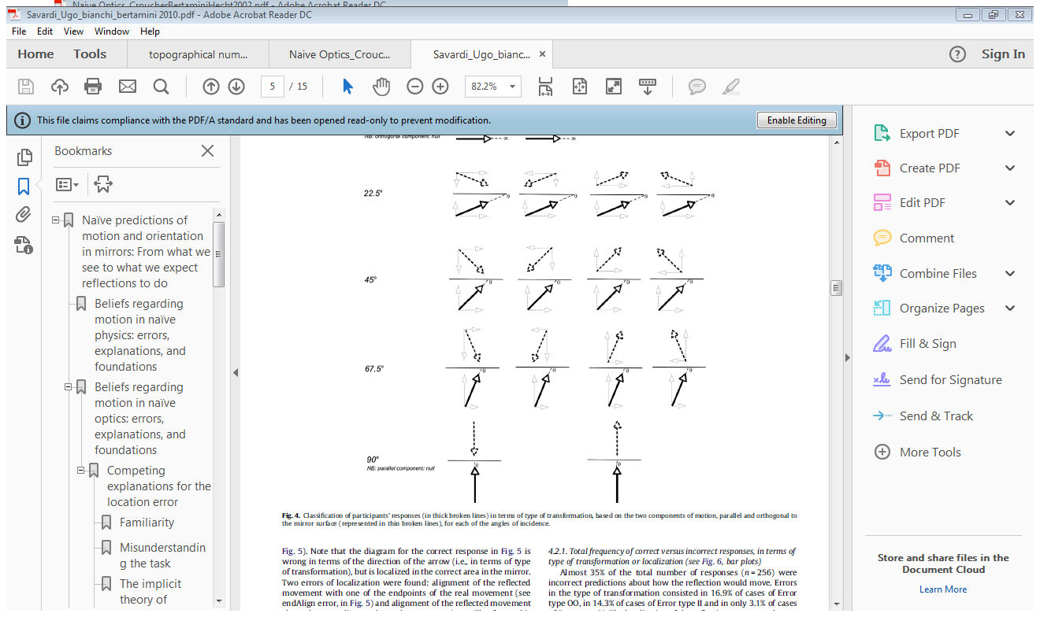
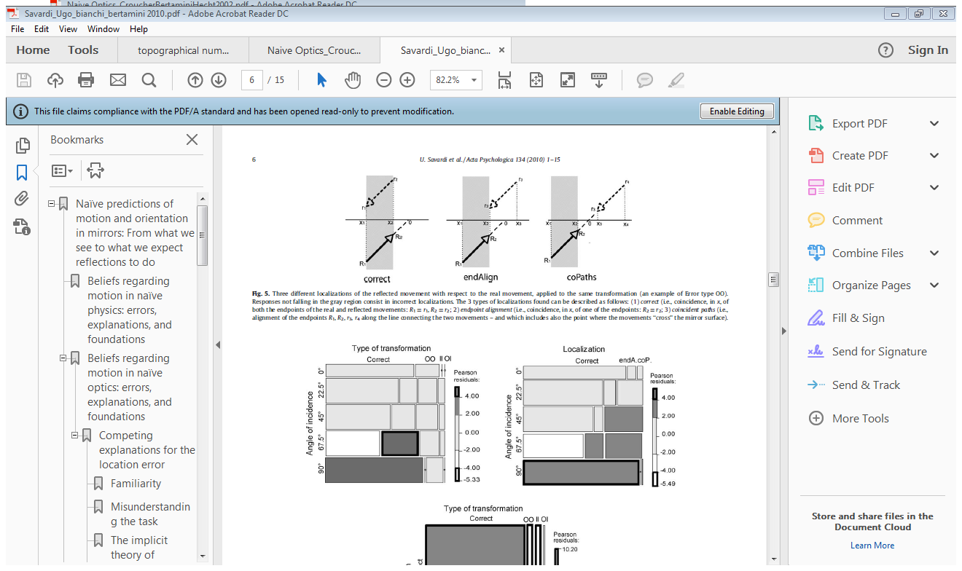
Spatial Reasoning & Naïve Optics
Savardi, Bianchi, and Bertamini (2010)
  individuals’ predictions of both dynamic and static mirror reflections
  people make either perceptual errors that can be corrected through visual feedback, or conceptual errors that cannot
Notes:
Look at neural correlates after seeing behavioral performance

Slide 12
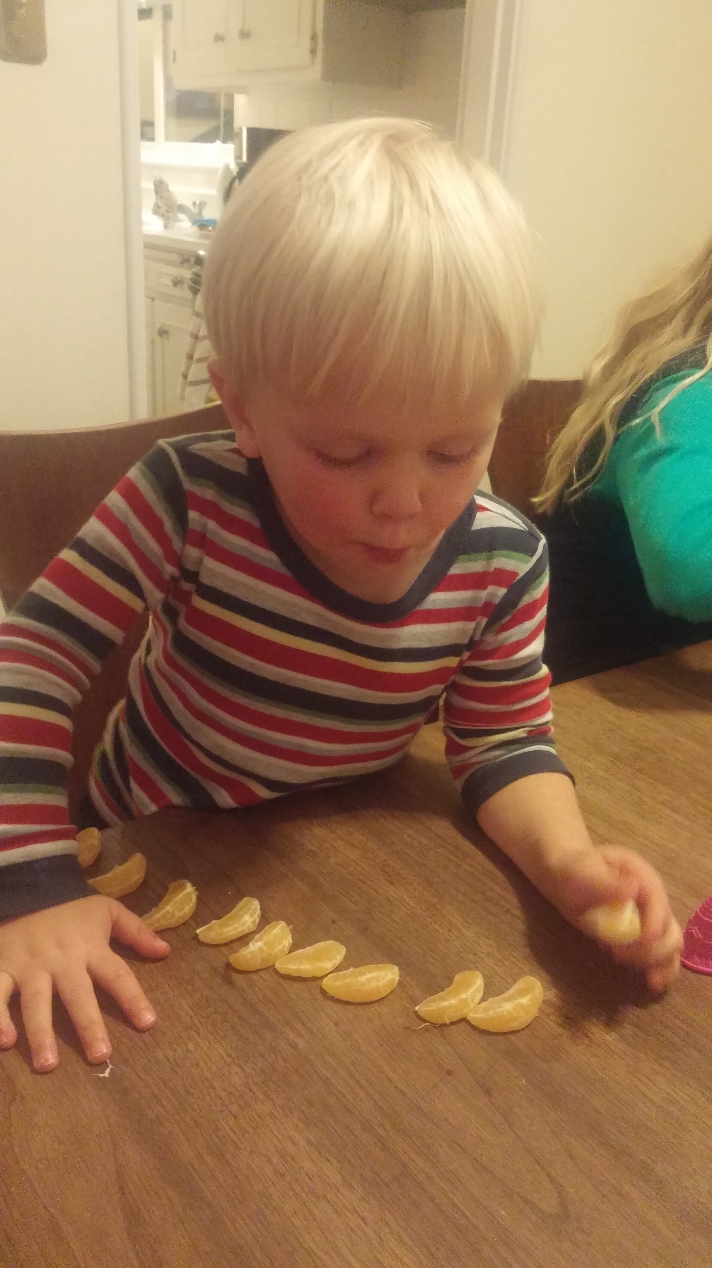
EEG, Children, & Spatial Reasoning

Slide 13
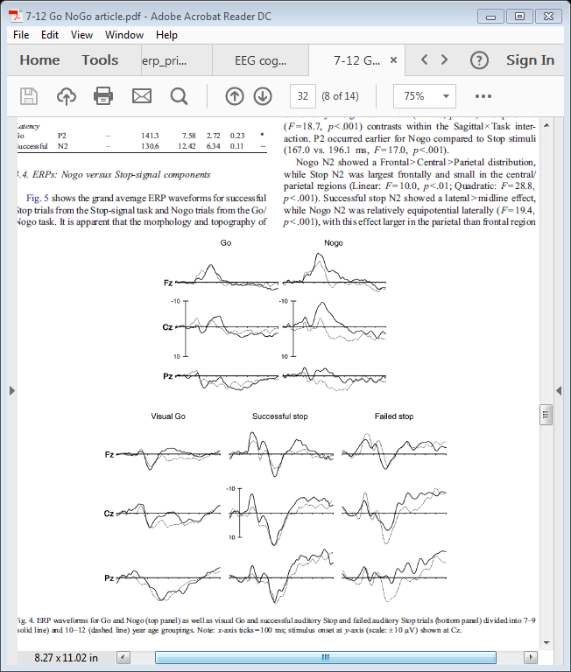
N200
N2 typically reflect inhibition processes of children in Go/NoGo tasks (Johnstone et. al., 2007)
Attention or Classification in repetitive stimuli (Patel & Azzam, 2005).
  Amplitude decreases with age (7-12)
  Efficiency of information processing
Notes:
Development of automaticity- literature networks change high attention demanding to lower negative correlation between performance etc…alpha power?

Slide 14
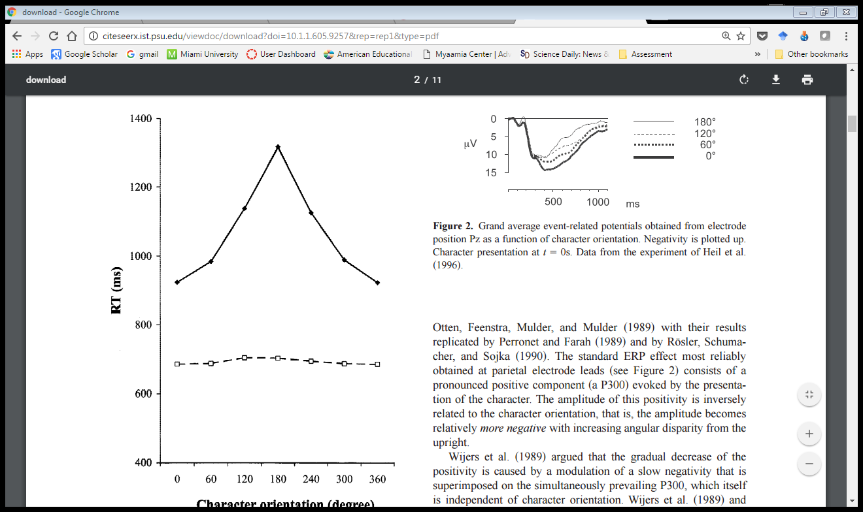
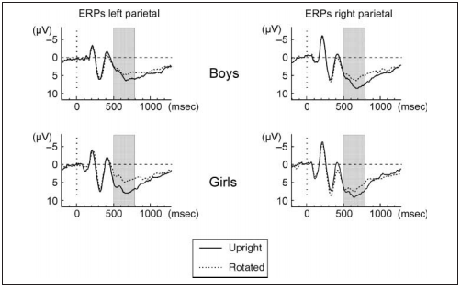
P300
P3 most active in parietal lobe during mental rotation
(Wijers et. al., 1989; Heil et. al., 2002, Milivojevic, et. al., 2009)
  Amplitude modulation as a correlate of mental rotation
Heath et.al., (2015) did not find increase in amplitude
  Qualitatively different task of reaching
Male/Female differences Hahn,Jansen, & Heil (2009)
  Hemispheric lateralization of 5yr-olds
  slow wave~spatial cognition
Notes:
Effortful encoding
- Thomas visual working memory task

Slide 15
Current Study
Law of Reflection

Slide 16
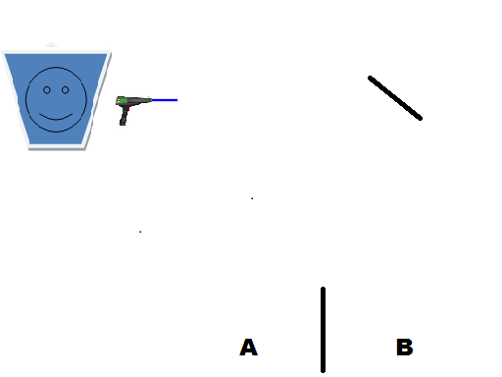
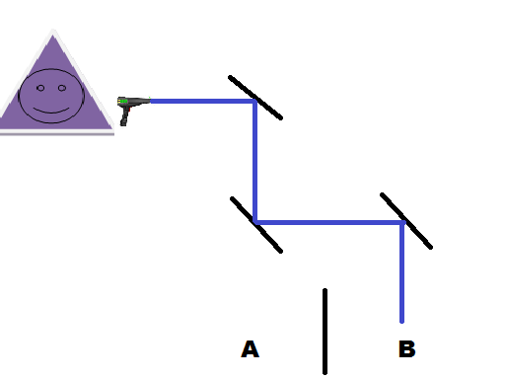
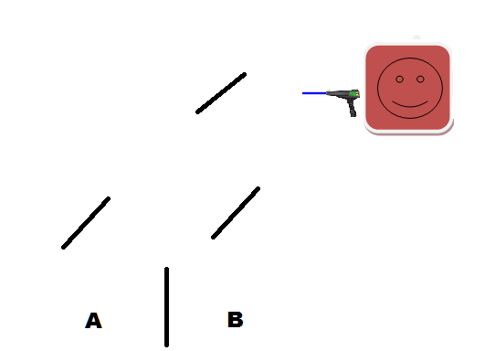
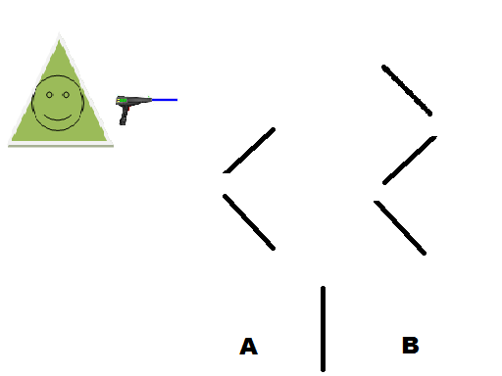
Notes:
Explain the set up of the game and the directions of the game.

Slide 17
Research Questions & Hypotheses
Can children increase spatial reasoning abilities through video game play?
  H₁= Yes they can.
Are there developmental and gender differences in behavioral performance during spatial reasoning video game play?
- H₁= Yes there should be with Males outperforming females.
What neural correlates of the brain are significantly impacted in spatial reasoning learning?
  H₁= Spatial Triangle; Frontal L/R differences & large parietal ERPs for more mirrors
Notes:
Frontal attentional processing- parietal encoding.

Slide 18
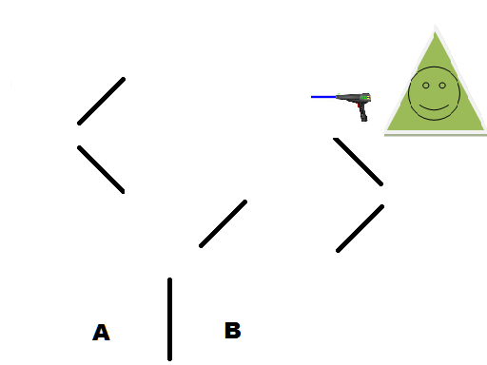
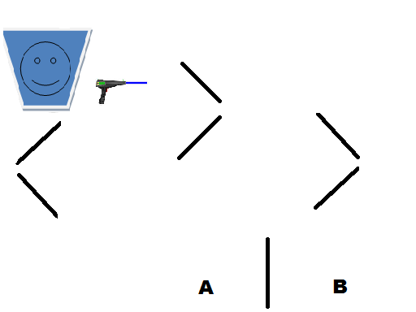
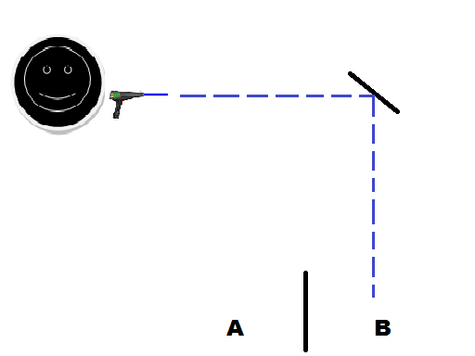
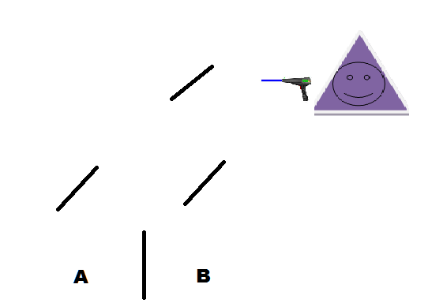
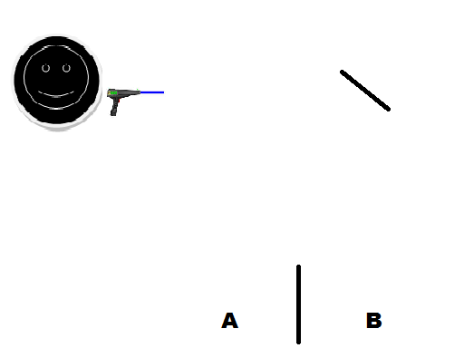
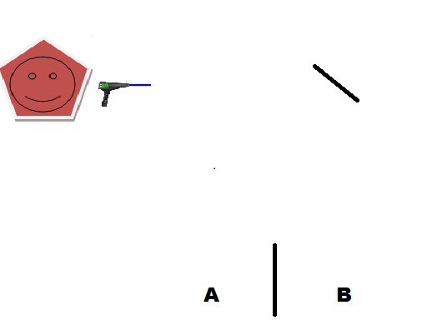
Methods
Study Design
Conditions within the 3 blocks; pretest, practice (with feedback, see figures), and posttest blocks; 1 mirror, 3 mirror, 5 presentations (& 7 posttest)
  three blocks totaled 150 trials, 50 trials pretest, 50 trials practice block, and 50+ trials posttest block
Notes:
EEG data was collected via Netstation
Presentation of video game stimuli was controlled by E-Prime v.4 software that also recorded reaction times and correct and incorrect responses.
Statistics completed with SPSS

Slide 19
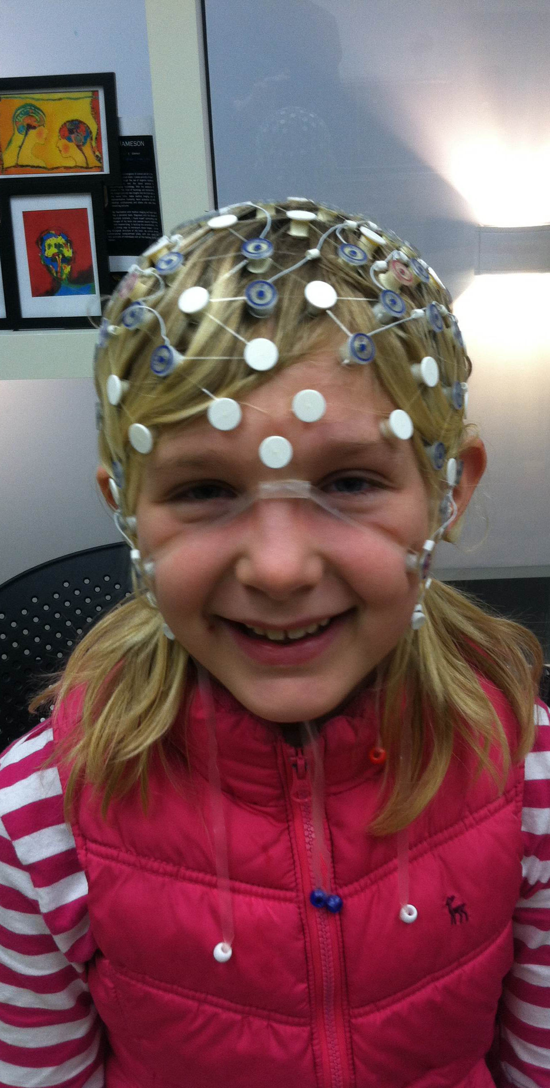
Participants
Twenty-one (21) children ages 6 to 12; 11 boys and 10 girls
Average Age 9.2
  7 children in the 6-7 Age group
  5 children in the 8-9 Age group
  9 children in the 10-12 Age group
All Right-handed

Slide 20
Can children increase spatial reasoning abilities through video game play?
Q1

Slide 21
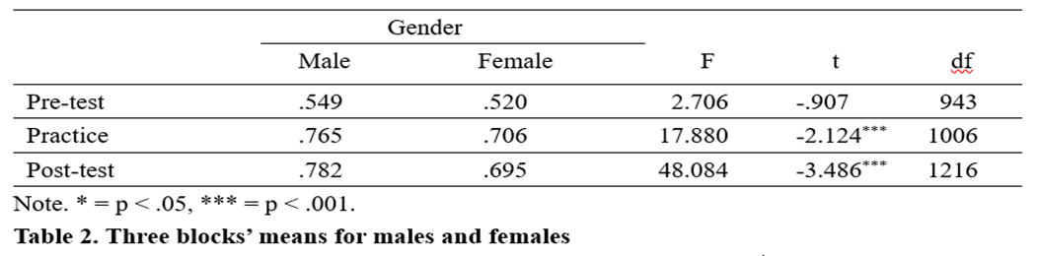
Results
Children overall performed better on the practice (F=7.97, p<.001) and the posttest (F=15.33, p<.001) than on the pretest.
Gender（Independent samples t-test）
Significant differences between gender were found in practice block (F= 17.88, p=.000) and post-test (F=48.08, p=.000）
No significant difference between males and females in the pre-test (F= 2.706, p=.100).

Slide 22
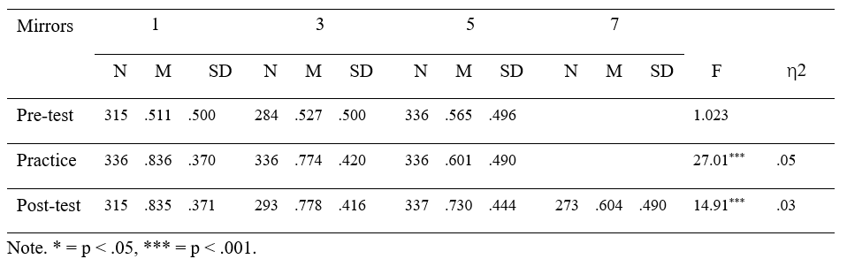
Results
Table 3
Total Average Score for the Number of Reflections over Three Blocks

Slide 23
Are there developmental and gender differences in behavioral performance during spatial reasoning video game play?
Q2

Slide 24
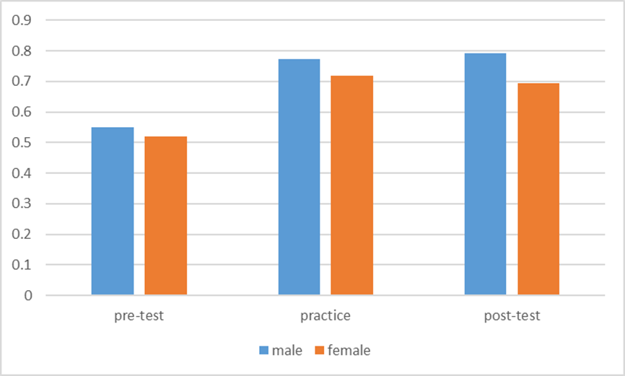
Results
Figure 1. Gender comparison over three blocks

Slide 25
Behavioral Results-Reaction Time
ANOVA (Developmental Level)
Significant differences were found in all three Blocks: Pretest F (1,942)=37.44, p<.001, Practice F(1,1005)=12.24, p<.001, Posttest F(2, 1215)=5.98, p=.003.
Posthoc results for Development (Scheffe)
  Significant differences between in Pre: 6-7 and 8-9, and 10-12
  Significant differences between in Prac: 6-7 and 8-9, and 10-12
  Significant differences between in Post: 8-9 and 10-12
    10-12 year-olds much faster 1,000ms
Notes:
Pretest results of older children support naïve optics theory

Slide 26
Behavioral Results-Reaction Time
Paired sample T-tests Pre-Prac-Post
Significant difference Pre-Prac t(944)=11.438, p<.001
Significant difference Practice-Post t(1007)=-11.11, p<.001
Significant difference Pre-Post t(944)=3.01, P<.005
  Pre Mean RT = 4,700ms
  Practice Mean RT = 2,174ms
  Post Mean RT = 4,012ms
    Correlation between Pre-Post r=.09, p=.005
Notes:
Pretest results of older children support naïve optics theory

Slide 27
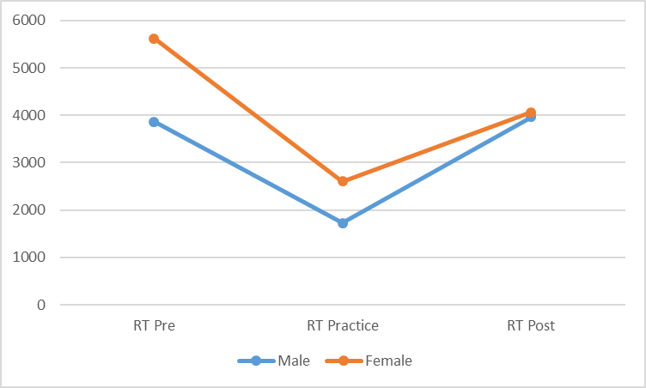
Results
Males overall had faster reaction times on all three blocks
Females’ reaction time decreased as the game progressed

Slide 28
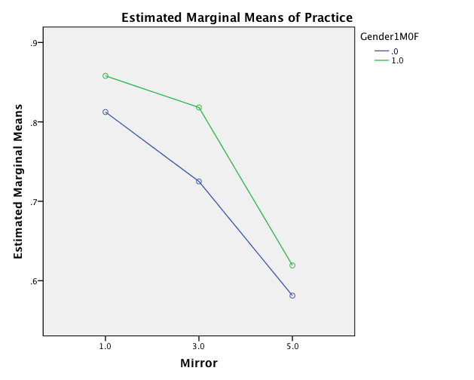
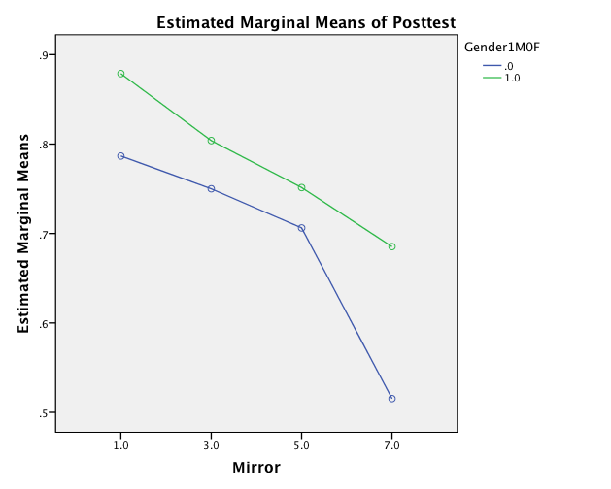
Practice | Posttest
Both genders performed better.
Males performed significantly better on Practice and Posttest for select mirrors
Notes:
Mirror: F(2,2)= 65.99, p=.015
η²=.99, Power=.97
Scheffé (5-1,5-3)= p<.001
Mirror: F(3,3)=12.12, p<.05
η²=.92, Power=.73
Scheffé (5-1)= p<.03; (7-5) p=.005;
(7-1,7-3) p<.001
Gender: F(1,3)=10.60, p<.05
η²=.78, Power=.60

Slide 29
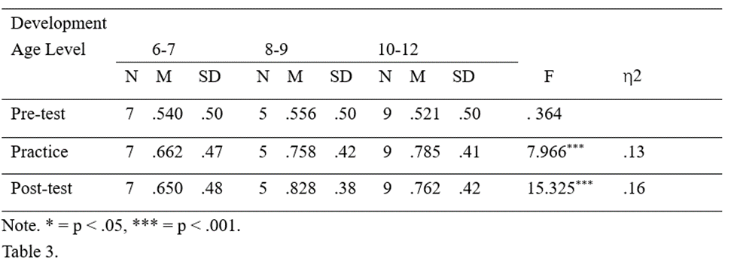
Results
Development (ANOVA)
No significant differences between developmental levels in the pretest (F=.292, p=.589)
Significant differences in developmental levels during the practice (F=14.72, p<.001) and the posttest (F=13.25; p<.001) blocks.
Table 2 Developmental comparison results

Slide 30
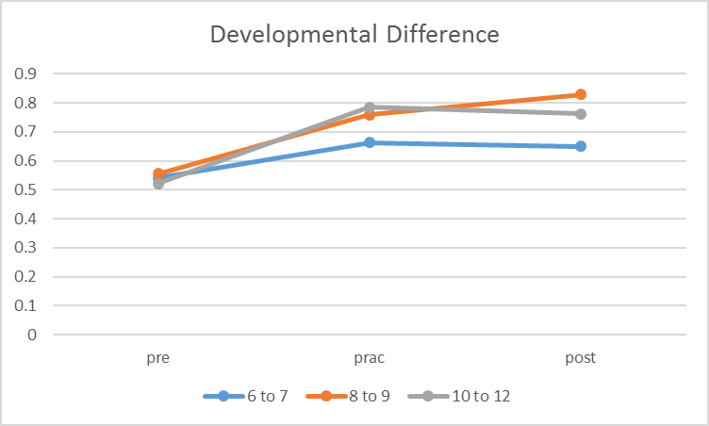
Results
Figure 2. Developmental comparison over three blocks

Slide 31
What neural correlates of the brain are significantly impacted in spatial reasoning learning?
Q3 & Are there Developmental and Gender differences as seen in the behavioral measures?

Slide 32
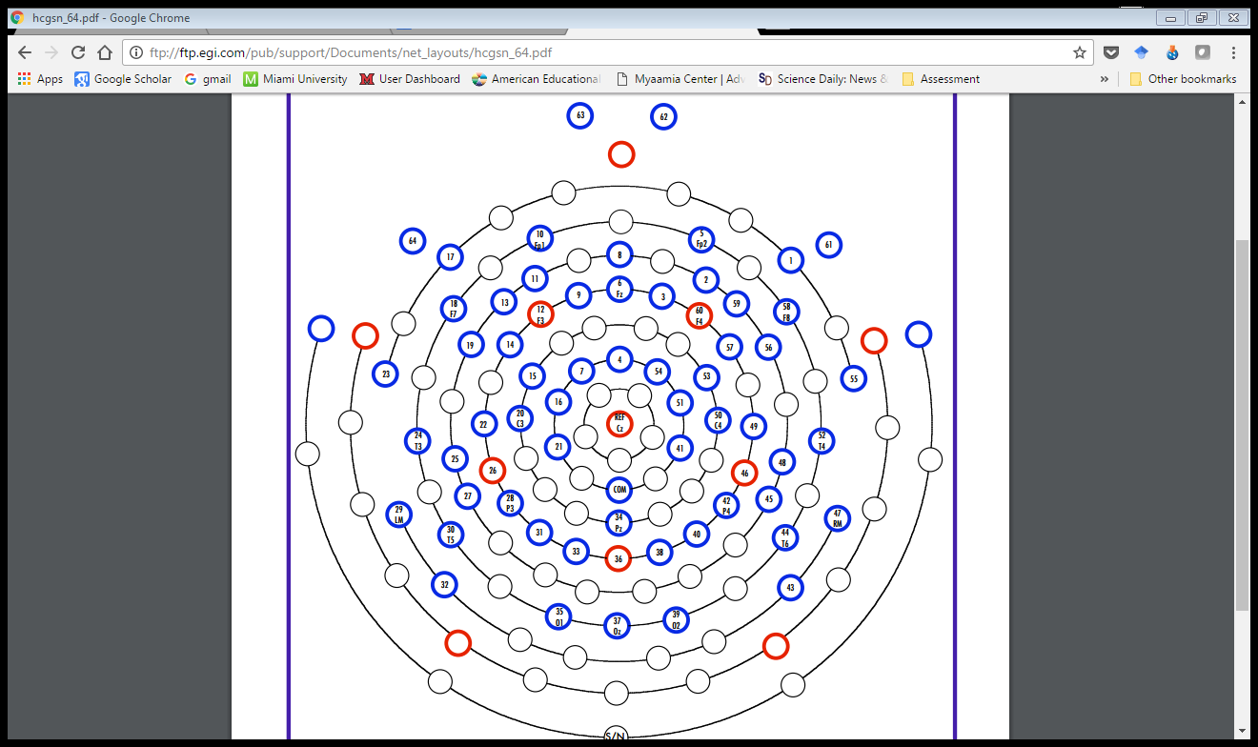
F3 LDLPFC (12)
F4 RDLPFC (60)
Pz Parietal & PP (36)

Slide 33
Methods: ERP Statistics
3x3 Repeated-Measure ANOVA
  Condition (3) and Mirror (3)
  Gender (2) and Developmental level (3) as between subjects
  Focus on N2 at frontal sites
  Focus on P3 at parietal

Slide 34
Parietal
Most typically associated with Spatial Processing

Slide 35
ERPs @Pz- Parietal
*t(20)=2.14, p=.045

Slide 36
ERPs @36- Posterior Parietal

Slide 38
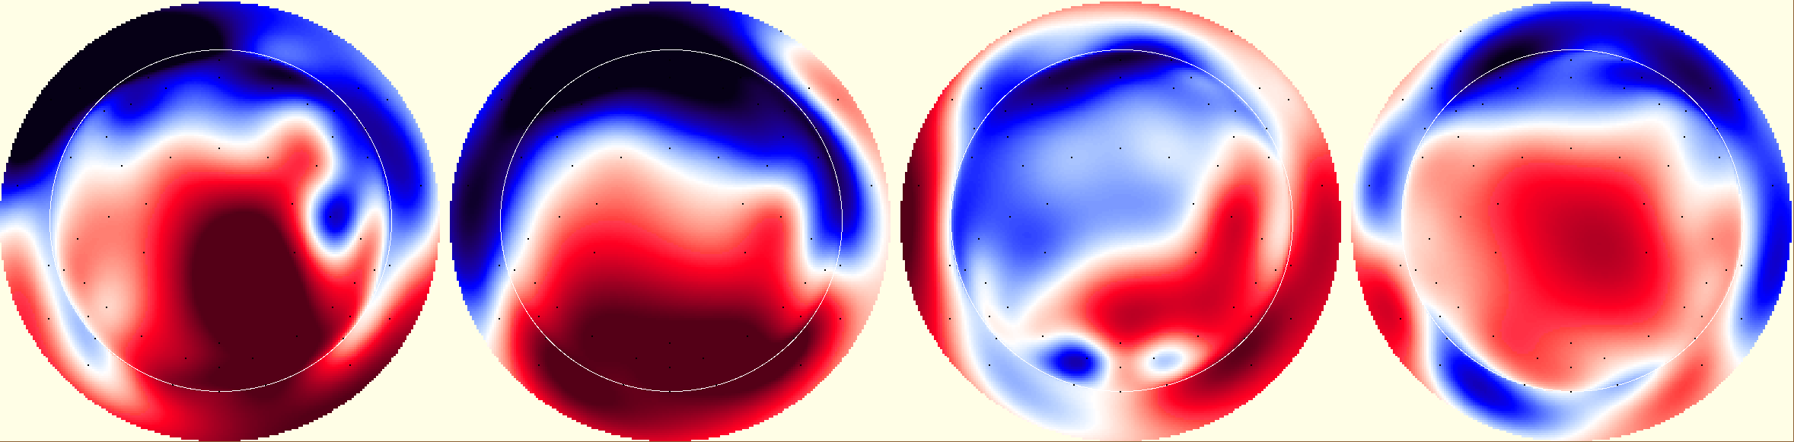
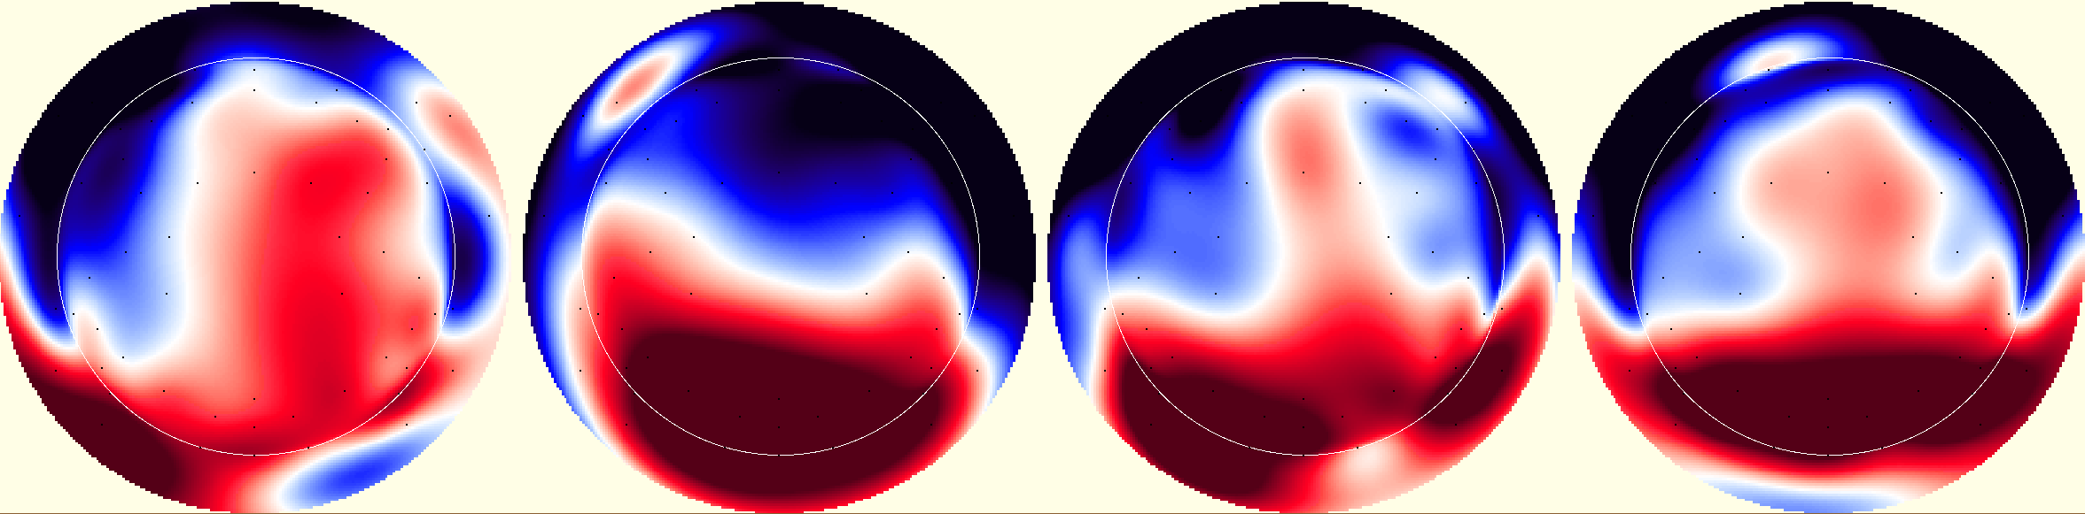
P3 | Pretest 1 | Practice 1 | Posttest 1
F
M
Notes:
Although the females were working harder, the males were getting it wrong.

Slide 39
F4
P3→N2

Slide 40
ERPs @F4- RDLPFC
Notes:
P3 Condition*Mirror Huynh-Feldt F(4,60)= 3.306, p<.02, effect size .18, power .811
*ERP responses vary by block. Paired sample t-tests confirm which mirrors differ in which block. [next slide]

Slide 41
F4 N200
Interaction between Block and Gender
  F (1, 15)= 3.426, p<.05 η² = .19, Power=.60
Interaction between Mirror and Gender
  F (1, 15)= 4.561, p<.02 η² = .23, Power=.73
Means | Pre | Practice | Post
Male | -2.14 | -2.86 | -1.27
Female | -3.16 | -.999 | -1.46
Means | 1 | 3 | 5
Male | -2.42 | -.583 | -3.26
Female | -2.29 | -2.19 | -1.13
Notes:
This tells us that the ERP during each condition depended upon the gender of the participant
Independent Samples t-test with gender as grouping variable- load in all blocks & mirrors for the site

Slide 42
F4 | Pretest | Practice | Posttest
F
M

Slide 43
F4 | 1 Mirror | 3 Mirror | 5 Mirror
F
M
Notes:
Waveforms in each of the block were dependent on gender.

Slide 44
F4 N200 (cont…)
Interaction between Block and Mirror
  F (4,)= 4.78, p=.002 η² = .25, Power=.94
Interaction between Block, Mirror, Gender, & Developmental Level
  F (8, )= 2.40, p=.026, η² = .24, Power=.854
Means | Pre | St.dev | Practice | St.dev | Post | St.dev
1 | -1.08 | .549 | -4.05 | .436 | -1.94 | .530
3 | -3.42 | .987 | -.167 | 1.10 | -.577 | 1.04
5 | -3.44 | .980 | -1.57 | .659 | -1.58 | 1.06
Notes:
How do I show 4 way interaction?

Slide 45
F4 | 1 Mirror | 3 Mirror | 5 Mirror
Pre
Prac
Post

Slide 46
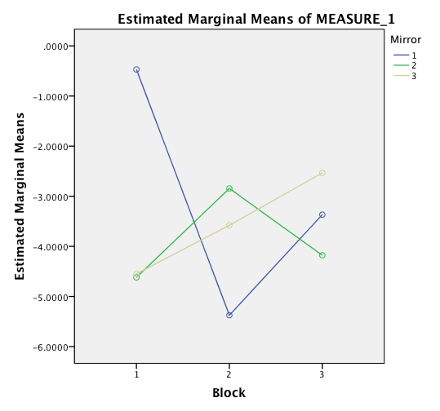
F4-P300
Block & Mirror Interaction: F(4,60)=3.31, p<.02, η²=.18, Power=.81
P300 Difference: T(20)= -2.405, p<.03; Pretest Mean=-.64, Practice Mean=-5.01
Mollinia et al (2015) attentional cues coming from the RDLPFC
during practice for the 1 mirror due to difficulty
Notes:
Mollinia et al (2015) attentional cues coming from the RDLPFC during practice for the 1 mirror due to difficulty

Slide 47
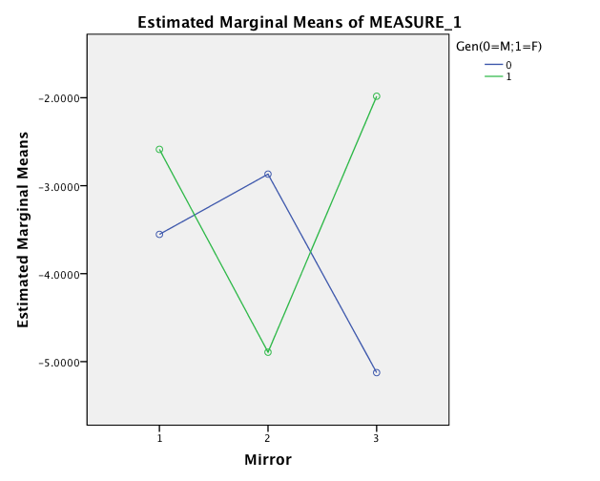
M/F difference Practice 1 Mirror
t(19)=-2.90, p<.01
Male mean=-7.26 Female mean=-2.55
1 3 5
Mirror
P3 Interaction between Mirror and Gender
  F (2, 18)= 5.16, p<.02
  η² = .26, Power=.79
Notes:
If attention is true then, boys paid more attention to 5 mirrors than girls who paid more attention to 3 mirrors. By attention we mean they were alerted.
Only keep the graph in red?
How to compare males within the mirror condition?
Grid line

Slide 48
F4 | 1 Mirror | 3 Mirror | 5 Mirror
F
M

Slide 49
F4 | 1 Mirror | 3 Mirror | 5 Mirror
6-7
8,9
10-12
Notes:
Note the beautiful P3 progression
The mental efficiency of the older group
The cognitive processing (slow waves) in the youngest group- similar to 1 mirror for the middle, and practice 1 mirror for the oldest
Orange square- mental check? Surety- practice slow demonstrates reconfiguration?

Slide 50
Block, Mirror, Developmental Level, Gender N2 Activity
1 Mirror Example

Slide 51
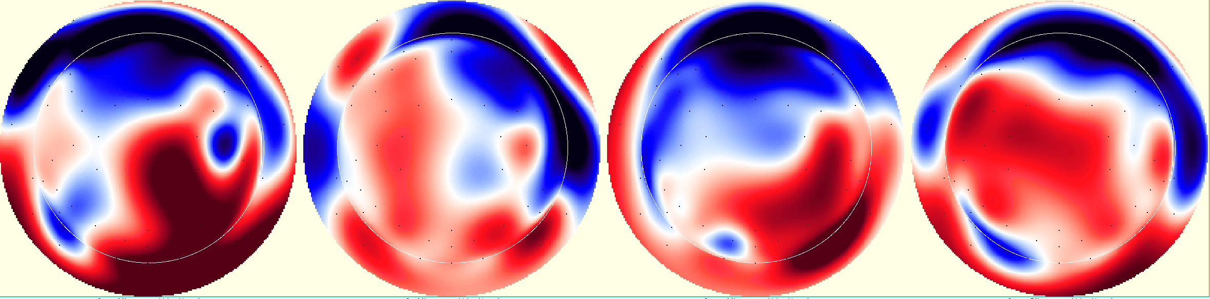
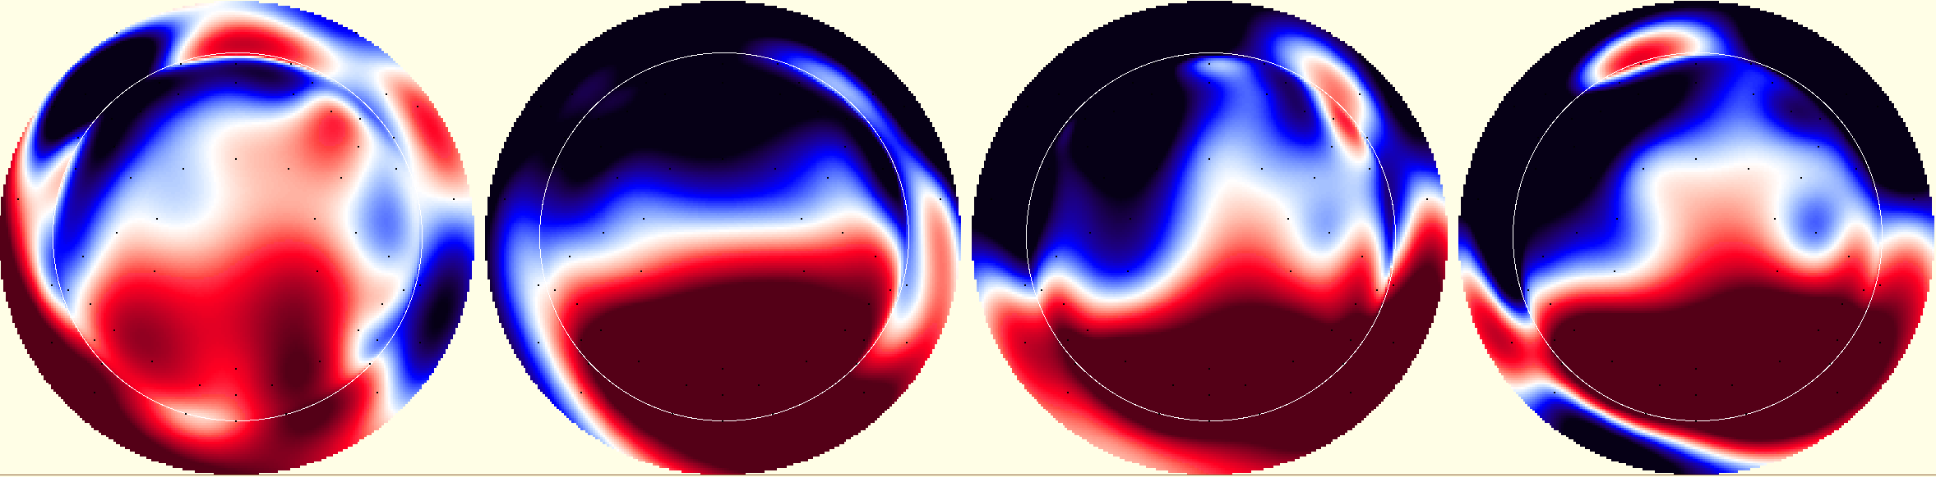
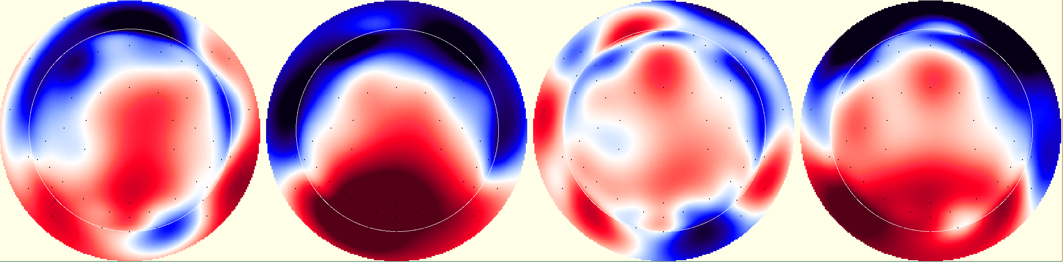
N2 1 Mirror | Pretest | Practice | Posttest
6-7
8,9
10-12
Notes:
Example of Block, Mirror, Dev. Level.
Age*Block N200 (165-200)
Negative deflecting amplitudes on the right (similar to those hypothesized to be N4 or slow wave deductive reasoning). With recall and practice occurring through parietal and PFC coordination (see P3) the older child’s brain is more efficient and the amplitudes are less strong.

Slide 52
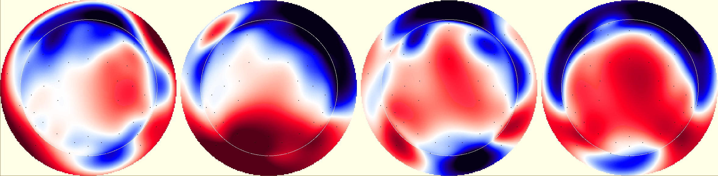
N2 | Pretest (1) | Practice (1) | Posttest (1)
F
M
Notes:
topos

Slide 53
F3
P3→N2

Slide 54
ERPs @F3- LDLPFC

Slide 55
P3 ERP Statistical Differences
@ F3 (LDLPFC)
Main Effect for Mirror
  F (2, 30)= 7.16, p<.005 η² = .32, Power=.91
Mirror | Mean | St. Dev.
1 | -6.69 | .677
3 | -4.32 | .937
5 | -3.92 | .751

Slide 56
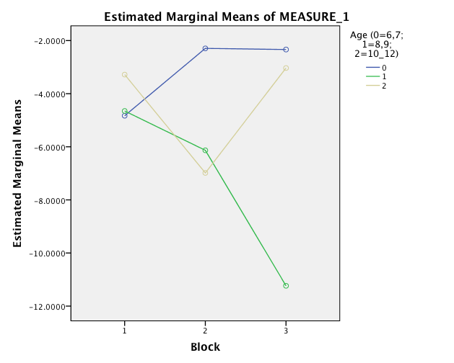
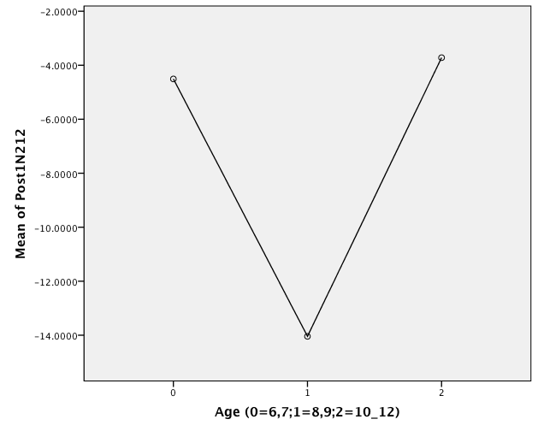
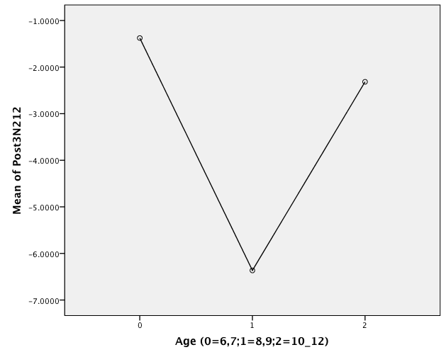
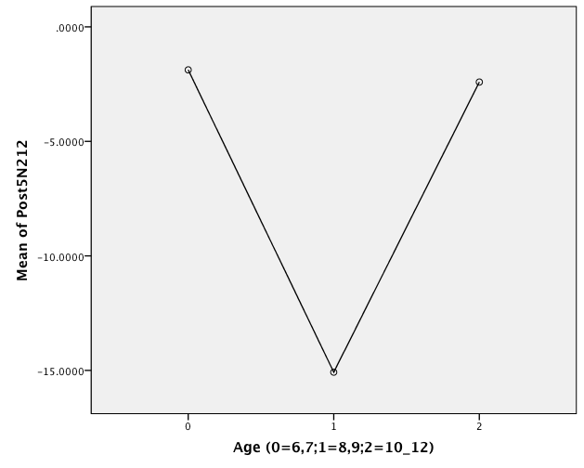
P3 Interaction between Block & Developmental Level
  F (4, 30)= 3.93, p=.011
  η² = .34, Power=.85
Post 1 & 5 Mirror Post difference: between 8,9 and 10-12 year olds
  1: F(2,18)=4.09, p<.05
  5: F(2,18)=10.79, p=.001
    8,9 & 6,7*p=.002
Notes:
Multiple Comparisons
Scheffe
Dependent Variable (I) Age (0=6,7;1=8,9;2=10_12) (J) Age (0=6,7;1=8,9;2=10_12) Mean Difference (I-J) Std. Error Sig. 95% Confidence Interval
Lower Bound Upper Bound
Post5N212 0 1 13.2004880* 3.1765940 .002 4.730760 21.670216
2 .5326344 2.7339768 .981 -6.756947 7.822215
1 0 -13.2004880* 3.1765940 .002 -21.670216 -4.730760
2 -12.6678536* 3.0259578 .002 -20.735941 -4.599766
2 0 -.5326344 2.7339768 .981 -7.822215 6.756947
1 12.6678536* 3.0259578 .002 4.599766 20.735941
*. The mean difference is significant at the 0.05 level.

Slide 57
F3/P3 | 1 Mirror Posttest | 3 Mirror Posttest | 5 Mirror Posttest
6-7
8,9
10-12
Notes:
1,3,&5 Mirror Posttest ERPs 67, 89, 10-12

Slide 58
 | 1 Mirror Posttest | 3 Mirror Posttest | 5 Mirror Posttest
8-9 F4
8,9 F3
8-9 Parietal

Slide 59
F3 N200 ERP Statistical Differences
Interaction between Block, Gender, and Developmental Level
  F (4, 30)= 4.817, p<.005 η² = .39, Power=.92
Interaction between Block, Mirror, and Gender
  F (4, 60)= 3.466, p<.05 η² = .19, Power=.83
Interaction between Block, Mirror, Gender, and Developmental
Level
  F (8,60)= 2.437, p<.05 η² = .25, Power=.86

Slide 60
Developmental Performance
No significant differences Pretest (F=.292, p=.589)
Significant differences during the
Practice (F=14.72, p<.001)
Posttest (F=13.25; p<.001)

Slide 61
F3 | 1 Mirror | 3 Mirror | 5 Mirror
6-7
8,9
10-12
Notes:
Age*Block N200 (160-180)
Red arrow Post 1 mirror resembles practice 1 mirror (see topo map)
Blue oval = consistency in the posttest.

Slide 62
Gender Performance

Slide 63
F3 | 1 Mirror | 3 Mirror | 5 Mirror
F
M

Slide 64
F3 | Pretest | Practice | Posttest
F
M
Notes:
Were the boys learning 3 mirror, and the girls learning 1 mirror? Behavioral stats on mirror during practice → important to not this slow wave indicated by the blue boxes and the magnitude and order of the waves as it varies by gender as indicated by the orange arrows. In any case, both M/F were working hard on 5 mirrors in the practice.
What does the P3 mean?

Slide 65
What about the 7 reflections?
Could the children apply what they learned?

Slide 66
7 Mirror Posttest
PFC
Parietal
Latency
Amplitude
Notes:
Error checking?

Slide 67
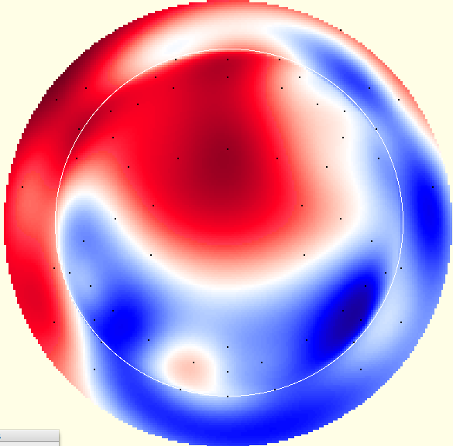

7 Mirror Posttest N2 P3
Female
Male
Notes:
Error checking?

Slide 68
discussion
Here’s a summary of what I’ve learned

Slide 69
Overall
Both sites had significant interaction effects for block, mirror, gender, and age.
  Mental Efficiency rule applies to frontal lobes
    Reduced amplitude yields better results
Important to speak about N4 & slow waves.
    Slow waves in P3 have been linked to spatial reasoning & Slow waves in PFC linked to inductive reasoning
    Reduction in slow amplitude in practice ERPs may suggest flow or mental efficiency

Slide 70

A network of topographic numerosity maps in human association cortex. Harvey & Dumoulin (2016)

Slide 71
Developmental
6/7 year olds- reduced N2 & P3 amplitudes in PFC
  Topo maps show different areas of the brain were activated than other age groups
8/9 year olds- overall larger amplitudes in PFC pre-post.
  Similar activation in PFC practice block to 10-12yo
  Outperformed other age groups in posttest
10-12 year olds- steady N2 & P3 peaks across blocks and trials in PFC

Slide 72
Gender
Overall: Male & Female differences in PFC activation
N2 & P3 practice blocks were similar, but posttest activation was different
  F4 Males: larger amplitude on 1 mirror in practice
  F4 Females: larger amplitude on 3 mirror in pretest
  F3 Males: larger amplitude on 3 mirror in practice
  F3 Females: larger amplitudes on 1 mirror across blocks
  Pz similar activation during practice

Slide 73
F3 & F4
Both sites had significant interaction effects for block, mirror, gender, and age.
  N2 & P3 differences speak to how the children of different genders and different ages cognitively process the game variables (block & mirror)
  Important to speak about N4 & slow waves.
    Slow wave linked to spatial reasoning & inductive reasoning
    Practice ERPs may suggest flow or mental efficiency

Slide 74
P3
Posttest & Higher Complexity mirrors =higher amplitude P3, P3b, and slow wave
  Spatial cognition
  Similar to Mental Rotation → Heil (2002), Liesefeld & Zimmer (2016)
3 mirror issue?
  Not statistically significant, but of note as different task-specific mirror patterns and alignments may result in brain activity difference

Slide 75
Conclusions
Here’s what it all means.

Slide 76
Research Questions & Hypotheses
Can children increase spatial reasoning abilities through video game play?
  H₁= Yes they can.
Are there developmental and gender differences in behavioral performance during spatial reasoning video game play?
- H₁= Yes there should be with Males outperforming females.
What neural correlates of the brain are significantly impacted in spatial reasoning learning?
  H₁= Spatial Triangle; Frontal L/R differences & large parietal ERPs for more mirrors
Notes:
Frontal attentional processing- parietal encoding.

Slide 77



While children of all ages can improve spatial reasoning skills, children 7-8 and up seem to be more cognitively ready.
Developmental alongside gender differences are suggested to exist in this spatial reasoning task
  ERPs demonstrate that the DLPFC is important in the selection of VSWM representations that lead to appropriate responses.
  Piaget & Inhelder benchmark for 7yr old for spatial abilities confirmed
  Gender differences may support social play differences in ECE

Slide 78
3. While fronto-parietal network is engaged in this spatial reasoning, several questions still exist in uncovering specific VSWM mechanisms that exist.
Posttest & Higher Complexity mirrors =higher amplitude P3, P3b, and slow wave
  Spatial cognition
  Similar to Mental Rotation → Heil (2002), Liesefeld & Zimmer (2016)
    Wave frequency coupling may provide further insight into L/R & Parietal connections
    JTF- PHASE coupling

Slide 79

Limitations & Future Research
21 participant generalizability
Something else?
Future:
Source Localization
Get lots of money
Rotate the mirrors
3D/immersive environment
Ages 8 & up
Notes:
Source analysis- difference waves- geosourcing

Slide 80


