Slide 1
Storytellers Welcome:
Demarginalizing Creative Writers in the Writing Center
Eric Rubeo, Creative Writing Consultant
Marissa Lane, Creative Writing Intern
Tammy Atha, Graduate Creative Writing Consultant
Sammie Osborne, Student Manager
Kate Francis, Advisor

Slide 2
History of the Creative Writing Initiative
Eric Rubeo, Creative Writing Consultant
rubeoee@miamioh.edu

Slide 3
Creative Writing at Miami University
Undergraduate students: ~16,000
CW majors: 200
CW minors: 56
Introduction to CW (ENG 226)
  100 students
Howe Center for Writing Excellence
  Consultations a semester: ~2000
  CW consultations: 10

Slide 4
Prior research (IWCA 2014)
“Why aren’t creative writers using our writing center services?”
Findings:
  Do not consider the writing center a space for creative work
  Worry feedback might not helpful
  Already receiving enough feedback in courses (majors only)
Notes:
HWCE consultants asked: “Why aren’t creative writers using our writing center services?”
Research findings:
creative writers do not consider the writing center a space for creative work
creative writers worry critique might not helpful; consultants might not be qualified
creative writers fear work is too personal to share
Already receiving enough feedback in courses (majors only)

Slide 5
Designing a solution
Recommendations:
  Increase awareness of creative writing services
  Promote in introduction to CW classes
  Develop consultant training programs
  Implement extra “one-shot” workshops
Who would do all this?
Notes:
Recommendations:
Increase awareness of creative writing services
promote in introductory classes
Develop consultant training program to better work with creative writers
Implement extra “one-shot” workshops on various aspects of craft

Slide 6
Focus on services offered
Action: Closely examine what we offer creative writers in a consultation.
45 minutes spent entirely on the writer’s work.
Focus on the writer’s concerns, not professors’ or peers’.
Writer is an active participant in conversation; not silently listening.
NOT attempting to replace creative writing classes.
Notes:
Closely examine what, exactly, do we offer creative writers in a consultation?
Embrace socratic seminar
Stress writer agency
Set specific goals based on the writer’s concerns
NOT attempting to replace creative writing classes.

Slide 7
The “Creative Writing Intern”
Goal: Hire an undergraduate creative writing major to pursue recommended course of action.
What to look for:
Experience organizing and hosting events
Experience training peers on creative craft
Existing relationship with faculty
Active in the creative writing community
The Creative Writing Intern is an idea-generator.
Notes:
Hire an undergraduate creative writing major to pursue recommended course of action. What to look for:
Experience organizing and hosting events
Experience training peers on creative craft
Existing relationship with faculty; active in the creative writing community.
Creative writing aptitude, to a lesser extent.
The Creative Writing Intern as an idea-generator.

Slide 8
Prepping for the Intern… My Role
We needed an existing consultant to introduce her to the center, the community, and basic consultant philosophies.
Begin as mentor → partner
The creative writing consultants continue to consult
Communicates consulting successes and failures
Notes:
To work alongside the Intern, we needed an existing consultant to introduce her to the center, the community, and basic consultant philosophies.
Begin as mentor → partner
The creative writing consultants continue to consult. Communicates consulting successes and failures to the Intern.

Slide 9
Creative Writing Initiative
Marissa Lane, Creative Writing Intern
laneme@miamioh.edu

Slide 10
What I Do
Work with/train Creative Writing Consultants
Communicate with the English Department
  Writing-oriented student organizations
Plan and host events
Fill a need in the Creative Writing Community

Slide 11
Mission Statement
“To establish a productive and supportive relationship between the Howe Center for Writing Excellence and the creative writing communities at Miami University, and improve student creative writing.”

Slide 12
Goals
To foster relationships between the Howe Center for Writing Excellence and the creative writing communities on campus.
Actions:
  Class Visits
  Monthly Undergraduate Reading Series
    Happy Captive Magazine & Howe Center for Writing Excellence
Notes:
Hire an undergraduate creative writing major to pursue recommended course of action. What to look for:
Experience organizing and hosting events
Experience training peers on creative craft
Existing relationship with faculty; active in the creative writing community.
Creative writing aptitude, to a lesser extent.
The Creative Writing Intern as an idea-generator.

Slide 13
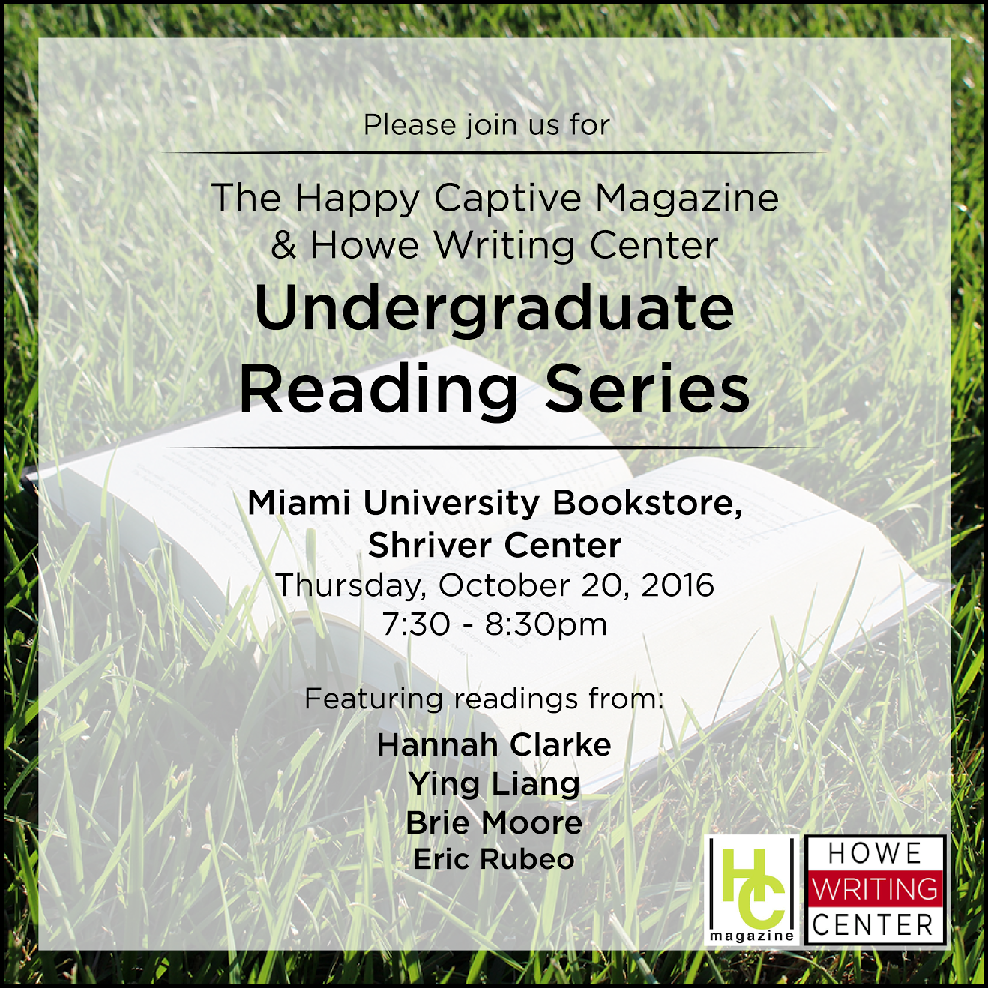

Slide 14
Goals
To bring more creative writers into the HCWE space and, in turn, be equipped to engage with creative works.
Actions:
  Specialized Training
  Indicators online
  Writers’ Workshops
    Partnership with the Association for Creative Writers

Slide 15
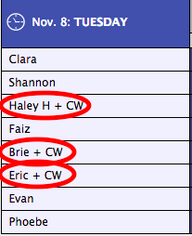

Slide 16
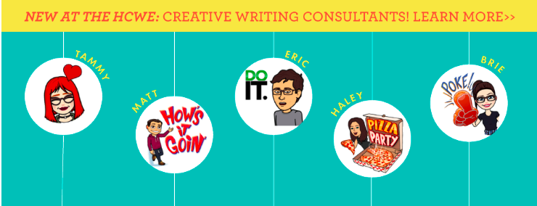

Slide 17
Where We’re At
CW consultations prior to current CW Initiative (2007-2014): 10
CW consultations since we’ve started (Fall 2016): 5
Roughly 30 attendees to undergraduate reading series
Roughly 15-20 attendees to writers’ workshop

Slide 18
Gauging Interest
Undergraduate creative writers seem to be more interested in big events and support rather than individual consultations.
We aren’t giving up on bringing creative writers into the center for consultations, but recognizing and working with the interests of creative writers as well.

Slide 19
Faculty Interviews
Tammy Jolene Atha, Graduate Creative Writing Consultant
athatj@miamioh.edu

Slide 20
Faculty Interviews
Faculty members are supportive of the Creative Writing Initiative, but…
Faculty members lacked a basic working knowledge of consultation best practices.
Faculty members were confident in the training of our creative writing consultants.
Faculty members are willing to help, but concerned with time commitment.
Faculty members need a reminder to send their students.

Slide 21
Do you understand the services the Creative Writing Initiative offers?
Faculty members lacked a basic working knowledge of consultations best practices.
“A peer review applied to creative work, not analytical work.”
“Yes, I think I do anyway. Students can bring their creative assignments in and get help on them.”
“Yes. I am not quite sure what a session looks like, though. I guess they bring their work to the writing center.”

Slide 22
Are you comfortable recommending the Creative Writing Initiative to your students?
Faculty members were confident in the training of our consultants.
“Yes, definitely. I know some of the people that work there personally and I know that they are able to provide valuable feedback.”
“Yes, because I know some of them and I have taught most of them. I feel very confident about their abilities.”

Slide 23
Are you interested in helping us further train consultants and grow the creative writing initiative?
Faculty members are willing to help, but concerned with time commitment.
“I would be happy to be involved, just depends on the time commitment.”
“It might be good to have some information about what goes on in the classroom, that would be of use.”
“Sure. It sounds like a good opportunity.”

Slide 24
Have you recommended the Creative Writing Initiative to your students?
Faculty members need a reminder to send their students.
“No, not yet, though I am thinking about it now. The initiative is very new.”
“My guess is that even if they knew they could go to the writing center for help with creative writing assignments they feel like they do not have time.”
“I haven’t offered any extra credit, but I am thinking about doing that now.”

Slide 25
Student Interviews
Sammie Osborne, Student Manager
osbornsl@miamioh.edu

Slide 26
Asking Questions
How did you hear about The HCWE?
What are your perceptions of the HWCE and our Initiative?
What holds you back from using our services?
What can we do to encourage CWs to use our services?

Slide 27
Students Interviewed
Student 1:
  CW Major
  Member of Association of Creative Writers
Student 2:
  CW Major
  Member of Association of Creative Writers
Student 3:
  CW/Prof Writing double major

Slide 28
Perceptions
“Inspiring Initiative… Great Services”
Believed in our mission
Beneficial… to a point.
Creative Writing is not emphasized
Excited to utilize consultations
Notes:
Perception: creative writing is a focus, but it’s minimal, including the support.
Used the phrase “workshopped or critiqued” in relation to consultations
Pair of outside eyes
Perceptions: beneficial to her major, the amount of writing she does
CW events: along the lines of Resume Blast and other sponsored workshops

Slide 29
Deterrents
“Honestly, I’m lazy…”
Perceived lack of need
Effort
Distance
Time
Notes:
CWI: I just know that it’s happening.

Slide 30
How Can We Encourage Writers?
They want to be a priority.
  Specialized Workshops
  Specialized Consultants
  Better understanding of training
  Breakdown (Poetry vs. Fiction)

Slide 31
Our Conclusions
Before:
  Creative writing aptitude, while valued, comes secondary to the relationship-building qualities of the CW Intern.
During:
  Undergraduate creative writers seem to be more interested in big events and support rather than individual consultations.
After:
  Faculty members need a reminder to send their students.
  CWs are looking for a continued interest and investment in their craft.

Slide 32
Moving Forward - This Semester
Continuing to co-host the Undergraduate Reading Series
Support the student-led writers’ workshops
Work closer with our marketing team to promote events throughout campus.

Slide 33
Moving Forward - Next Semester
Specialized Consultants
Undergraduate Drop-In Writing Hours
Ensure faculty members have an in-depth understanding of the Creative Writing Initiative.
Craft Seminars

Slide 34
Questions?
What is the creative writing culture at your Writing Center?
What events do you find draw in the most creative writers?
What do your creative writing appointments look like?
Is creative writing a focus for your Writing Center? Why or why not?
Support from faculty is important: what is fair to ask of them?
How do you find creative writing workshop strategies (Iowa) differ from consultation strategies?

Slide 35
Thank You!

Slide 36
Implementation
Writers’ Workshops
  Partnership with the Association for Creative Writers
Monthly Undergraduate Reading Series
  Happy Captive Magazine & Howe Center for Writing Excellence
Notes:
Specialization Training/Tags
Class Visits
Writers’ Workshops in
Partnership with the Association for Creative Writers
Monthly Undergraduate Reading Series,
Happy Captive Magazine & Howe Center for Writing Excellence

Slide 37
Moving Forward
Ensure faculty members have an in-depth understanding of the Creative Writing Initiative.
Increase knowledge of consultation best practices for faculty members
Build value of the creative writing initiative in the introduction to creative writing classes
  Midterm reminders
  Offering extra credit
Get faculty members involved in seminars or craft talks

Slide 38
Next Steps
Continuing Fall 2016:
  Continuing to co-host the Undergraduate Reading Series and
  Support the student-led writers’ workshops
New Spring 2017:
  Specialized consultants
  Undergraduate drop-in writing hours
  Craft seminars
Notes:
Specialized consultants
Training consultants who are not creative writing students to work with creative works
Undergraduate drop-in writing hours
Craft seminars
Continuing to co-host the Undergraduate Reading Series and support the student-led writers’ workshops

Slide 39
CWs are looking for a continued and emphasized interest in their craft.

