Slide 1
Affordable Learning!
Tips & Opportunities

Slide 2
Presented by:
Jennifer Bazeley
Coordinator, Collection Access & Acquisitions
312 King Library
513-529-4216
bazelejw@miamioh.edu
Eric Resnis
Organizational Effectiveness Coordinator
212 King Library
513 529 7205
eric.resnis@miamioh.edu
Carla Myers
Coordinator of Scholarly Communications
303B King Library
513-529-3935
myersc2@miamioh.edu

Slide 3
Textbook Affordability
Notes:
Barriers to higher education: textbook costs
How did we get here?
The College Board estimates that the average student in the US (at a public 4 yr) spends ~$1200/year on books & supplies

Slide 4
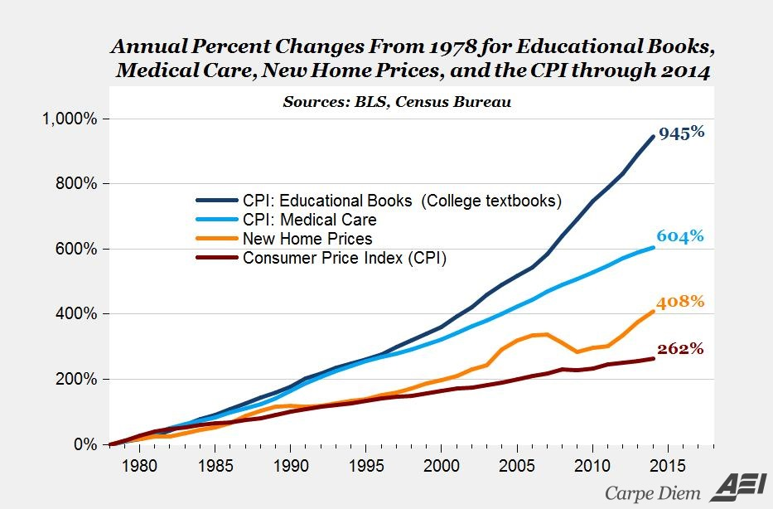
Notes:
https://www.aei.org/publication/the-new-era-of-the-400-college-textbook-which-is-part-of-the-unsustainable-higher-education-bubble/
Between 1978 and 2014, the cost for educational textbooks has risen 945%, outpacing the inflation of medical service costs (604%), new home prices (408%), and the consumer price index significantly (262%).

Slide 5
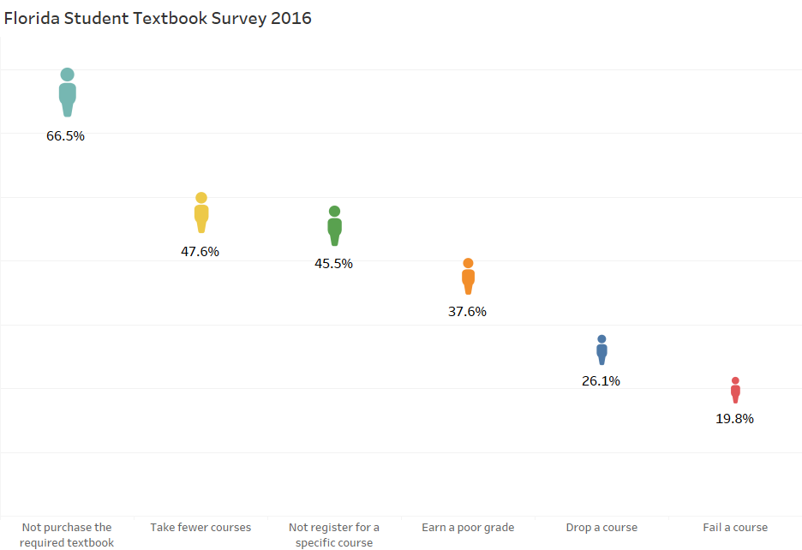
Notes:
Textbook costs have impacted students and we have a variety of survey data to show that. Some of the most telling survey data has come from the higher education consortia in Florida. The Florida Virtual Campus consortium has conducted surveys in 2010, 2012 and again in 2016 to identify how textbook costs affect students. Each year, the survey was sent to approximately 22,000 Florida students, with response rates around 21,000 students. Survey results across all three survey years are remarkably consistent. Some of the statistics identified: (percentage of students who responded to the statement “in your academic career, has the cost of textbooks caused you to”):
66.5% reported they had not purchased a required textbook due to cost
476.% reported they took fewer courses due to the cost of textbooks
45.5% reported they had not registered for a specific course because it’s textbook was costly
37.6% reported they had earned a poor grade due to the cost of a textbook
26.1% reported they had dropped a course due to a high cost textbook
And 19.8% reported they had failed a course due to a high cost textbook
2016 Survey
https://florida.theorangegrove.org/og/file/3a65c507-2510-42d7-814c-ffdefd394b6c/1/2016%20Student%20Textbook%20Survey.pdf
2012 Survey
http://www.openaccesstextbooks.org/pdf/2012_Florida_Student_Textbook_Survey.pdf

Slide 6
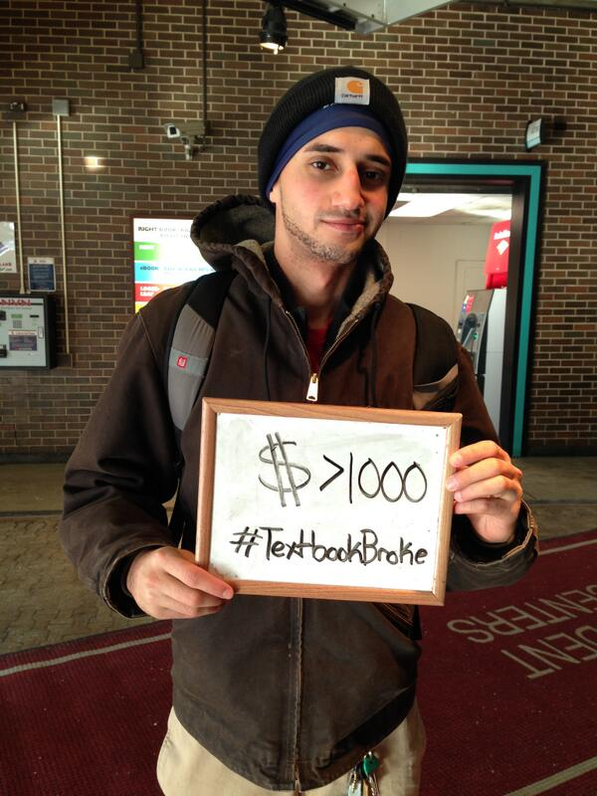
Why are textbooks expensive?
Flaw in publishing industry
Not a “normal” market
No checks/balances
5 textbook companies control most of market
Notes:
If you search for the hashtag “textbookbroke” on Twitter, you’ll come across hundreds of photos of student textbook costs, some of which are shocking. Students are struggling to pay for textbooks.
http://twitter.com/IllinoisPIRG/status/428266752066088960/photo/1
Why are textbooks so expensive?
-Flaw in publishing industry
-In normal market, direct relationship between consumer and provider; consumer can choose to purchase products that are a good value, and competition forces producers to lower costs and meet demand.
-In textbook industry, no checks and balances exist. Professor chooses the book but student must pay price. Without any options for students, publishers can drive prices very high.
-Just five textbook companies control more than 80% of the 8.8 billion dollar publishing market.
-Renting and buying used help but publishers undermine that by publishing new editions regardless of changes in subject and by creating “bundles” that cost significantly more.

Slide 7
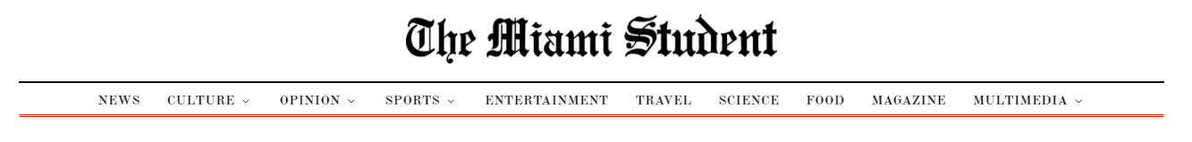
But it’s not a problem at Miami, right?
“ASG discusses proposed textbook price limits, prepares bill” (2/27/17)
"Price hike has students 'booking it' out the door" (2/7/14)
“Textbook law fails to bind publishers” (9/10/13)
“Textbook policies aim to help, though not strictly enforced” (9/10/13)
“King puts high-demand textbooks on reserve” (8/20/12)
“MU slow to comply with textbook law” (10/27/11)
“Miami must act quickly to better comply with textbook law” (10/27/11)
“Ohio arranges for free textbooks” (3/28/11)
“Rising textbook costs shine light on affordability crisis” (3/25/08)
Notes:
The Miami Student has published upward of a dozen articles in recent years about textbook issues and solutions, and anecdotally, we know that our students are feeling the pain of these costs just as students at other schools are. Our students request current and older editions of their textbooks via ILL with regularity each semester.
Additionally, checkouts of textbooks on reserve at King library account for 10% of all yearly transactions—in 2014, textbooks circulated 18,680 times (2 hour blocks).

Slide 8
Addressing Textbook Affordability
Faculty learning communities
ASG resolution
Textbooks on reserve
Open Textbook Network
Open Educational Resources (OER)
Notes:
Faculty learning communities
ASG resolution
Textbooks on reserve
Open Textbook Network
Open Educational Resources (OER)
Proven Benefits to students include:
Cost savings
decreased financial burden for students
lower debt
Improvement in academic performance.
Rise in course completion
Increased retention rates
Students take more courses

Slide 9
Our Goals
Significantly lower the cost of textbooks to enrolled students in a specific course
Maintain or improve student learning outcomes and satisfaction with the required materials
Contribute to the growing body of affordable materials or Open Educational Resources (OER) available to the global higher education community
Notes:
Significantly lower the cost of textbooks to enrolled students in a specific course
Maintain or improve student learning outcomes and satisfaction with the required materials
Contribute to the growing body of affordable materials or Open Educational Resources (OER) available to the global higher education community

Slide 10
Miami University OER/AL Grant Programs

Slide 11
OER-Explore
2 hours workshop, usually held in the fall and spring of each year
Learn more about OER and AL initiatives and resources
Provide an online review of an OER
$200 stipend

Slide 12
OER-Adapt & Adopt
3 semester-3 year commitment
Replace your current commercial textbook with an OER
If needed, adopt the resource to your specific needs
$1000 in professional development funds granted for the completion of each phase of the grant
Phase 1, analyze student learning with commercial text
Phase 2, Introduce use of OER and analyze student learning
Phase 3, plan for long-term use and continue to analyze learning.

Slide 13
OER-Create
Launching in 2018
Award of funds for the creation of an OER to be used for course instruction

Slide 14
Affordability Initiative-Course Pack Consultation Service
For faculty using readings-based course packs
Reading list will be analyzed to determine what works can be made accessible to students freely under US copyright law
$200 in professional development funds for going through the consultation service

Slide 15
Affordability Initiative-Alternate Textbook Program
Replacing a commercial textbook with works that can be made freely available to students under US copyright law
May also include replacing current course materials with alternate, low-cost options
Grant funding: TBD

Slide 16
Assessment via SGID
Why SGID?
Valuable qualitative information
Allows for follow-up questions
Easy to focus on OER quality and Learning
Low stakes method
High ‘return’ rate
Student familiarity

Slide 17


Learn More
MU OER/AL Grant Webpage
http://miamioh.edu/academic-affairs/teaching/open-educ-res/index.html

Slide 18
Questions?
Jennifer Bazeley
Coordinator, Collection Access & Acquisitions
312 King Library
513-529-4216
bazelejw@miamioh.edu
Eric Resnis
Organizational Effectiveness Coordinator
212 King Library
513 529 7205
eric.resnis@miamioh.edu
Carla Myers
Coordinator of Scholarly Communications
303B King Library
513-529-3935
myersc2@miamioh.edu

