Slide 1

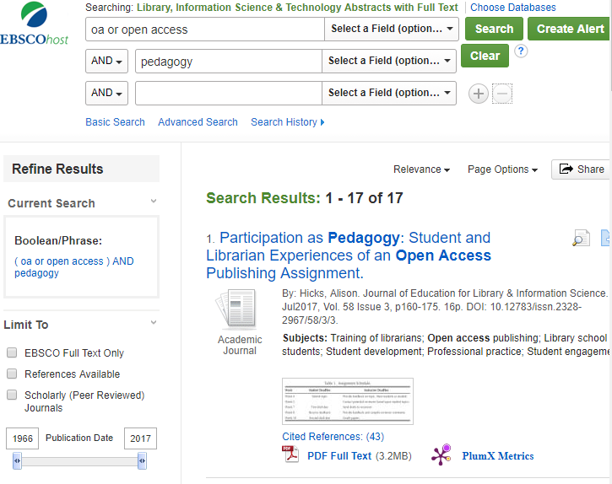

Demystifying the Opaque: Train Faculty and Others to
Assess Open Access Resources
Anna Liss, Jacobsen
Miami University Oxford OH
Purpose
Review methods currently used to assess already-published OA
Develop criteria to train faculty and others to evaluate OA resources
Results & Discussion
Fundamental Skills
Evaluate Publisher
  OASPA / COPE / WAME
  Website content, transparency and more
Evaluate Journal
  DOAJ / Cabell’s / African Journals Online (AJOL) / INASP
  Transparency of procedures, content and more
  Indexing
Evaluate Author
  Name recognition
  Publication history
Evaluate Article
  Content validity / reliability / quality
  Locked pdf / searchable
Acknowledgments
Eric Johnson
Susan Baker Brehm
Methods
Literature Review
Academic Search Complete
Library, Information Science & Technology Abstracts
Notes:
Copyright Colin Purrington (http://colinpurrington.com/tips/academic/posterdesign).

