Slide 1
They’re Going to Google It Anyway
Using An Information Scoring System to Teach Students How to Use Problematic and Biased Sources

Slide 2
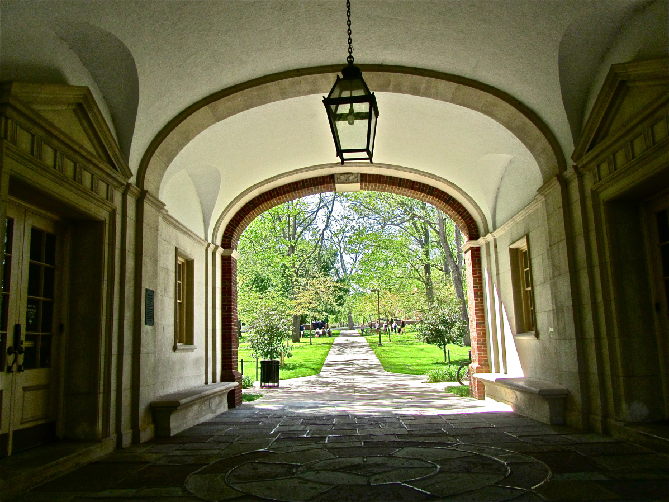
The Source
The system that I will present was initially developed by Dr. Glenn Muschert (Sociology) and Michael Howser (Social Sciences Librarian) at Miami University in 2006
It was a product of a Faculty Learning Community of information fluency
I was involved in later revisions to the assignment and the rating scale

Slide 3
The Original Assignment
Students in a 400 level SOC class were conducting research on specific incidences of school violence. Some student topics lacked scholarly sources because they were:
  very recent
  obscure
Faculty member desired a structure that would allow students to use biases and questionable sources.

Slide 4

The Problems

Slide 5
The Problems:
Binary evaluation of information
Frequency of bad sources, especially when researching very current topics
Students’ information seeking behavior

Slide 6
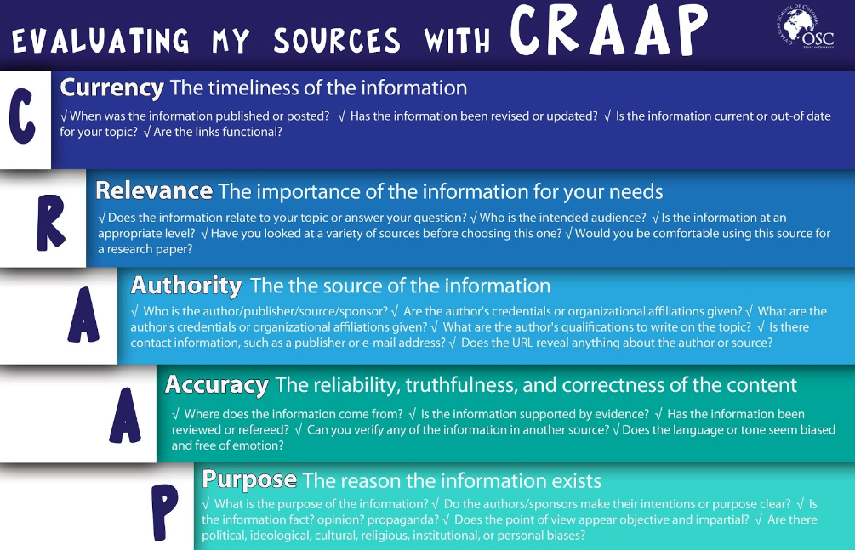
Problem One: Binary Evaluation
CRAAP Test (Blakeslee, 2004) was designed to help students avoid “bad” sources. We wanted to develop a system that allows students to make use of sources that would be considered CRAAP.

Slide 7
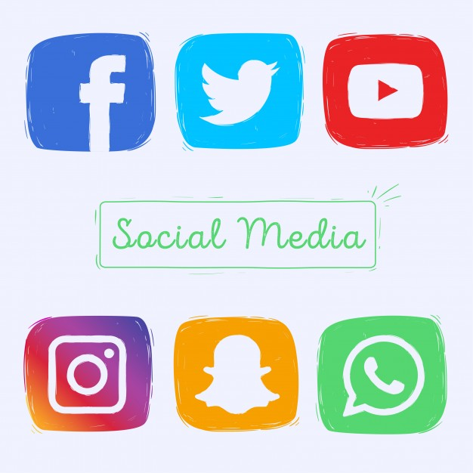
Problem 2: So much CRAAP
”Bad” sources are produced faster than good sources.
Popular sources are produced faster than scholarly sources.
Sometimes sources that fail the CRAAP test, like personal blogs or social media, are valuable for a particular topic.

Slide 8
They’ll Google it Anyway
“When asked, on a scale of 0-10, how skilled they are at finding information online, […] the average self rating was 7.75” (Georgas, 2013).
Even with 4 years of library instruction, 45% of students began their research with a Google search (Perruso, 2016).
”…performance features, along with ease of use, were primary factors influcing database selection (Walsh & Borkowski, 2018).

Slide 9
The Assignments

Slide 10
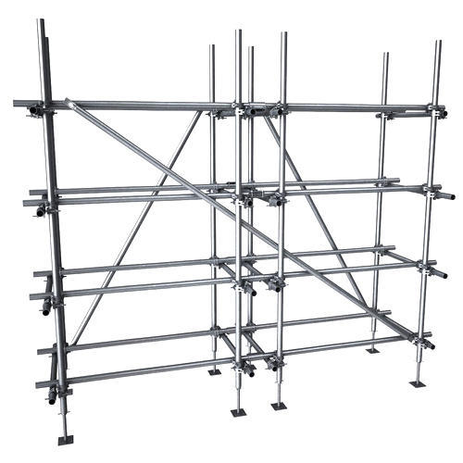
Dr. Muschert’s Assignment
SOC 410/Juvenile Delinquency
Comprehensive Search
Annotated bibliography with standard source evaluation
Select sources for final paper
Draft
Final Paper

Slide 11
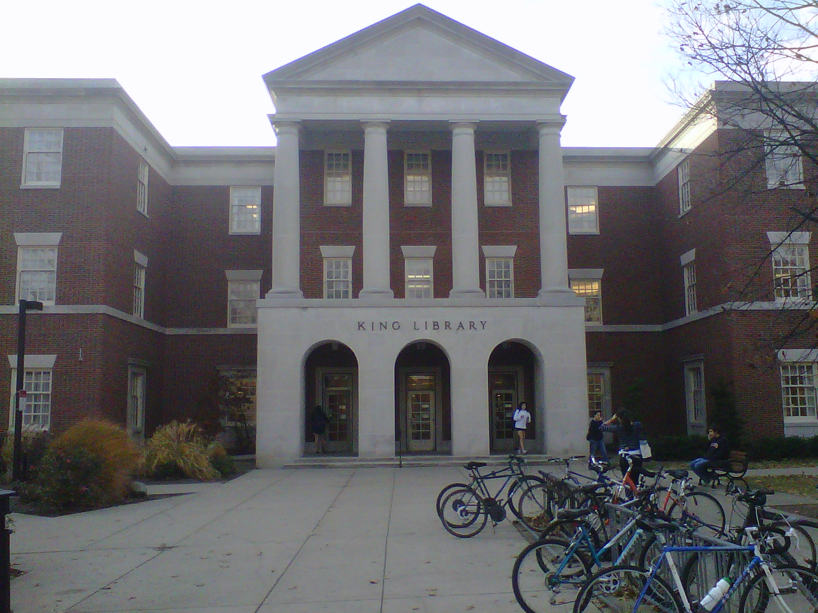
Dr. Muschert’s Assignment
Step 1 (~3rd week)
Students in library to do comprehensive search
Library instruction
  Scholarly databases + catalog
  Effective Google searching

Slide 12
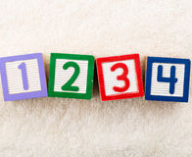
Dr. Muschert’s Assignment
Step 2 (~6th week)
Students in library for lesson on
  Annotating sources
  Evaluation system
We also talk about step 3 (selection of sources for final project)
Notes:
Turn to hand out and discuss the scale

Slide 13
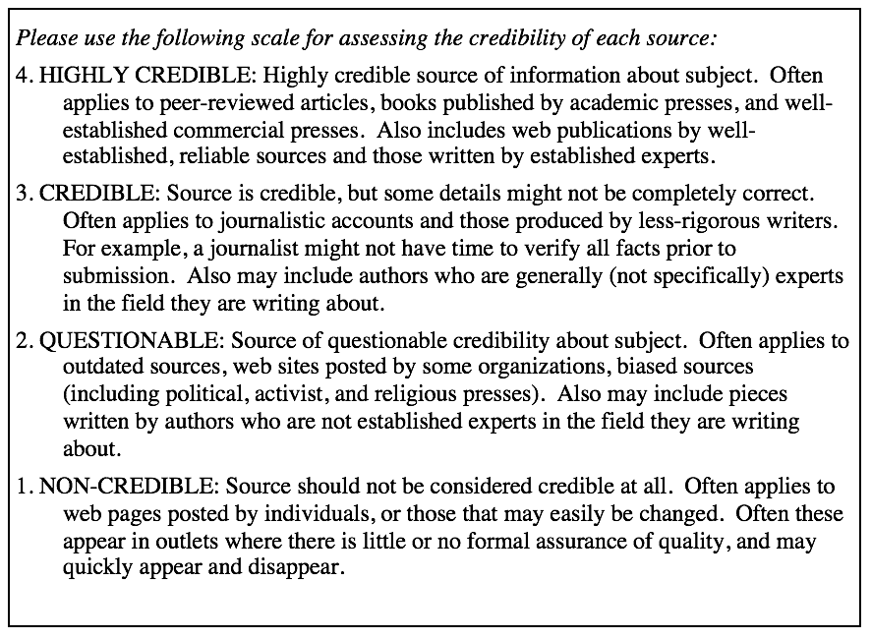
The Scale

Slide 14
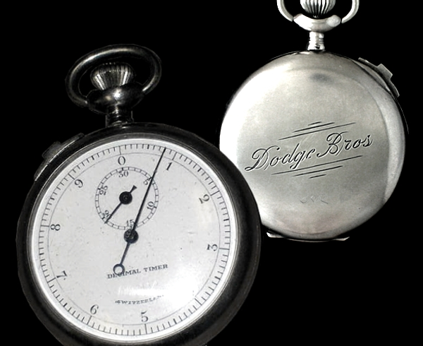
Assignment Adaptations
One Shot
Step One: Students evaluate common set of sources using scale
Step Two: Students search on their own topic
Step Three: Students evaluate three of their sources.
By Time Maven at en.wikipedia - Transferred from en.wikipedia by Ronhjones, Public Domain, https://commons.wikimedia.org/w/index.php?curid=17885493

Slide 15
Assignment Adaptations
Semester-length course
Step One: Students evaluate common set of sources using scale
Step Two: Students hand in annotated bib with sources evaluations
Step Three: Source evaluations included in reference list of final papers

Slide 16
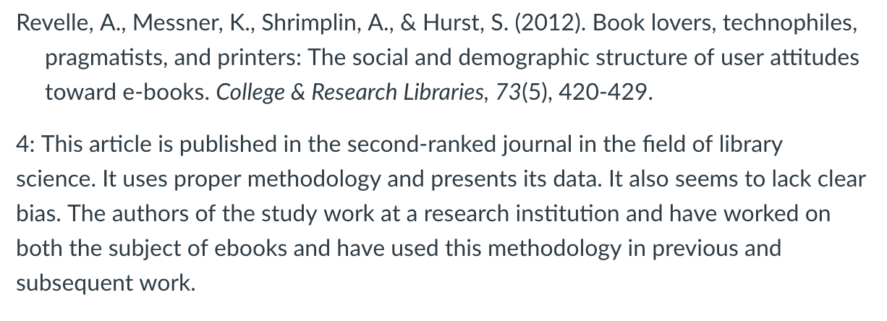
Example Reference with Evaluation

Slide 17
Lets Evaluate Some Sources
CRAAP vs 4 point scale
https://www.beefitswhatsfordinner.com/nutrition
https://nyti.ms/2KrDT20
https://www.buzzfeed.com/davidlight/amazon-invade-the-pharmacy-prescription-drug?utm_term=.efEXkLpgJ

Slide 18
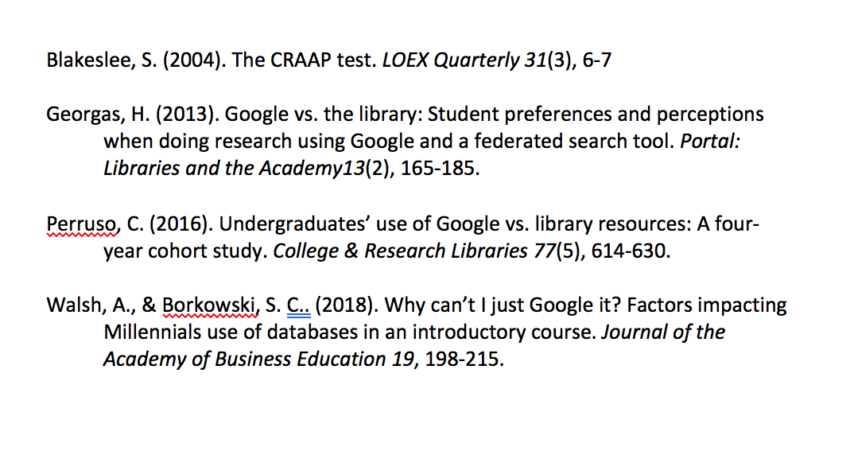
References

