Slide 1
Cultivating Connection by Caring:
Using Empathetic Marketing to Reach Distance Students and Ease Library Anxiety
Carrie Girton, Miami University Hamilton
girtonc@miamioh.edu

Slide 2
What is Empathy?
the action of understanding, being aware of, being sensitive to, and vicariously experiencing the feelings, thoughts, and experience of another of either the past or present without having the feelings, thoughts, and experience fully communicated in an objectively explicit manner; also : the capacity for this¹

Slide 3
What is Empathetic Marketing?
It’s not about getting people to use your product. It’s about seeing a need and then saying “I have a product/service that will meet that need.”²
“Too many companies create corporate-centric, rather than customer-centric, content. The former is about you; the latter is about what you do for your customer—a subtle yet critical shift.”³

Slide 4
What is Empathetic Marketing?
“First and foremost, you have to reframe the way you see the people you serve—stop calling them your target market—or any name that turns them into a statistic or a bullseye. Instead, consider them to be people: the people you hope to serve, your stakeholders. That reframe alone opens your eyes and leads you into a different type of engagement with them.”⁴

Slide 5
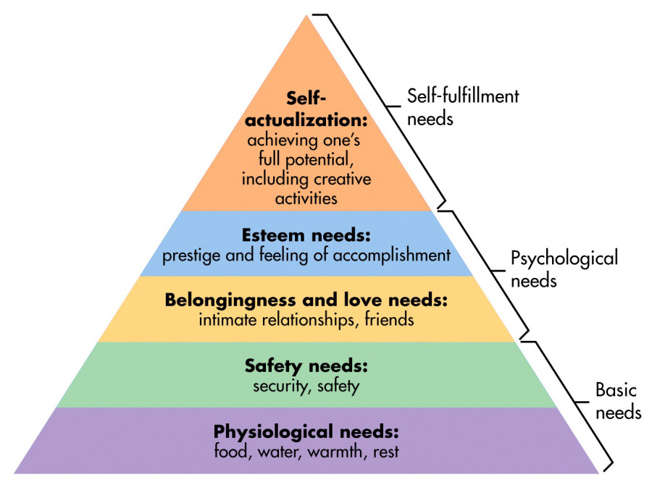
Maslow’s Hierarchy of Needs
https://www.simplypsychology.org/maslow.html

Slide 6
Examples of Empathetic Marketing
https://www.youtube.com/playlist?list=PLBEYn8q4ZI_7ueS8Z8QHB40vF0x6yuh_c

Slide 7
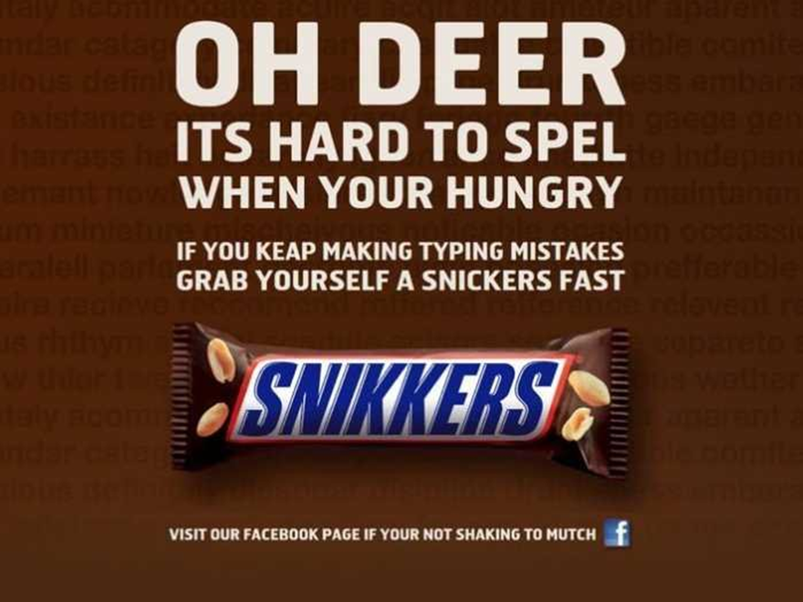
http://www.businessinsider.com/snickers-purposely-misspells-its-name-in-ad-2013-5

Slide 8
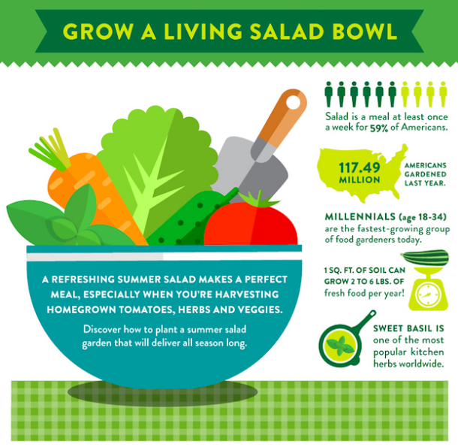
Home Depot
https://blog.hubspot.com/marketing/empathetic-content-marketing-examples

Slide 9
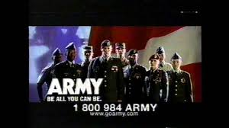
https://www.youtube.com/watch?v=YProZYuMUNk

Slide 10
Meeting the Needs of Distance Students
“While the standards of an information literate student can be seen within self-actualization, we must consider the varied and hierarchical needs of students. We cannot address information literacy in isolation. Therefore, in our instruction and daily interaction with students, we must also give attention to their more basic needs, for it is only after the fulfillment of those needs that an individual can focus on those skills required for information literacy.”⁵

Slide 11
Meeting the Needs of Distance Students
“…we feel some needs the most, such as security, when we’re deprived of them. When life is humming by smoothly, we don’t actively pay attention to some of our needs….The fact that we ignore important needs, such as security, for the sake of other pursuits also creates opportunities for businesses that can anticipate consumers’ dormant needs and head them off before an audience is seriously deprived.”²
“By answering questions, you are addressing specific pain points, demonstrating that you understand customers’ specific issues and concerns.”³

Slide 12
Meeting Needs Reduces Library Anxiety
“The literature indicates that acknowledging the anxiety and its legitimacy, and then providing successful experiences to counteract the anxiety is the most effective method for treatment.”⁷
“…only a good instruction librarian can convince them the library isn’t scary.”⁷

Slide 13
Library Anxiety
“Students feel their own library-use skills are inadequate while the skills of other students are adequate
Students believe the inadequacy is shameful and should be hidden
Students think that the inadequacy would be revealed by asking questions so they chose not to ask any questions.”⁵

Slide 14
Maslow’s Hierarchy of Needs
https://www.simplypsychology.org/maslow.html

Slide 15
Safety Needs
Security, safety
“In relation to the library, the need of safety can be seen most clearly in the patron’s level of library anxiety.”⁵
Some anxiety about “who” they are talking to in online interactions.⁶
Need to feel comfortable to ask questions.⁷ (Belonging, Esteem)

Slide 16
Belongingness and Love Needs
Intimate relationships and friends
The sense of having a place and fitting in with others while still being self
This is especially critical and more difficult for distance students
Inform them that they have same access to resources as on-campus students⁸
Notes:
Ingwer asserts that this need is critical because “Imagine what it would feel like if everything in the world felt foreign or alien….Feeling invisible is among the psychologically most desperate predicaments in which a person can find him- or herself.”

Slide 17
Esteem Needs
Prestige and feeling of accomplishment
Self-expression
Need to feel comfortable/confident to ask questions⁷ (Safety, Belonging)
Also addressed through achievement, respect for others, and respect by others⁵
Notes:
Francis explains that “The fourth level of need addressed by Maslow is esteem. This is addressed through self-esteem, confidence, achievement, respect of others, and respect by others. Esteem can take several forms in the library. For some patrons, the importance of the library is seen in the respect they are shown by the library staff. Their reading habits are not questioned and they are allowed time and space to conduct research. The library is also a place for patrons to increase their knowledge, which will correspond to an increase in self-esteem. Also, through the use of the library, patrons develop confidence in the skills necessary for research, such as performing a search in a database or evaluating a source. This confidence is displayed when they share these skills with others by helping a friend find a book or telling neighbors about what they have found in the library.”

Slide 18
Self-Actualization Needs
Achieving one’s full potential, including creative activities
Growth period
“Aspects of [self-actualization] include problem solving, lack of prejudice, acceptance of facts, morality, creativity, and spontaneity. These traits correspond readily to the outcomes set forth within the ACRL Standards.”⁵
Notes:
Francis puts this need in library terms by asserting “Aspects of [self-actualization] include problem solving, lack of prejudice, acceptance of facts, morality, creativity, and spontaneity. These traits correspond readily to the outcomes set forth within the ACRL Standards. Problem solving is addressed when a student is able to create search strategies in order to effectively and efficiently search for information. Lack of prejudice is an important mindset when evaluating information. Acceptance of facts is seen when a student incorporates information into his or her knowledge base and value system. Morality is addressed by using information legally. These outcomes imply the use of high-order critical thinking skills. An information literate individual requires the traits and skills portrayed within the level of self-actualization.”

Slide 19
“We must focus on the student as a whole individual. This requires time and energy focused on addressing their needs beyond the time we see them during instruction sessions. This places importance on topics such as library anxiety, the library as place, and user experience. By looking to Maslow’s Hierarchy of Needs and working with the whole student, we will be able to reach them and aid their development into information literate individuals.”⁵

Slide 20
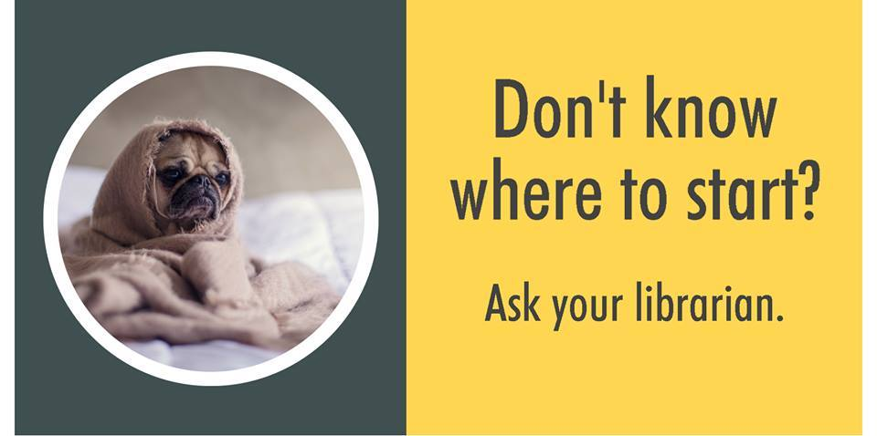
Examples of Empathetic Marketing in Libraries
Stressing about your final research paper? We're here to help!!

Slide 21
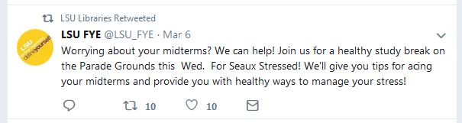
Examples of Empathetic Marketing in Libraries
Louisiana State University
First Year Experience

Slide 22
Examples of Empathetic Marketing in Libraries
Rod Library at University of Northern Iowa⁹
“by using the Rod Library you will decrease your frustration and increase the quality of your efforts.”
Looking for answers in all the wrong places? Try the library!
The end is near! – The library is here.
Way too busy – feeling down? Too much homework makes you frown? We turn those frowns – upside down! @ The Rod Library.

Slide 23
Activity
Get into a group of 4 or 5.
Choose one of the Needs (Safety, Belonging, Esteem, or Self-Actualization) and think of a service or product that your library provides that could meet that need.
Create a slogan or marketing idea to promote that service/product to distance students in a way that meets the need.

Slide 24
References
¹Empathy. (n.d.). https://www.merriam-webster.com/dictionary/empathy
²Ingwer, M. (2012). Empathetic marketing: how to satisfy the 6 core emotional needs of your customers. New York, NY: Palgrave Macmillan, 2012.
³Handley, A. (2013). Empathy pains. Entrepreneur, 41(8), 70.
⁴Tripp, C. (2013). No empathy - no service. Design Management Review, 24(3), 58-64. doi:10.1111/drev.10253
⁵Francis, M. (2010). Fulfillment of a higher order: Placing information literacy within Maslow’s hierarchy of needs. College & Research Libraries News, 71(3), 140-159.
⁶Fagan, J. C., & Desai, C. M. (2002/2003). Communication strategies for instant messaging and chat reference services. The Reference Librarian, 79/80, 121-155.
⁷Mellon, C. A. (1986). Library anxiety: a grounded theory and its development. College & Research Libraries, 47, 160-165.
⁸Bonella, L., Pitts, J., & Coleman, J. (2017). How do we market to distance populations, and does it work?: Results from a longitudinal study and a survey of the profession. Journal of Library Administration, 57(1), 69-86. doi:10.1080/01930826.2016.1202720
⁹Neuhaus, C., & Snowden, K. (2003). Public relations for a university library: A marketing programme is born. Library Management, 24(4-5), 193-203. doi:10.1108/01435120310475293
Tremblay, P., & Wang, Z. (2008). We care—virtually and in person: A user-centered approach to assessment, implementation and promotion of library resources and services to a remote graduate campus. Public Services Quarterly, 4(3), 207-232. doi: 10.1080/15228950802100545

