Slide 1
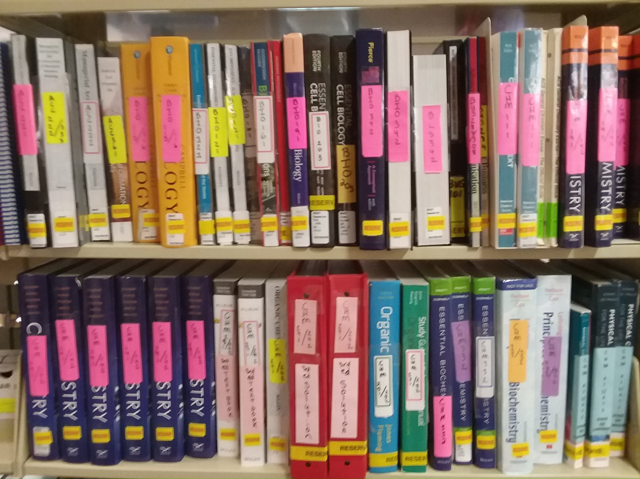

Taking Action to Contain College Expenses: Cultivating a Collection of Textbooks for High Use Classes
Challenge: The College Board estimated that the cost of textbooks per student per year was nearly $1,200. According to a 2014 national study, 65 percent of students have opted not to buy a textbook during their academic career because of cost.
Response: The Libraries made fundraising for Textbooks on Reserve a priority, both when working with donors and when working on Miami Move-in Day, when University Staff assist first-year students and their parents with moving into dormitories and receive donations in exchange for their services.
These efforts are raising thousands of dollars annually. In Fall 2018, the Libraries once again began to purchase textbooks for classes in which all sections were not using a common set of textbooks
Launch and Growth: The Libraries purchased copies of textbooks initially for the top-25 enrolled courses, then expanded to the top 50. The number of copies depended on the size of the class.
Initially, the collection was based at Miami’s central facility, King Library, which is open 24/7. Eventually, a second copy of books covering Business, Engineering and the Sciences were added in the Business, Engineering, Science and Technology (BEST) Library.
Annual checkouts quickly grew to 8,000 – 10,000 checkouts.
Crisis: The funds from which Textbooks on Reserve were funded ran out in 2016. New restrictions on purchasing:
No more than 1 copy of book per library, regardless of class size.
No books for classes in which all sections were not using a common set of textbooks.
Checkouts of textbooks plunged rapidly in the following years, sinking to less than 4,000 annually.
Response: Textbooks on Reserve began over 10 years ago in support of past President Hodge's initiative to support students from disadvantaged groups.
Initial Funding: Initially, funding came from the Associated Student Government, the Parents’ Fund, and the Libraries. After helping to launch the program, ASG and the Parents’ Fund moved on to other projects. The Libraries thereafter used their own funding, which became exhausted in 2016.
Maintenance: Books are normally removed from the collection as they are superceded by a new edition; however, the at the discretion of the Reserves supervisor, 1-2 older editions may be retained if the item has enjoyed high use.
Selectors view removed items to determine if the items should be added to the collection and receive a full catalog record, or should be discarded.
Rob Withers
Coordinator, Access Services
witherre@miamioh.edu

