Slide 1
Keeping up with Free-Range Internet Tools
Mark Shores
Miami University Hamilton
AA Highway Library Staff Conference
May 18, 2012

Slide 2
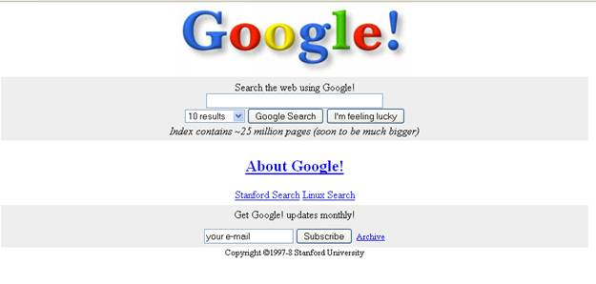
Back in the day…

Slide 3
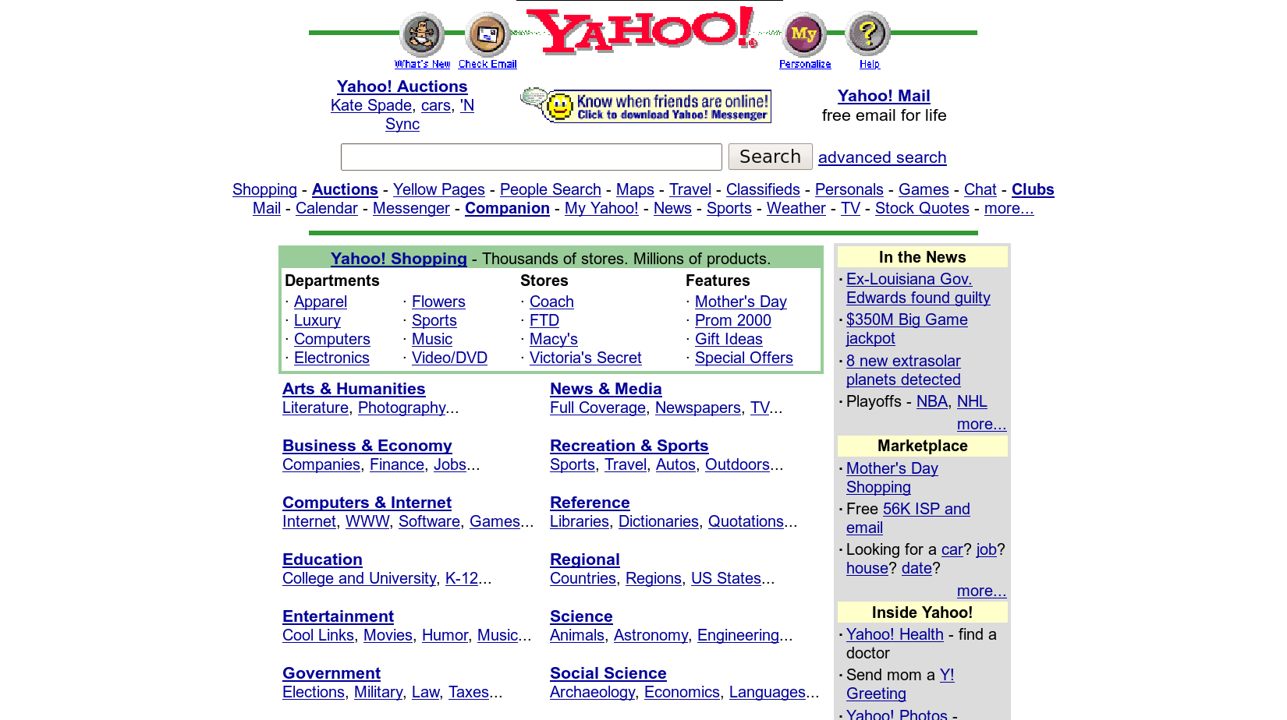
Yahoo, then….

Slide 4
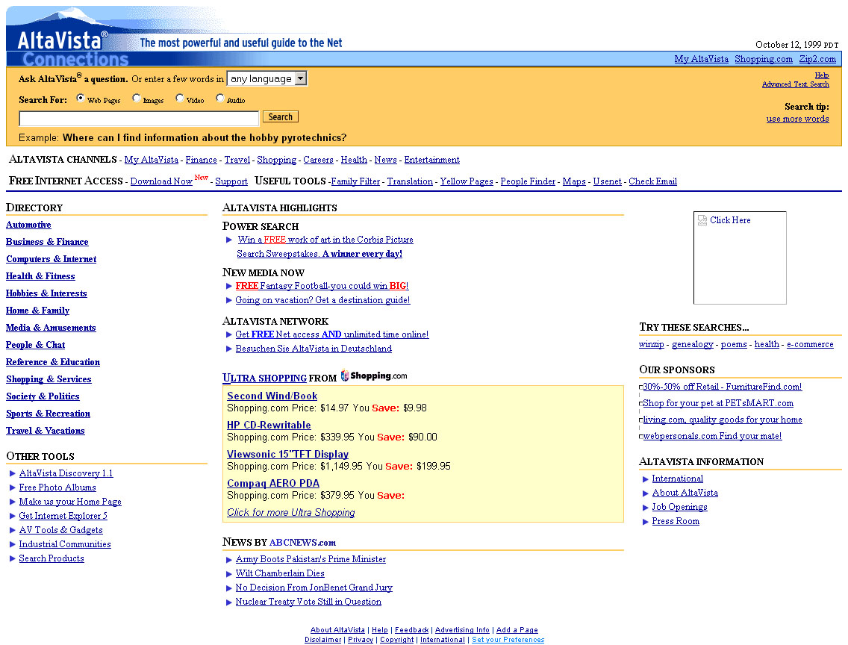
In memoriam….

Slide 5
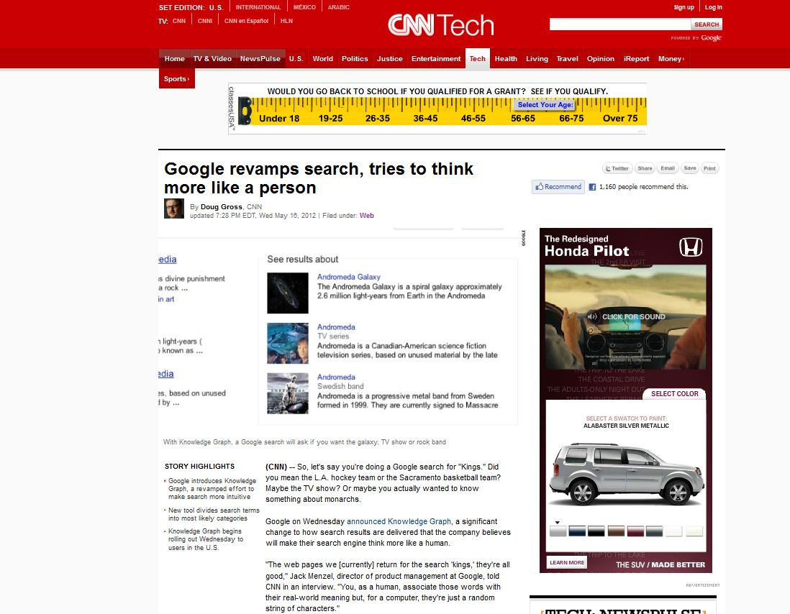
And now…

Slide 6
3 things….
Why are you here?
Content
Tools
What else?

Slide 7
Content – Magazines, Journals, etc.
MagPortal.com
FindArticles.com
LISA (Library and Information Science Abstracts)
Project Gutenberg
Directory of Open Access Journals

Slide 8
Content - Reference
Bartleby.com
Nationmaster.com
Encyclopedia.com
Archive.org
Stanford Encyclopedia of Philosophy
AcronymFinder.com
Timeline of Art History
ODLIS (Online Dictionary of Library & Information Science)
Encyclopedia of Life

Slide 9
Tools for Creating Bibliographies
EasyBib
Bibme.org
Zotero Standalone
Noodlebib
Son of Citation Machine

Slide 10
More Tools
Delicious.com
Ikeepbookmarks.com
Yahoo and Google “Shortcuts”
URL shorteners – Bit.ly and TinyURL.com
Evernote.com
Dropbox.com

Slide 11
How to stay current
Internet Public Library
Infomine
Resource Shelf newsletter by Gary Price
Internet Scout Report

Slide 12
Anything I’ve missed?
Thanks!

