Slide 1
Deciding, Documenting, and Disseminating Library Policies & Practices:
A Case Study from a Newly-Created Unit

Slide 2

Background: About Miami University
Notes:
Miami university is a state affiliated institution with selective admissions and an undergraduate emphasis. It enrolls just over 17,000 undergraduates and 2,000 graduate students. The most important thing to know about Miami for today’s conference-goers: it is not in sunny Florida, but in wintery and blustery Ohio, where it was founded before Florida became a state.

Slide 3
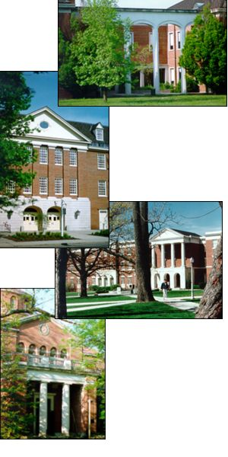
Background: About the Libraries
4 locations
5 circulation points
22 staff
Circ points provide tier 1 research help
Main location = 24/7
Notes:
The Libraries have four locations which house 5 circulation points. In 2018, responsibility for Tier 1 research assistance shifted to circulation points in the two larger libraries. The main facility maintains 24/7 hours during the academic year (excluding holidays and breaks).

Slide 4
Documentation helps . . .
Help compare/contrast practices to facilitate standardization
Identify opportunities to adopt/adapt practices from one site to another
Ensure continuity of knowledge and practices in times of change
Notes:
Documentation can be helpful. But if it’s so helpful, why was it so hard to do?

Slide 5
Challenge: Multiple Reporting Lines
Assistant Dean,
Access & Assessment
Assistant Dean,
Public Services
Art Library
BEST Library
Main Circulation + Document Delivery
Music Library
Notes:
One of the primary challenges to gathering, documenting, and negotiating conflicting practices was organizational: The Libraries experimented with a variety of reporting lines which included circulation operations, but only in 2018 were all operations consolidated into a single department. Sometimes, the circulation units reported to different assistant deans. During these phases, circulation supervisors from the branches met together.

Slide 6
Challenge: Multiple Reporting Lines
Assistant Dean,
Access & Assessment
Head, BEST Library
Art Library
BEST Library
Main Circulation + Document Delivery
Music Library
Notes:
Sometimes, the lines reported to the same Assistant Dean, but different Department Heads

Slide 7
Challenge: Multiple Reporting Lines
Assistant Dean,
Access & Assessment
Art Library
BEST Library
Main Circulation + Document Delivery
Music Library

Slide 8
Challenge: Multiple Reporting Lines
Head, Access & Borrow +Management Team
Art Circulation
Main Circulation + Document Delivery
BEST Circulation
Music Circulation
Notes:
With a reorganization in 2018, Circulation units were combined into the Access & Borrow department, together with the former Technical Services department. The Technical Services unit had compiled a detailed set of policies and procedures, but at that time, there was no shared resource for circulation units.

Slide 9

Different Practices
Notes:
Some differences in procedures have evolved at separate physical library locations. Examples:
One location would not check out study room keys to a group unless the person who made the reservation was present… and made people leave the rooms 30 minutes before closings. The other two locations with study rooms didn’t.
Closing announcements varied depending on the type (if any) of a public address system.

Slide 10
Challenge: Staff Turnover
BEST Manager
Overnight Supervisor III
Evening Music Supervisor
Overnight Supervisor I
Research Assistance Manager
Evening Music Supervisor
Overnight Supervisor II
Evening ArtArch Supervisor
Evening Main Supervisor
Notes:
Frequent staff turnover is a challenge both to gathering existing practices and to training. In the first 20 months of the Access & Borrow department, there were more than one dozen vacancies. In many cases, we retain people who move to more favorable schedules, but the challenge of documenting and training persists.

Slide 11

Notes:
There are good, solid reasons for promoting standardization of certain practices across service points. These include (but are not limited to):
Staffing levels necessitate increasing the number of staff who regularly work at more than one site--it’s not fair to them (and will burn them out faster) if everything changes at every site
Different practices with respect to materials/services offered at multiple service points can confuse patrons - such as different technology checkout periods, one site allowing certain items to go out of the building while other sites require on-premises use only

Slide 12

Identifying the Right Tool (aka “Selecting a Platform”)
Notes:
We were looking for something already in use. Options: Google Docs, LibGuides / Libanswers, Canvas, PBWorks
Why a wiki?
Consistent with tech services unit documentation of practices and policies.
Allows for variable levels of permissions on documents
Allows for backups
Allows notification of edits and tracking of edits
We are using LibGuides in Access and Borrow for statistical data shared outside the unit; we are using Canvas for student training

Slide 13
Populating the wiki: Phase I
Incorporating (or dismantling) pre-existing documentation
Discussion, debate, compromise
External documentation
Notes:
This is the low-hanging fruit – easy to quickly assemble:
Each site had their own practices and their own ways of disseminating that information to staff, in some cases including physical binders of procedures. Creating new uniform standards necessitated interpolating or getting rid of the old records. (Print gets out of date quickly, gets lost, tied to a physical space)
Lots of discussion / debate (student employee attendance expectations, dress code)
Consider linking to external documentation (policies from parent institution, user guides for software, etc.); no need to reinvent
Consider revising to maintain a consistent voice

Slide 14

Breaking Down Silos
Notes:
Breaking down silos can be a challenge. When dissent or differences arise, the decision-making body consists of managers of the various circ points. We have tried to “break down silos” and get people to think beyond the needs just of their service point by:
Having managers regularly work the circ desk at another facility for one semester
Regularly scheduling staff who would be backups for branches to work regularly scheduled shifts in that branch
Creating floating positions, with regular shifts in more than one branch

Slide 15
Populating the wiki: Phase II
Tasks done by 2 or fewer positions
Task falls to those with primary responsibility if possible.
Consider job shadowing for those uncomfortable with writing
Priority to those without backups
Notes:
This was what most concerned us, because of lack of backup:
Document the tasks done by the fewest number of individuals first
Tasks should be documented by those who do it; boots-on-the-ground perspective essential for “how tos”; more buy-in when you help create
If staff are uncomfortable, use job-shadowing
Consider revising to maintain a consistent voice

Slide 16
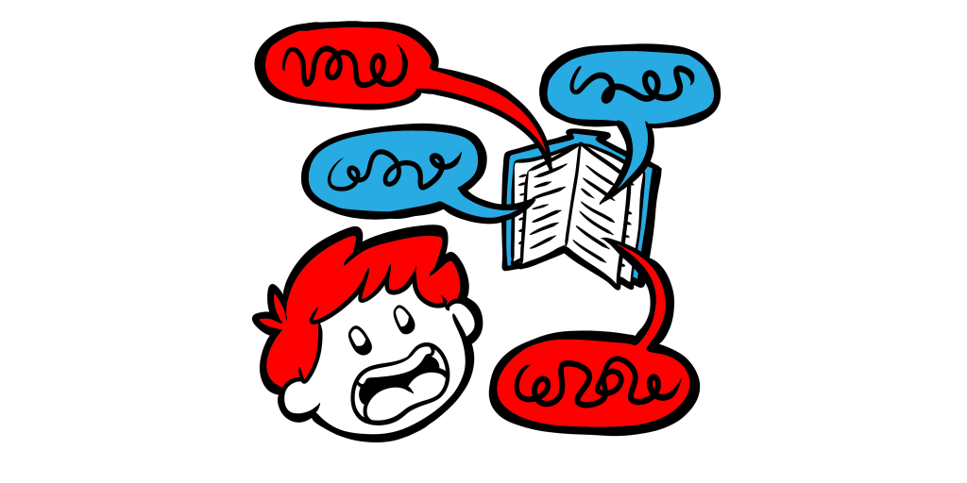
The dangers of too much detail
Notes:
Tempting to document every possible eventuality in excruciating detail, but users get lost.
Built for scanning, not reading, and for practical use, not a legal document.
Focus in on essentials and likely scenarios with perhaps links to additional pages.
Important to find balance so as to account for multiple possibilities without overwhelming.
Examples: what to do in facility emergencies (need quick answers); how to process on-the-fly records for reserves (need detail, step by step, but recording every possible scenario would be too dense)

Slide 17

Editing and ongoing maintenance
Notes:
Compiling a set of documentation isn’t worthwhile unless it undergoes review, expands to include new processes, and undergoes periodic backups. These small investments of time can reap huge dividends.
Review of procesess shared by 2 or fewer people: Each summer, by people who created documentation
Review of circulation desk procedures: Each summer, by staff in meeting; follow-up with Circ managers if needed.

Slide 18
Benefits
Standardization of procedures
Ability to seamlessly move staff to different locations
Ability to train and update staff outside business hours

Slide 19

Notes:
ALEA
How do we promote standardization while also supporting site individuality?

Slide 20






Further Information
Rob Withers
Coordinator, Access Services
witherre@miamioh.edu

Slide 21

Notes:
ALEA
Different service points (libraries) have different customer bases and resources.
We want to embrace/maintain what makes them unique -- but at the same time . . .
We identified positions likely to be back-up at branches and gave them weekly shifts there. This allowed us to identify idiosyncracies and to more effectively negotiating.

Slide 22

Notes:
ALEA
Documentation can also be key in a time of high personnel change

Slide 23

Notes:
ALEA
One tactic -- promoting transparency through documentation. [in this case: creation of a shared wiki]. This serves multiple purposes -- it allows for information gathering (what are we doing?), comparison (hmm, you’re doing it a little bit differently or a lot), and either affirmation of different practices (ah, that’s why you do X differently, that makes sense) or identification of areas to standardize (huh, these could cause confusion, we’d better pick one practice)

