Slide 1
Default Report
Multiple Monitors : CSE Miami University
August 14th 2017, 1:07 pm MDT

Slide 2
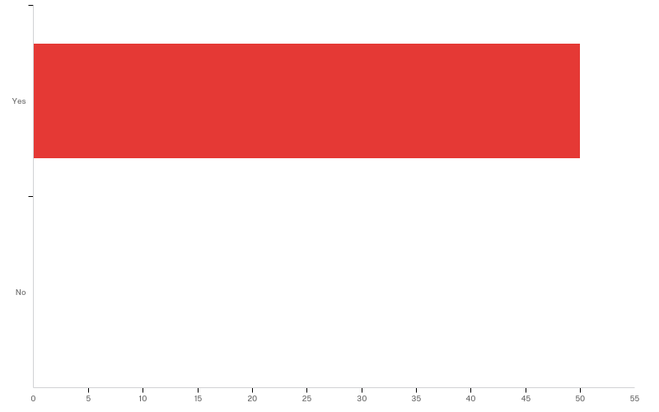
Q1.1 - The purpose of this research is to examine the impact of students using multiple monitors in labs in order to learn introduction programming. Completing the survey should take about 5-10 minutes.
This study is being conducted by researchers from the Computer Science and Software Engineering Department at Miami University. Invitations to complete this online survey will be sent to about 150 students. Participation in this research is restricted to persons 18 years of age or older.
Your participation is voluntary, you may skip questions you do not want to answer, and you may stop at any time. The survey does not request information that would explicitly identify you. If you inadvertently include identifying information, such information will be removed from stored data. Only the researchers will have access to individual responses. Results of the survey will only be presented publicly as aggregate summaries. If you have any questions about this research or you feel you need more information to complete this survey or you would like to receive a report of the general results of this project please send an email to Dr. Matthew Stephan at matthew.stephan@miamioh.edu , unless you have already done so.
If you have questions or concerns about the rights of research subjects, you may contact our reviewing body: the Research Ethics and Integrity Office at Miami University at (513) 529-3600 or humansubjects@miamioh.edu.
‐‐‐‐ Thank you for your participation. Dr. Matthew Stephan
If you agree, please select "Yes". Otherwise, you may click "No" or close the page.

Slide 3
Q1.1 - The purpose of this research is to examine the impact of students using multiple monitors in labs in order to learn introduction programming. Completing the survey should take about 5-10 minutes.
This study is being conducted by researchers from the Computer Science and Software Engineering Department at Miami University. Invitations to complete this online survey will be sent to about 150 students. Participation in this research is restricted to persons 18 years of age or older.
Your participation is voluntary, you may skip questions you do not want to answer, and you may stop at any time. The survey does not request information that would explicitly identify you. If you inadvertently include identifying information, such information will be removed from stored data. Only the researchers will have access to individual responses. Results of the survey will only be presented publicly as aggregate summaries. If you have any questions about this research or you feel you need more information to complete this survey or you would like to receive a report of the general results of this project please send an email to Dr. Matthew Stephan at matthew.stephan@miamioh.edu , unless you have already done so.
If you have questions or concerns about the rights of research subjects, you may contact our reviewing body: the Research Ethics and Integrity Office at Miami University at (513) 529-3600 or humansubjects@miamioh.edu.
‐‐‐‐ Thank you for your participation. Dr. Matthew Stephan
If you agree, please select "Yes". Otherwise, you may click "No" or close the page.
# | Answer | % | Count
1 | Yes | 100.00% | 50
2 | No | 0.00% | 0
 | Total | 100% | 50

Slide 4
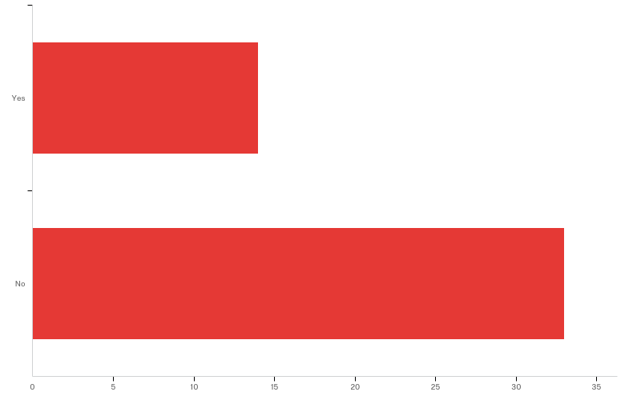
Q2.1 - Was this your first time using multiple monitors?

Slide 5
Q2.1 - Was this your first time using multiple monitors?
# | Answer | % | Count
1 | Yes | 29.79% | 14
2 | No | 70.21% | 33
 | Total | 100% | 47

Slide 6
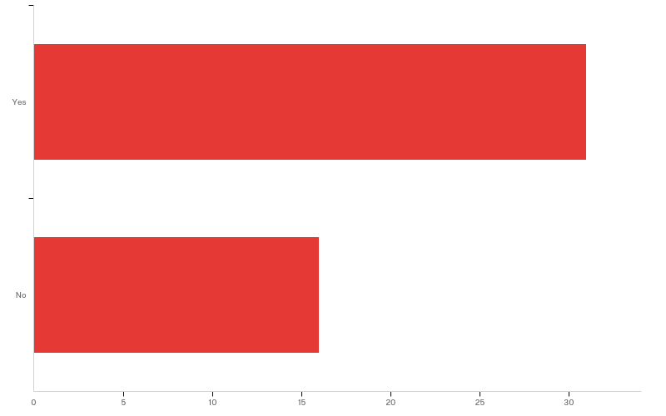
Q2.2 - Was this your first time using multiple monitors for programming?

Slide 7
Q2.2 - Was this your first time using multiple monitors for programming?
# | Answer | % | Count
1 | Yes | 65.96% | 31
2 | No | 34.04% | 16
 | Total | 100% | 47

Slide 8
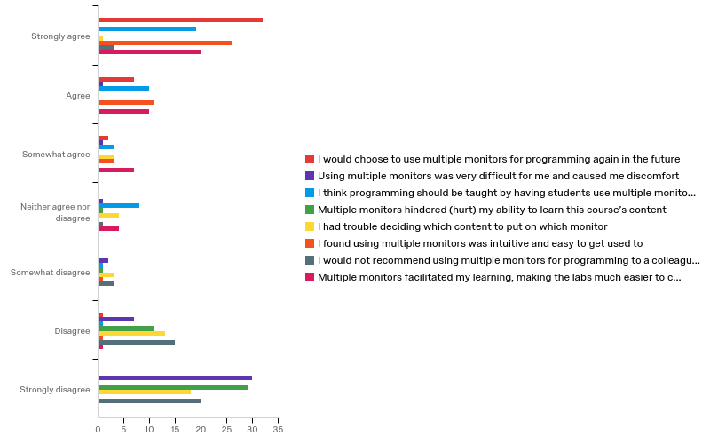
Q3.1 - Please indicate how much you agree (left) or disagree (right) with the following statements

Slide 9
Q3.1 - Please indicate how much you agree (left) or disagree (right) with the following statements
# | Question | Strongly agree |  | Agree |  | Somewhat agree |  | Neither agree nor disagree |  | Somewhat disagree |  | Disagree |  | Strongly disagree
1 | I would choose to use multiple monitors for programming again in the future | 31.68% | 32 | 17.95% | 7 | 10.53% | 2 | 0.00% | 0 | 0.00% | 0 | 2.00% | 1 | 0.00% | 0
2 | Using multiple monitors was very difficult for me and caused me discomfort | 0.00% | 0 | 2.56% | 1 | 5.26% | 1 | 5.26% | 1 | 18.18% | 2 | 14.00% | 7 | 30.93% | 30
3 | I think programming should be taught by having students use multiple monitors | 18.81% | 19 | 25.64% | 10 | 15.79% | 3 | 42.11% | 8 | 9.09% | 1 | 2.00% | 1 | 0.00% | 0

Slide 10
Q3.1 - Please indicate how much you agree (left) or disagree (right) with the following statements
# | Question | Strongly agree |  | Agree |  | Somewhat agree |  | Neither agree nor disagree |  | Somewhat disagree |  | Disagree |  | Strongly disagree
4 | Multiple monitors hindered (hurt) my ability to learn this course’s content | 0.00% | 0 | 0.00% | 0 | 0.00% | 0 | 5.26% | 1 | 9.09% | 1 | 22.00% | 11 | 29.90% | 29
5 | I had trouble deciding which content to put on which monitor | 0.99% | 1 | 0.00% | 0 | 15.79% | 3 | 21.05% | 4 | 27.27% | 3 | 26.00% | 13 | 18.56% | 18
6 | I found using multiple monitors was intuitive and easy to get used to | 25.74% | 26 | 28.21% | 11 | 15.79% | 3 | 0.00% | 0 | 9.09% | 1 | 2.00% | 1 | 0.00% | 0

Slide 11
Q3.1 - Please indicate how much you agree (left) or disagree (right) with the following statements
# | Question | Strongly agree |  | Agree |  | Somewhat agree |  | Neither agree nor disagree |  | Somewhat disagree |  | Disagree |  | Strongly disagree
7 | I would not recommend using multiple monitors for programming to a colleague/peer | 2.97% | 3 | 0.00% | 0 | 0.00% | 0 | 5.26% | 1 | 27.27% | 3 | 30.00% | 15 | 20.62% | 20
8 | Multiple monitors facilitated my learning, making the labs much easier to complete | 19.80% | 20 | 25.64% | 10 | 36.84% | 7 | 21.05% | 4 | 0.00% | 0 | 2.00% | 1 | 0.00% | 0
 | Total | Total | 101 | Total | 39 | Total | 19 | Total | 19 | Total | 11 | Total | 50 | Total | 97

Slide 12
Q4.1 - List out and describe any/all the ways in which you used the multiple monitors? What content did you have on each monitor?
List out and describe any/all the ways in which you used the multiple monit...
On the left monitor i had eclipse open and on the right i had the assignment, lecture slides or stackoverflow open.
I would have the lab requirements and/or lecture notes on one screen and then be programming on the other
I had the assignment details on one monitor, while using the other monitor to work on the assignment.
I had Eclipse open on one screen and Google Chrome open on the other. I switched between the lab requirements and StackOverflow on the Chrome tab.
Have the assignment on one monitor and Eclipse on the other
I put Eclipse (where I code) on one monitor and the requirement of the lab on the other monitor
Eclipse on one monitor and lab requirements and lecture slides on the other.
Almost always the code I was writing was on one screen, usually the right. The other screen either had the API, the PDF fir the assignment, or just any other helpful information/material. Sometimes I even had previously created code I wrote from other assignments or that we had from class lecture.

Slide 13
Q4.1 - List out and describe any/all the ways in which you used the multiple monitors? What content did you have on each monitor?
List out and describe any/all the ways in which you used the multiple monit...
I would keep the PDF of my lab on the left monitor and have eclipse open in the right monitor. If I had to look anything up I did it on the left monitor.
For the most part, I put the assignment on the left monitor to refer to, and actually coded on the right monitor.
I had Eclipse in the left monitor and the assignment requirements in the right monitor.
I was able to have Eclipse open on one monitor and the lab instructions or anything necessary that I needed to see such as notes on the other monitor. This allowed for me to easily look back and forth and get the information I needed in a fast notion.
I put my actual coding on one monitor and the lab description and my web browser on another.
I would have eclipse on one and any other stuff on the other
Had the lab instructions on one screen and eclipse on the other
On one monitor, you could have eclipse running while on the other have the PDF with the requirements of the lab. It let you code while periodically glancing over at the actual lab.

Slide 14
Q4.1 - List out and describe any/all the ways in which you used the multiple monitors? What content did you have on each monitor?
List out and describe any/all the ways in which you used the multiple monit...
I would have the two lectures from the week on one monitor and the lab instructions and lab discussion up on the other monitor and then I actually programmed on eclipse on my laptop.
The monitor that was positioned to face directly at me I used to contain the Eclipse window and to do the actual coding in. The other monitor, the one that was tilted more towards its side, held lecture slides, additional internet windows, and anything else that was deemed as helpful towards my coding.
It was really helpful to have Eclipse pulled up on one of the monitors and Google Chrome pulled up on the other one. On Chrome, I had the lab pulled up for the most part. When I experienced a problem coding, it was nice to be able to go to stack overflow to receive help while also having my program pulled up at the same time.
I put lab instructions and power points from class on the left monitor and eclipse on the right monitor.
On one monitor I would have my eclipse software and the other I would have the lab requirements or even the lecture slides.
The requirements/coding examples on one side and eclipse on the other

Slide 15
Q4.1 - List out and describe any/all the ways in which you used the multiple monitors? What content did you have on each monitor?
List out and describe any/all the ways in which you used the multiple monit...
I would always go out of my way to put myself in a situation where I have multiple screens for programming, whether it be my laptop and a computer, or my iPad, everything is much easier with two screens. You can place the outline for the lab on one monitor with the compiler on the other. You can also place other resources such as the textbook on a separate monitor from your compiler.
I generally used the left monitor for multiple resources like design documents and java docs. I used the right monitor for code exclusively.
I would have the lab assignment on the right monitor and then lecture notes on the left. I also unnecessarily brought me laptop and would program on my laptop and use the monitors as aids.
instruction on left screen and program on right screen, this help me program while watch the rules and the requirement.
I had project requirements on one monitor and the project on another. Or I had two different classes on each monitor. This helped.
I had a web browser to access previous lectures and posted example code on one monitor, and on the other monitor I had Eclipse opened

Slide 16
Q4.1 - List out and describe any/all the ways in which you used the multiple monitors? What content did you have on each monitor?
List out and describe any/all the ways in which you used the multiple monit...
Typically I would have my IDE on one monitor, and on the other monitor I would rotate between the programming language API on the internet and the lab requirements handout.
I would have the assignment or a reference on one monitor and eclipse on the other.
I'd put eclipse on one, and other resources on the other. I could put the lecture notes or other research on the other screen. It was very useful and much easier than switching back and forth.
I would usually have eclipse open on one monitor and have the lab requirements and notes on the other monitor.
When I used multiple monitors for programming, I usually have the instructions for the lab/project, as well as the internet, on one screen, and my IDE on the other.
Eclipse on one. Lab instructions on the other
The prompt was split along with helper material on the left monitor and my code was on the right monitor.
Normally, I would have my IDE open all the time on one screen and use the other screen to go through the assignment and look up resources to help write the code so I could write and look at useful information at the same time.

Slide 17
Q4.1 - List out and describe any/all the ways in which you used the multiple monitors? What content did you have on each monitor?
List out and describe any/all the ways in which you used the multiple monit...
I would put the instructions or helpful websites on one monitor and I would code on eclipse on the other monitor.
On one monitor I usually had program specifications and anything I was searching online (such as API documents), and the other monitor almost always was the eclipse window of the code I was working on
Browser on left monitor, with assignment/requirements open. Code on right monitor
I like to have the right-side monitor dedicated entirely to the Eclipse window. On the left I have all my browser windows and the Lab requirements pdf

Slide 18
Q4.2 - Describe ways in which you found multiple monitors assisted your learning?
Describe ways in which you found multiple monitors assisted your learning?
I didnt have to alt tap to look something up and im used to having more than one monitor
Able to read the requirements more thoroughly and be able to easily reference back to lecture notes to review material. Allowed for a less stressful process of flipping between pages.
I could easily refer to assignment guidelines or class notes on one monitor without losing sight of my code.
It didn't really help with learning. It's just a convenience not having to switch programs or have smaller versions of them setup next to each other.
Was able to keep focus much easier by not needing to tab through multiple windows constantly
I can look at different site on the computer at the same time, which is really convenient
Didn't have to minimize windows constatantly, which let me concentrate on the actual work.
Being able to have code on one screen and info on another screen. Like being able to easily learn how to use some code that is new to me and simultaneously implementing it in my program with switching windows like I would with one screen.

Slide 19
Q4.2 - Describe ways in which you found multiple monitors assisted your learning?
Describe ways in which you found multiple monitors assisted your learning?
It helped me to complete my labs quicker and more efficiently and helped me with the content of my programs because I was able to see the requirements as I did the lab.
I thought it was easier just because I didn't have to keep switching between applications to check the assignment and then going back to the program.
More information was able to be displayed at any one time, allowing for me to quickly look back and forth between my program and notes.
Everything isn't so cluttered onto one screen and you don't have to switch back and forth between each window you're using, everything is just laid out for you.
Efficient in getting my work done
Able to look up help while looking at code simultaneously
Learning something is easier when you can do it faster. Multiple monitors decreases the amount of time it takes to code by not having to switch between multiple screens. Also, you can have a tutorial up on one screen walking you through a specific idea and be trying it on your own at the same time.
It cut out the time spent between finding different windows and having everything all jumbled up and hard to find

Slide 20
Q4.2 - Describe ways in which you found multiple monitors assisted your learning?
Describe ways in which you found multiple monitors assisted your learning?
Multiple monitors allowed me to better organize my window and center my focus when coding. When I had a single window on one of the monitors dedicated to holding the entire Eclipse application, it allowed me to keep my focus on that single task and my attention was less likely to stray. It also provided me with a quicker method of finding necessary tabs/windows when looking for resources to help me code because I could simply turn my head and it was all there, just on a separate monitor. Rather than sift through endless tabs with the Eclipse window crowded on one side of my laptop's screen, which proved to be an overwhelming work environment, the multiple monitors spaced everything out and provided a clean and easy to navigate interface.
It saved me so much time! When I program on my laptop, I have to keep switching back and forth between Chrome and Eclipse. The double monitors are nice to have to be able to problem solve easier and more effectively.
The screen wasn't as cluttered and it made it easier to navigate between different pages.
I was more likely to frequently look at the directions for the labs more often because it took less effort. I was also more will to consult resource material.
Accelerated programming process

Slide 21
Q4.2 - Describe ways in which you found multiple monitors assisted your learning?
Describe ways in which you found multiple monitors assisted your learning?
In every way.
Being able to glance back and forth between code and documents was incredibly helpful, as compared to only being able to view one at a time.
I was able to look at multiple things at once, helping me better understand concepts and more efficiently look up notes or questions.
It's more efficient when you want to check some codes or api because you don't need to hide your own code and also you can compare your code with the solution founded online.
It allowed me to more easily use sources to complete my work and allowed me work more quickly in general.
It made going from reference (lecture material or posted codes) to programming much easier.
It made it easier to reference information that was immediately relevant when writing code. For instance, using two monitors allowed me to write a method or constructor directly from the API without needing to toggle back and forth between windows if I forgot small details which reduced the mental energy I needed to spend on minutiae. I believe this ultimately helped me retain more of the information and lessons learned from a lab session than when I used one monitor.

Slide 22
Q4.2 - Describe ways in which you found multiple monitors assisted your learning?
Describe ways in which you found multiple monitors assisted your learning?
I found that I did not have to switch between references or my assignment and eclipse all the time, making the assignment much easier to complete.
It made the process of researching and implementing your research much more efficient. It allowed me to look at my code on one screen, and look at research on the other to see what exactly I'm doing wrong and how to fix it.
By having one monitor with eclipse and one with the lab requirements and notes, I could easily make sure I followed all of the directions without flipping between my work and the requirements.
Multiple monitors seems to simplify my workflow in a way because I do not have to spend time clicking back and forth between webpages, documents, or IDEs.
Meant that you didn't have to keep switching windows
It allowed me to view multiple material conveniently.
I was able to read class notes and other resources while writing code simultaneously. This was especially helpful for me because I am a very visual learner. It also helped organize my work space, which made it easier to focus on coding instead of managing all the information on my desktop.

Slide 23
Q4.2 - Describe ways in which you found multiple monitors assisted your learning?
Describe ways in which you found multiple monitors assisted your learning?
It was quicker- I didn't have to switch back and forth. Less room for error that way.
It's much easier to have everything in front of you (where it's also large enough to see) than flipping back and forth between multiple tabs trying to figure out where certain applications are
easier to take in more information at once
Being able to cross reference between multiple documents at once saves a ton of time and frustration. It's annoying to have to memorize something while you switch to a new window. Having both right there in front of me makes a big difference in the speed I am able to work as well as my enjoyment

Slide 24
Q4.3 - Which aspects of using multiple monitors did you find challenging? Did they hinder your learning in any way?
Which aspects of using multiple monitors did you find challenging?
I didnt find anything hindering me.
None.
No
When I sat at a different computer I had to switch around which one I wanted as my main display and whether it was extended or copy ever now and again, but other than that I had no trouble using them.
Finding the correct setup for what window should be on what screen
Not at all
Nope
None actually.
They did not hinder my learning, I did not find using multiple monitors challenging.
Did not hinder at all.

Slide 25
Q4.3 - Which aspects of using multiple monitors did you find challenging? Did they hinder your learning in any way?
Which aspects of using multiple monitors did you find challenging?
None, no.
The only thing I had to pick up on was if i wanted to switch from window to window I have to actually click on the window I want to work on to edit it.
The only time there was a problem is when you turned the computer on and for some reason it swapped which was which so that you had to go off the left screen on the left side to get to the screen on the right. This was easily fixed by 'turning it off and back on again'.
Nothing about using multiple monitors was challenging
It was a bit overwhelming and often times I chose to simply use my own laptop in class. Not because the multiple monitors were in anyway disadvantageous towards my coding, but because I found it easier to access whatever work I had completed during the allotted lab time if I'd started it on my own laptop. Often time I would forget to send my own work to myself at the end of the lab period and would have to come back at random hours to access the network.
They didn't hinder my learning in any way!
I didn't think any part was challenging and do not think it hindered my learning at all.

Slide 26
Q4.3 - Which aspects of using multiple monitors did you find challenging? Did they hinder your learning in any way?
Which aspects of using multiple monitors did you find challenging?
Nothing.
None
No challenges. Very simple stuff.
Multiple monitors on the Mac OSX operating system function differently than multiple monitors on a windows system. Tool bars and such migrate in counter-intuitive ways.
I didn't find them hindering at all.
May be some people will feel uncomfortable at the first, but when I used to it multiple is very useful and comforter than only one screen.
I didn't. And no.
It was somewhat annoying moving windows between monitors (sometimes windows would open on a monitor that I didn't want it to open on), but it didn't hinder my learning.
There was nothing challenging about using two monitors.
I did not find using multiple monitors challenging at all. I did not think that they hindered my learning.

Slide 27
Q4.3 - Which aspects of using multiple monitors did you find challenging? Did they hinder your learning in any way?
Which aspects of using multiple monitors did you find challenging?
This made nothing more challenging. I think it was a great addition.
I did not find the monitors challenging to use.
No
They did not.
I do not feel they hindered my learning any way. It made my experience much easier.
None
Sometimes applications open up on a different monitor than the one I clicked on, but all I had to do was drag it to the other side
Full screen on OSX is a little weird, but nothing too bad. Did not hinder my learning in any way.
Honestly I didn't think it was challenging at all. I have no negative comments about using multiple monitors.

Slide 28
Q4.4 - What other comments, observations, or conclusions do you have?
What other comments, observations, or conclusions do you have?
I have been using multiple monitors for years now. I have one as my main monitor and the other as a notification/google monitor. I have also occasionaly hooked up a third monitor as well, though only when i have streamed because I turn to look at 6-7 different windows while gaming. People will be more or less productive based on how they use them. If they use the second monitor to browse social media or watch videos their production will decline. I find that with my own computer 90% of the time i will be looking and paying attetion to my main monitor only looking occasionally to the others. The second monitor drastically reduces the time spent checking a message or changing a spotify station. I belive that some people will have trouble if they try to split there attention 50/50. When its 50/50 they are not fully engaged on their one task. Multiple monitors dont allow for multiitasking but they do allow for decreased time spent on things outside of a task. The effectivness of multiple monitors depends on the person. I am personally for multiple monitors but I belive that there would be some people that use the secondary monitor for distracting things that causes reduced productivity. As long as you continue to monitor the situation I would think that in a lab setting people wil do more work. The issue only occurs when people are not interested in the task they are doing. That is also why alot of studies have different results, depending on the workplace. TL;DR I like them but be cautious as people are affected differently.
I think they're nice, but not a necessity. Personally I like to use my own personal computer to complete projects so I only used them when I was forced to be in the room for a lab.

Slide 29
Q4.4 - What other comments, observations, or conclusions do you have?
What other comments, observations, or conclusions do you have?
Multiple monitors is great, would recommend it to everyone
None
Multiple screens in itself is great but the way the screens are set up in room 10 are perfect. Both facing inwards at an angle, so there was no awkward position I had to sit at.
None
Although I found it useful, towards the end of the semester I used my laptop because it was easier to keep track of my program.
This isn't so much as a "multiple monitors" issue but a hardware issue: I know the reason many of my classmates and I were dissuaded from using the multiple monitors was because, over time, we'd come to learn the hard way that many of the computers would slow down, freeze, and then crash when we would compile and run our codes. Many times this resulted in the loss of work (because we'd forgotten to save before it crashed) and much frustration, and eventually, we just began bringing our own laptops to class. I don't know if this an issue that concerns you guys, but an issue worth noting nonetheless.
Double monitors are the way to go! It makes life easier for the student.

Slide 30
Q4.4 - What other comments, observations, or conclusions do you have?
What other comments, observations, or conclusions do you have?
No down side
Thank you for getting this going. I would love for more multiple monitor stations in Benton, or increased availability of the lab with them so I can use them outside of class.
Sometimes I would type in the wrong keyboard lol
multiple monitors is good, but if the total area of screen is same as only one screen than it's becomes not to effective. Because the larger size single screen can have nearly same function as multiple monitor did. So it's better to have larger size multiple monitor.
They're great. It's how the real world codes.
I've only briefly used multiple monitors before, but it felt really nice for workflow. It instantly felt like I had more real estate to work with, and I never felt crowded or confused navigating between different windows (sometimes on a single monitor it can feel cramped or confusing when there are many windows open)
Using two monitors was a major improvement to the lab experience -- dual monitors made it easier to program and follow instructions / reference programming resources as well as complete the labs in less time. As a result, it also made the labs more enjoyable.

Slide 31
Q4.4 - What other comments, observations, or conclusions do you have?
What other comments, observations, or conclusions do you have?
I thought it was a wise decision to have multiple monitors, and most other colleges I visited prior to coming to Miami also had multiple monitors.
I use two monitors for my setup, and the only qualm I have is that I don't have 3.
Overall, I liked the addition of the multiple monitors.
I found myself primarily using my laptop, even when multiple monitors were available, simply because it made taking my work on the go significantly easier. For the CSE 271 labs, I generally like to start the lab in class on my computer and then simply take it with me to make working outside of class/lab much easier.
I liked the dual monitors.
Having multiple monitors greatly impacted the easiness of working on labs during class
I really loved having multiple monitors in lab, as that is what I prefer for programming in general.
It's a no-brainer for me... use multiple monitors when they are available. I would love to have multiple monitors for when I do CAD work.

Slide 32

Q4.3 - Topics

Slide 33
Q4.3 - Topics
Answer | % | Count
Total | 100% | 0

