Slide 1
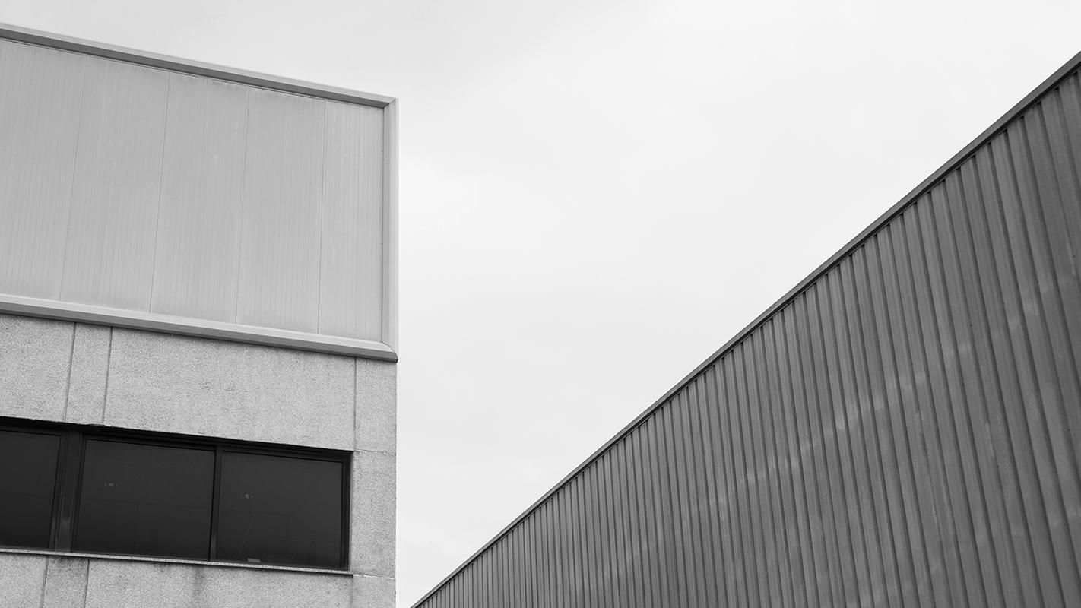
building with the
bauhaus
Integrating art and maker education
Stefanie Hilles
Arts & Humanities Librarian
Sarah Nagle
Creation & Innovation Services Librarian
Miami University

Slide 2
Kandinsky Ice-Breaker!

Slide 3
a brief introduction to the bauhaus

Slide 4
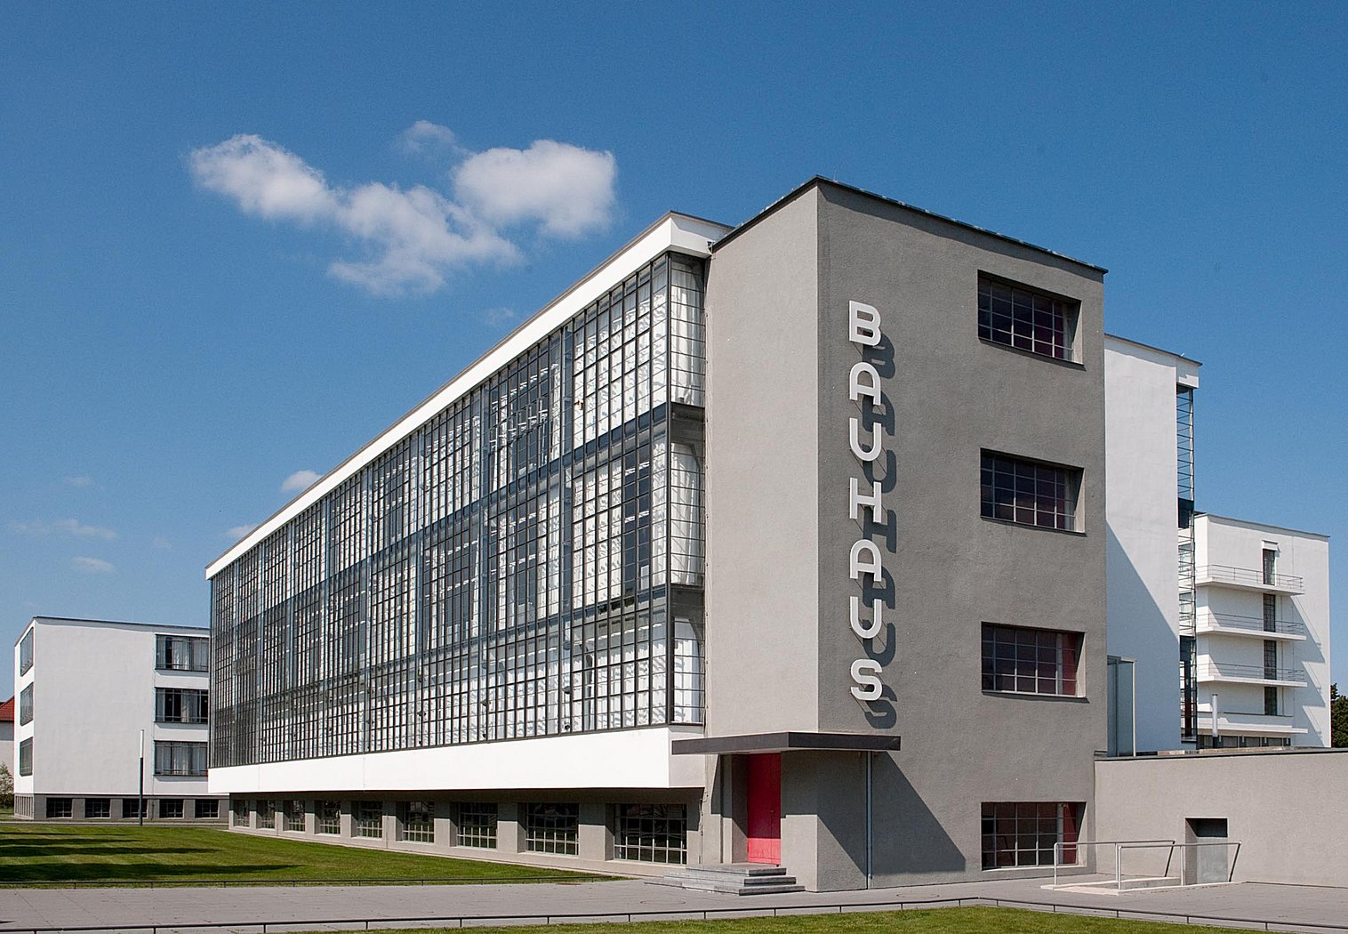
Walter Gropius
Bauhaus Building, Dessau
1925

Slide 5
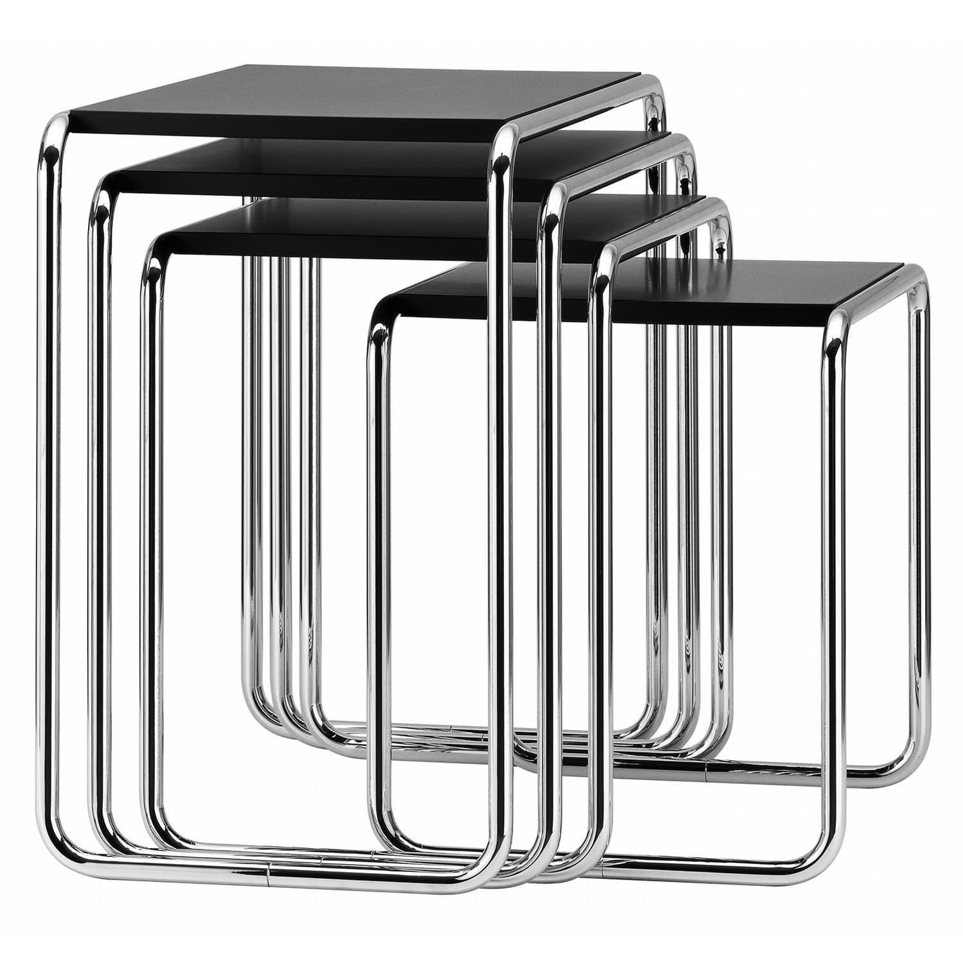
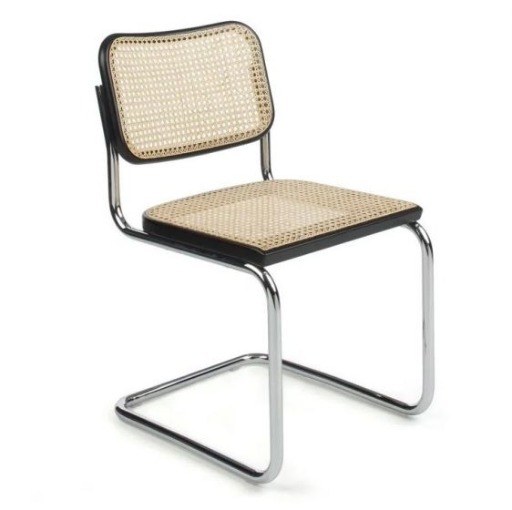
Marcel Breuer
Side Table Set
1925
Marcel Breuer
Dining Chair
1929

Slide 6
the bauhaus philosophy

Slide 7
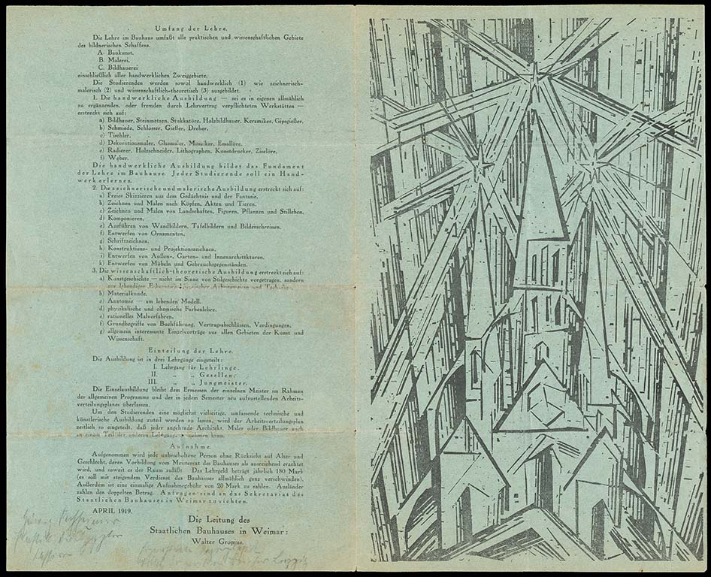
Walter Gropius, Bauhaus Manifesto, 1919
Lyonel Feininger, Cathedral, 1919

Slide 8
the bauhaus style

Slide 9
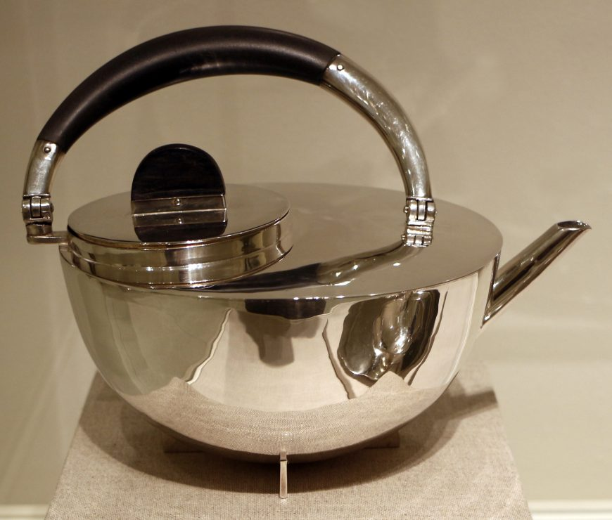
Marianne Brandt
Tea Pot
1924

Slide 10
the foundational curriculum

Slide 11
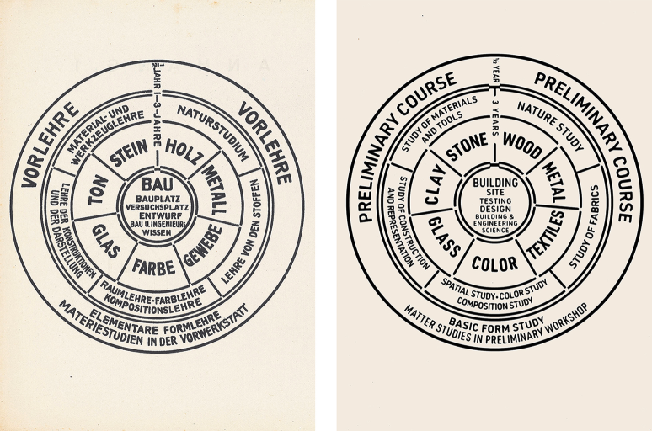
Diagram of the Bauhaus curriculum (adapted, right), Walter Gropius, 1922. Lithograph.

Slide 12
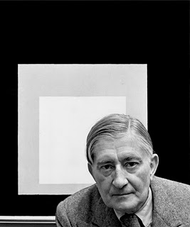
Joseph Albers

Slide 13
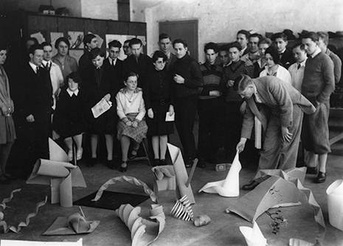
Josef Albers Discussing Paper Sculptures presented by his Students (1928-1929). Photo by Umbo (Otto Umbehr) © The Joseph and Anni Albers Foundation

Slide 14
makerspaces and the bauhaus

Slide 15
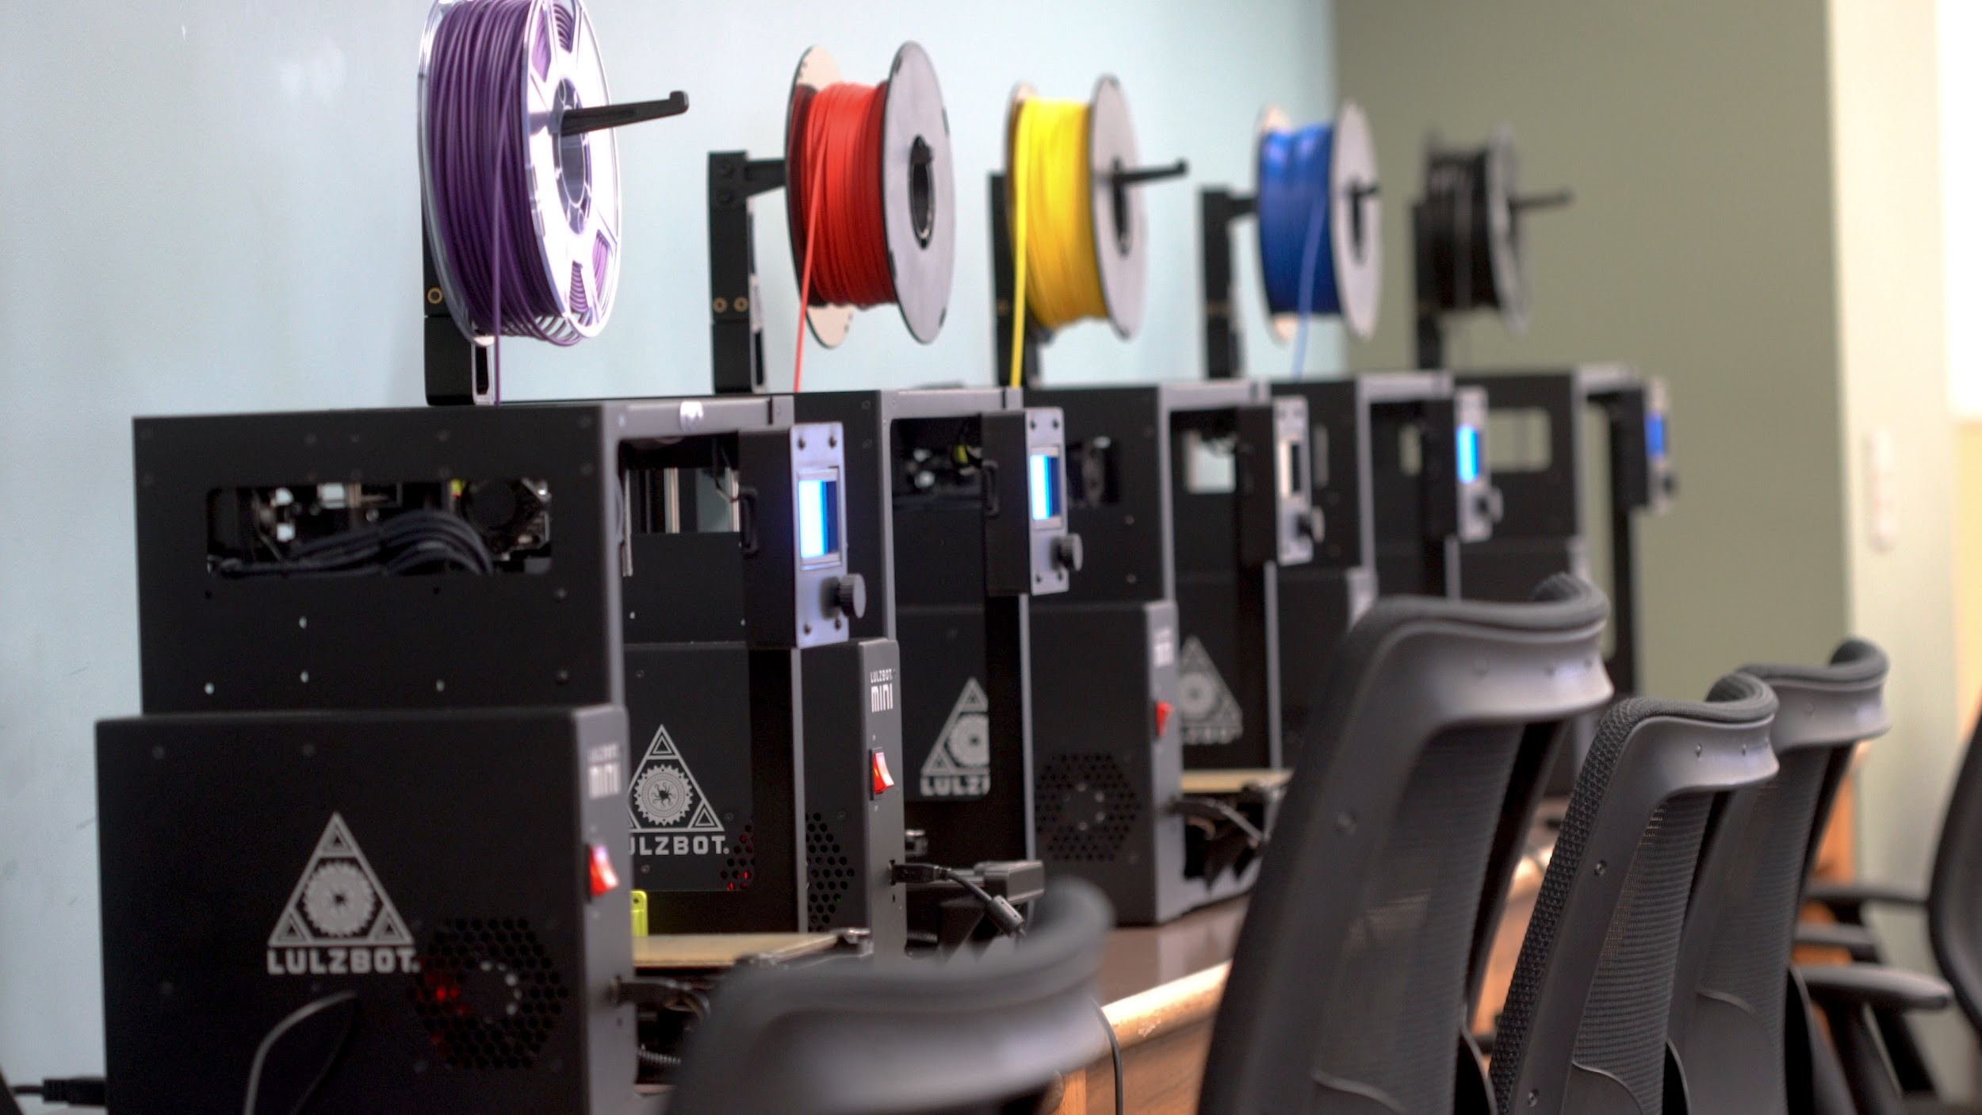
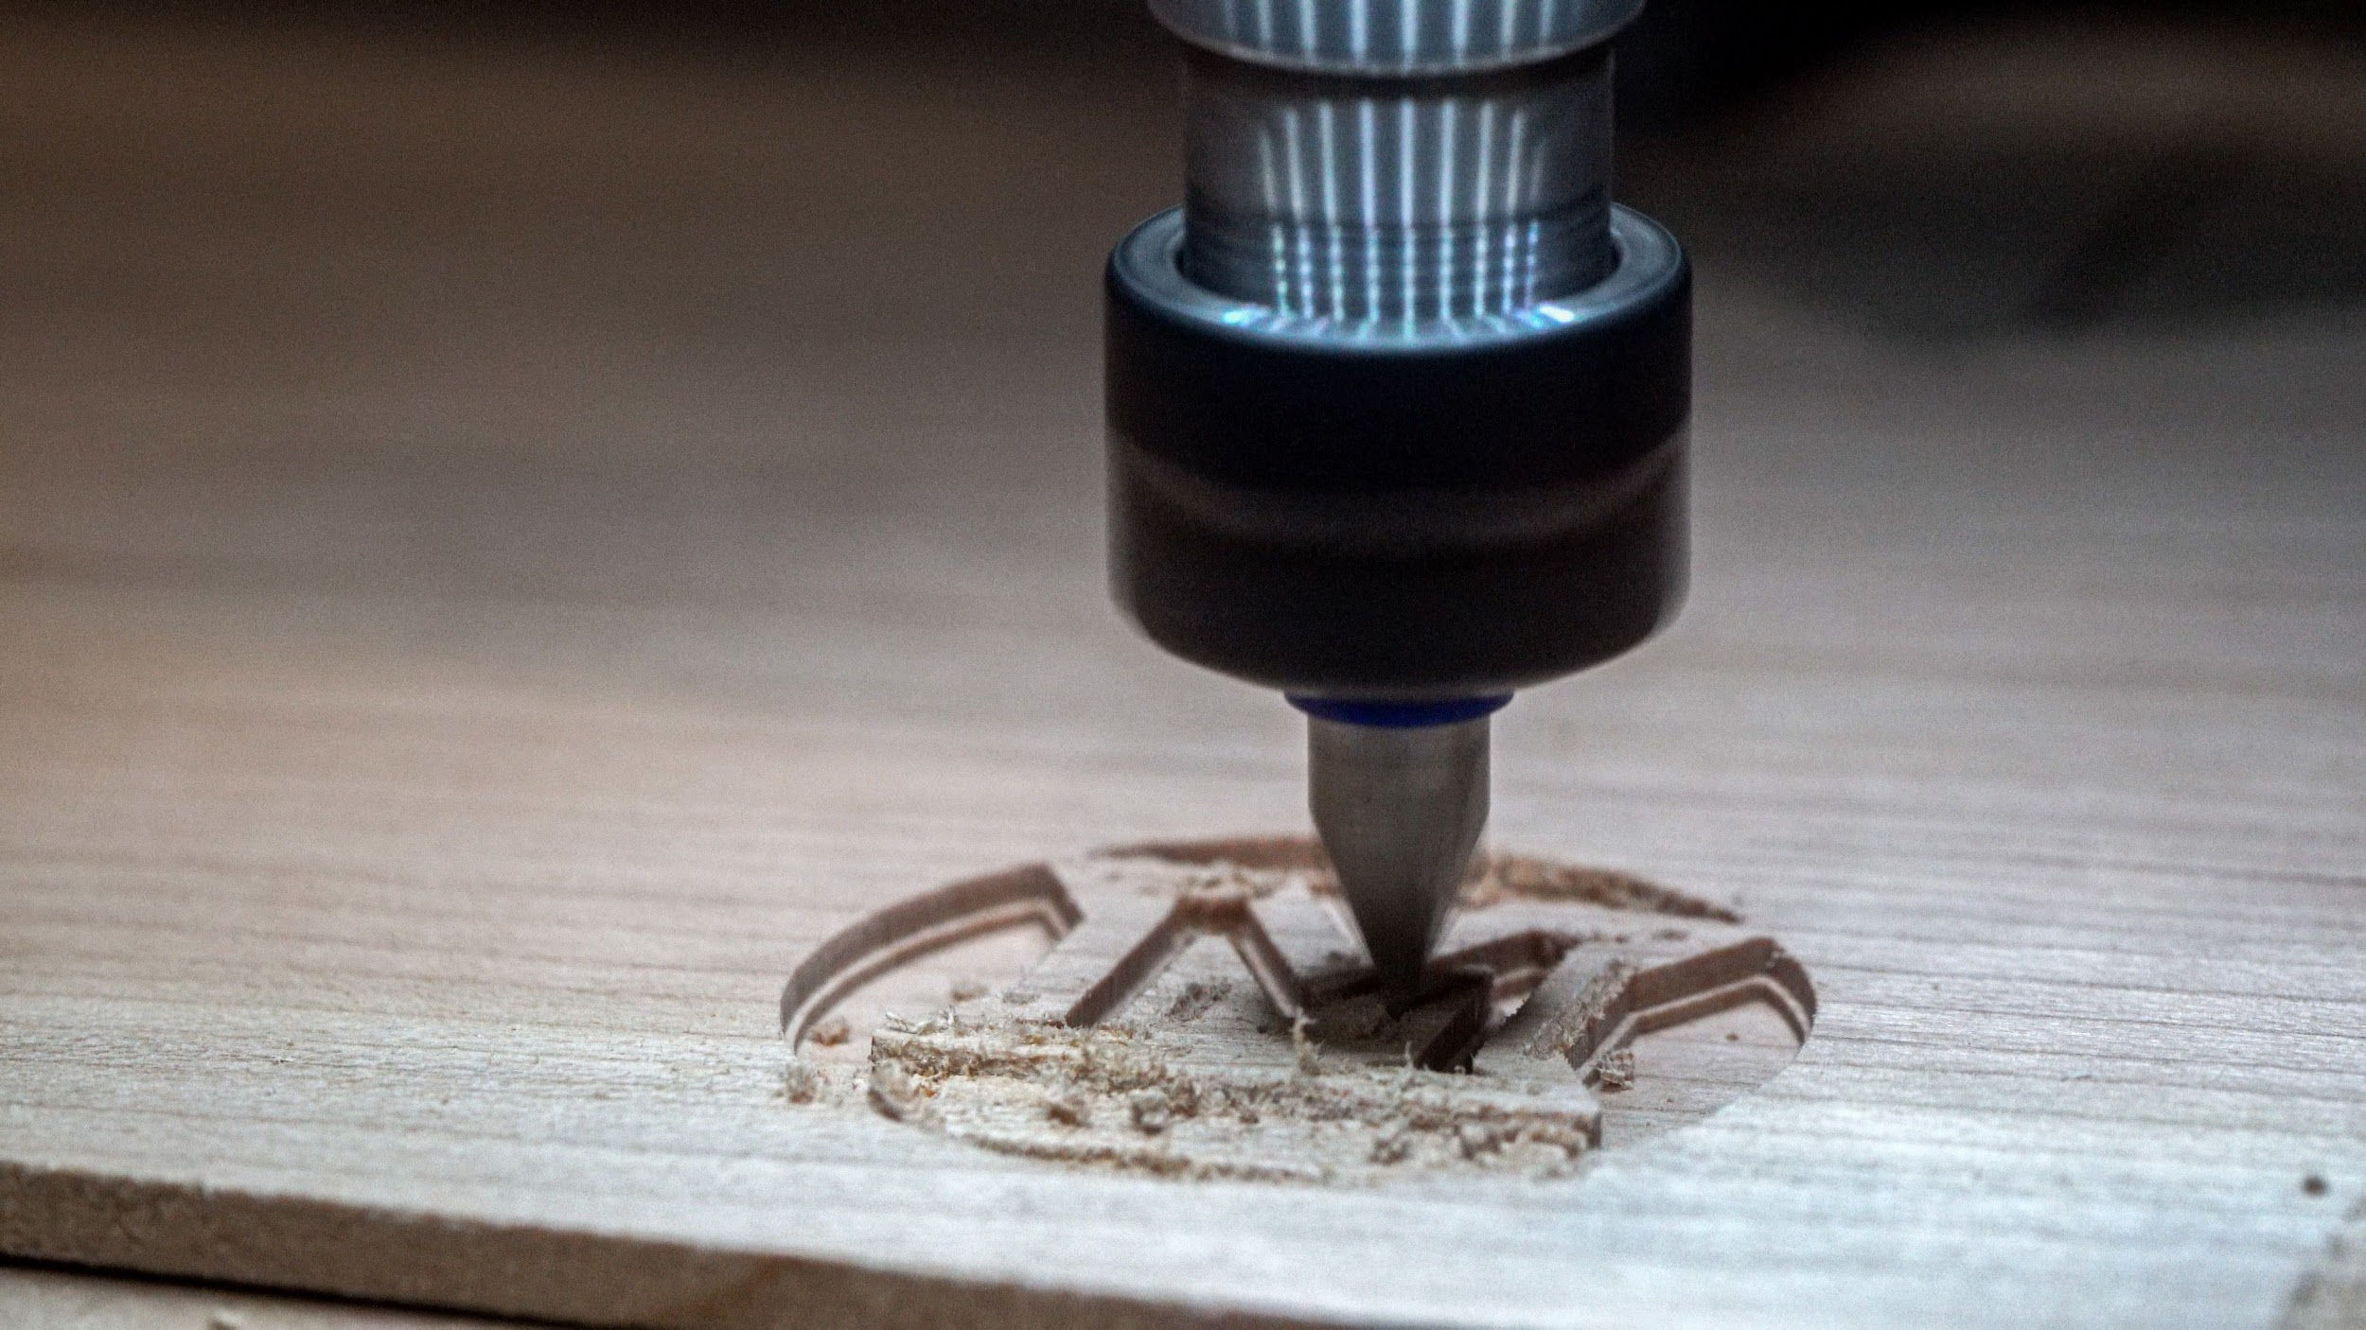
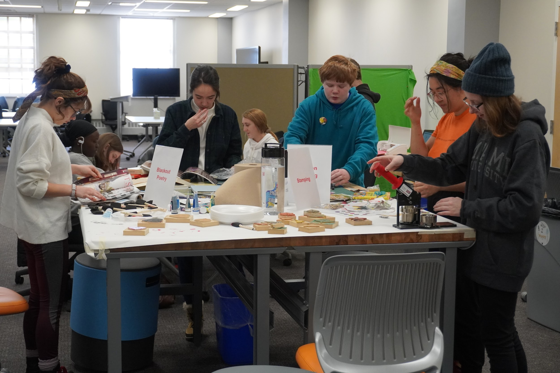
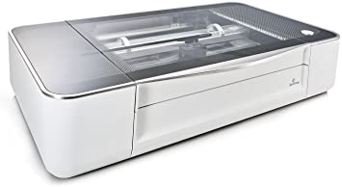
The Makerspace @ King Library
A hands-on, highly collaborative, and experiential learning space located in King Library
Equipment:
Lulzbot Mini 2 3D Printers
Carvey CNC Machines
Brother Sewing/Embroidery Machines
Heat Press
Silhouette Cameo 4 Craft Cutters
Sawgrass Sublimation Printer
Glowforge Plus Laser Cutters
VR Lab
A/V Lab

Slide 16
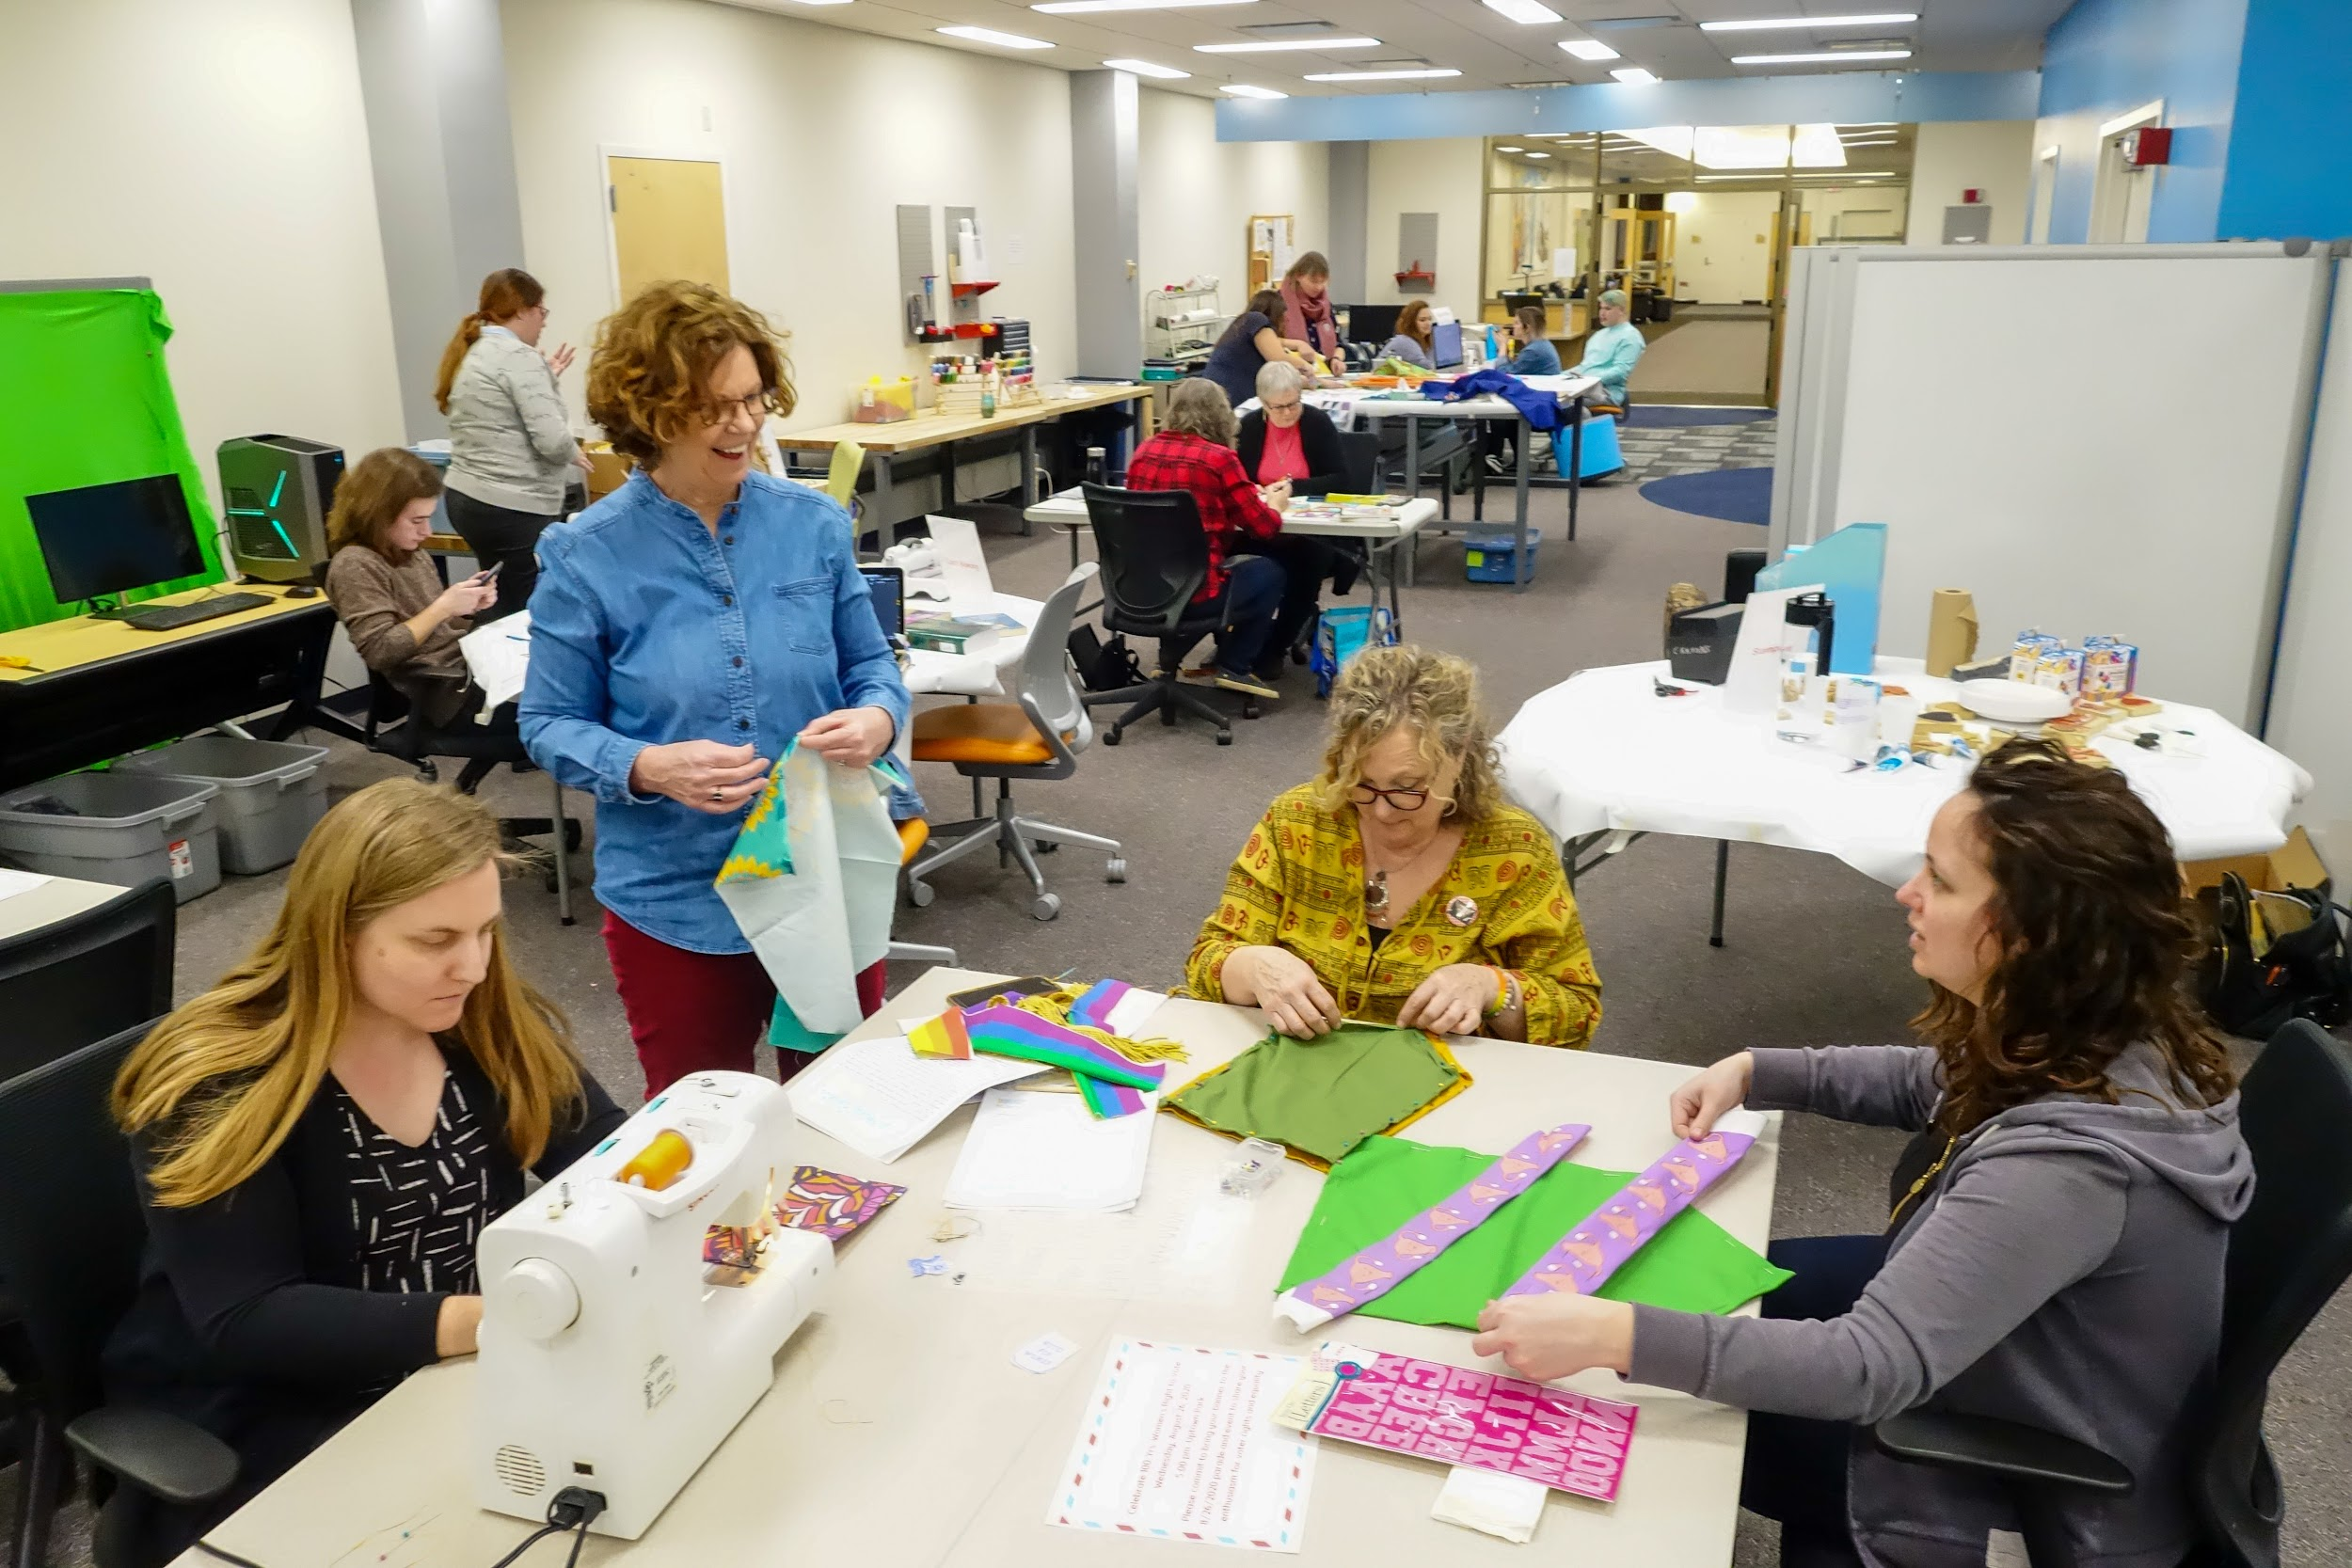
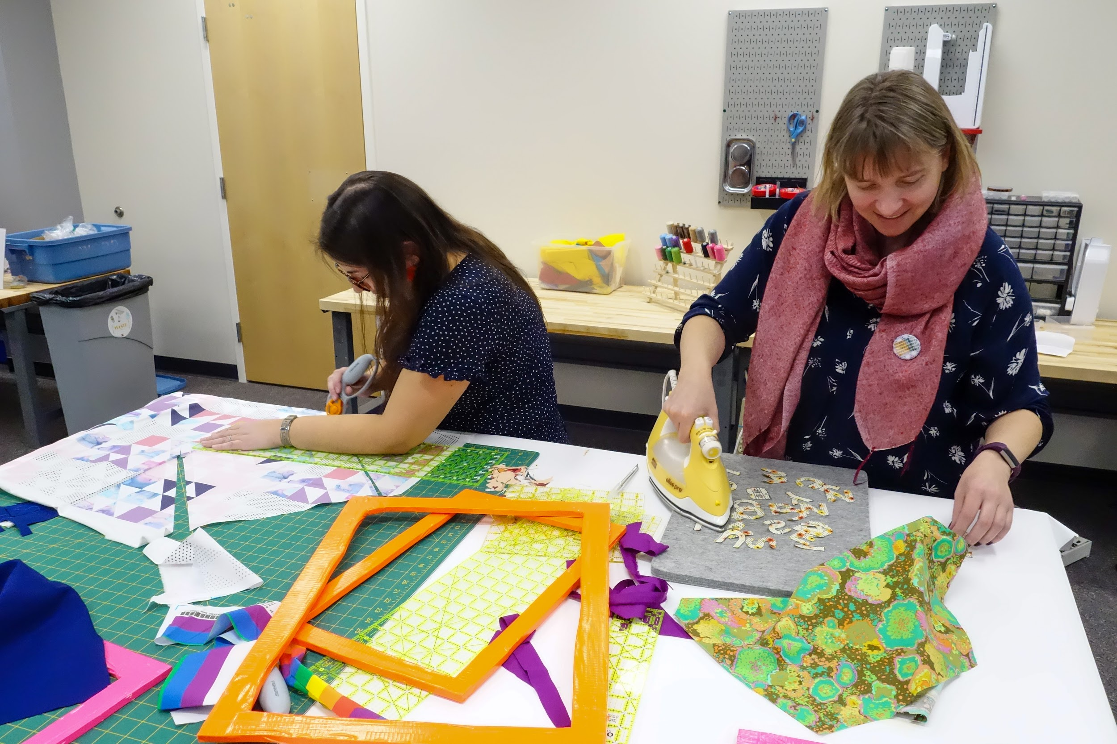
Maker-centered Learning
Shift from consumer to creator
Empowerment
Civic Mindedness

Slide 17
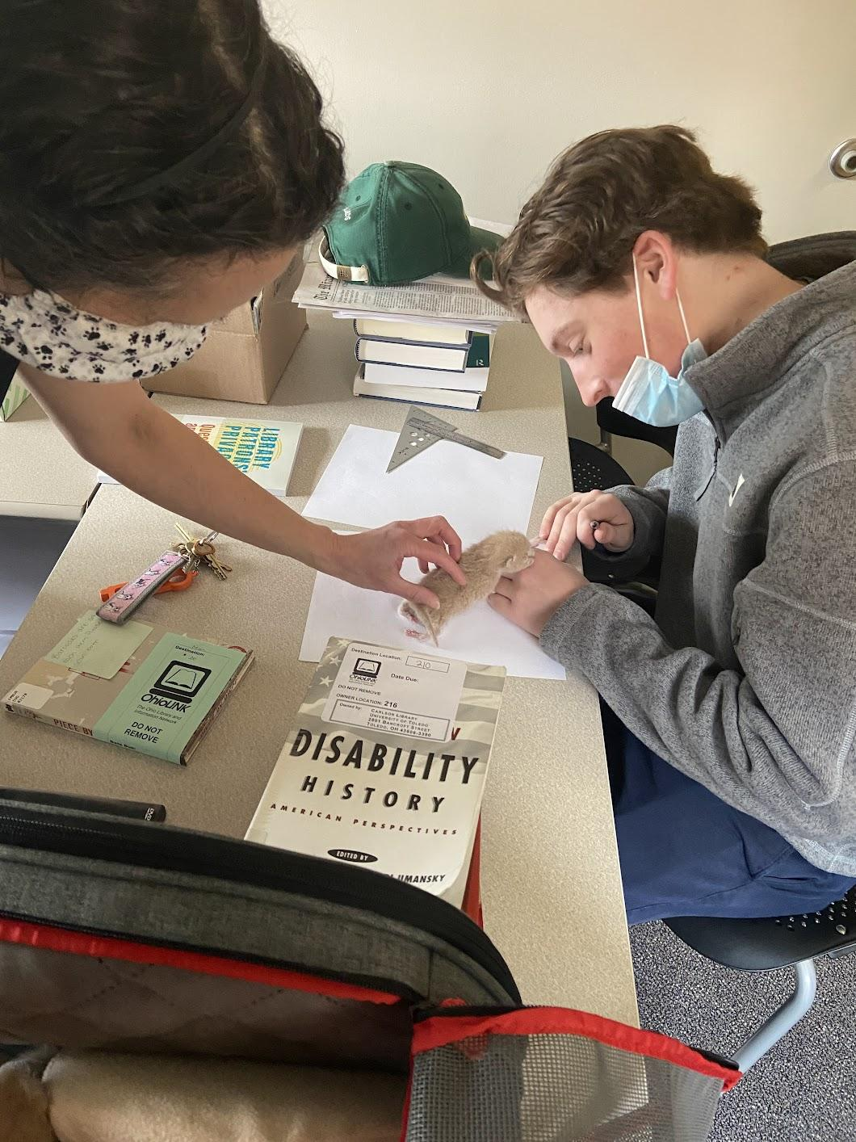
Maker-centered Learning & the Bauhaus
Learning by doing
Basic understanding of materials and tools
  Students learn through solving problems
  Sensitivity to design
Collaborative learning
Learner empowerment

Slide 18
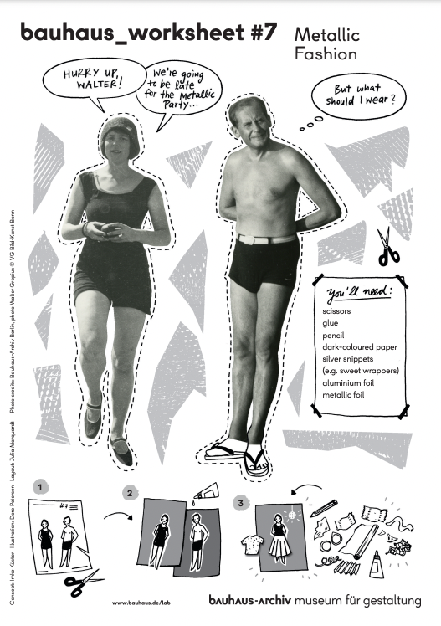
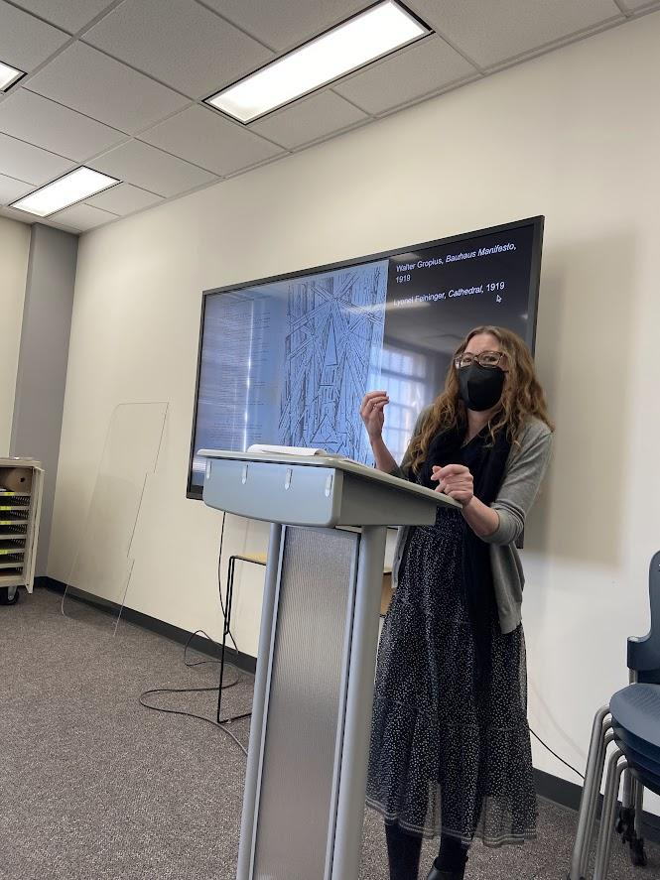
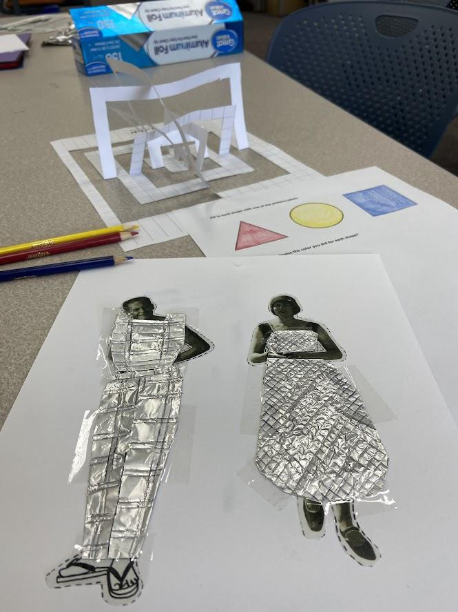
Bauhaus/Maker Workshop for Students

Slide 19
making with the bauhaus

Slide 20
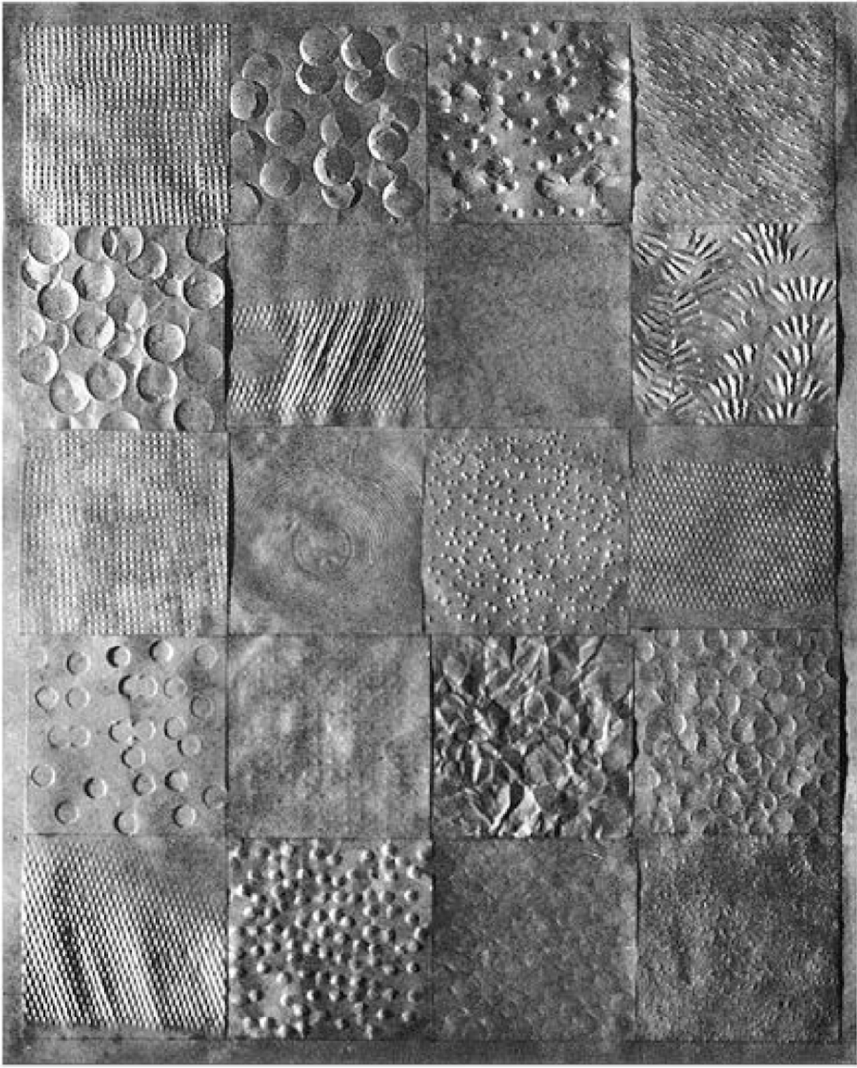
tactile boxes
Gerda Marx
Surface treatments of paper
1927

Slide 21
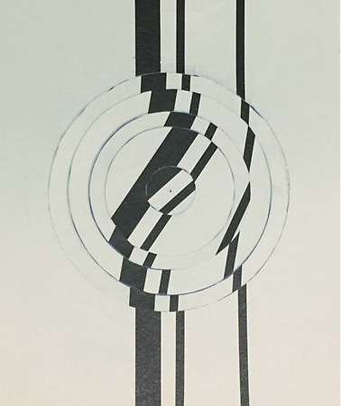
illusion of movement
Monica Bella Ullmann-Broner
Movement study
1929/30

Slide 22
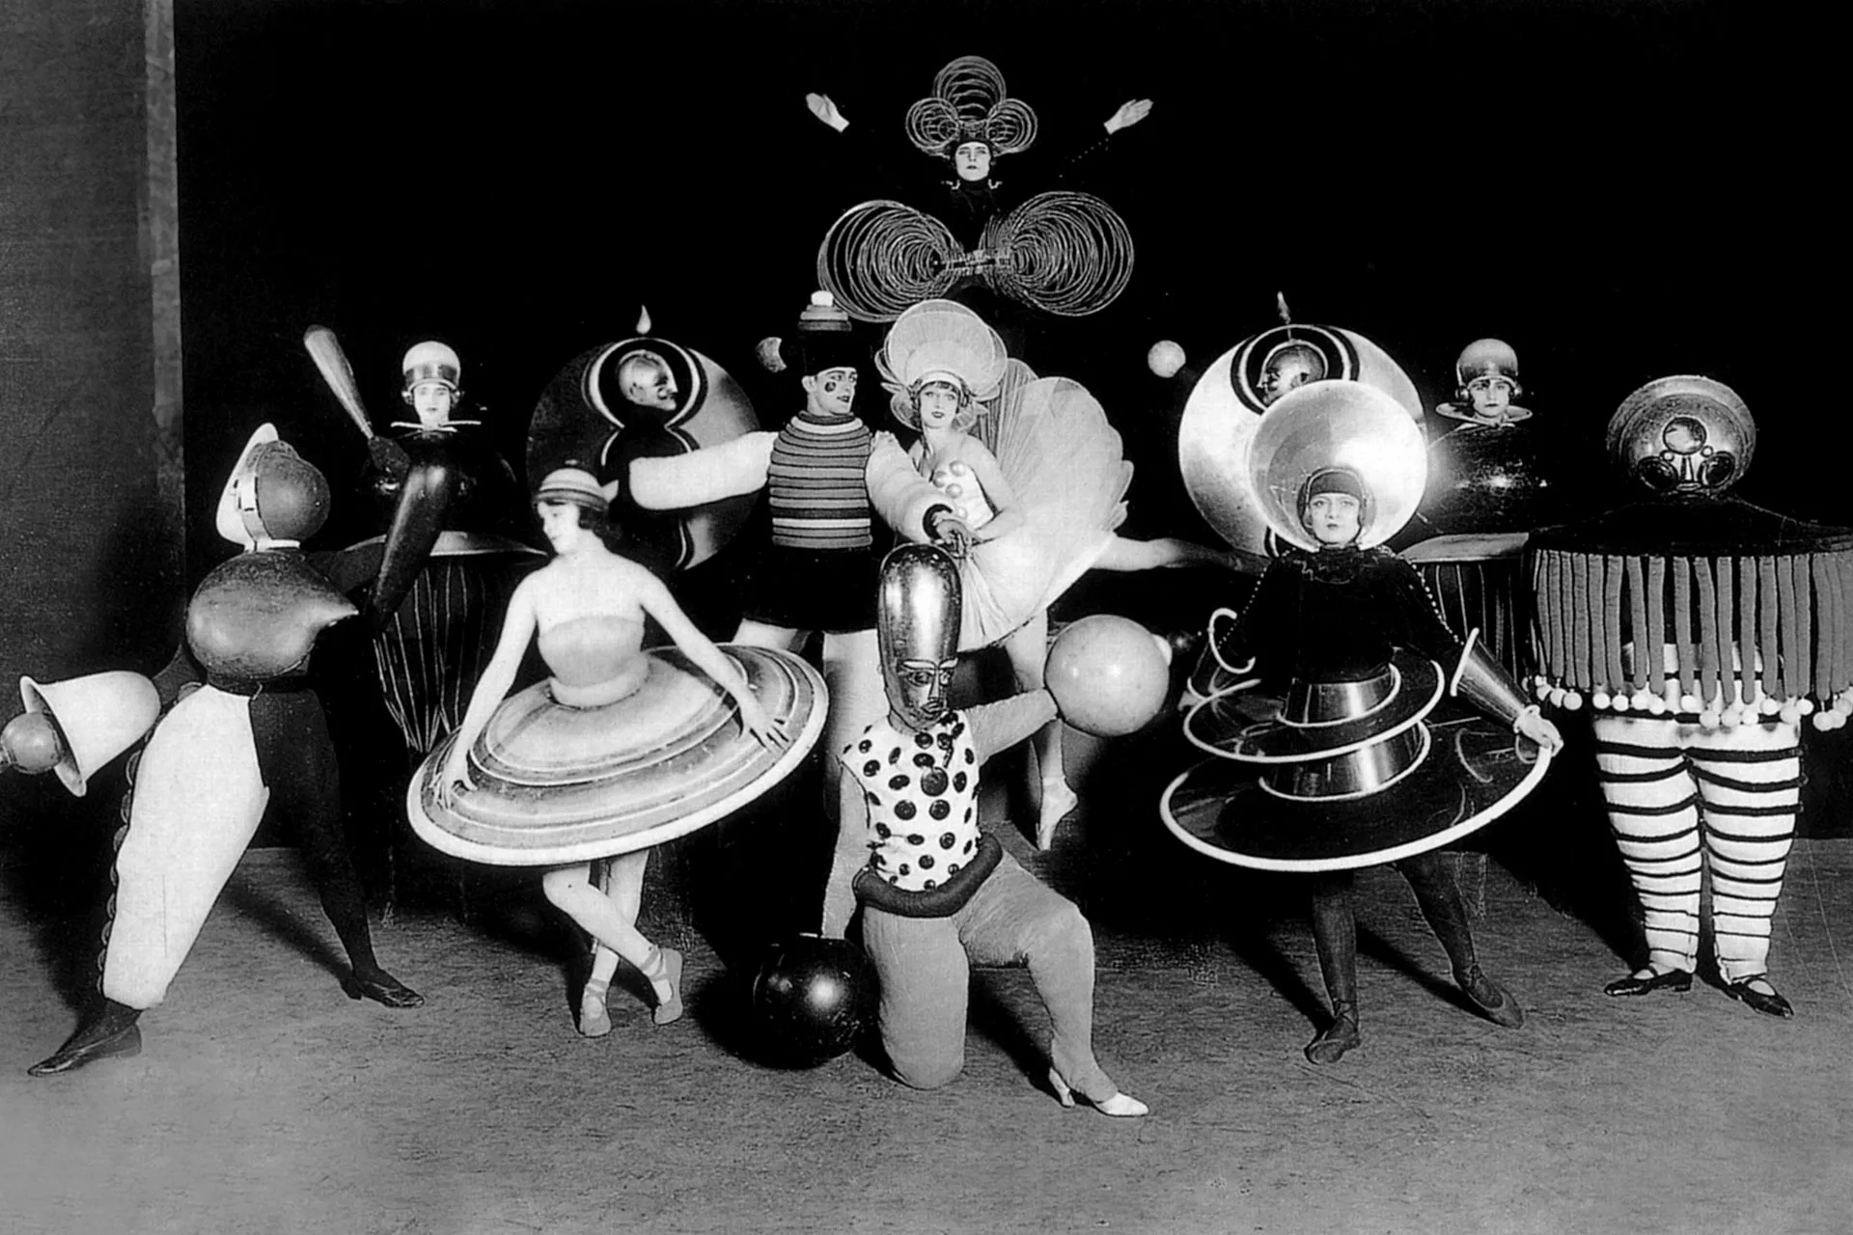
foil fashion
Oskar Schlemmer
Bauhaus theatre, Triadisches Ballett
1923

Slide 23
Workshop Resources
Contact Us
bit.ly/bh_maker
Stefanie Hilles, hillessa@miamioh.edu
Sarah Nagle, pricesb@miamioh.edu
Twitter: @SarahNagle10

