Slide 1
Ideas for Action: Creating and Collaborating for Inclusive Teaching
Sarah Nagle & Abigail Morgan, Miami University

Slide 2
Land Acknowledgement
Miami University is located within the traditional homelands of the Myaamia and Shawnee people, who along with other indigenous groups ceded these lands to the United States in the first Treaty of Greenville in 1795. The Miami people, whose name our university carries, were forcibly removed from these homelands in 1846.
In 1972, a relationship between Miami University and the Miami Tribe of Oklahoma began and evolved into a reciprocal partnership, including the creation of the Myaamia Center at Miami University in 2001. The work of the Myaamia Center serves the Miami Tribe community and is dedicated to the revitalization of Miami language and culture and to restoring that knowledge to the Myaamia people.
Miami University and the Miami Tribe are proud of this work and of the more than 140 Myaamia students who have attended Miami since 1991 through the Myaamia Heritage Award Program.
For more information: miamioh.edu/miami-tribe-relations/
Notes:
Sarah
Give group time to read (45 seconds)
We are happy to be celebrating the 50th anniversary of the relationship between Miami University and the Miami Tribe of Oklahoma.

Slide 3
Table of contents
01
02
03
About the group
Journal club
Shared Values Workshop
04
05
06
Privilege checklist
Next Steps
Discussion
How and why we started the Inclusive Teaching Interest Group
What we have discussed as a group
A way to dig into the kind of instruction we want to embody
Background and how it works
Our conclusions, feedback from group, and future plans
We’d like to hear your thoughts and ideas!
Notes:
Sarah

Slide 4
About us
Sarah Nagle - she/her- Creation and Innovation Services Librarian
Abigail Morgan - she/her - Social Sciences Librarian

Slide 5
01
About the group
How and why we formed the Inclusive Teaching Interest Group

Slide 6
About the Inclusive Teaching Interest Group
Began in summer 2020
Wanted to embed critical pedagogy into our teaching practices in a more meaningful and intentional way
The need for a community of practice
Varied instruction duties (sharing with each other)
Notes:
Sarah

Slide 7
—Original group
Liaison librarians x6
Special collections librarians x2
Student success librarians x2
Regional campus librarian
Makerspace librarian
Notes:
Sarah

Slide 8
Critical Pedagogy
Emphasizes education that helps students truly see the world for what it is, including the systems of power, then taking action against oppressive elements
Teachers must engage in self-reflection in order to identify their own positionalities and positions of power
Dialogue (vs. lecture) is the preferred method of gaining knowledge
Students’ lived experiences are seen as valuable and equally important funds of knowledge
Notes:
Abi

Slide 9
Critical Information Literacy
Encourage critical engagement with information sources
Recognize that all information falls within complex power structures
Students must navigate these power structures any time they engage with information - through creation, consumption, analysis, classification, etc.
Can lead students to challenge power structures, particularly those that oppress
Notes:
Sarah

Slide 10
Benefits of a Community of Practice
Prevents burnout
Not trying to learn everything on your own
Can seek clarification from others
Share stories and experiences
Notes:
Sarah

Slide 11
02
Journal club
Individual members choose an article to read and summarize. We share back summaries during our meeting and discuss.
Notes:
Sarah

Slide 12
Main takeaways
Reduce Burnout
Know Your
Colleagues
Wide Perspective
Takes the pressure off of individuals to read every article, every resource, etc.
Understand their perspective, what they find most important, what tools/techniques they use.
Go beyond our comfort zones.
Notes:
Sarah

Slide 13
03
Shared Values Workshop
A workshop to identify and discuss shared teaching values. Fifteen instructional values were evaluated, discussed, and ranked by priority.
Notes:
Sarah

Slide 14
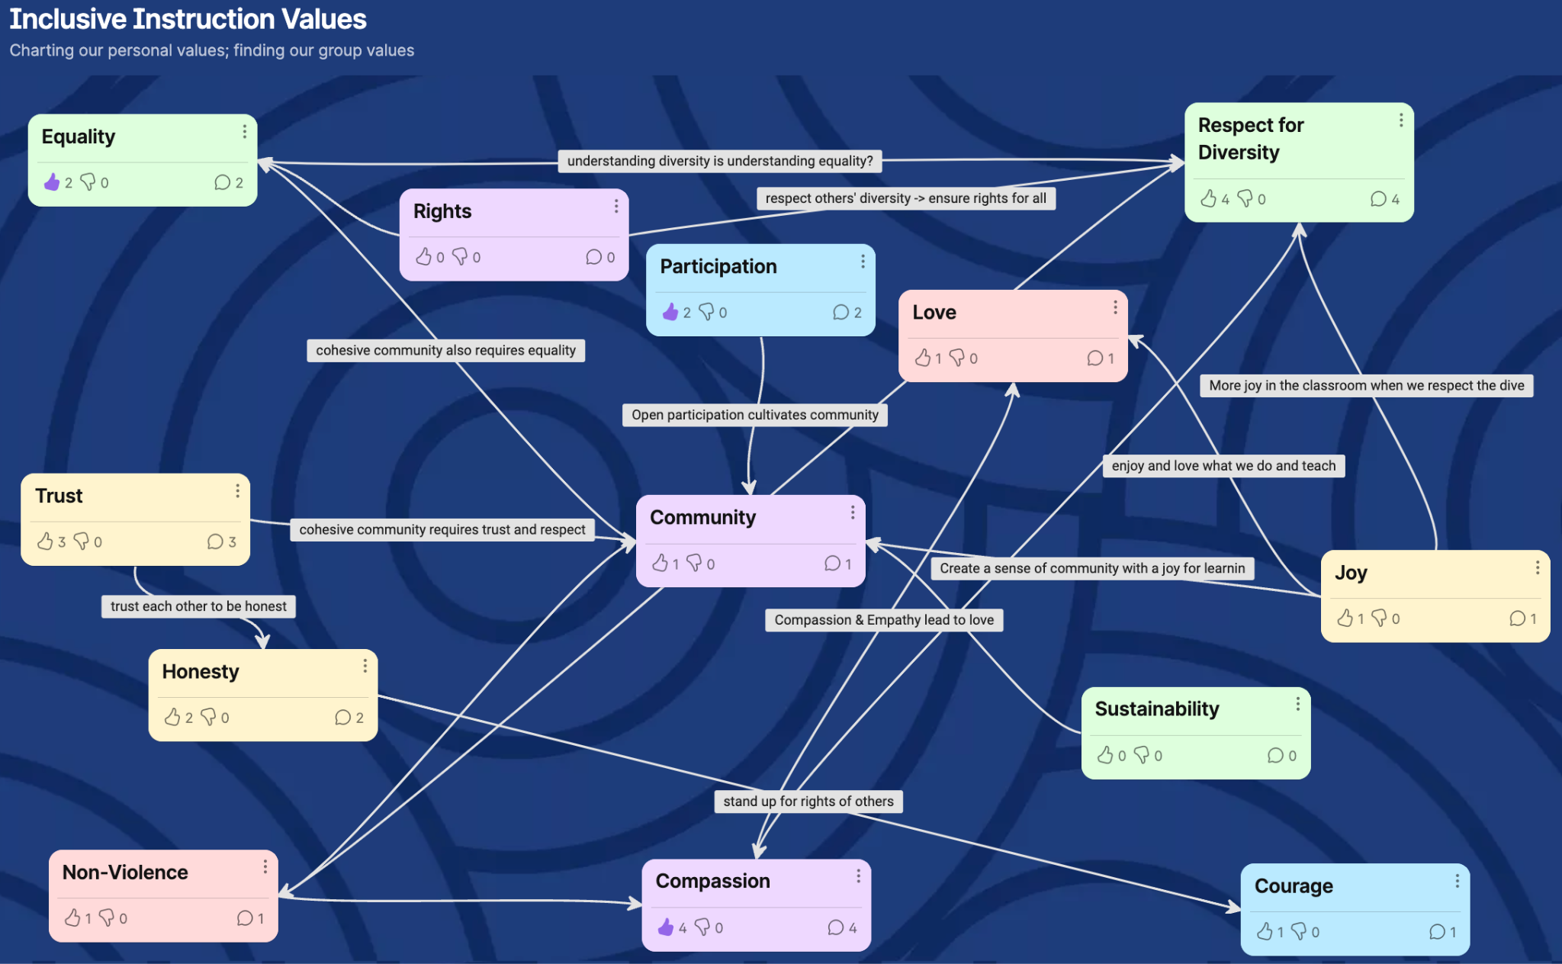
Notes:
Sarah

Slide 15
Main takeaways
Personal Values
Group Identity
Values <-> Instruction
Understand our own values and the connection they have to each other
Develops group identity and solidifies our shared instructional mission
Aligns our instruction more closely with our values
Notes:
Sarah

Slide 16
04
Privilege Checklist
Background and how it works
Notes:
Abi

Slide 17
Privilege Checklist
Developed as a way to think about implicit assumptions about the value of libraries and how they operate
Deeply indebted to Peggy McIntosh’s foundational article “White Privilege: Unpacking the Invisible Knapsack”
Understanding one’s own positionalities is a key concept in critical theory in education
Checklist asks about experiences with education and libraries
And the most important thing: do our experiences match our students?
Notes:
Abi

Slide 18
Library privilege vs. information privilege?
Library privilege
Information Privilege
Named this for lack of better term
What are the practices of using the library?
What are the social, cultural, familial, and personal values that are associated with those practices?
Levels of access to scholarly research
Equally important!
Open access movements are much needed to break down barriers
Notes:
Abi

Slide 19
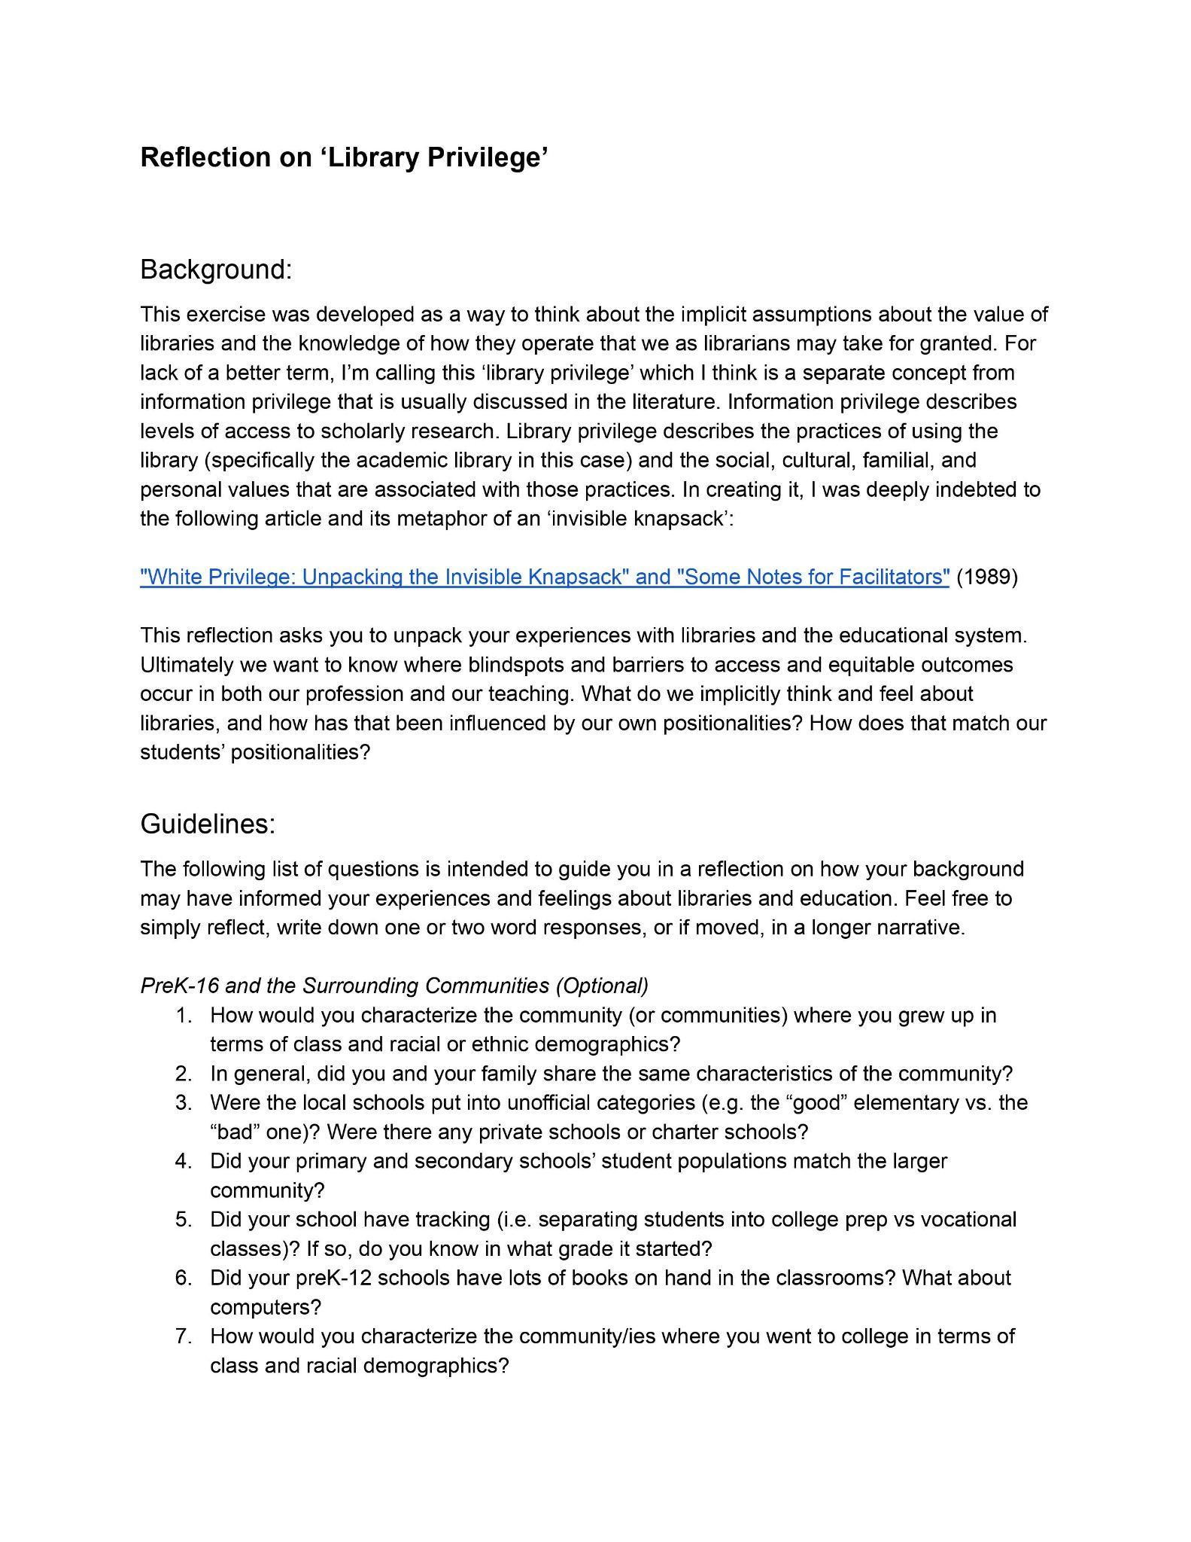
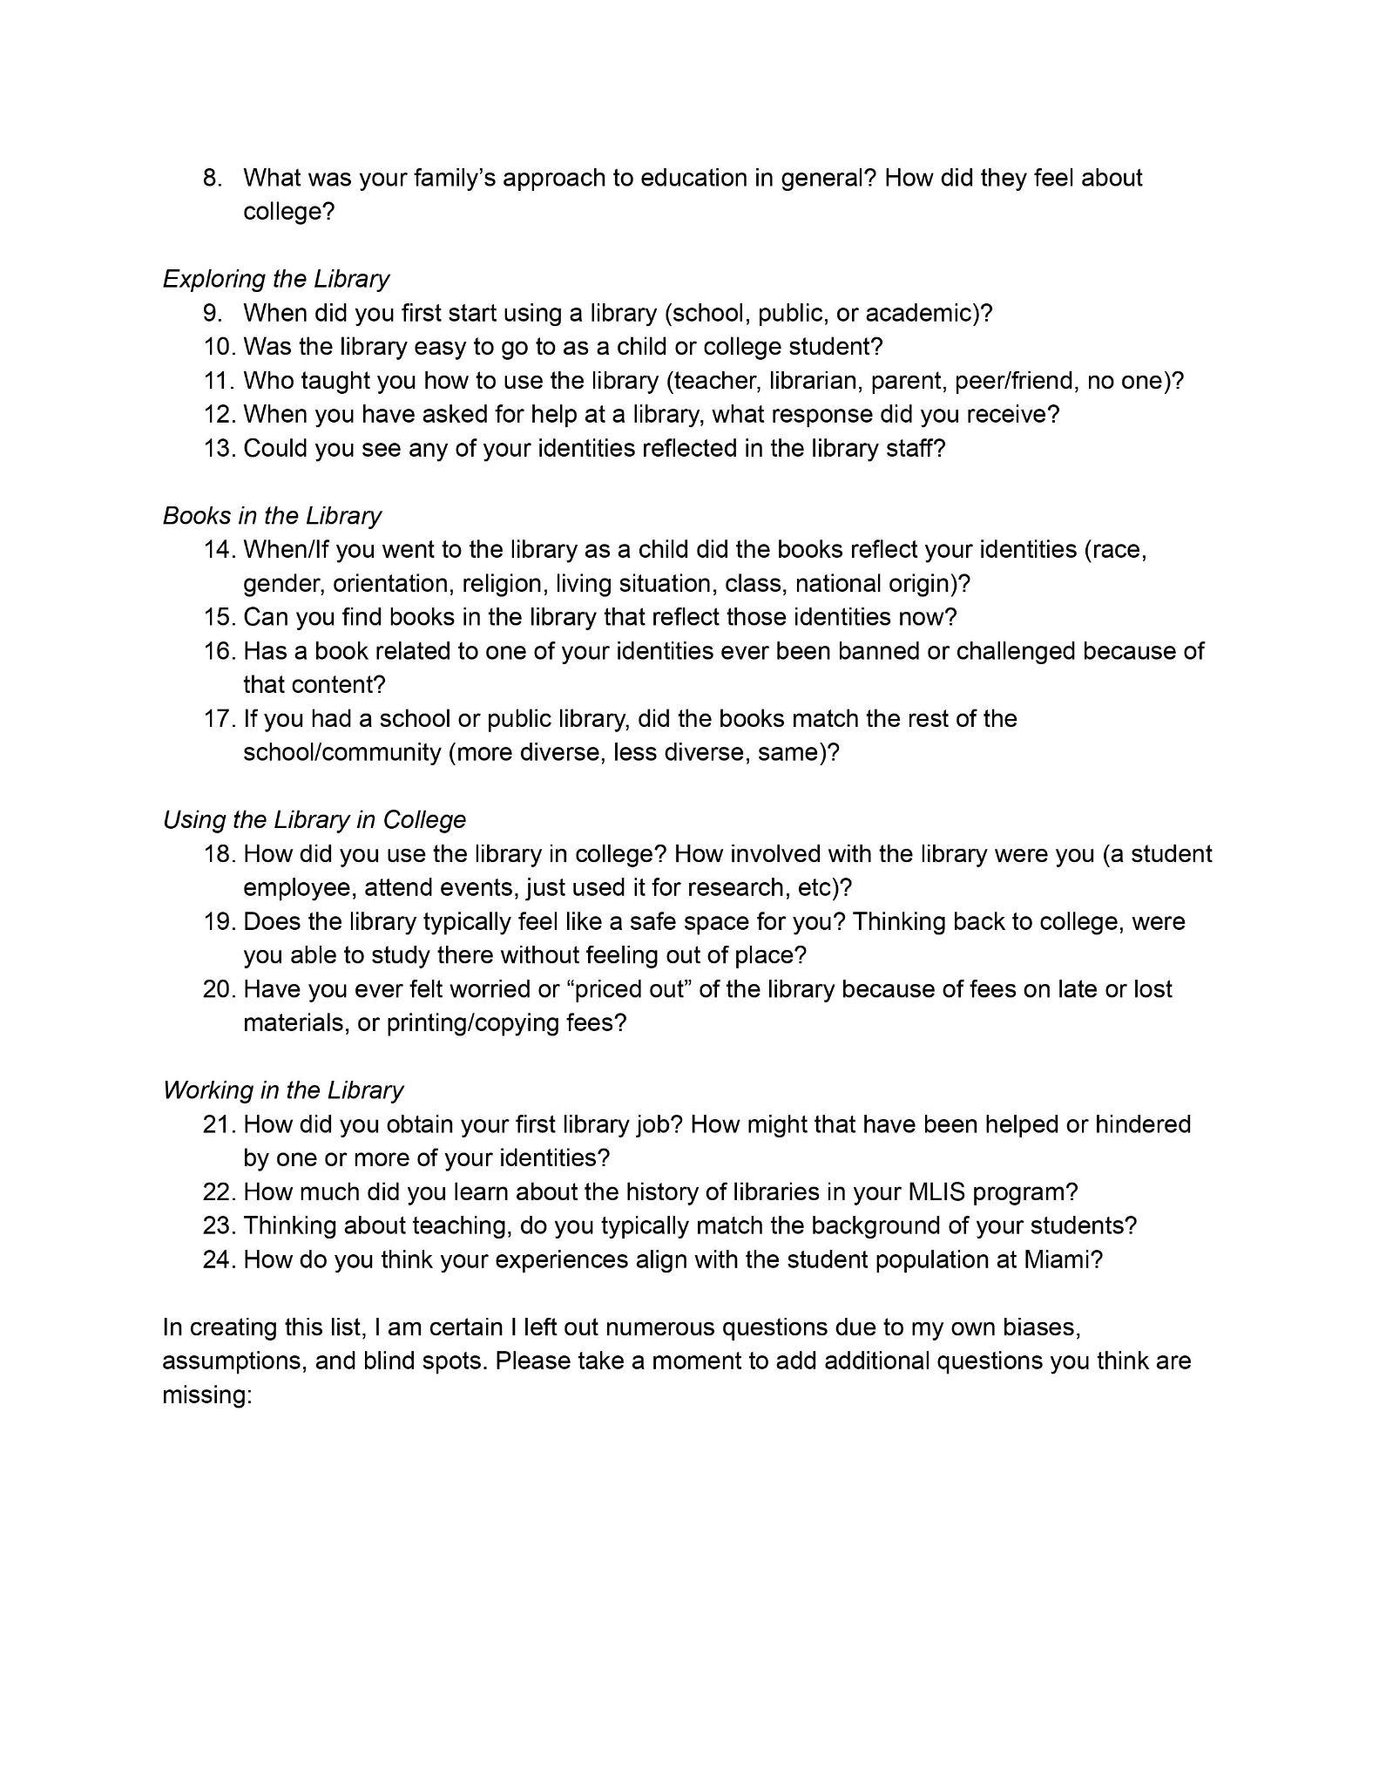
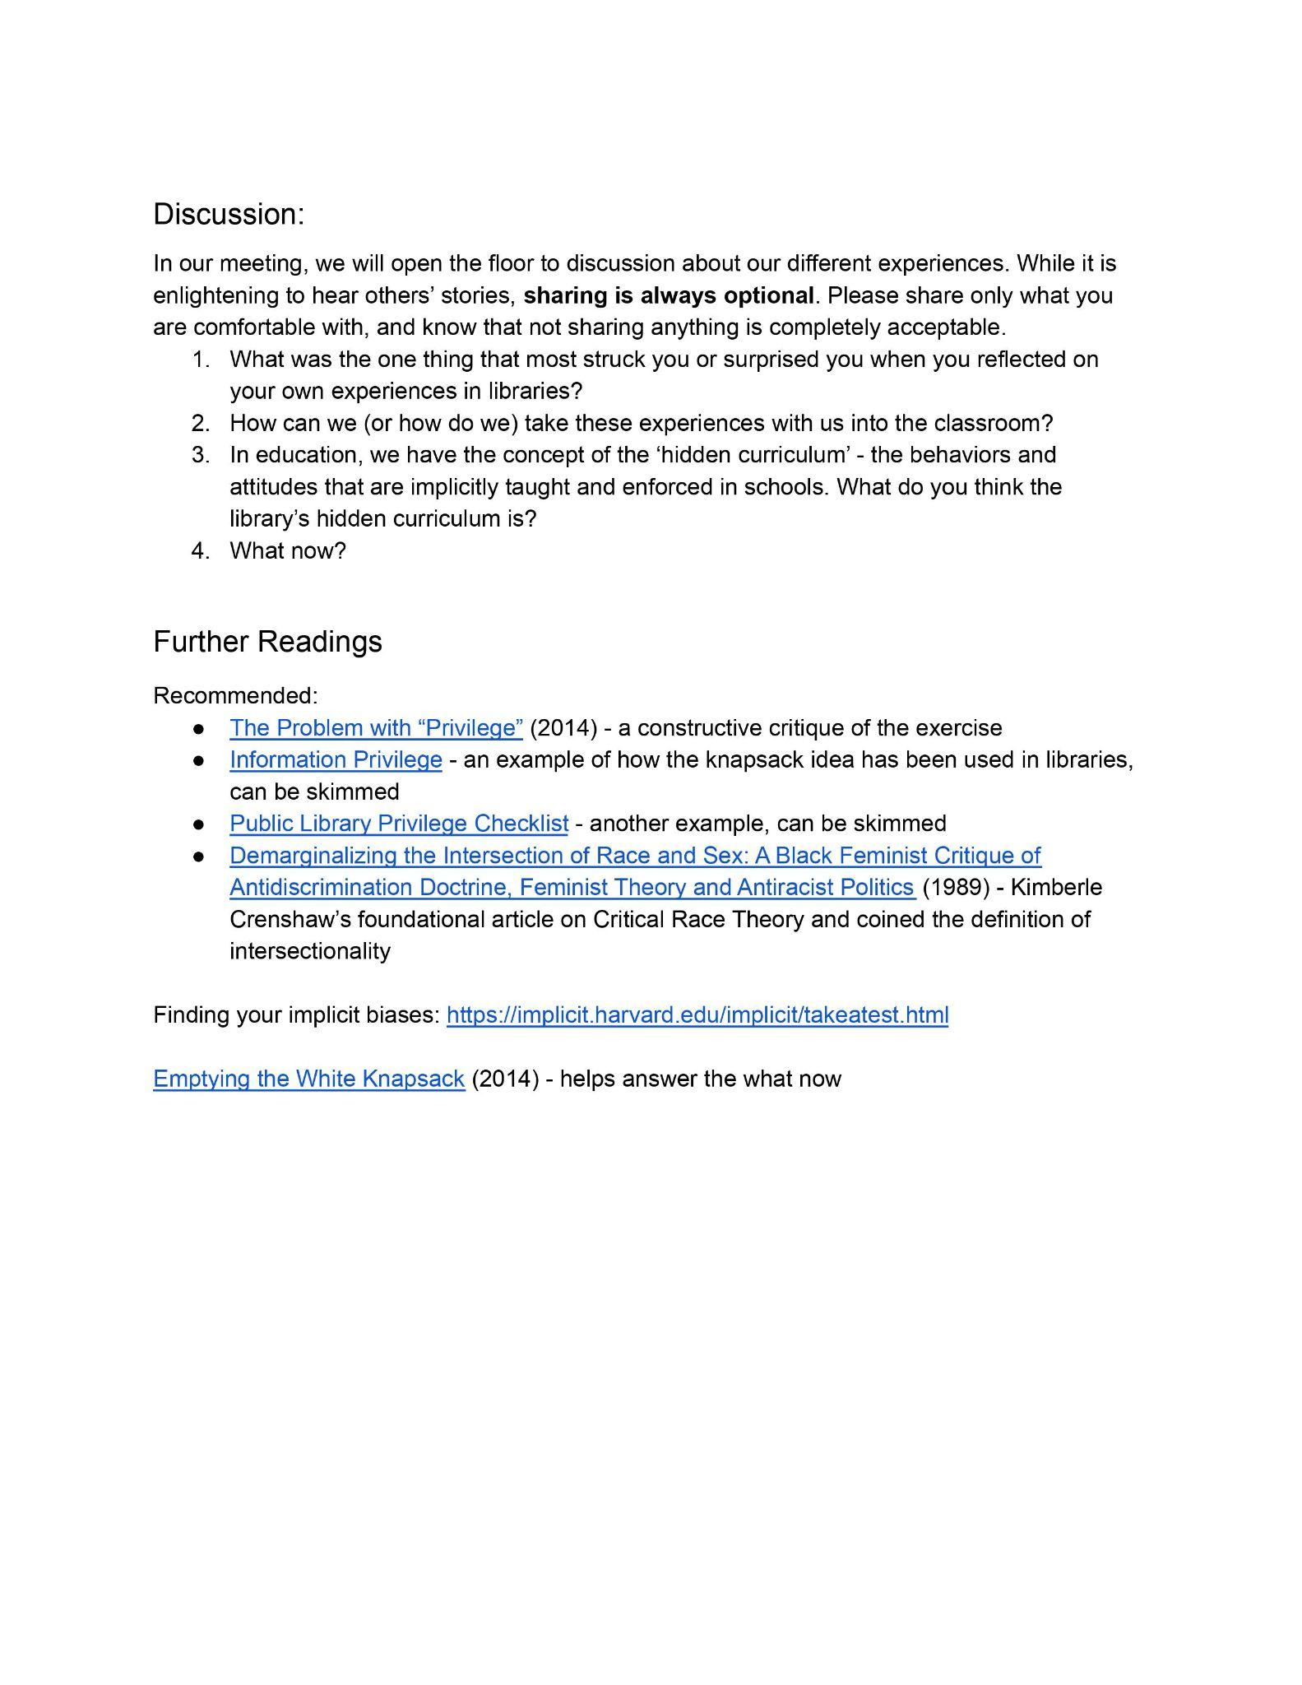
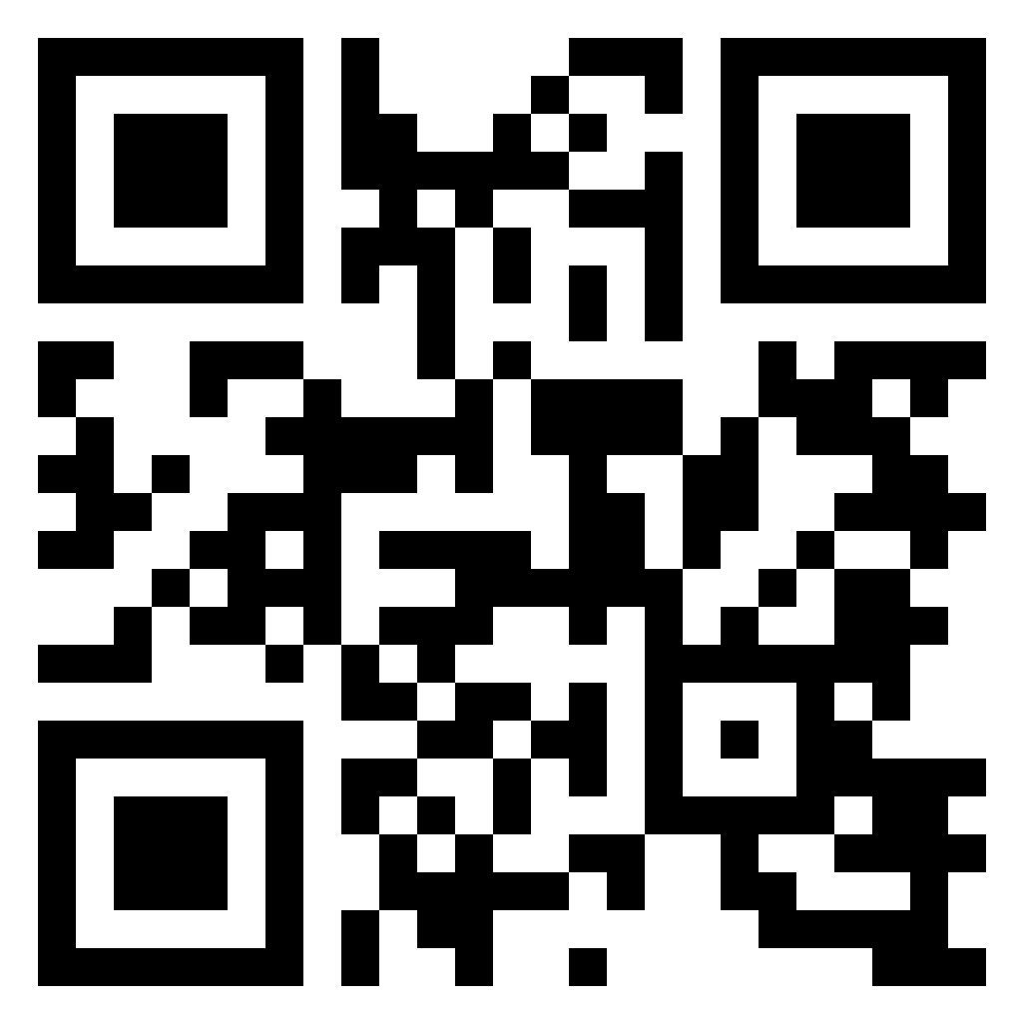
Download here
Use the QR code or go to
https://tinyurl.com/ycymvzr6
Notes:
Abi

Slide 20
Major takeaways
Time
Usefulness
Work in Progress
Fully participating in this activity takes time for both the reflection and the discussion
Colleagues have noted that the activity is meaningful:
“It was the realization that not everyone sees the library as a safe place. I...always felt like I belonged there. I assumed everyone had similar experiences.”
We welcome suggestions and additional questions to add, resources to consider, or additional context to provide.
Notes:
Abi

Slide 21
05
Next Steps
Our conclusions, feedback from group members, and future plans

Slide 22
Feedback from group members
Response 1:
The accountability, honestly. It's so easy to let things fall off your plate when you're busy but having a community of practice is motivation for it not to fall off.
Response 2:
It's a helpful reminder to consider inclusivity when planning and reflecting on my teaching.
Response 3:
[The biggest challenge for participating] is the time involved.
Notes:
Sarah

Slide 23
Future Ideas
More journal discussions
Open discussion on DEI issues we are seeing in our daily work or library specialty
Group ideation for values/mission
Collage activity for our values
Work with the new Library-wide DEI committee and strategic planning group
Notes:
Abi
Sarah (group ideation values/mission)

Slide 24
06
Your Turn! Discussion
What other ideas do you have?

Slide 25
Brainstorm/Discussion
What have you done to foster critical pedagogy practices or critical librarianship at your institution?
How might you expand on any of these activities?

Slide 26
Thanks!
Do you have any questions?
pricesb@miamioh.edu
morgan55@miamioh.edu
Please keep this slide as attribution

