Slide 1





Makerspaces:
Hubs for Interdisciplinary Learning
Sarah Nagle
Creation & Innovation Services Librarian
Miami University
Internet Librarian Conference
October, 2022

Slide 2
What We’ll Cover Today
01
Maker-Centered Learning Frameworks
04
Maker Literacy Student Learning Outcomes
02
Metaliteracy
05
Course Integration Examples
03
Liminality
06
Discussion/Wrap Up

Slide 3
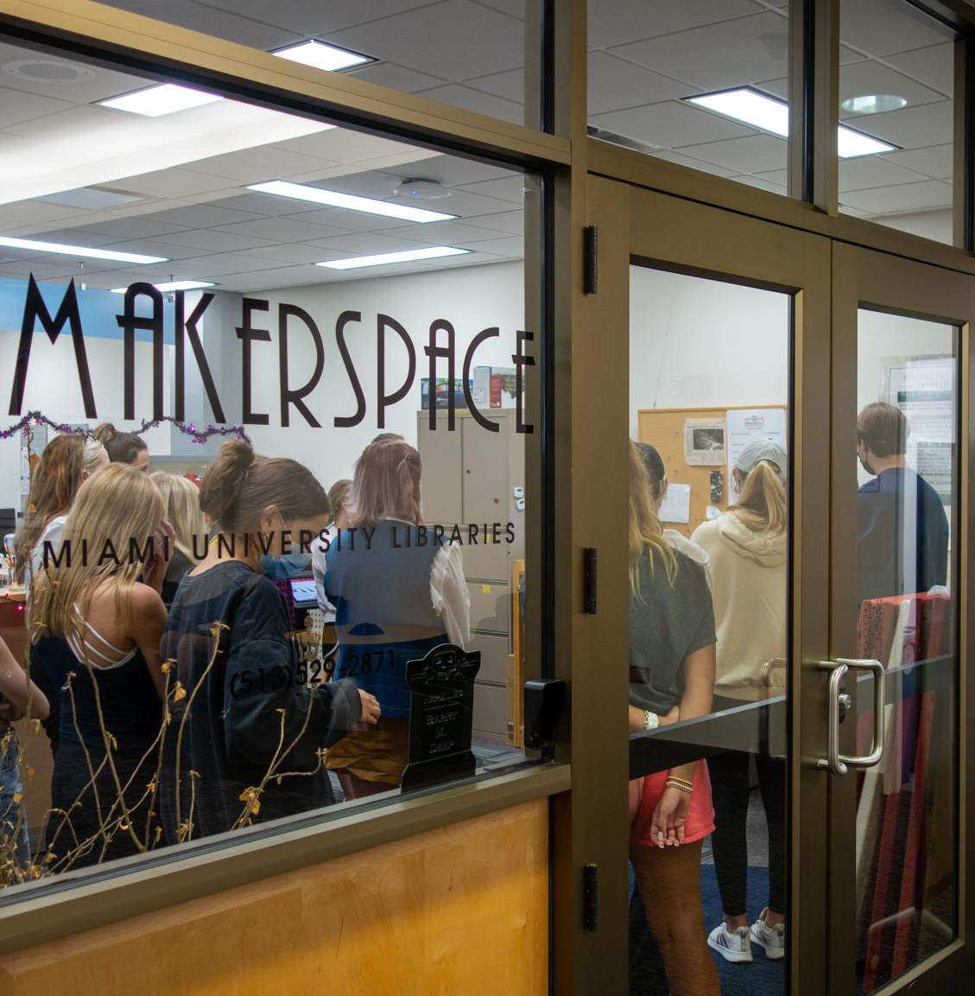
The Makerspace
@ King
Hands-on, experiential learning space
3D printing, laser cutting, vinyl cutting, sewing, embroidery, VR, AV recording, and more
Open to all Miami students, faculty and staff

Slide 4
Makerspaces in Academic Libraries
Growing Popularity
Staying
Relevant

Slide 5
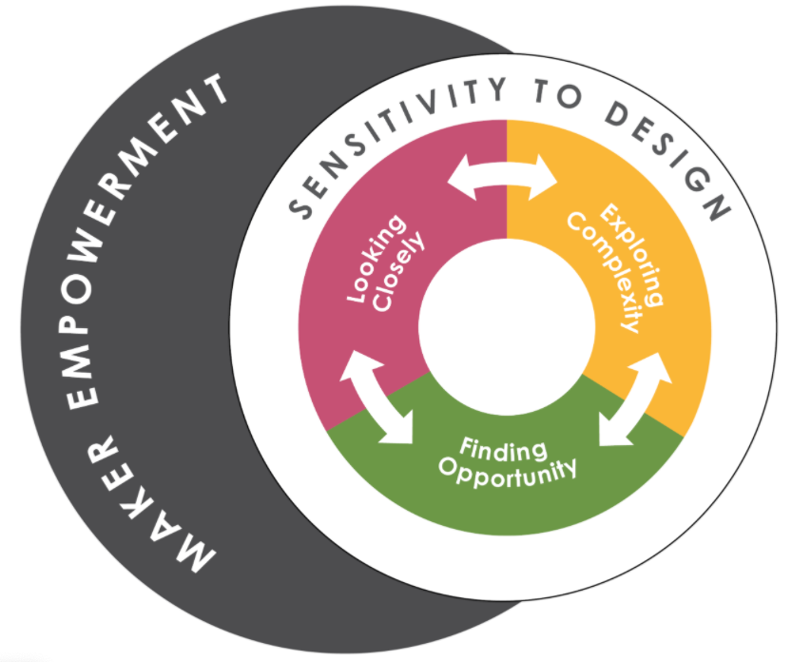
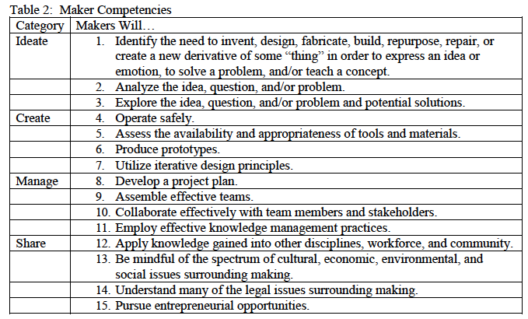
Maker-centered
Learning Frameworks
Agency by Design (K-12)
Maker Literacies Project (Higher Ed)
Agency by Design. (n.d.) The Framework for Maker-Centered Learning. http://www.agencybydesign.org/explore-the-framework
Boardman, B. S., & Wallace, M. K., & Chivers, M. (2019, July 28). A Makerspace Project for New Transfer Students. Paper presented at the 2019 First Year Engineering Experience Conference, Pennsylvania, PA. Retrieved from https://peer.asee.org/33697

Slide 6
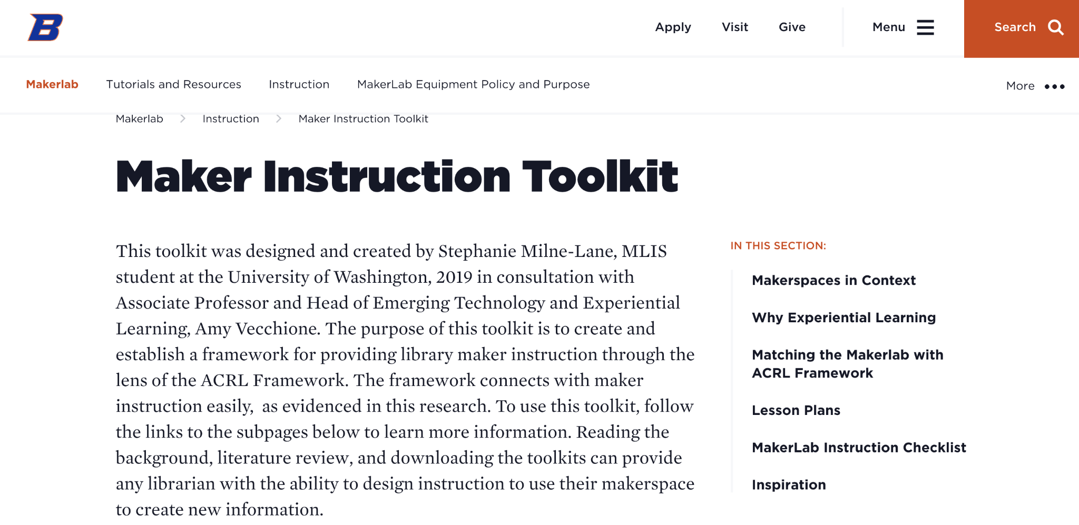
Maker Instruction Toolkit
Stephanie Milne-Lane and Amy Vecchione
Milne-Lane, Stephanie and Amy Vecchione. “Maker Instruction Toolkit.” Accessed May 20, 2021. https://www.boisestate.edu/library-makerlab/makerlab-instruction/maker-instruction-toolkit/.

Slide 7

Metaliteracy
Thomas Mackey and Trudi Jacobson
An overarching framework for emerging literacies.
Mindset > skill acquisition
Empowerment
Creation over consumption
Civic mindedness
Metacognition

Slide 8
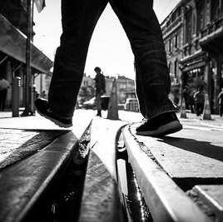
Liminality
And Maker Learning
Gennep (1908)
Turner (1960s)
Meyer and Land - Threshold concepts
Kim Skjoldager-Nielsen and Joshua Edelman, “Liminality,” Ecumenica 7, no. 1-2 (2014): 33-40.
Jan H.F. Meyer and Ray Land, “Threshold Concepts and Troublesome Knowledge (2): Epistemological Considerations and a Conceptual Framework for Teaching and Learning,” Higher Education 49, no. 3 (April, 2005): 377.
Image credit: Tuncay on Flickr, https://www.flickr.com/photos/tuncaycoskun/29287713956

Slide 9

Liminality
Barbara Fister
“...the place where we are between understandings. It’s the borderland we’re passing through as we move from a familiar place to an unknown place. It’s where we are unsettled, where we might turn back because it’s just too uncomfortable—or where we might feel exhilarated by the challenge.”
Fister, Barbara, “The Liminal Library: Making Our Libraries Sites of Transformative Learning,” (Paper presented at the LILAC Conference, April 13, 2015), 4, https://barbarafister.com/LiminalLibrary.pdf.

Slide 10
Maker Literacy and Liminality
The Maker Mindset
Open ended
Tinkering
Failure as learning

Slide 11
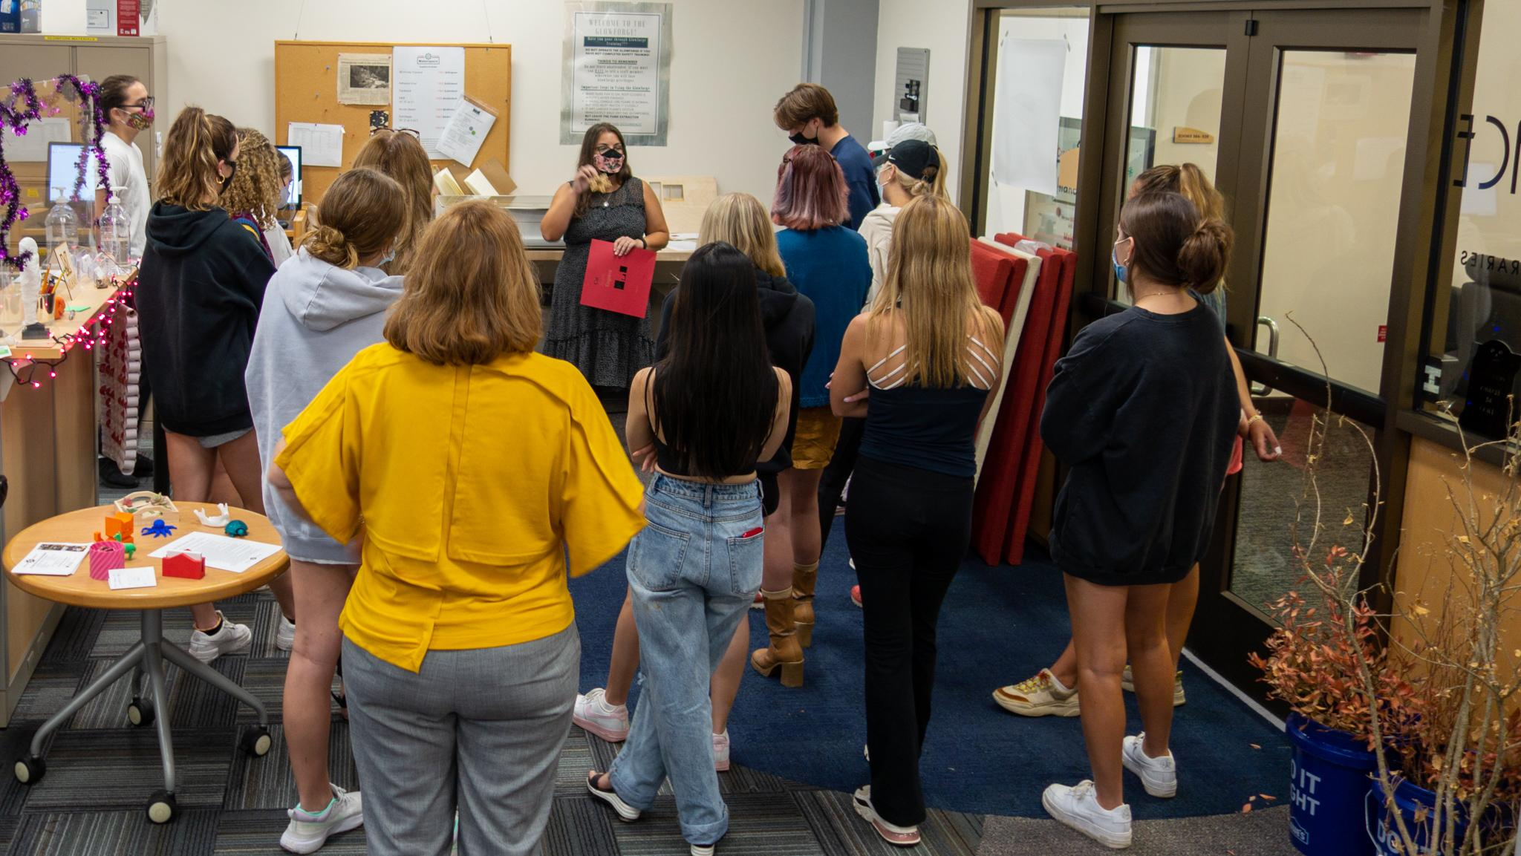
Student Learning Outcomes
For each Frame:
Foundational
Emerging
Culminating
Learning Outcomes: https://docs.google.com/document/d/1dc6WptVHVAgd-uuZvrpuc4gKdTgi-2AqoMtulawYxVc/edit?usp=sharing

Slide 12
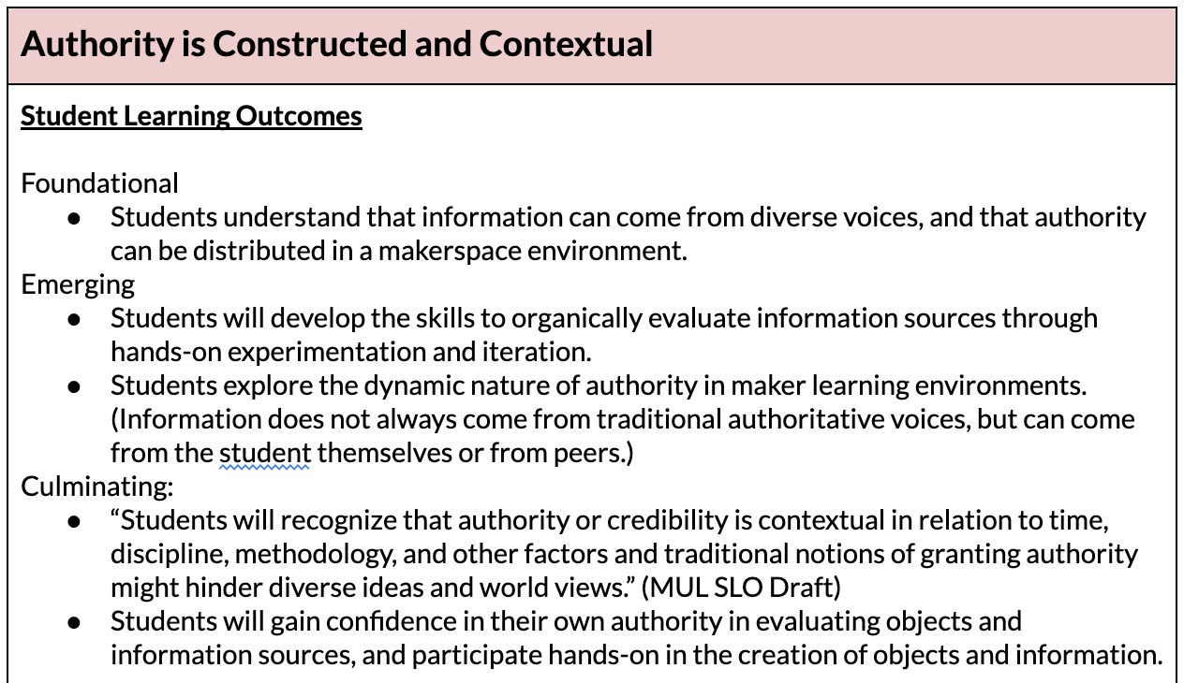
SLO Examples
Learning Outcomes: https://docs.google.com/document/d/1dc6WptVHVAgd-uuZvrpuc4gKdTgi-2AqoMtulawYxVc/edit?usp=sharing

Slide 13
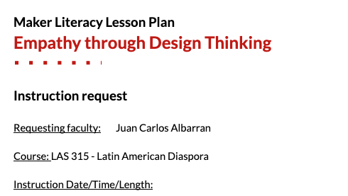
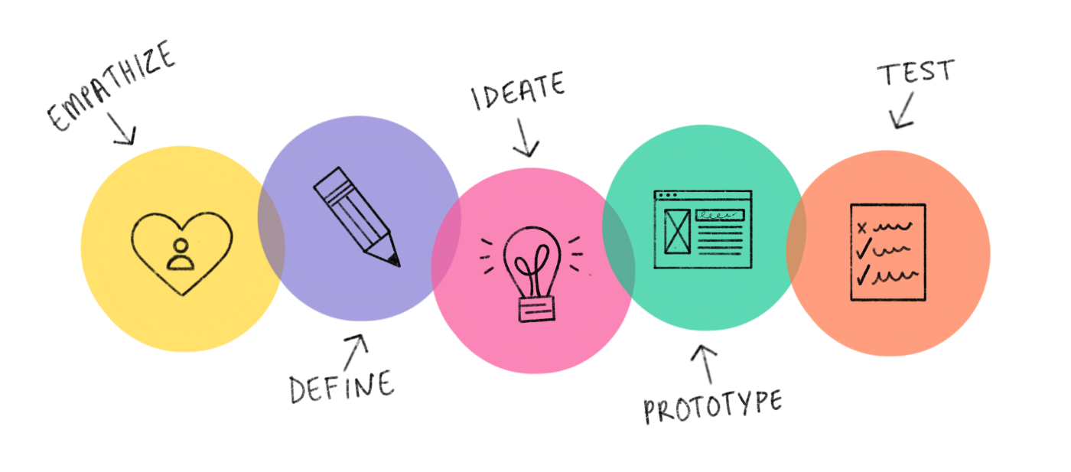
LAS 315 Latin American Diaspora in the US
Flipping the script of design thinking
Empathy interviews
Assumptions vs. insights
Create a logo design
(Metacognition, empowerment, civic mindedness)

Slide 14
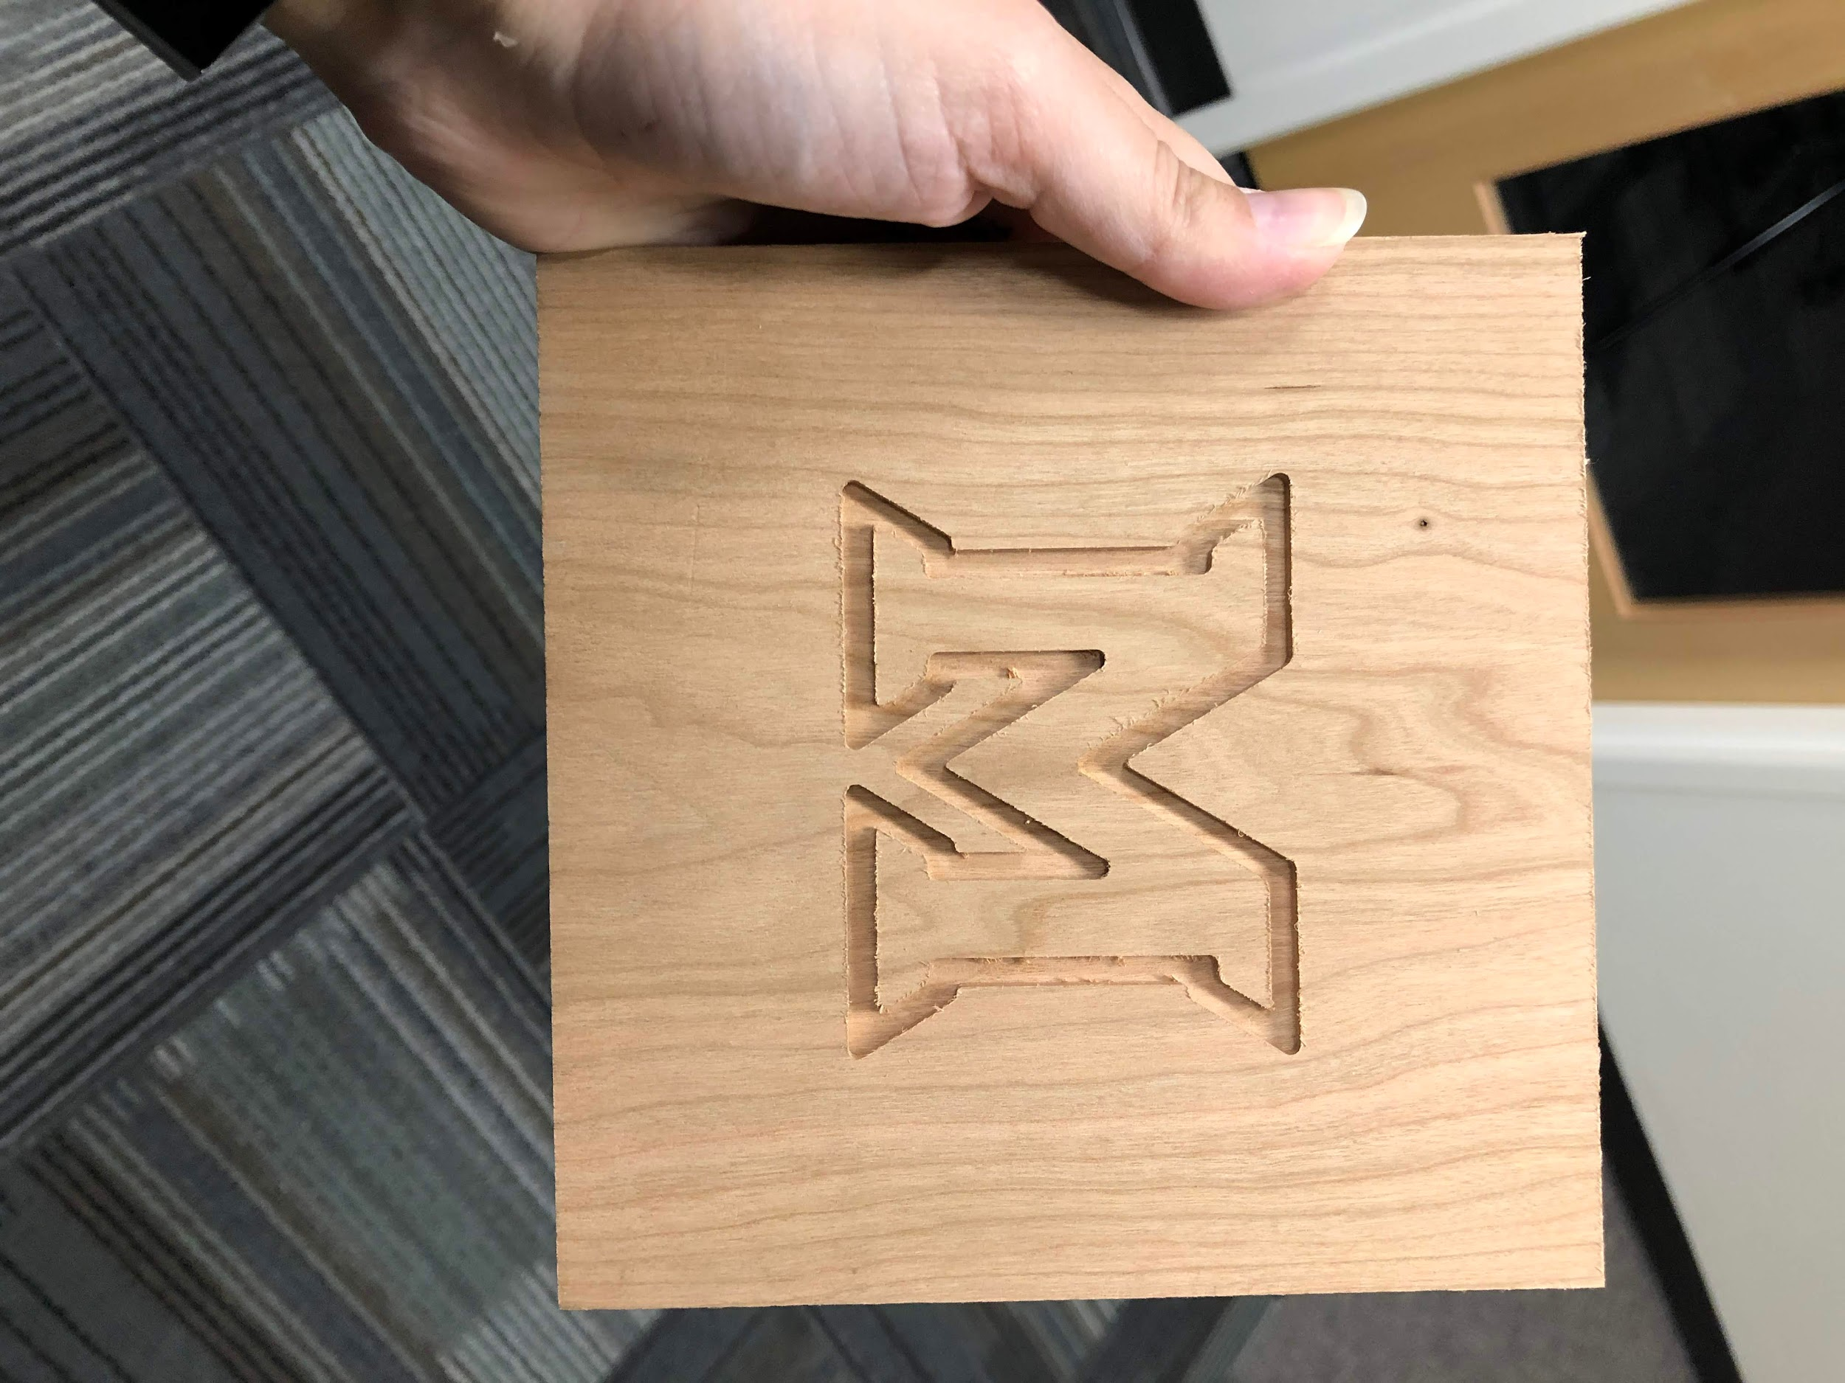
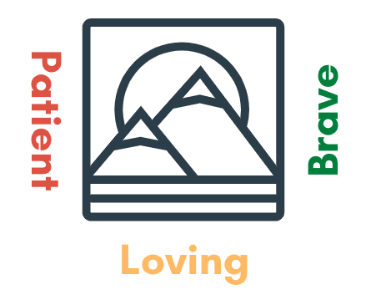
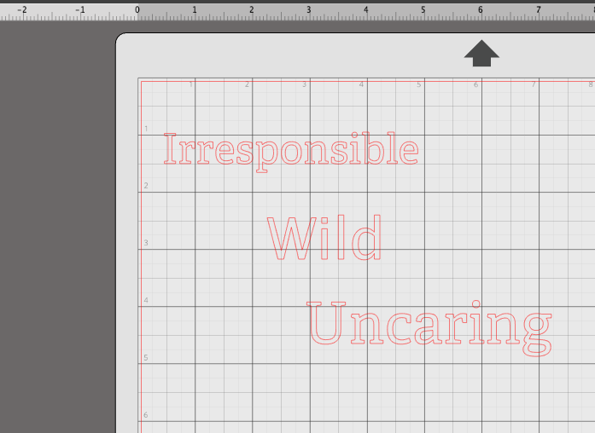
UNV 101 Identity Exploration Assignments
Who I Am Not
Who I Am
(Metacognition as a tool for self-discovery)

Slide 15
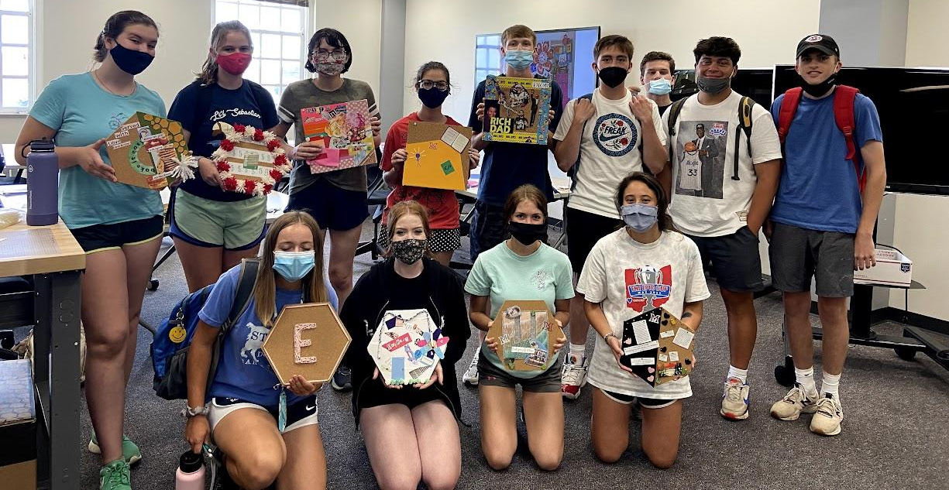
UNV 101 Identity Exploration Assignments

Slide 16
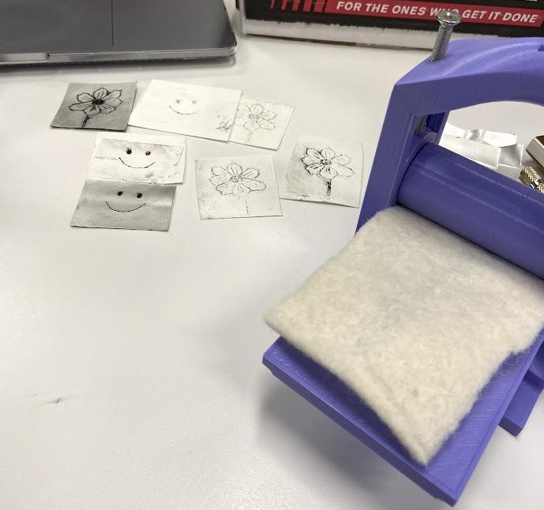
SPN 450: Short Forms of the Mexican Revolution
Print & photography tech of the Mexican Revolution
  Printing presses
  Halftone photography
Hands-on with historical technology!
(Empowerment through hands-on tinkering and exploration of technology)

Slide 17
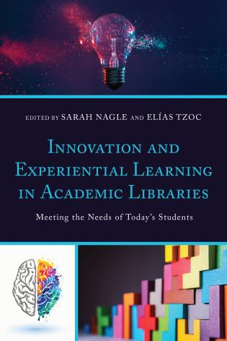
Thanks
Do you have any questions?
pricesb@miamioh.edu
Twitter: SarahNagle10
Please keep this slide for attribution

Slide 18
Sources
Agency by Design. (n.d.) The Framework for Maker-Centered Learning. http://www.agencybydesign.org/explore-the-framework
Boardman, B. S., & Wallace, M. K., & Chivers, M. (2019, July 28). A Makerspace Project for New Transfer Students. Paper presented at the 2019 First Year Engineering Experience Conference, Pennsylvania, PA. Retrieved from https://peer.asee.org/33697
Fister, Barbara, “The Liminal Library: Making Our Libraries Sites of Transformative Learning,” (Paper presented at the LILAC Conference, April 13, 2015), 4, https://barbarafister.com/LiminalLibrary.pdf.
Jacobson, Trudi, Tom Mackey, and Kelsey O’Brien, “Metaliterate Learner Roles,” 2018, https://metaliteracy.org/ml-in-practice/metaliterate-learner-roles/
Meyer, Jan H.F. and Ray Land, “Threshold Concepts and Troublesome Knowledge (2): Epistemological Considerations and a Conceptual Framework for Teaching and Learning,” Higher Education 49, no. 3 (April, 2005): 377.
Milne-Lane, Stephanie and Amy Vecchione. “Maker Instruction Toolkit.” Accessed May 20, 2021. https://www.boisestate.edu/library-makerlab/makerlab-instruction/maker-instruction-toolkit/.
Skjoldager-Nielsen, Kim and Joshua Edelman, “Liminality,” Ecumenica 7, no. 1-2 (2014): 33-40.
Wallis, Lauren and Andrew Battista, “The Politics of Information: Students as Creators in a Metaliteracy Context,” in Metaliteracy in Practice, ed. Trudi Jacobson and Thomas Mackey (Chicago: American Library Association (ALA)/Neal-Schuman Publishers, Inc., 2016), 23-46.

