Slide 1
MAKING
CHANGES
Sustaining Innovative Services During a Pandemic
Lori Chapin
Sarah Nagle
Miami University Libraries

Slide 2
What We’ll Cover Today
Examples of online maker services
Maker Kits
Justifying new/ongoing costs of emerging tech to leadership

Slide 3
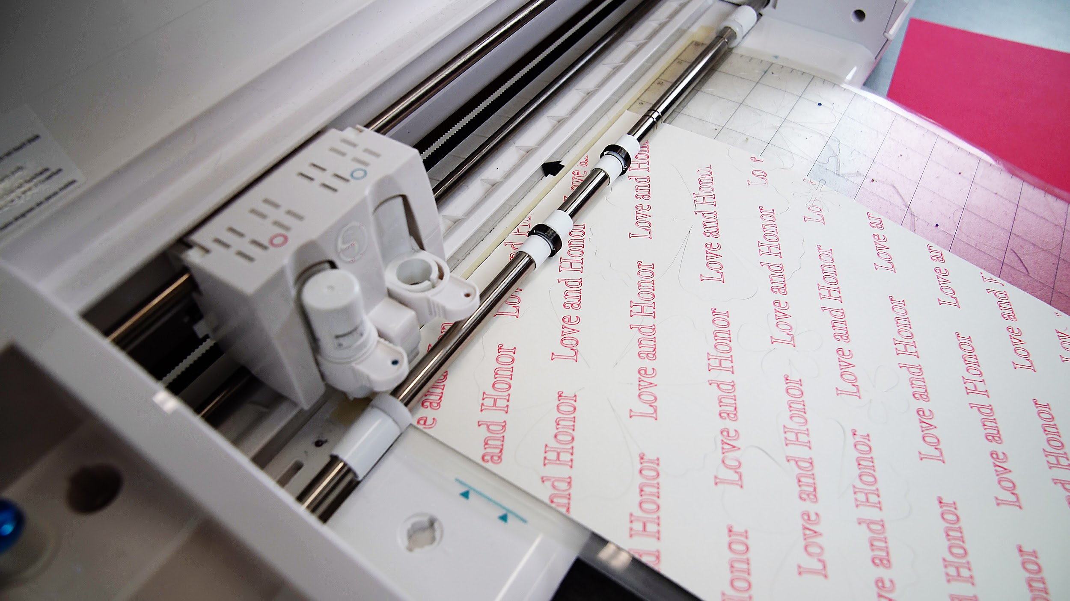
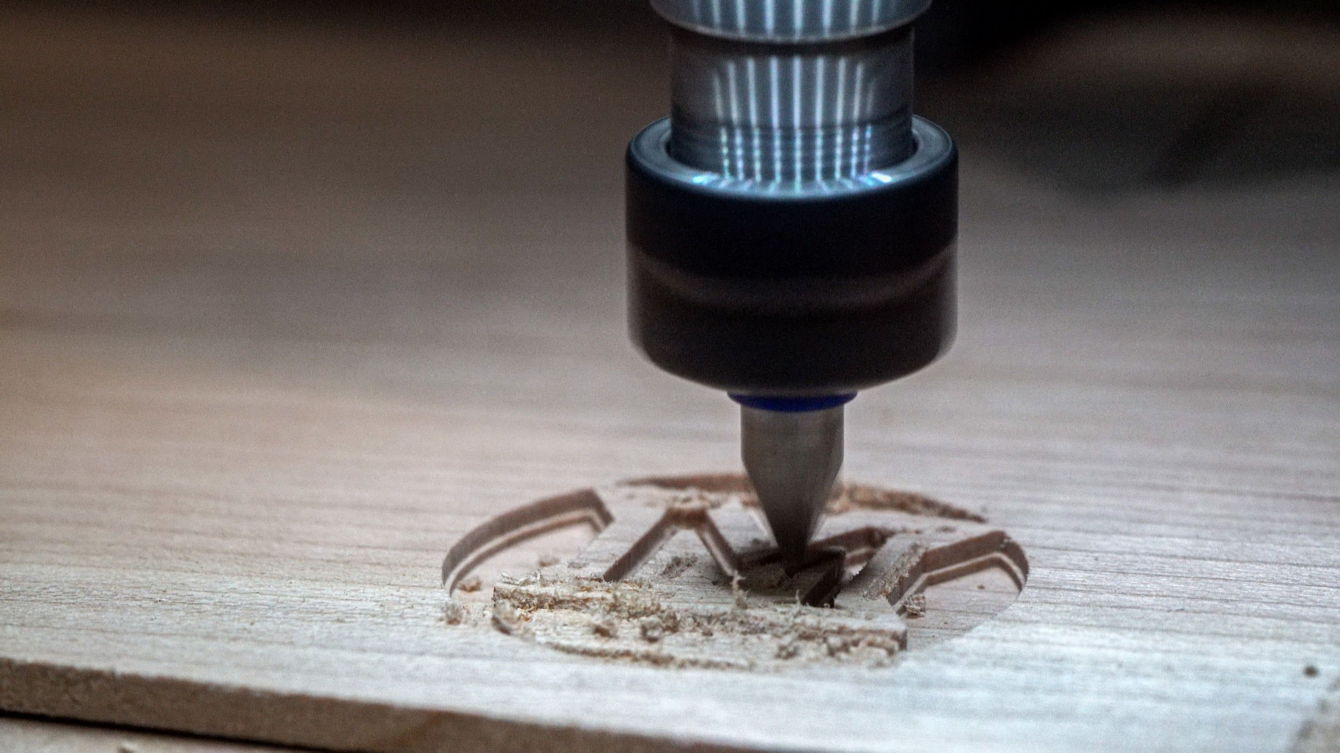
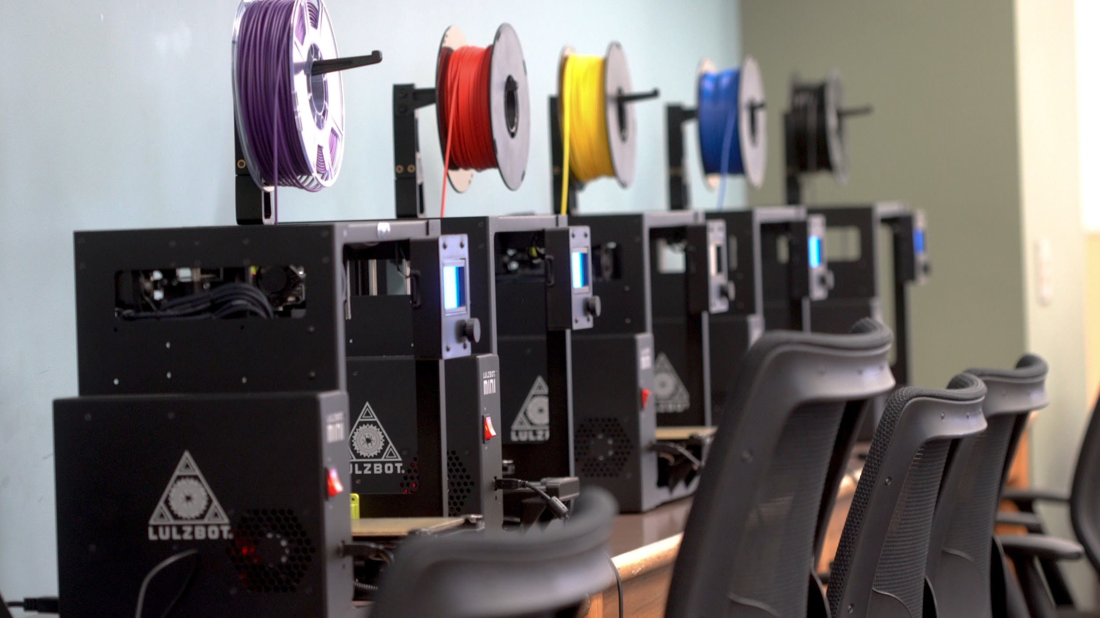
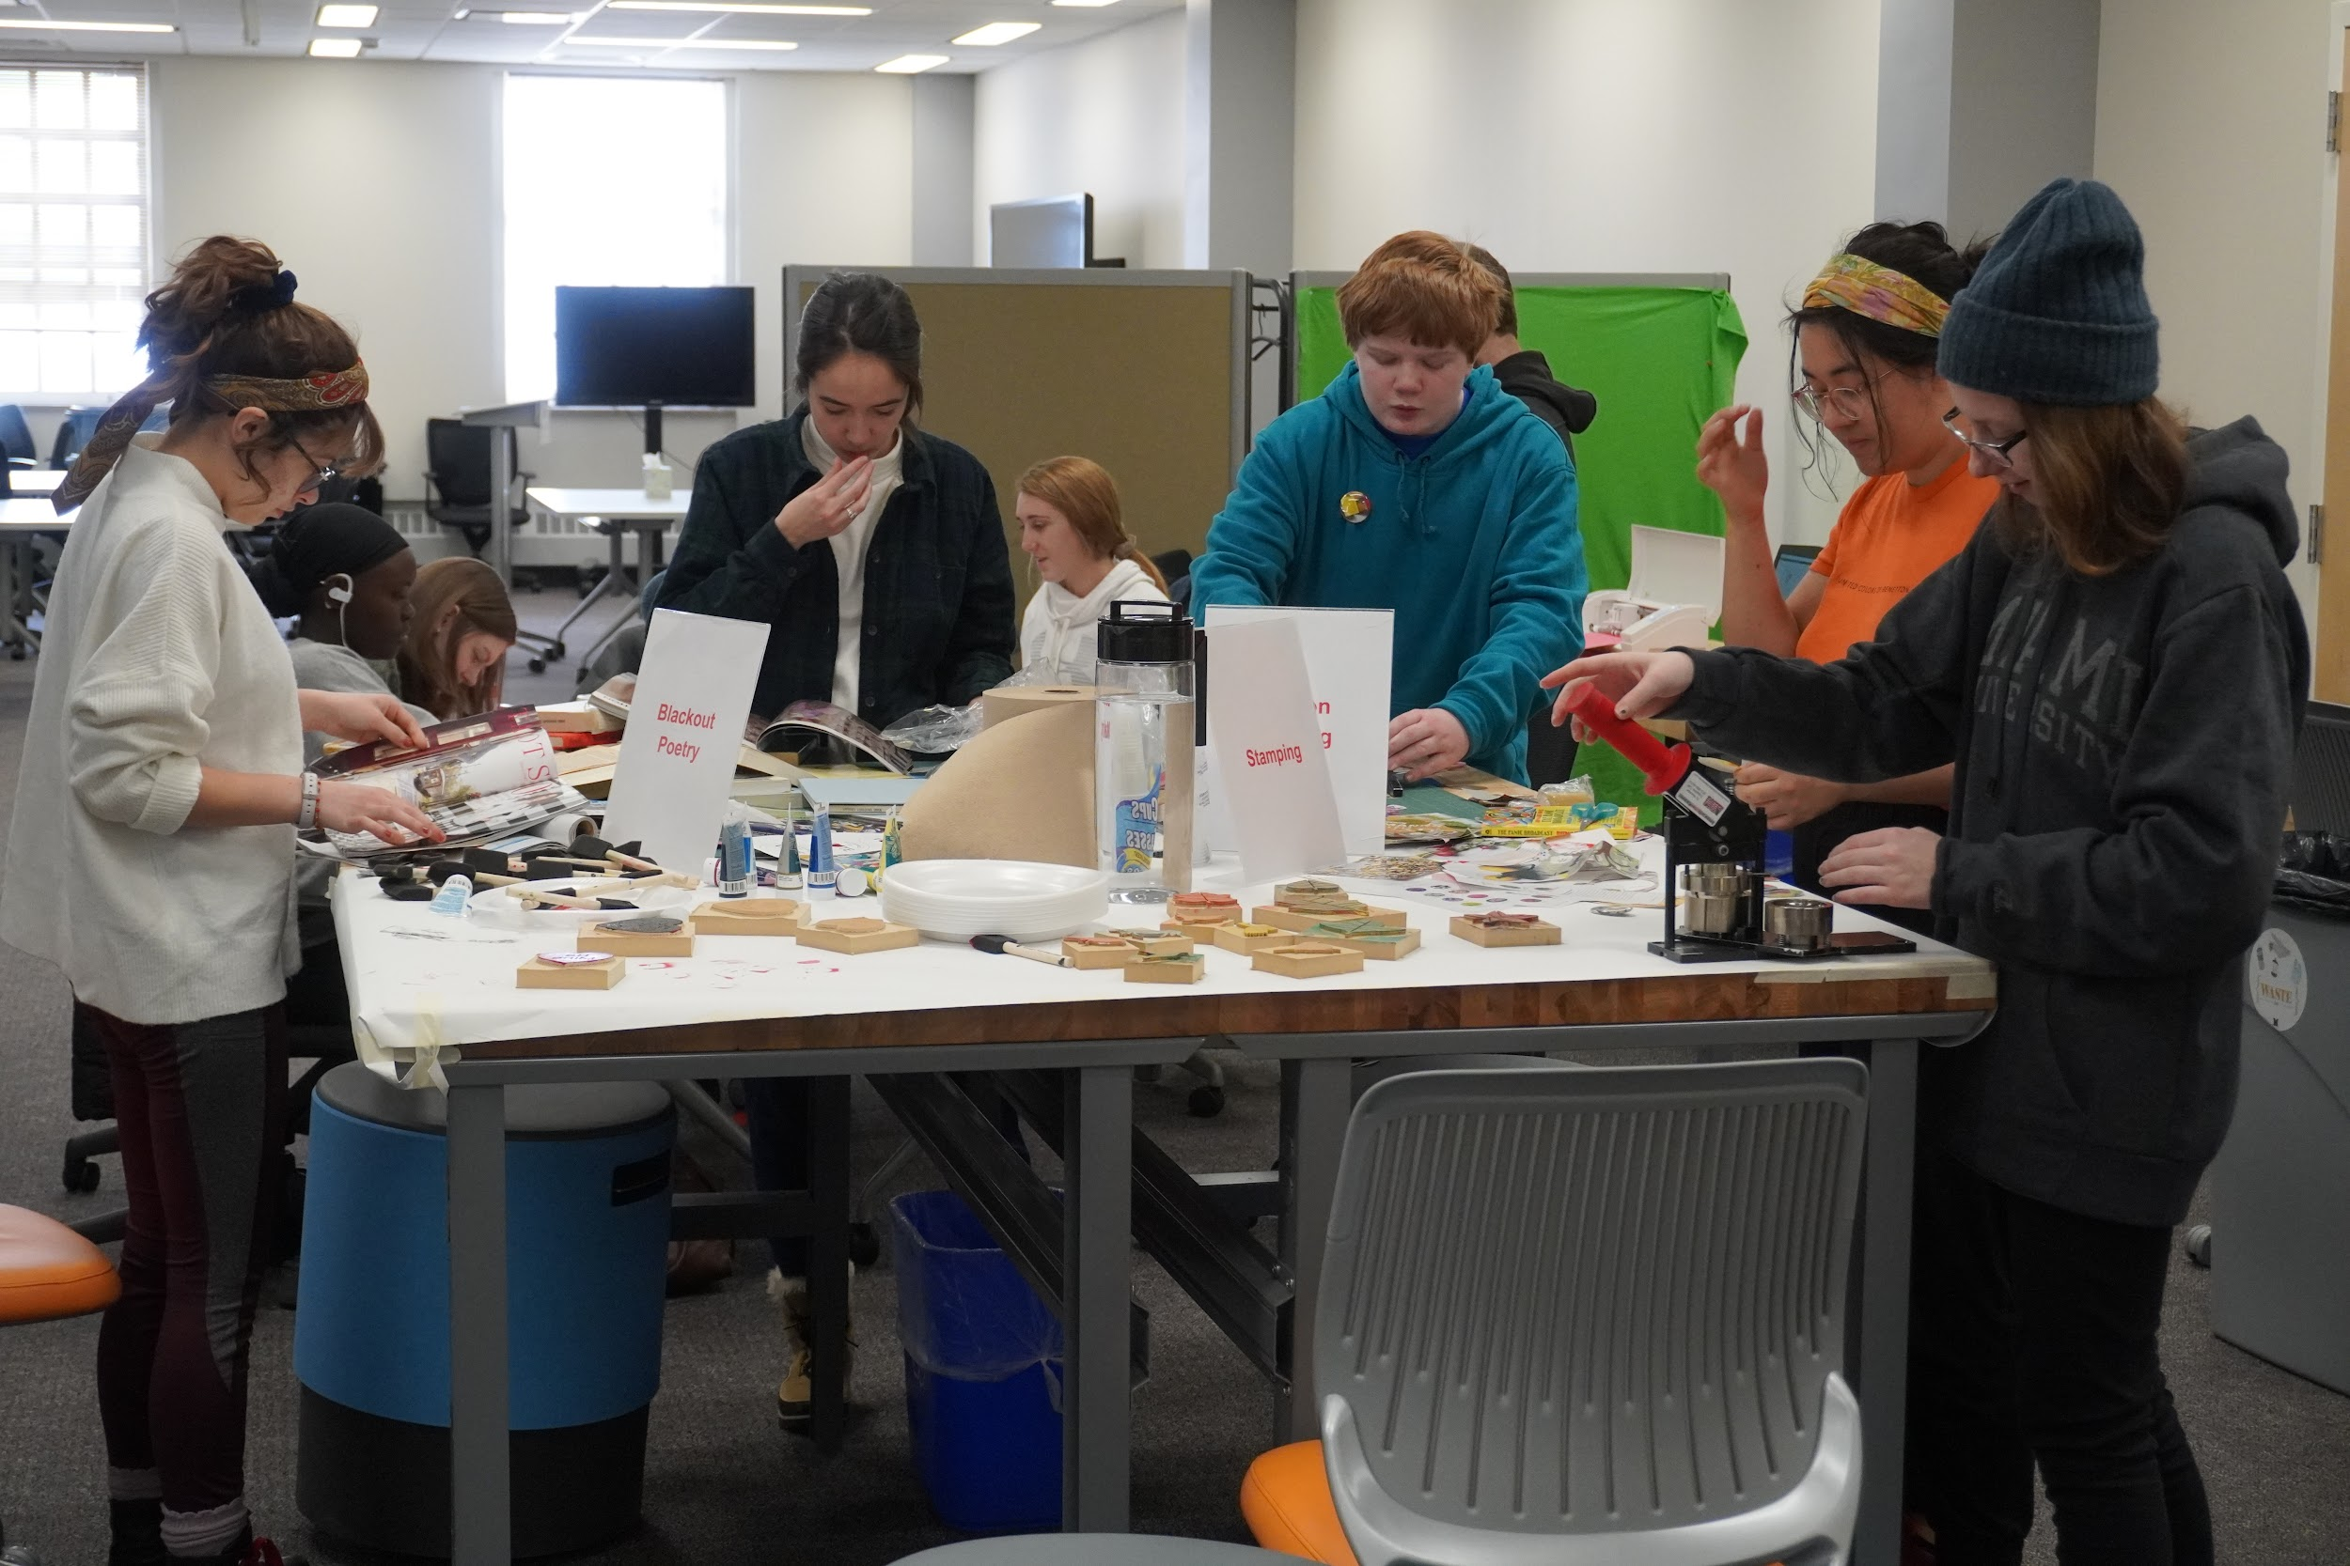
About the MUL Makerspace
Opened in August 2019
Equipment:
  3D Printers
  Carvey CNCs
  Sewing/Embroidery Machines
  Silhouette Cameos
  Heat Press
  Sublimation Printer
From the Makerspace’s opening in August 2019, to our COVID-related closure in mid-March, 2020, we saw 977 total walk-ins, and 312 unique registered users

Slide 4
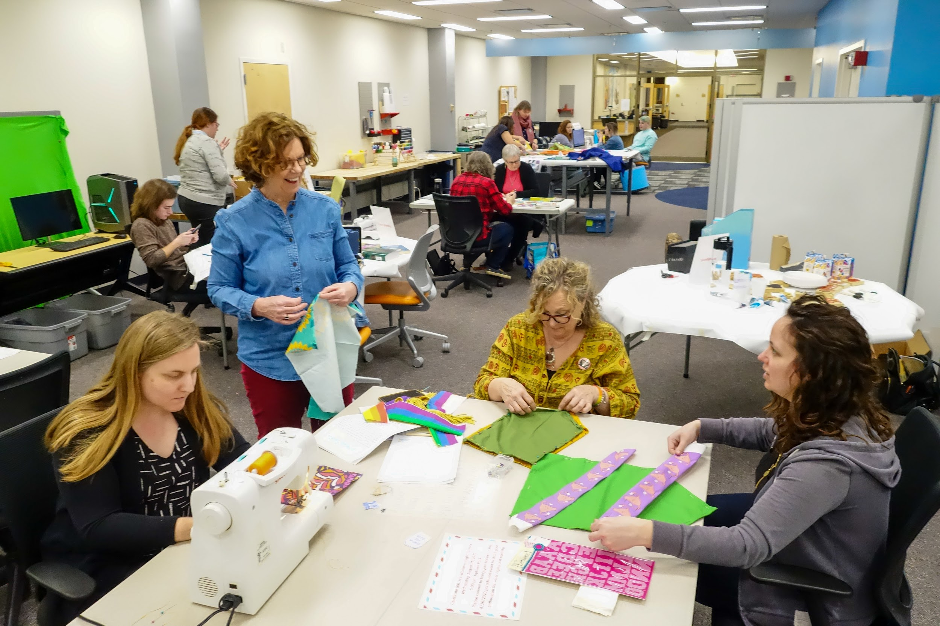
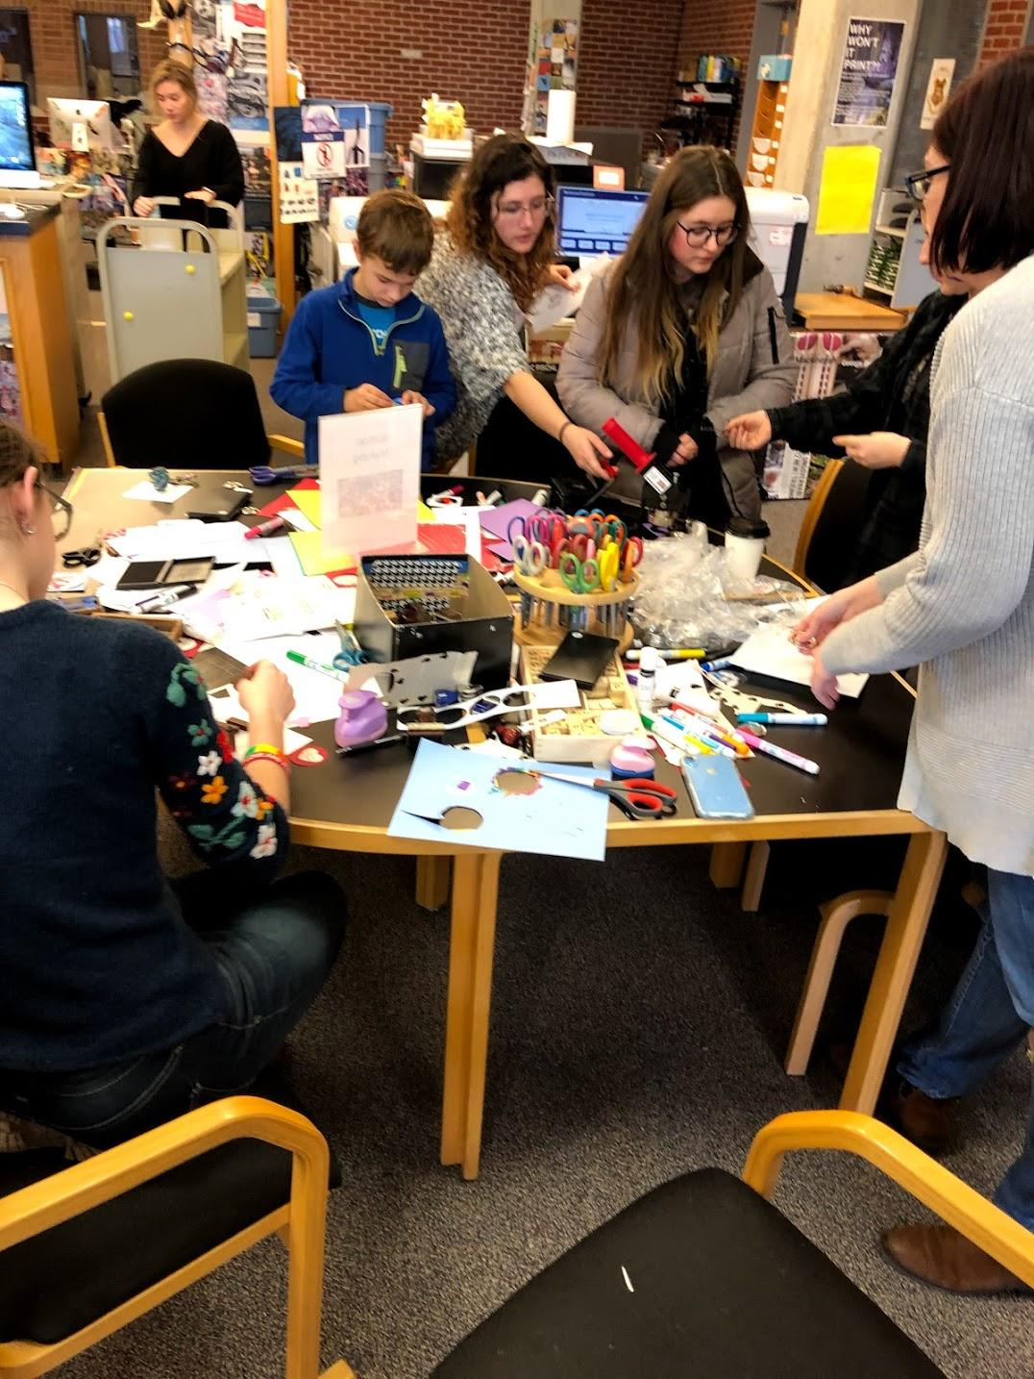
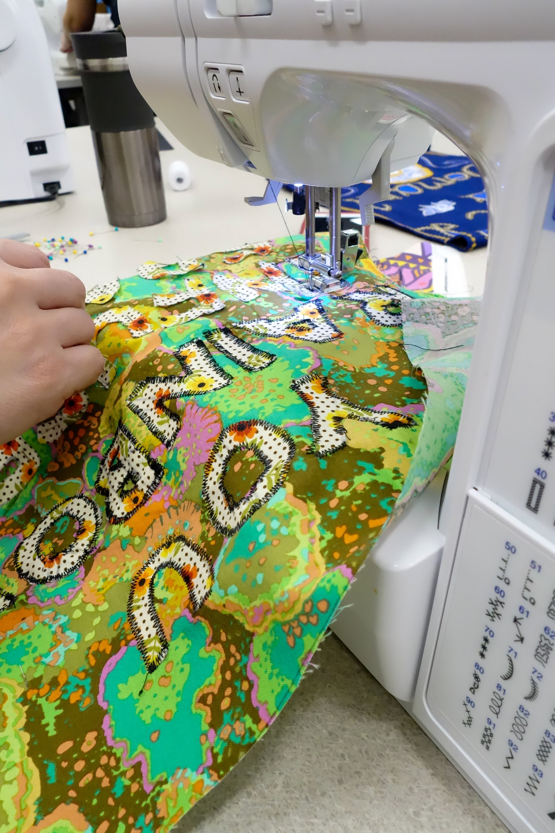
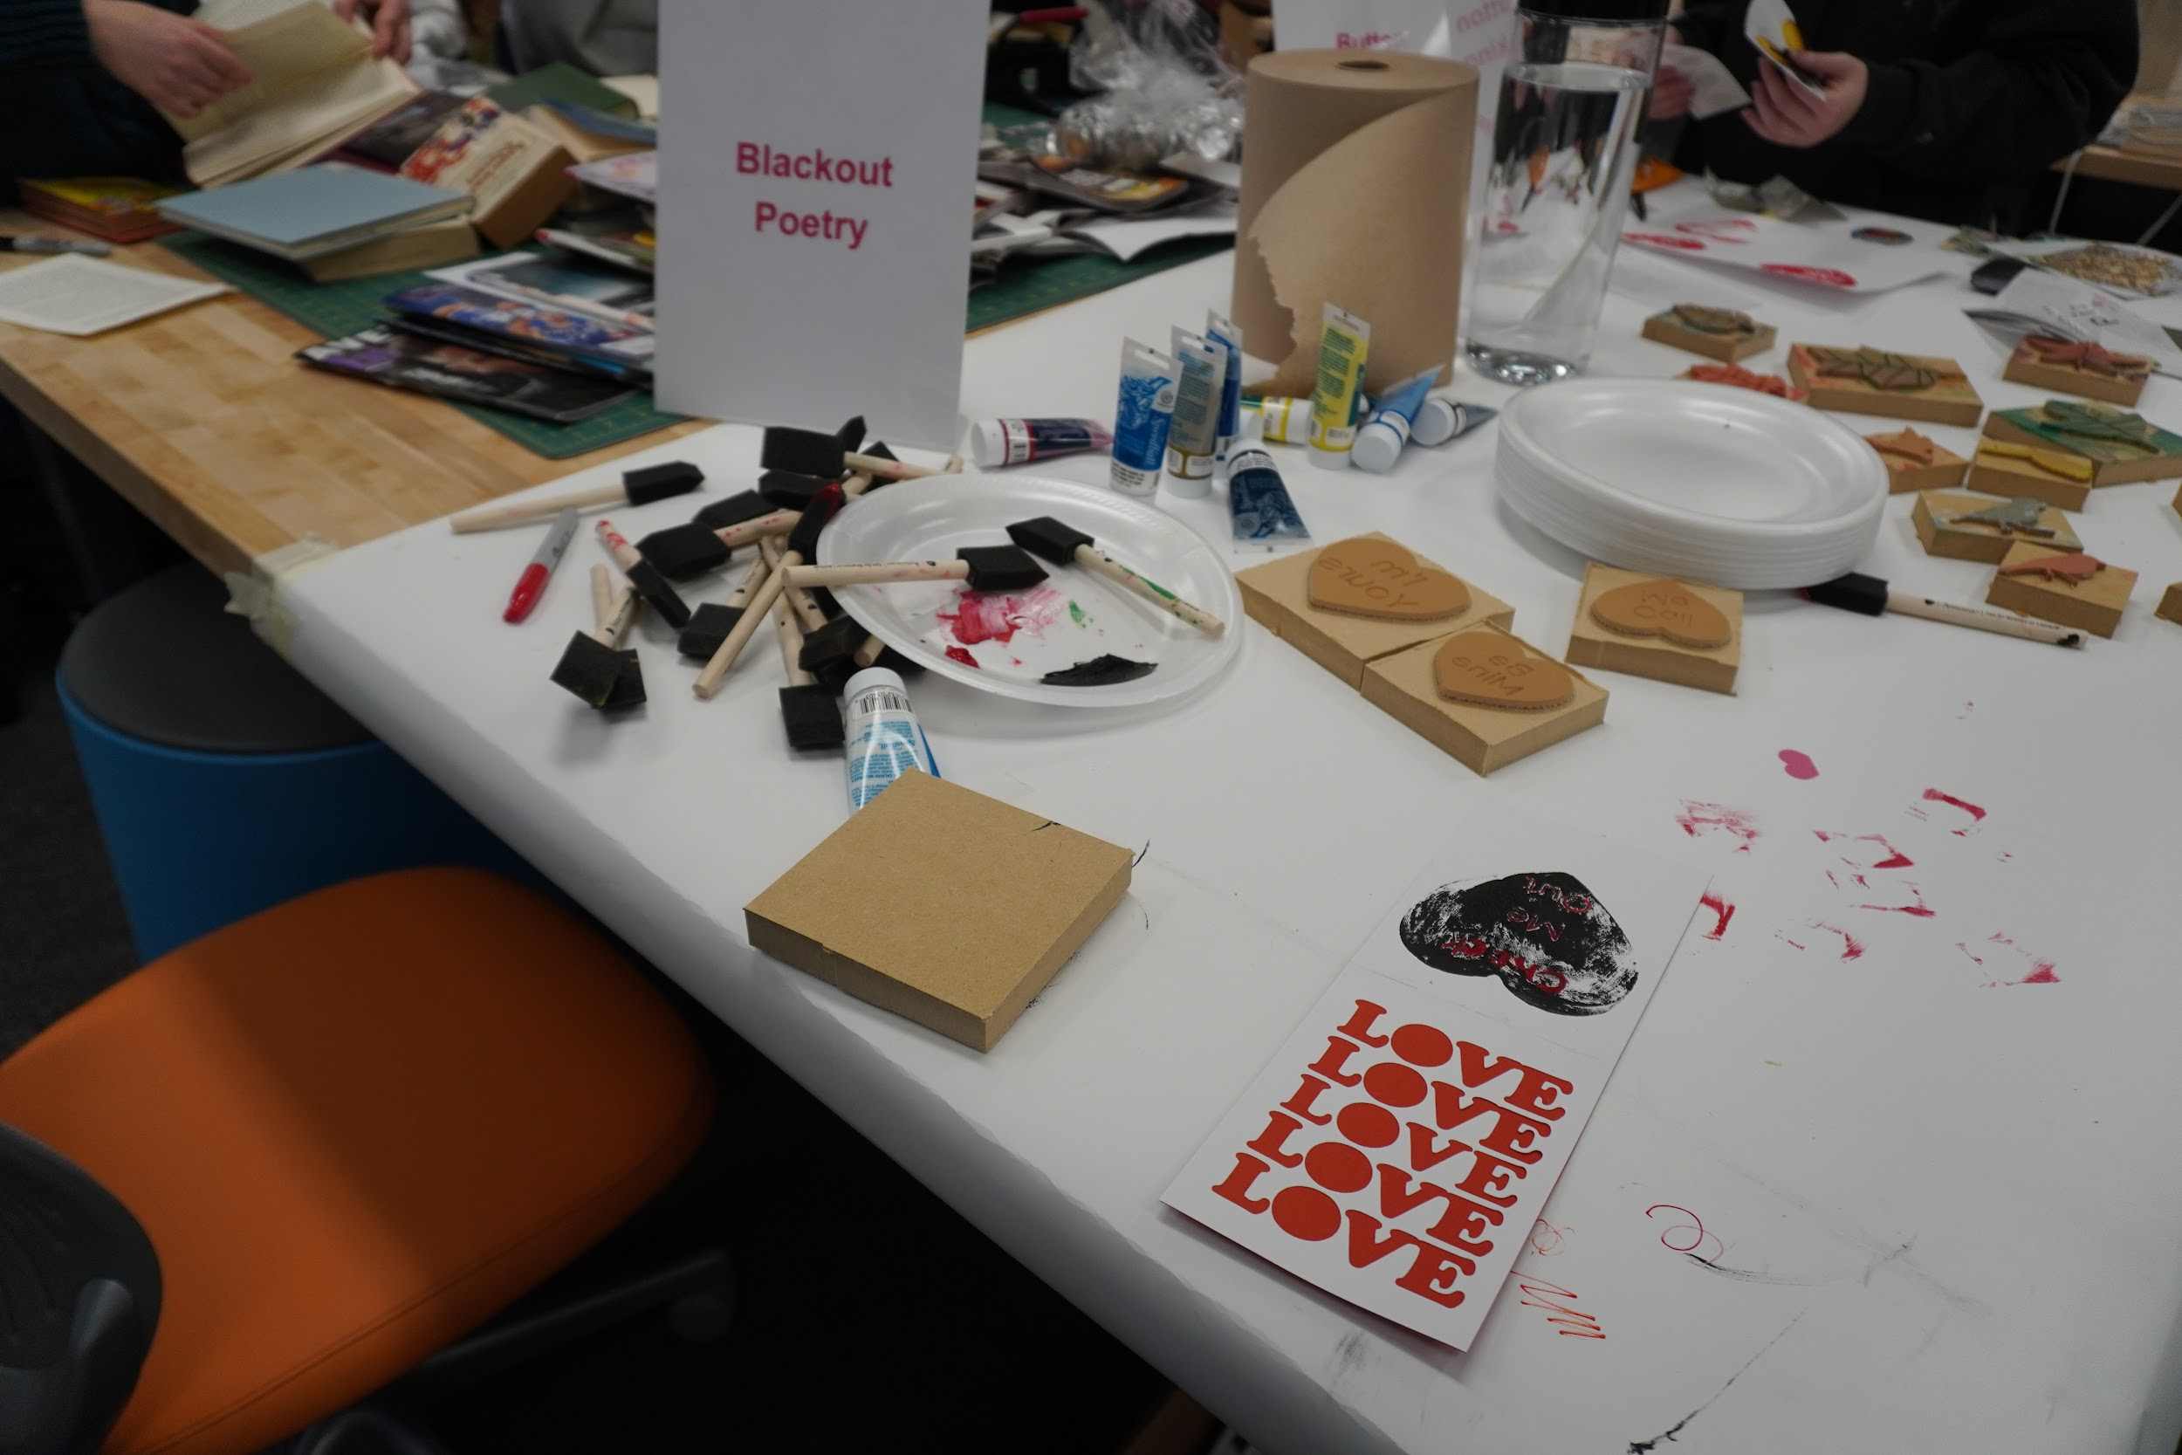
In-person Events
Total attendance for Fall 2019 Makerspace events was 561, and 115 for the first part of Spring 2020 semester before closing
I Heart Art
Creepy Crawly Crafts
Craft Your Heart Out
MakeHERspace

Slide 5
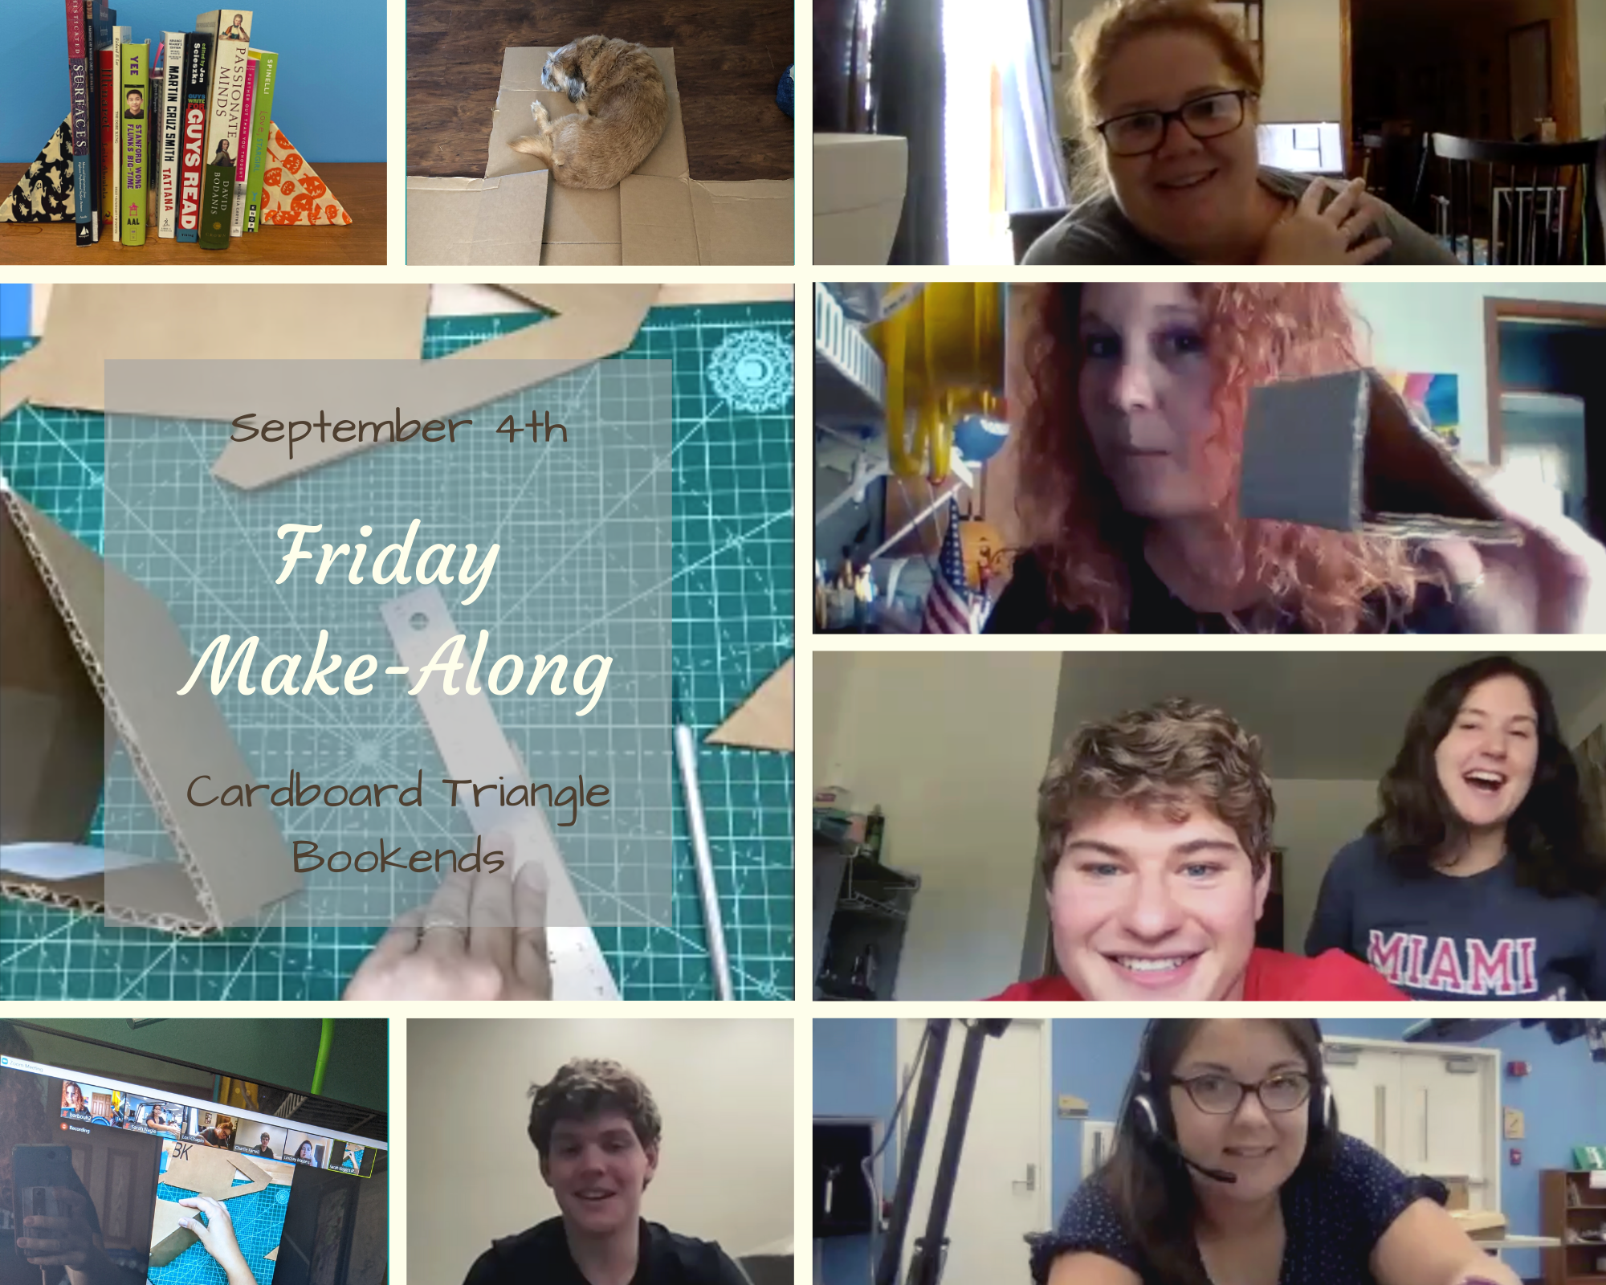
Friday Make-Alongs
Recreate community of in-person events
Very simple projects
Focus on student well-being, anti-stress

Slide 6
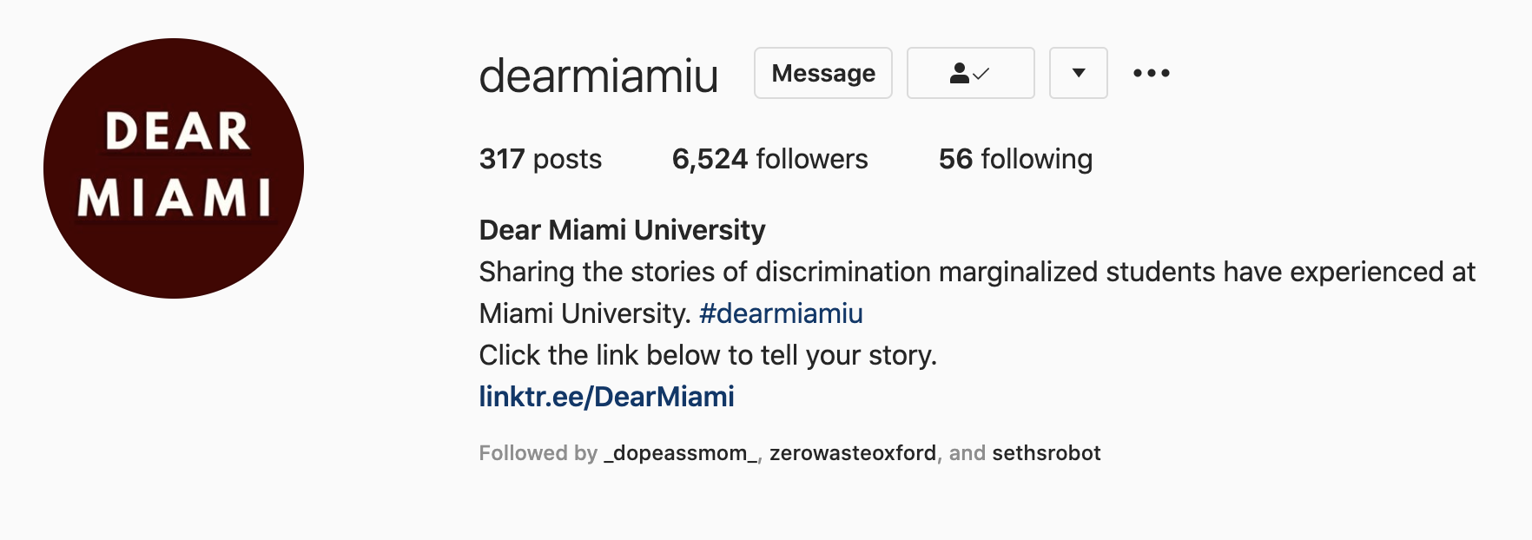
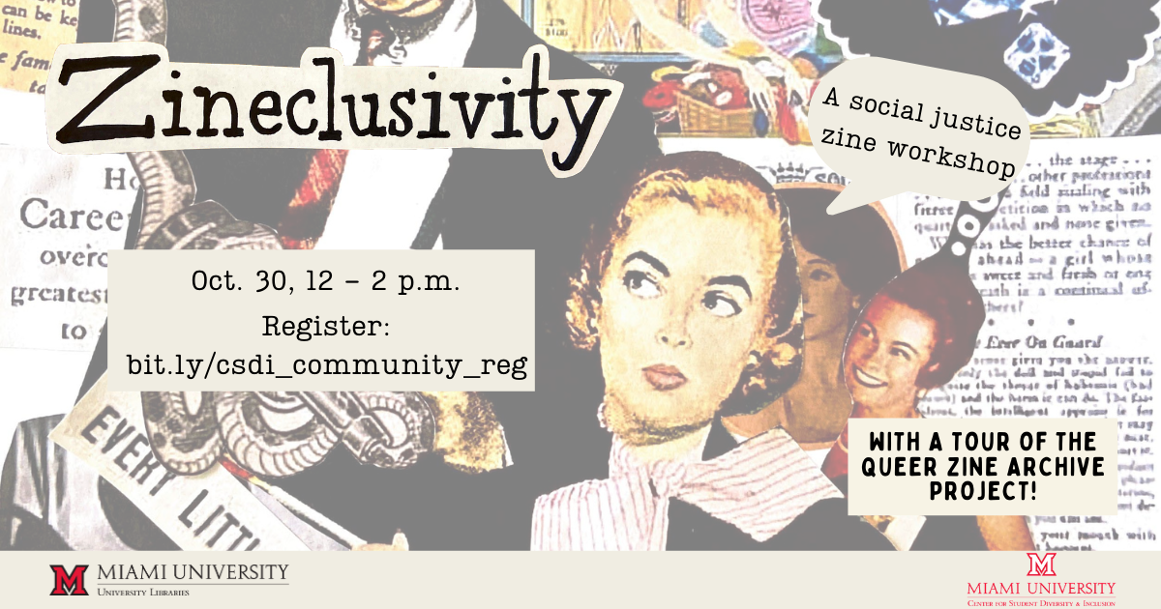
Zineclusivity
Stories of discrimination, micro-agreessions, sexual harassment
Students expressing frustration
Give students a voice and outlet
“How can we make Miami more inclusive”
Tour of Queer Zine Archive Project
  Talk on using zines for social justice

Slide 7
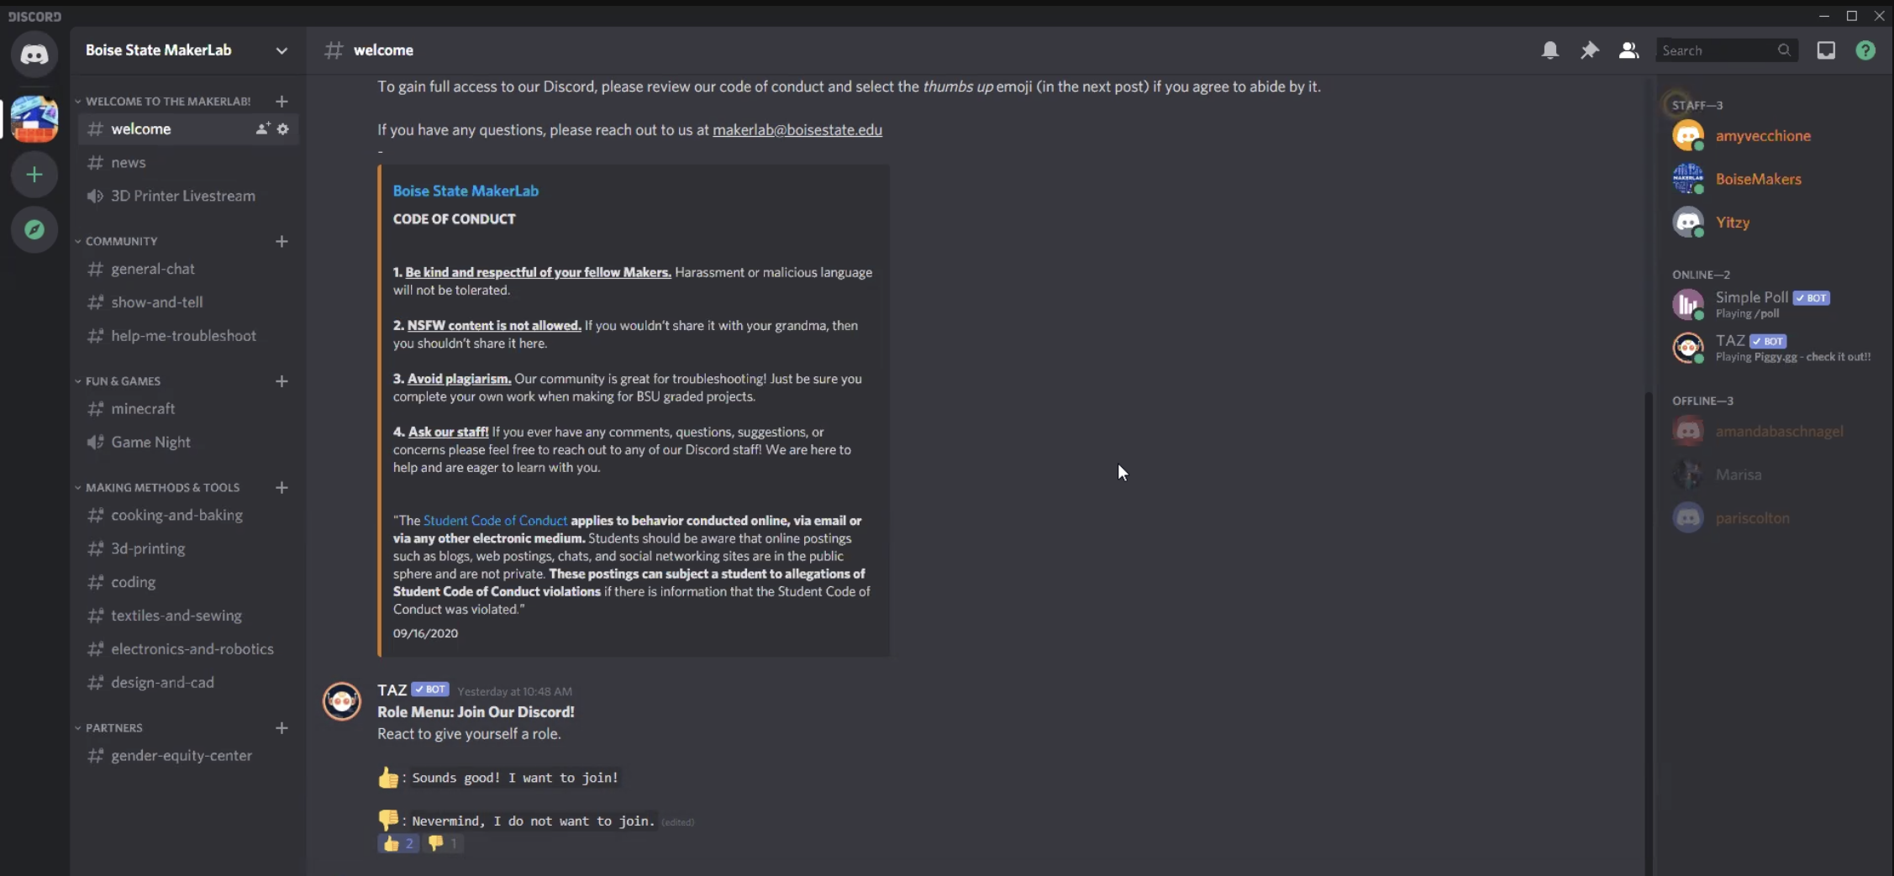
Discord
Screenshot from Boise State MakerLab Discord Server

Slide 8
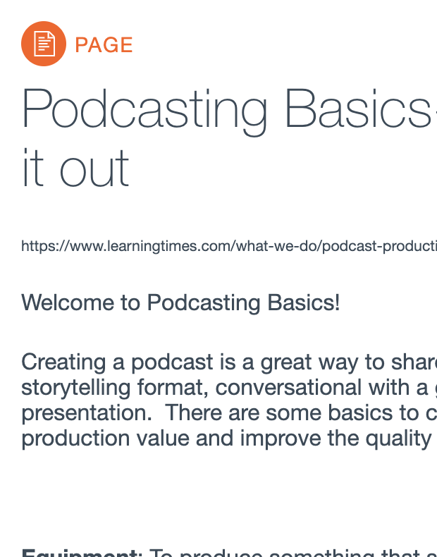
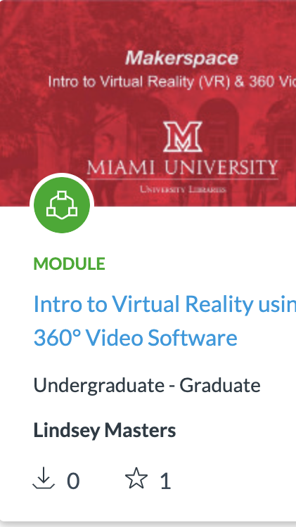
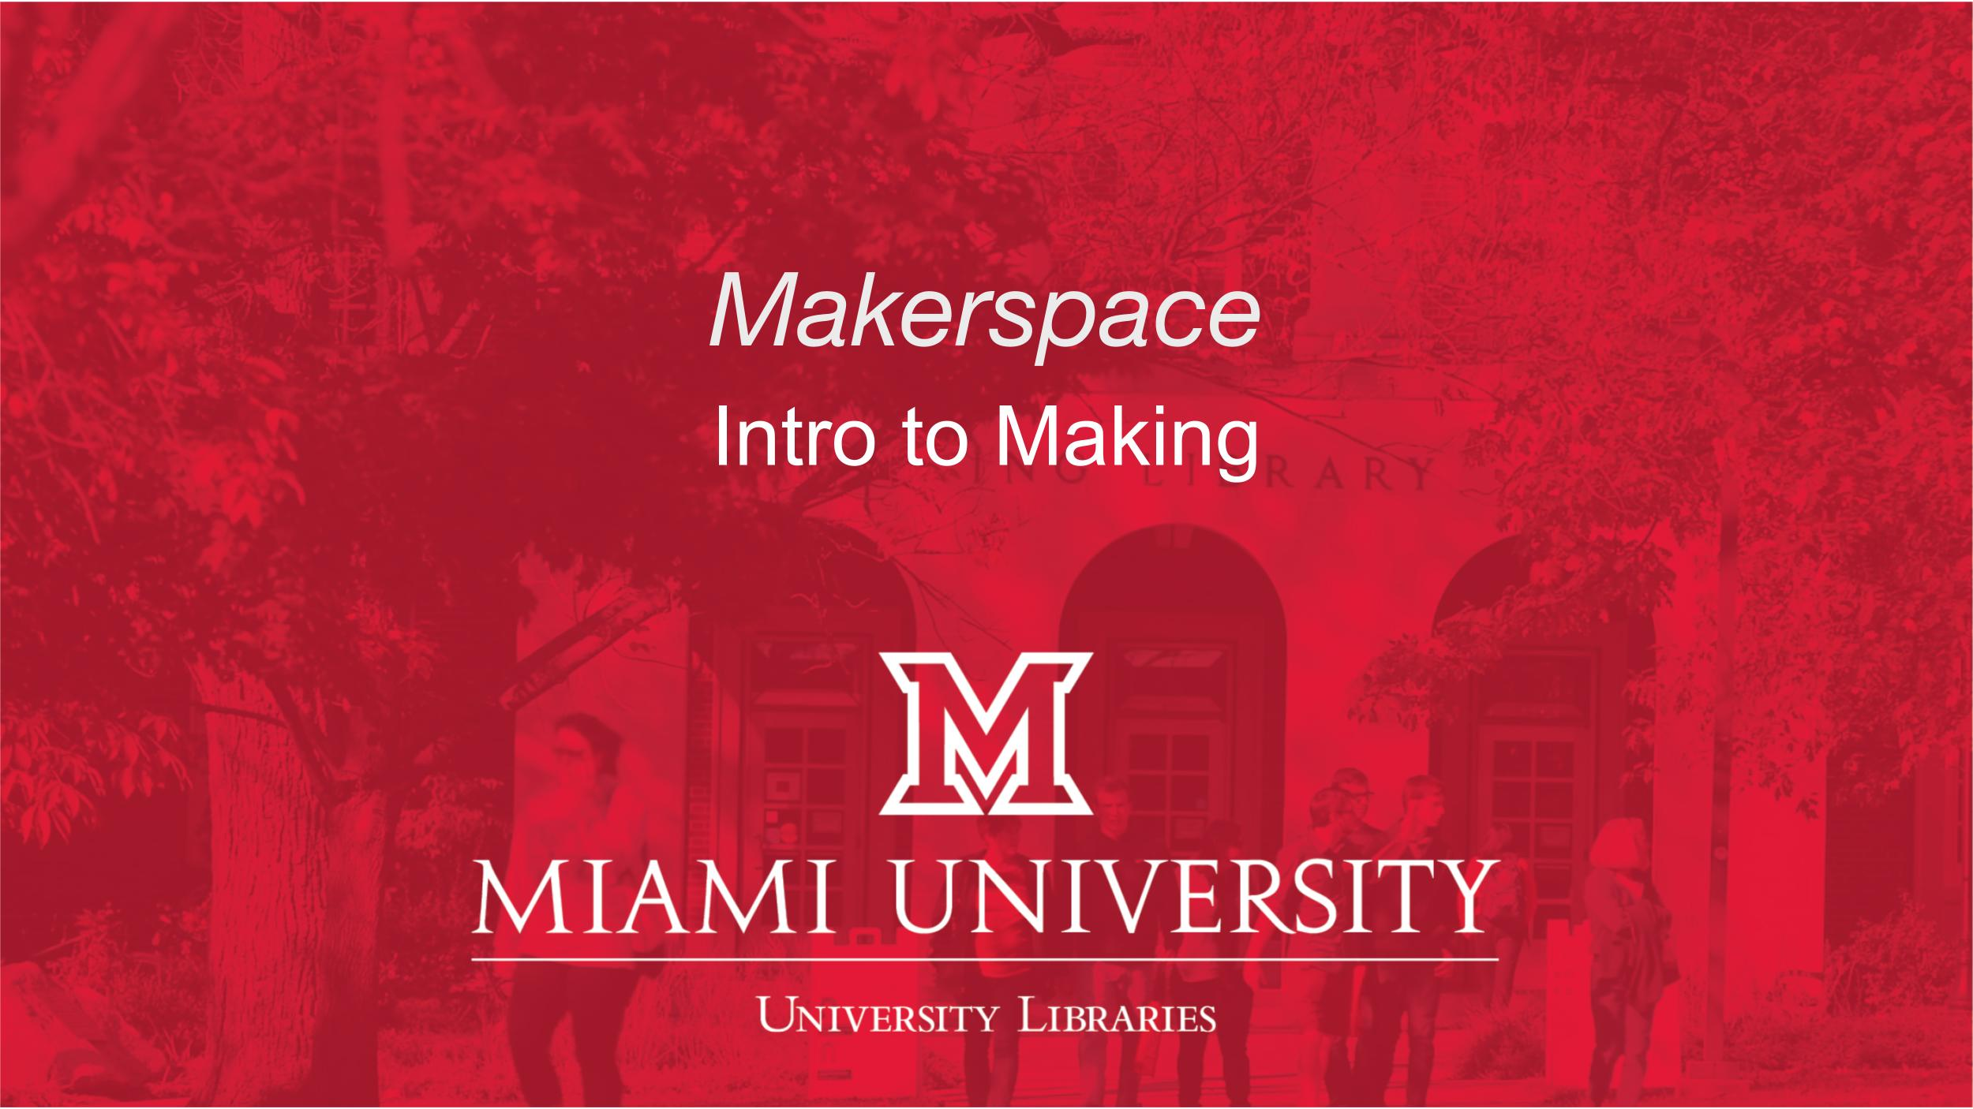
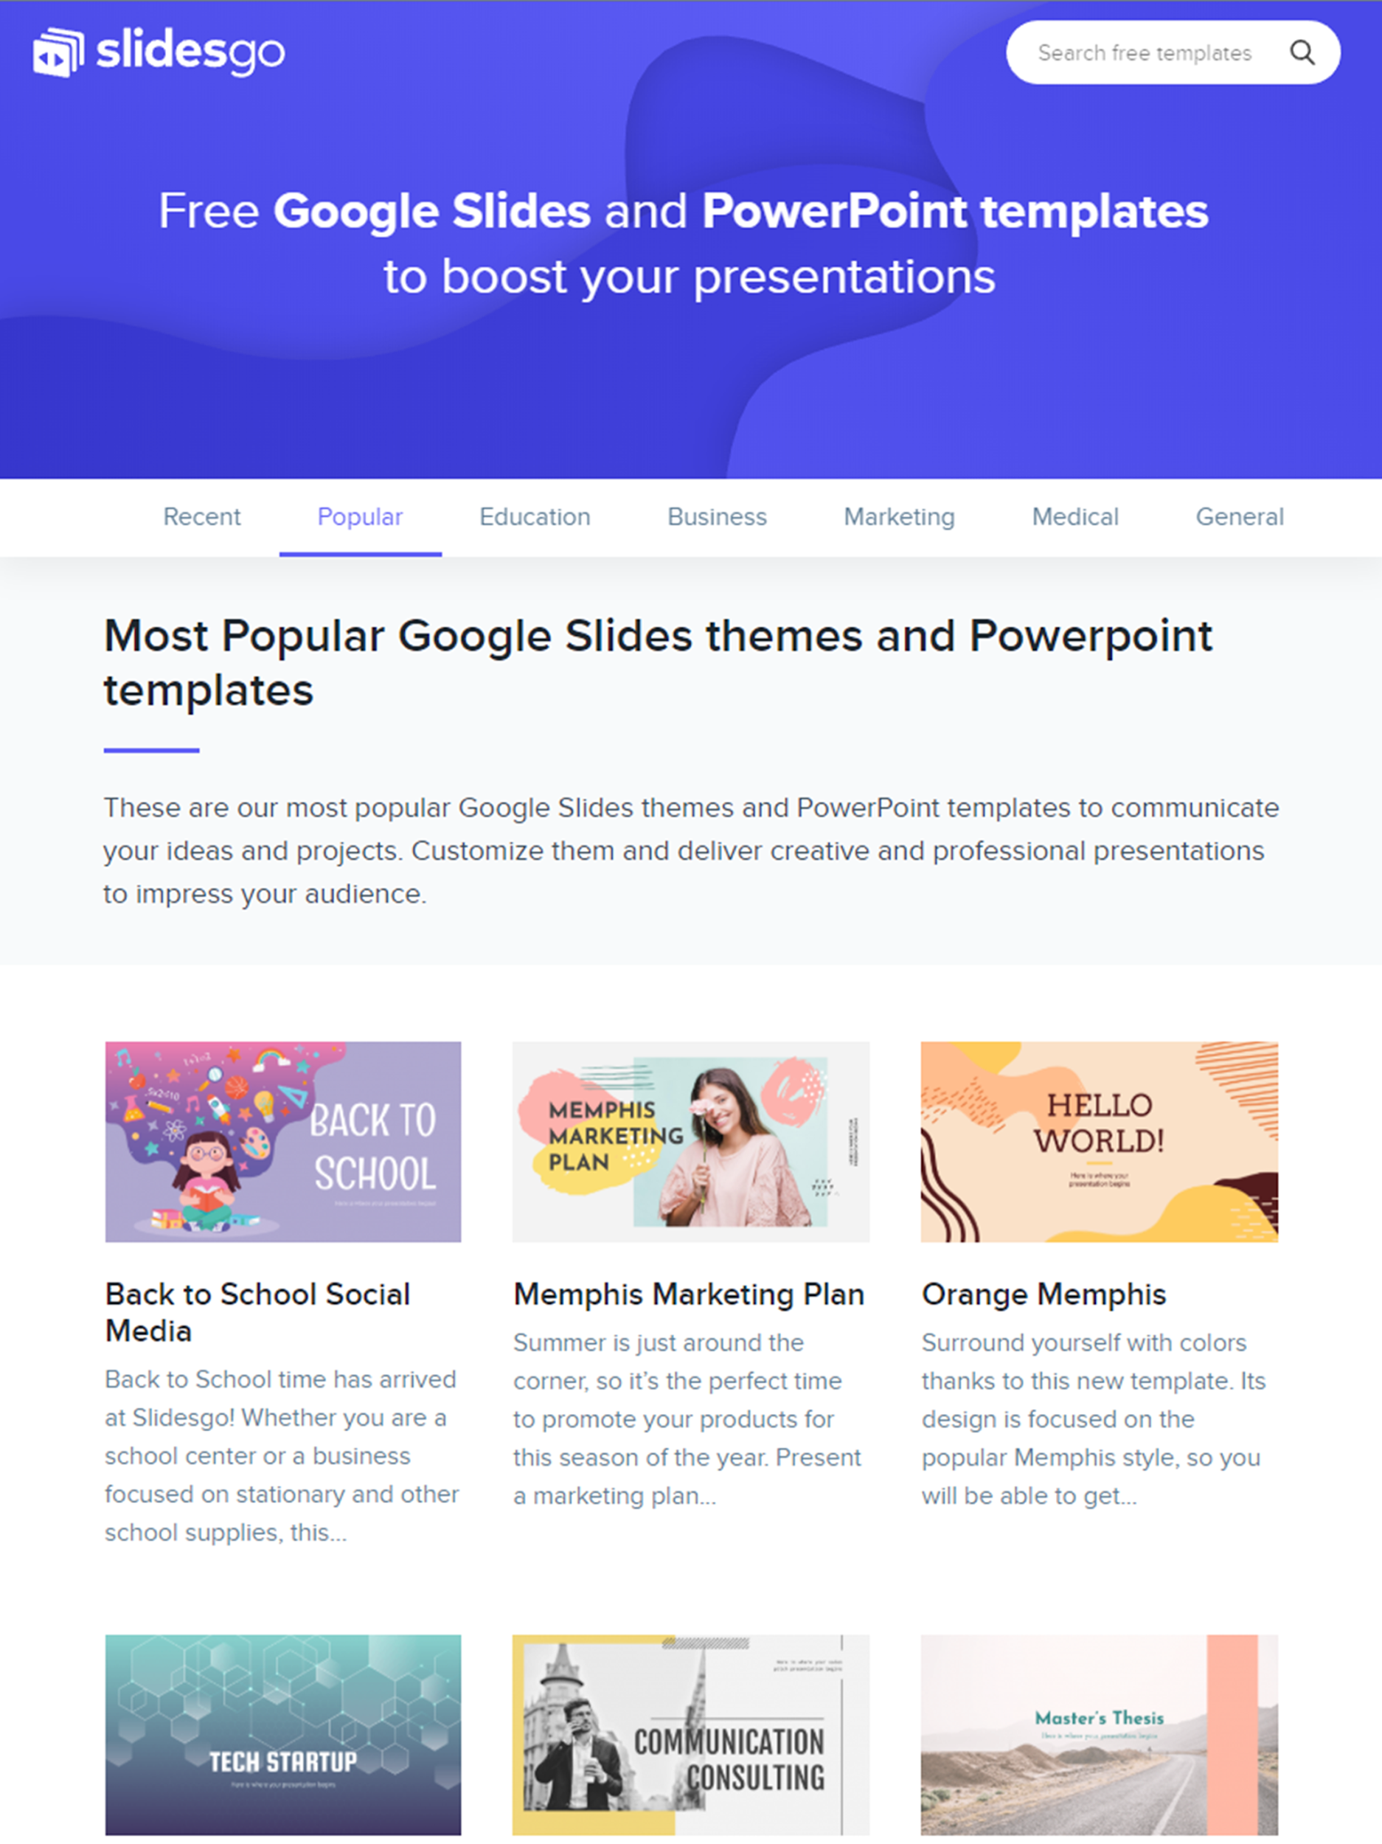
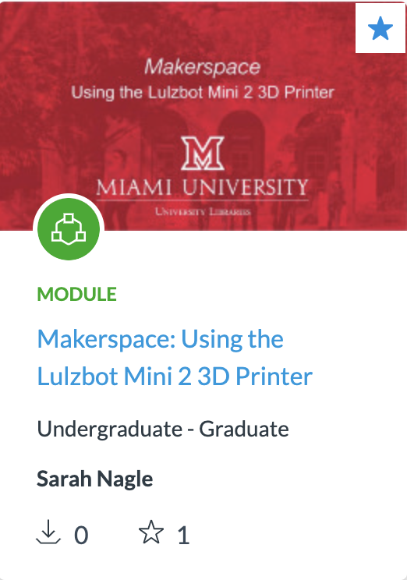
Canvas Modules

Slide 9
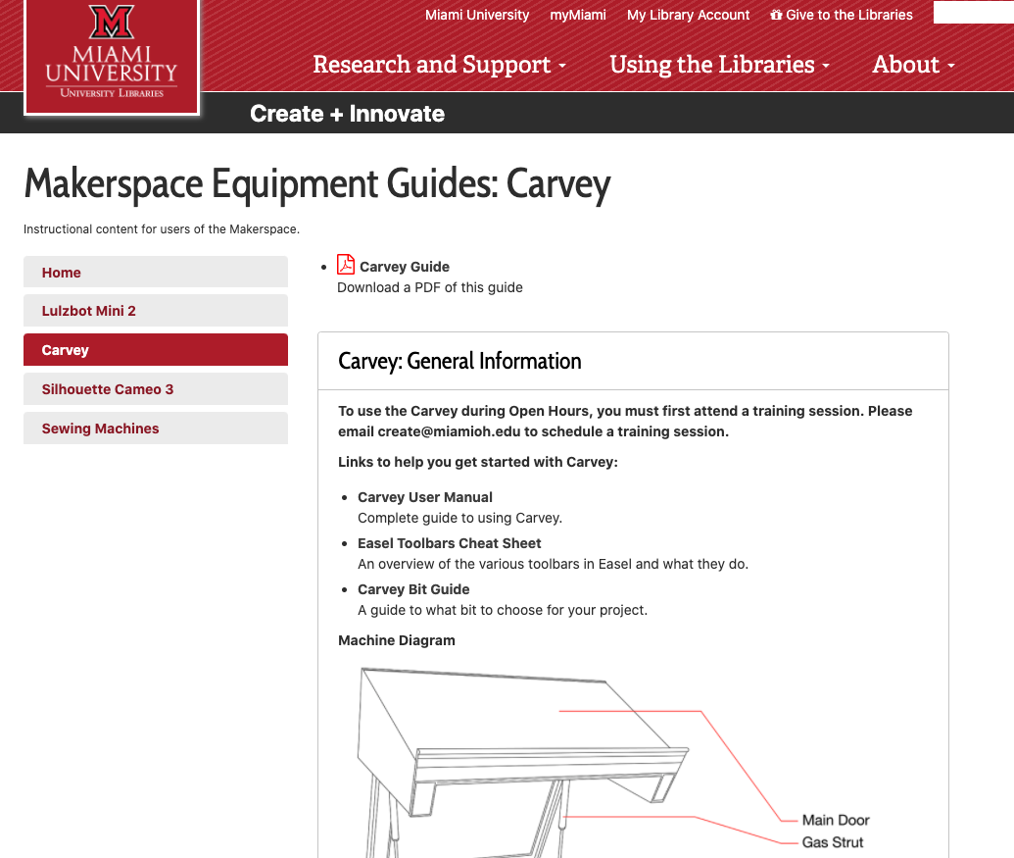
Libguides
Equipment specific
&
Spaces/Labs

Slide 10
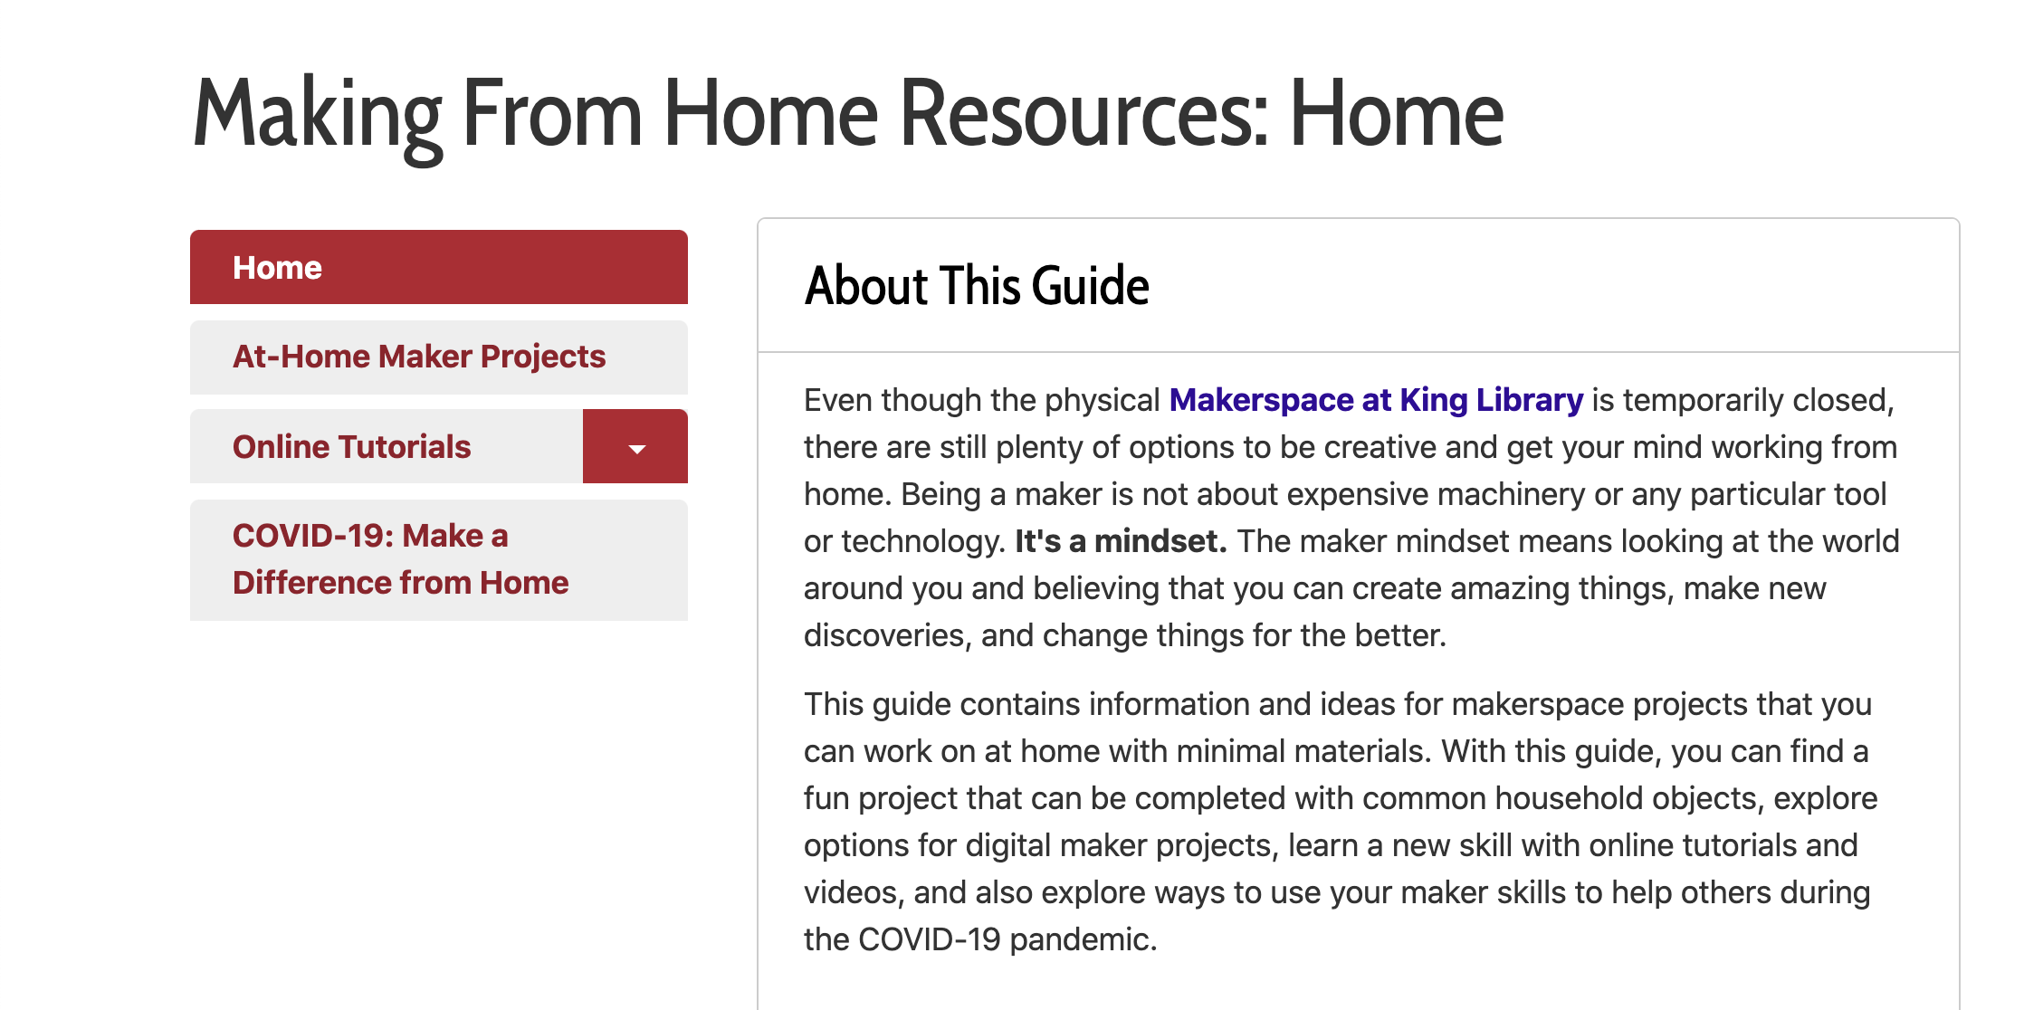
Libguides
Making From Home Guide

Slide 11
Chat Service

Slide 12
Kits: Making the connection
—attributed to Benjamin Franklin
“Tell me and I may forget, teach me and I may remember, involve me and I learn.”

Slide 13
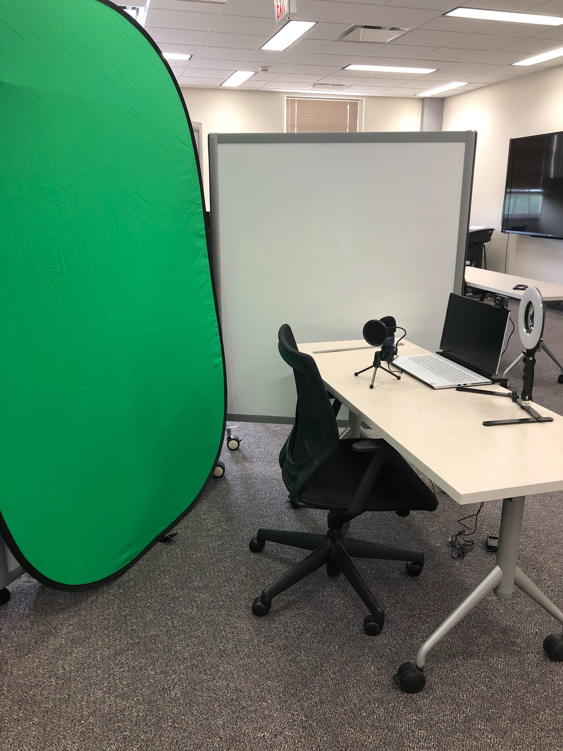
Kits Available for Check Out
AV Kits:
USB Mic w/ tripod stand and pop filter
Portable backdrop w/ stand white/black
Backdrop panel chroma key green/blue
HD Webcam
Desktop Ring Light

Slide 14
Future Kits in Development
Sewing Kits
Arduino Kits
Audio Kits
Robotics Kits

Slide 15
—SOMEONE FAMOUS
Text

Slide 16

Augment Costs with Grants
Shows library leadership:
Ideas have value
You have dedication
Library doesn’t have to shoulder all costs

Slide 17
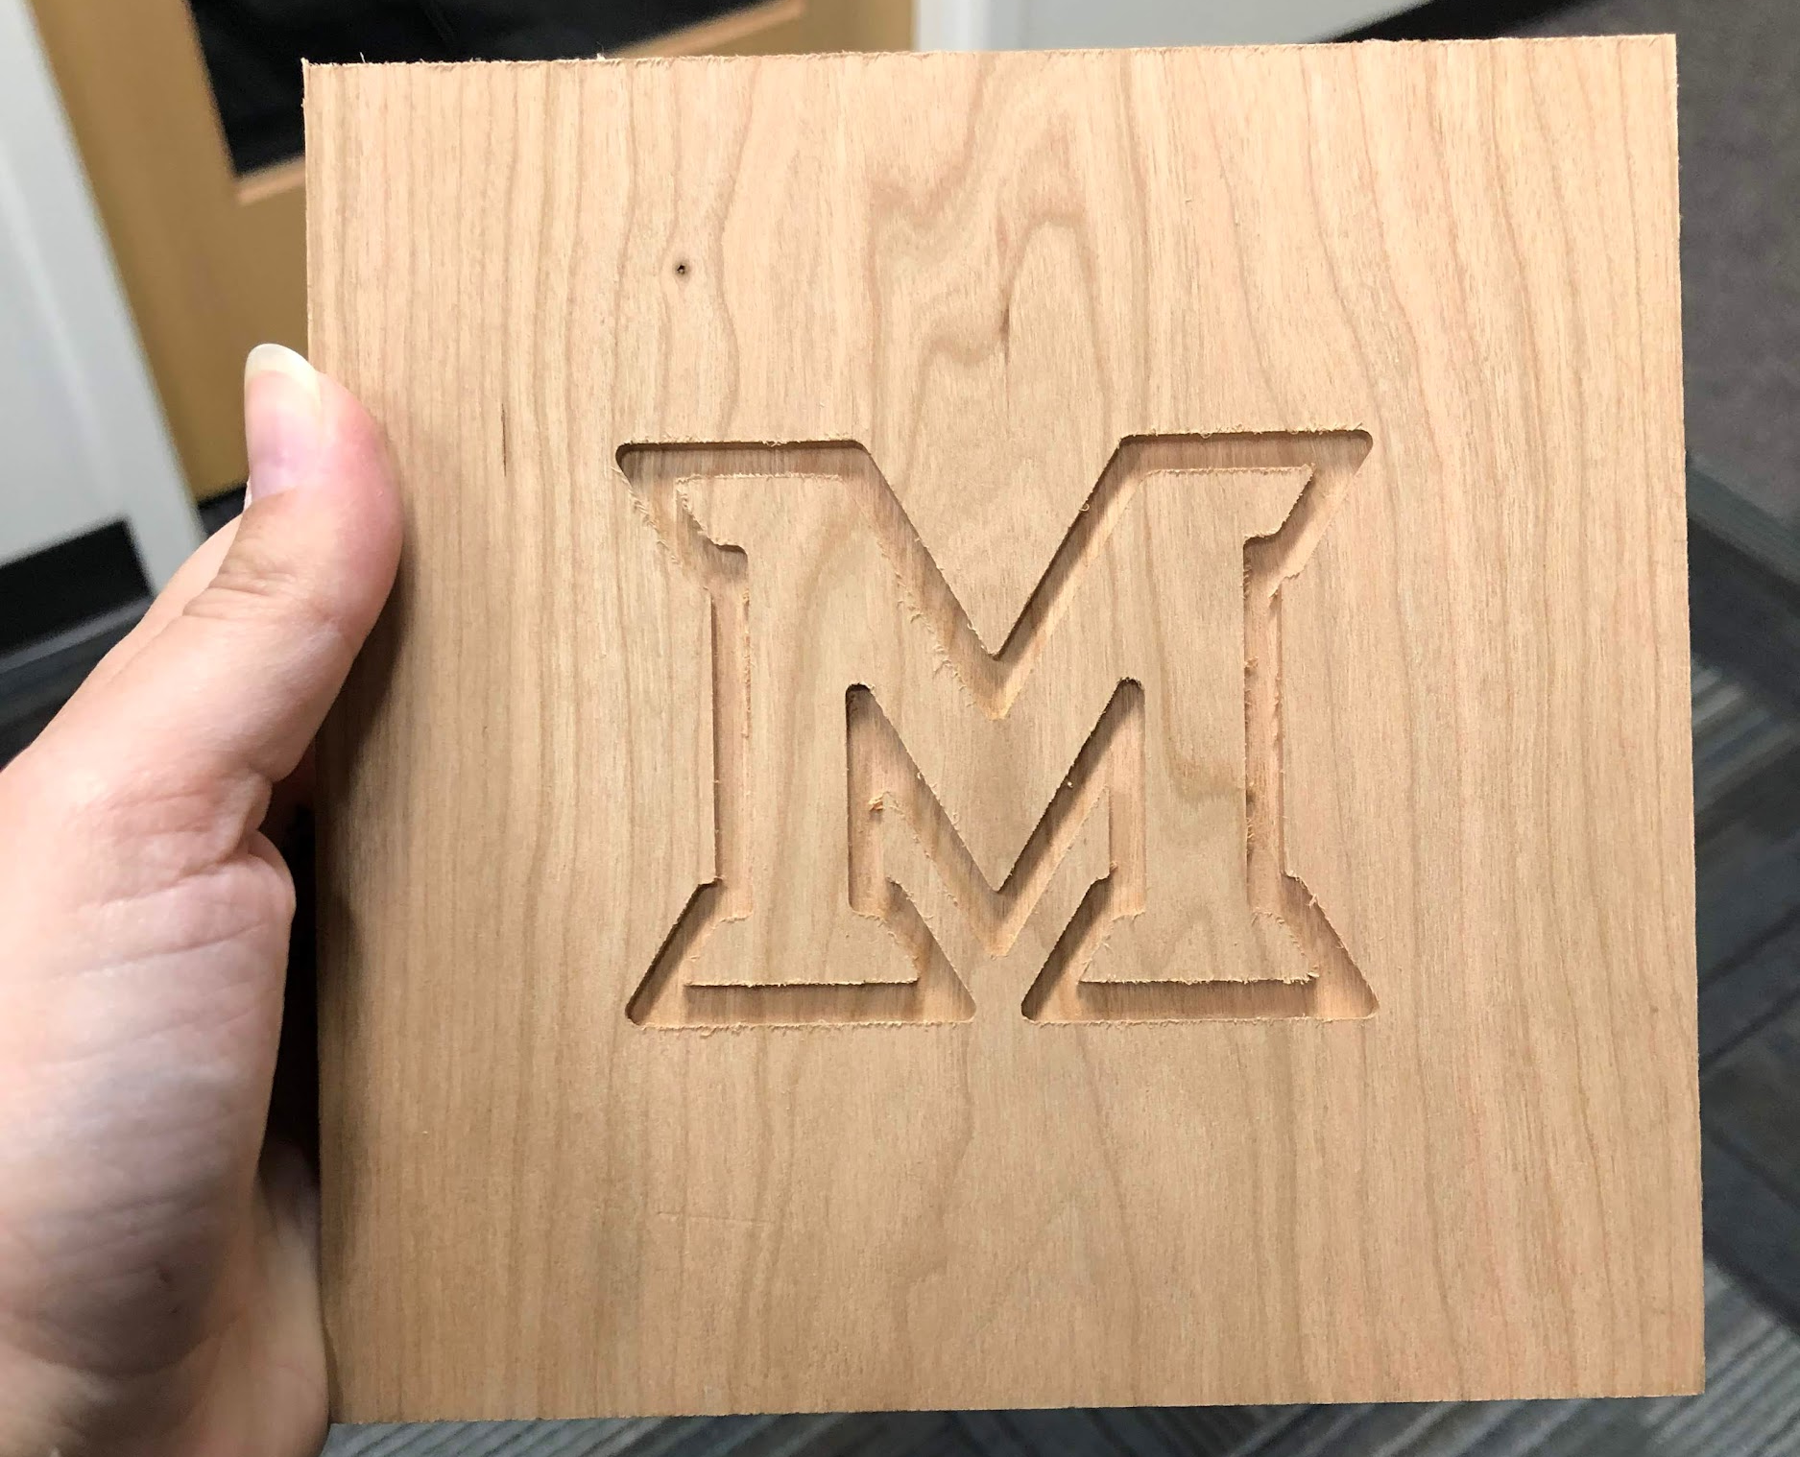

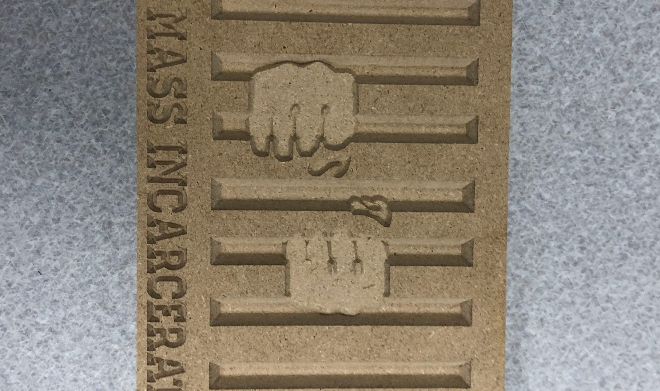
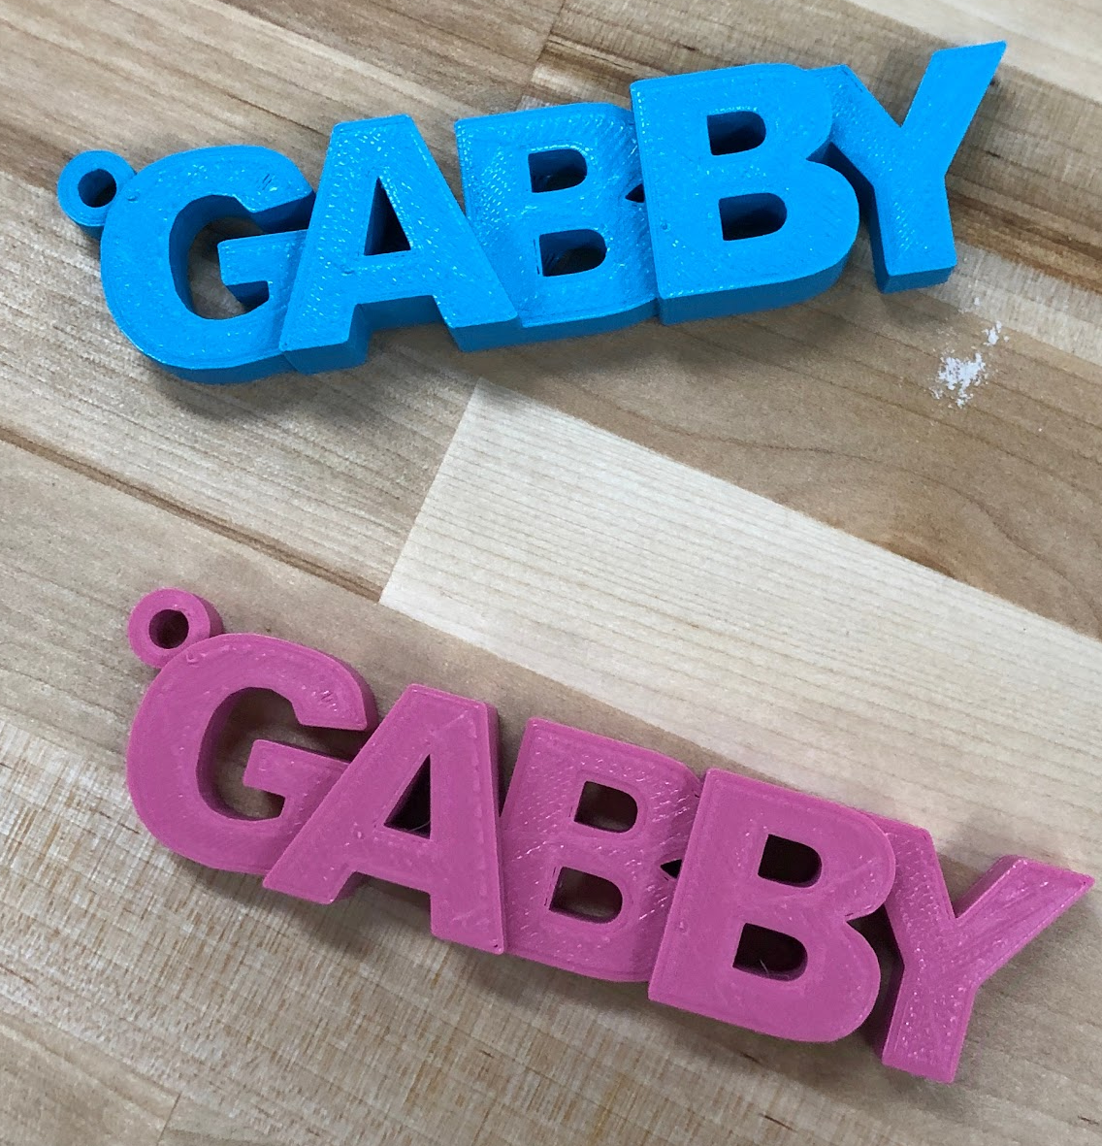
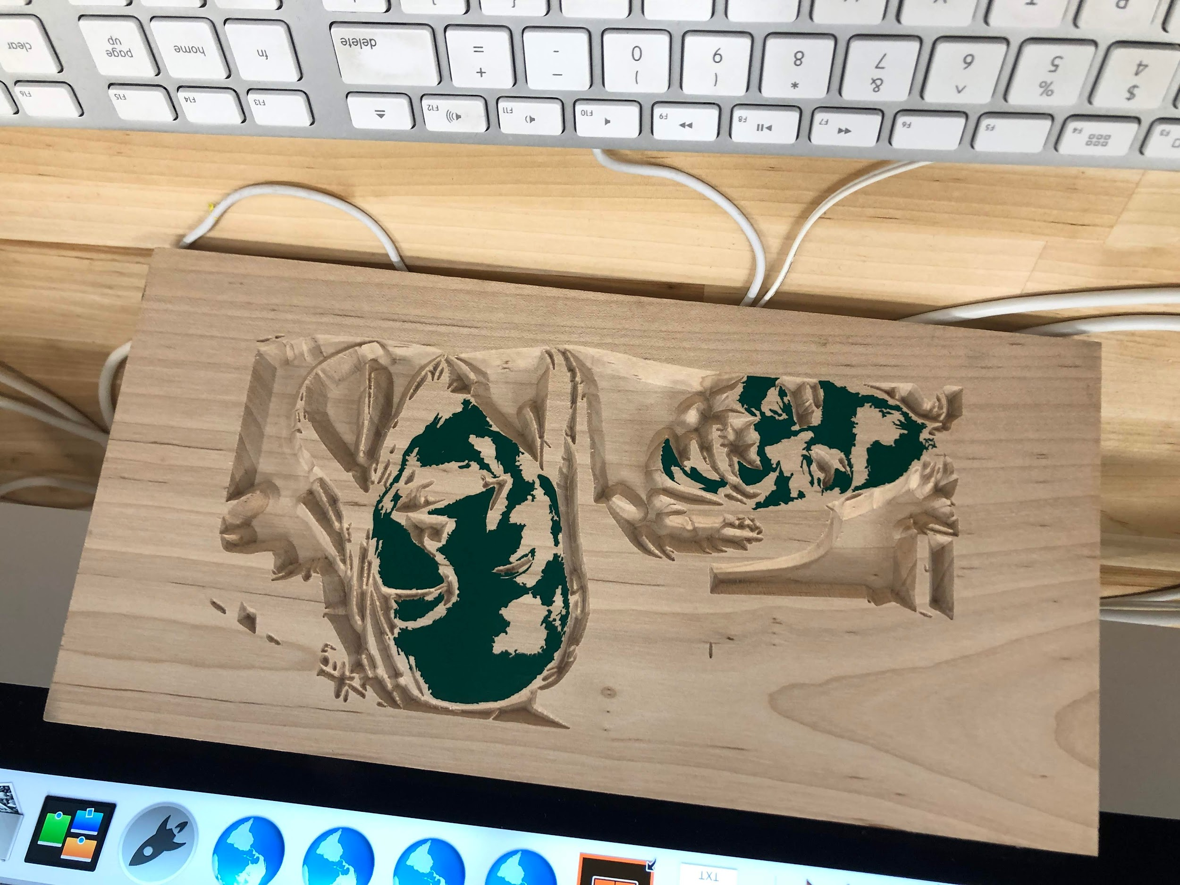
Working with Faculty
Increase traffic & usage
Shows value to admin
Enrich learning at your institution

Slide 18
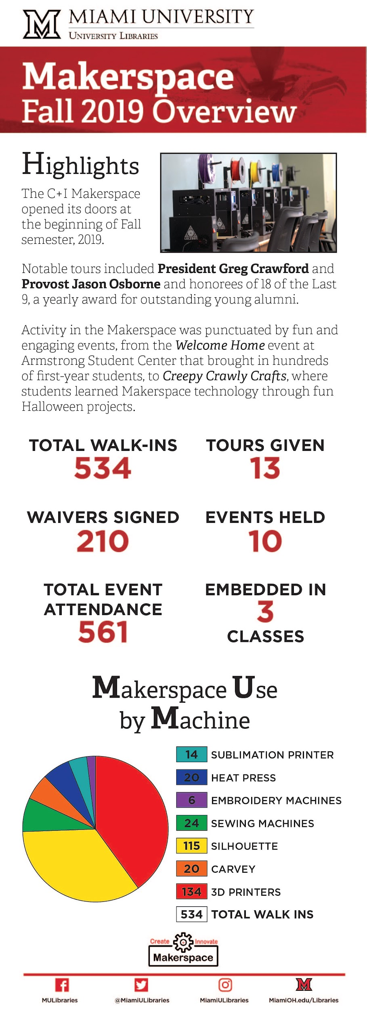
Infographics are Your Friend!

Slide 19
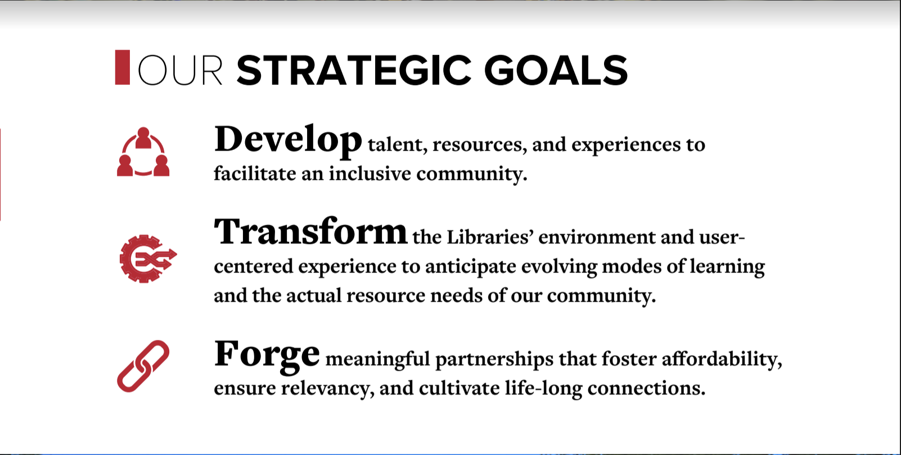
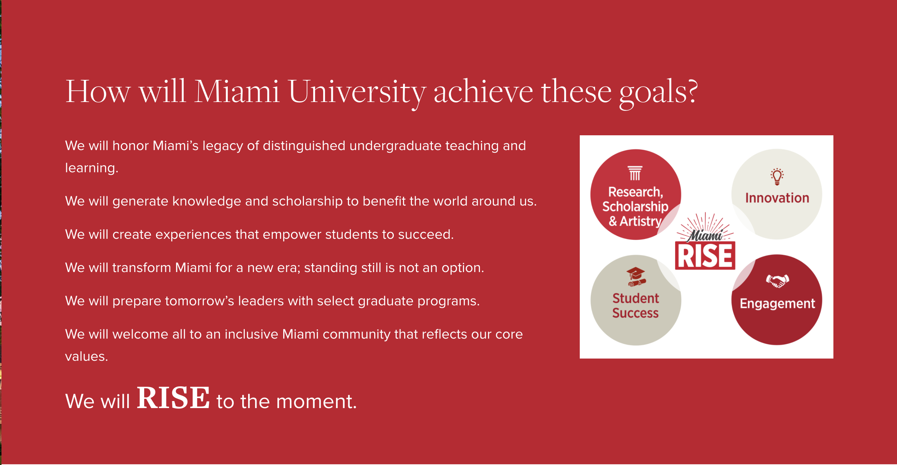
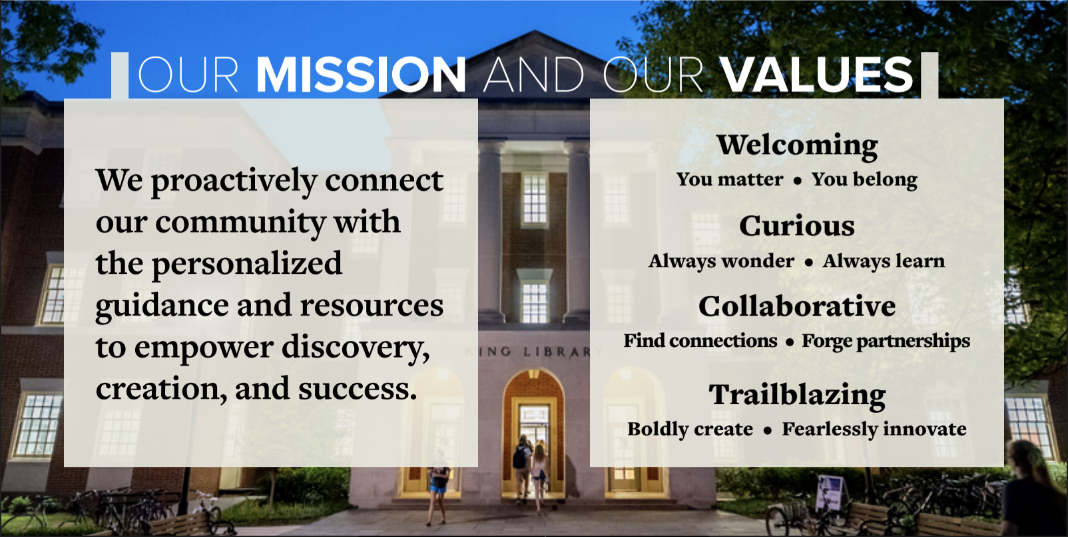
Connecting to MUL and Miami Strategic Plans/Mission/Values

Slide 20

Questions?
Contact Us!
Lori Chapin pheanila@miamioh.edu
Sarah Nagle pricesb@miamioh.edu @SarahNagle10

