Slide 1
MAKING CONNECTIONS
Multidisciplinary Makerspace Curriculum Integrations
MIRA 2020
Sarah Nagle
Creation & Innovation Services Librarian
Miami University
pricesb@miamioh.edu

Slide 2
Why?
Increase traffic & usage
Shows value to admin
Enrich learning at your institution

Slide 3
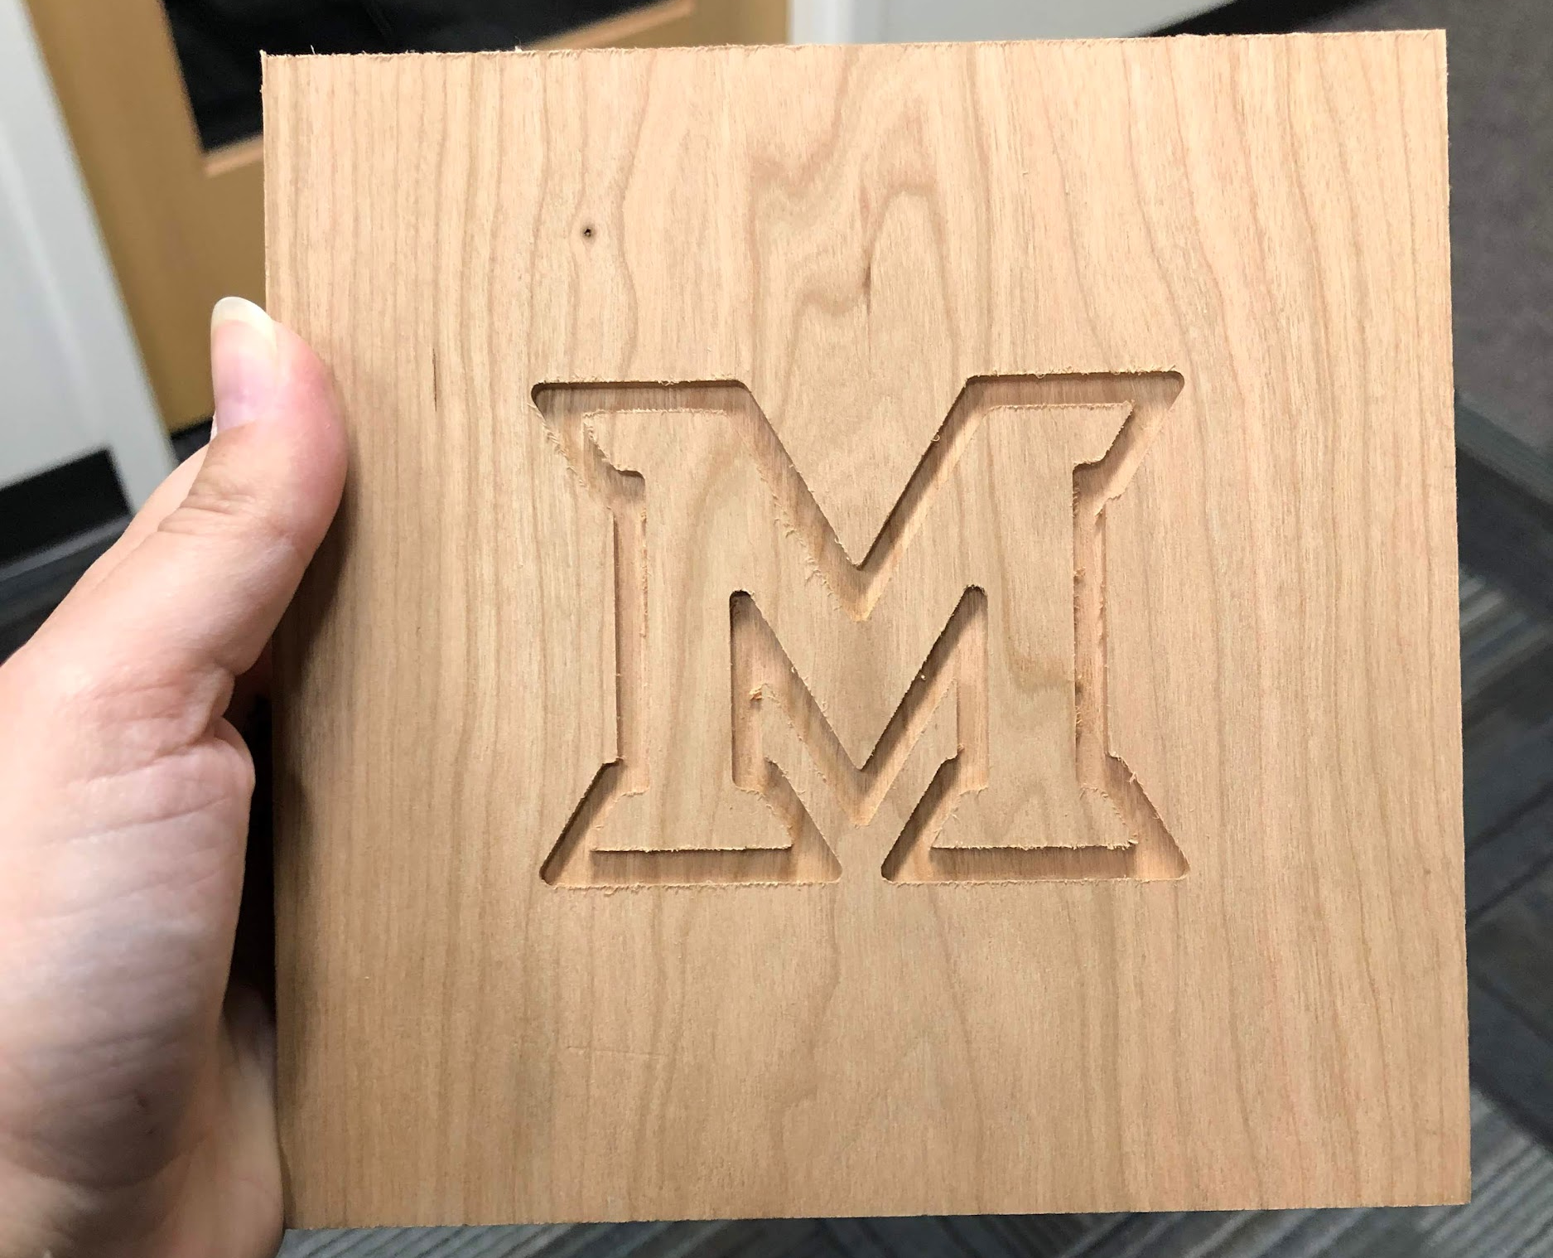

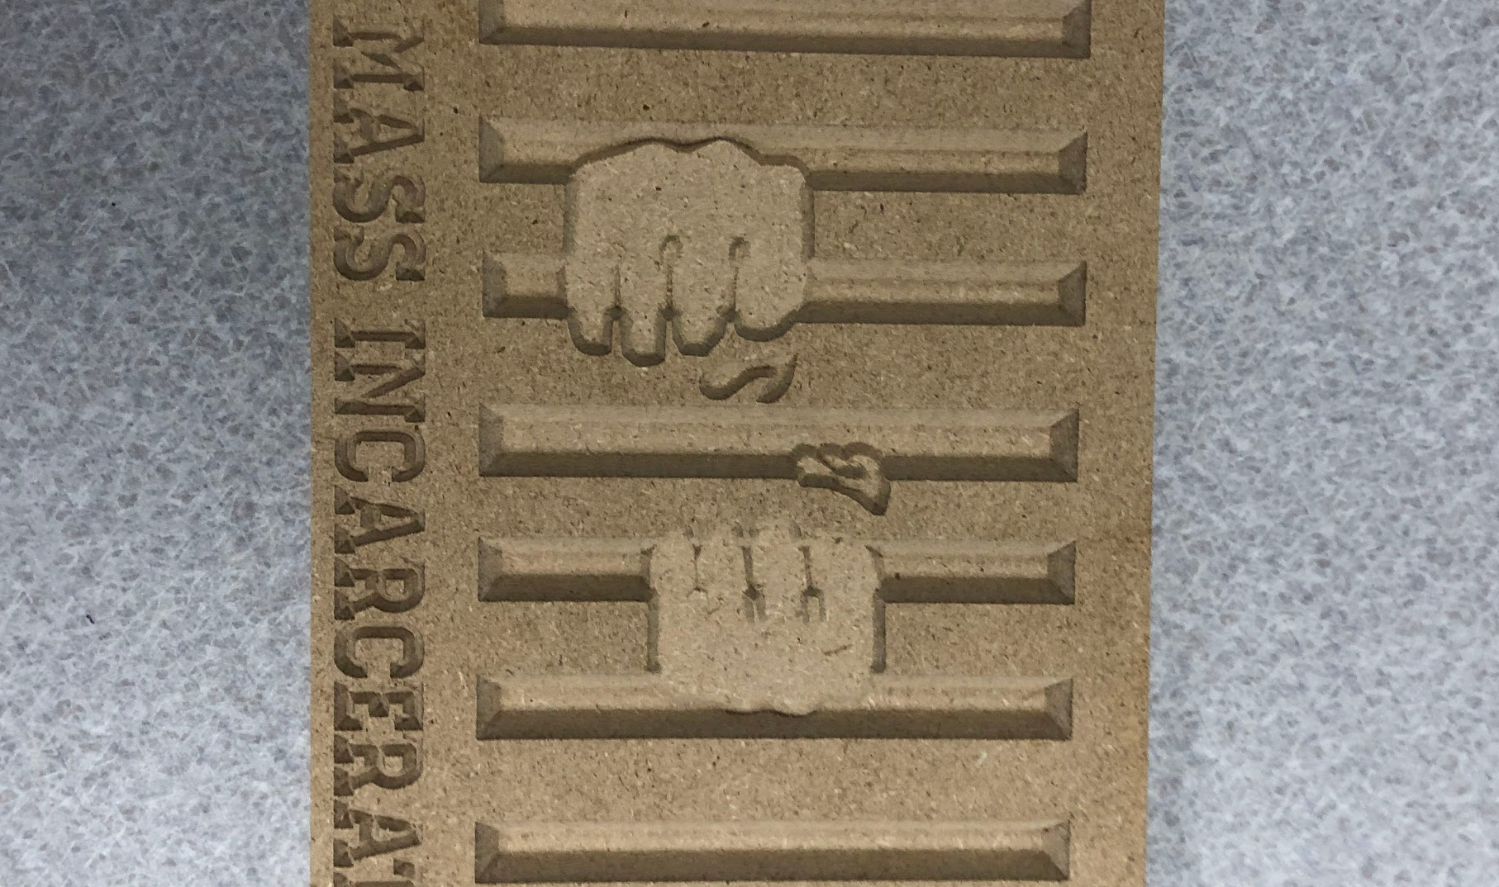
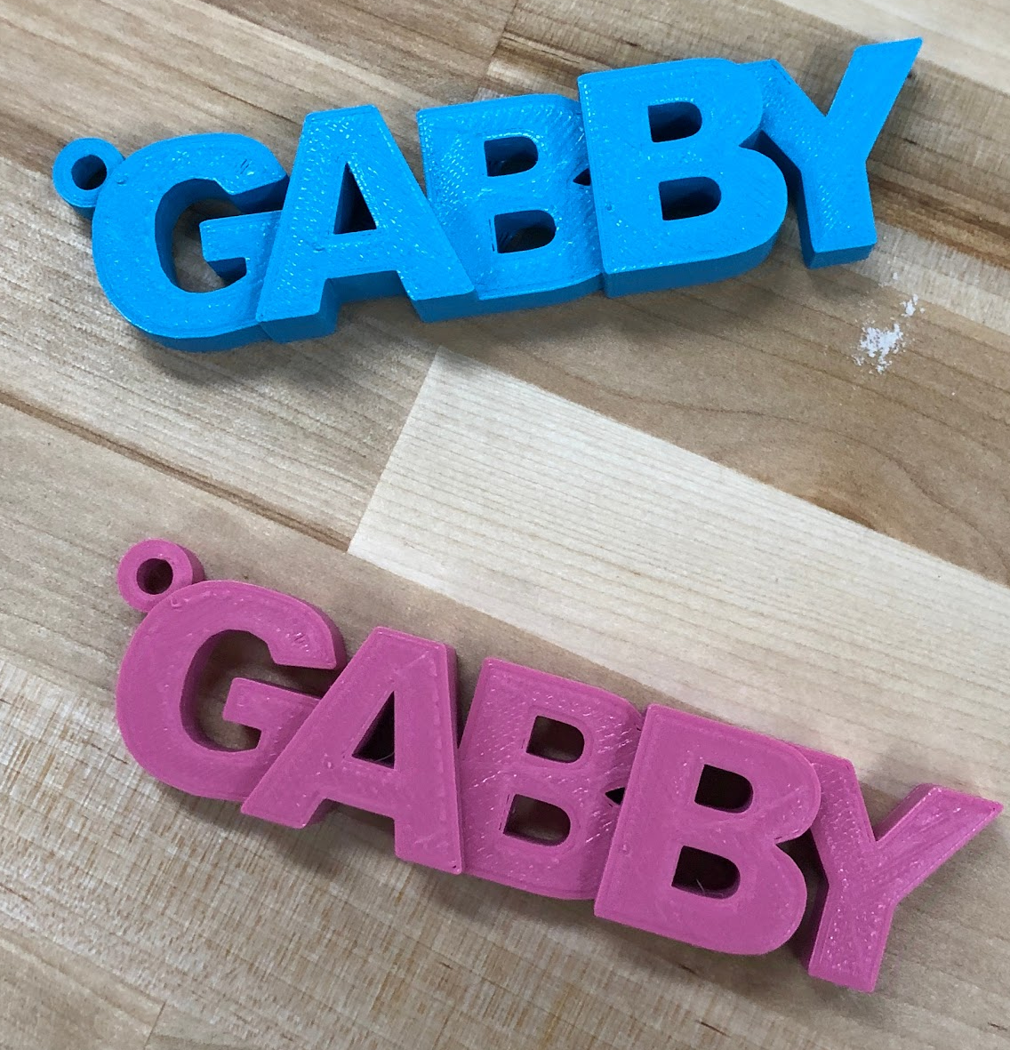
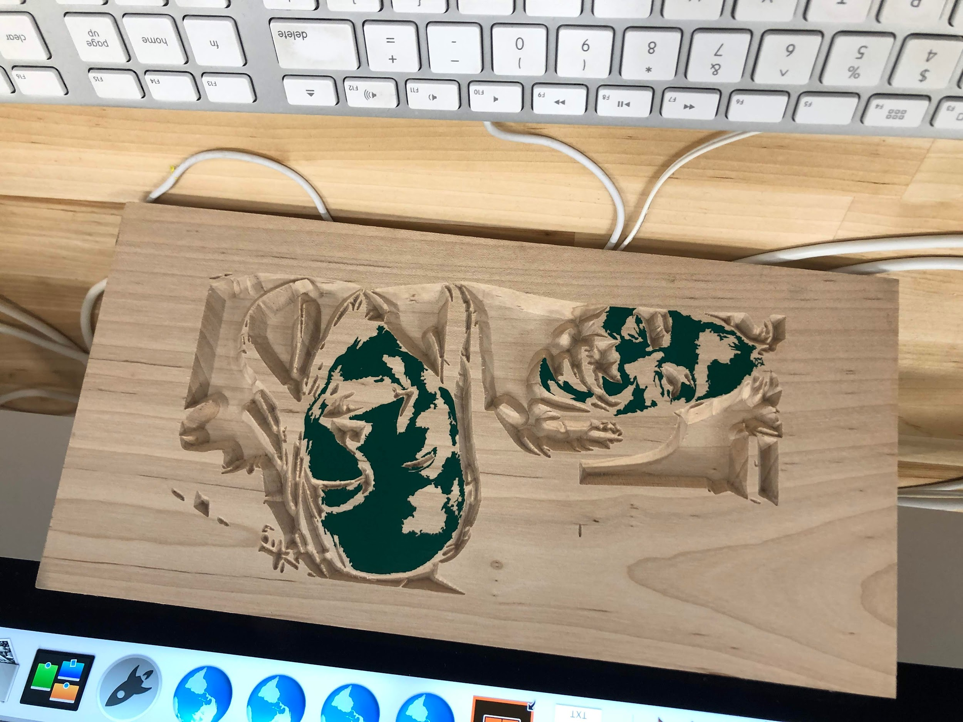
COURSE INTEGRATIONS
University 101
Global & Intercultural Studies
Creative Technology
First-Year English Composition
Public Speaking
Interactive Media Studies
Italian Renaissance
Chemistry
Fashion Design

Slide 4
ELEVATOR PITCH
How?
Maker-centered learning benefits students of all disciplines. Maker activities help students build a maker mindset, which empowers students through design sensitivity, helps them develop failure positivity, and develops a host of other multidisciplinary “soft skills” that will help them get a job(judgment and decision making, fluency of ideas, active learning, originality).
Could your students benefit from more active, engaging learning activities.
Makerspace activities can also be a way to illustrate hard-to-grasp concepts through hands-on examples.
Offer to help create assignments or to embedding makerspace topics holistically into a course.

Slide 5
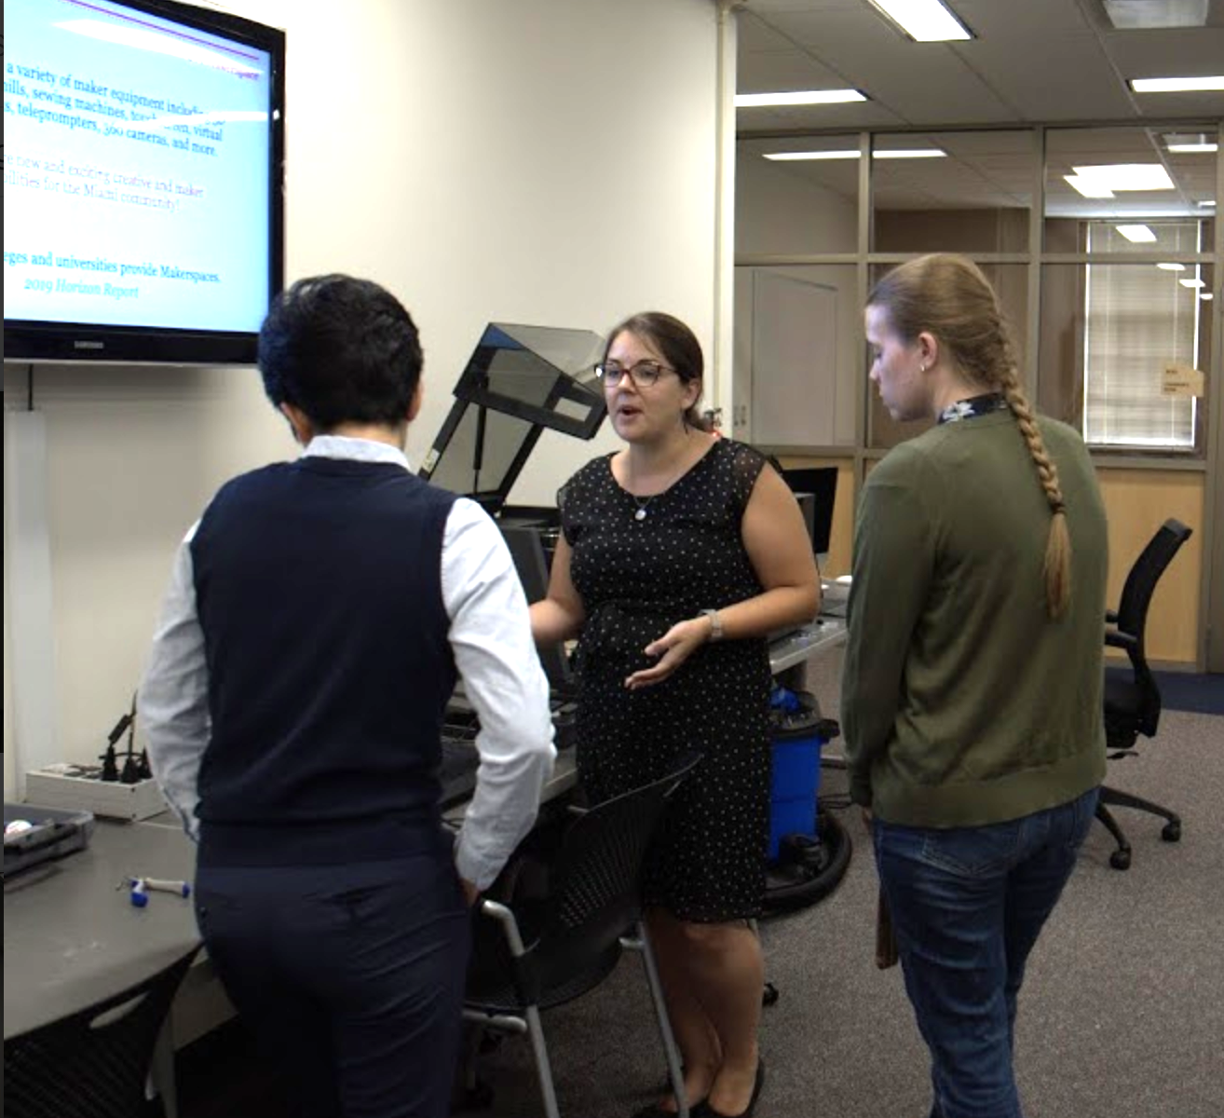
How?
New faculty events
Faculty Prof Dev
Liaison librarians

Slide 6
Thank you!
Connect with me
Sarah Nagle
pricesb@miamioh.edu
Twitter: @SarahNagle10

