Slide 1
CREATING IN QUARANTINE
Making Online During COVID-19
Stefanie Hilles, Arts & Humanities Librarian
Sarah Nagle, Creation & Innovation Services Librarian
Miami University

Slide 2
WHAT WE WILL COVER TODAY
Best practices for making online (or, lessons learned so far)
Asynchronous--Spring 2020
  Example projects
  How we moved our maker content online
  Challenges
Synchronous--Fall 2020
  HyFlex model
  Ideas and plans for projects

Slide 3
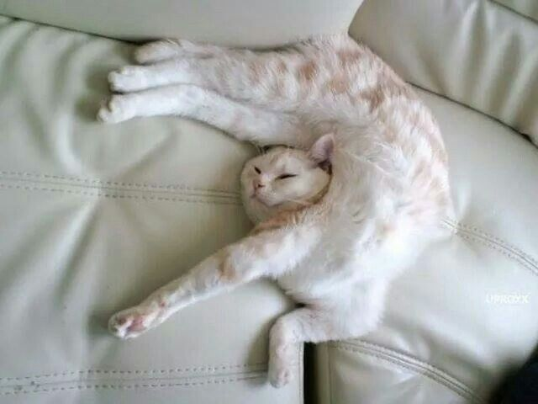
—UNKNOWN
“Blessed are the flexible, for they will not be bent out of shape.”

Slide 4
BEST PRACTICES
Keep materials/tools simple
Be flexible with tools and supplies
Don’t reinvent the wheel
Facilitate collaboration with digital tools
Google Jamboard
Padlet
Lino
Aggie
Breakout rooms

Slide 5
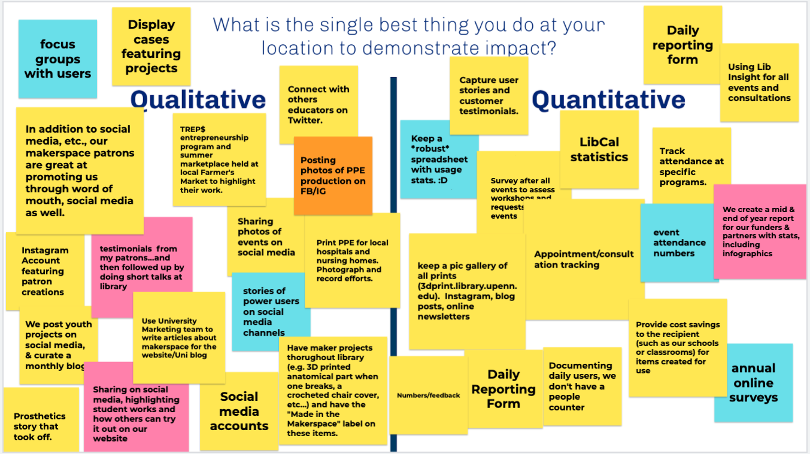
Google Jamboard - NOMCON, June 2020

Slide 6
BEST PRACTICES
Scaling back is OK!
Content should be delivered in manageable pieces
Use your LibGuides!
Don’t forget about accessibility
Web Content Accessibility Guidelines
LibGuides Accessibility Best Practices

Slide 7
Asynchronous

Slide 8
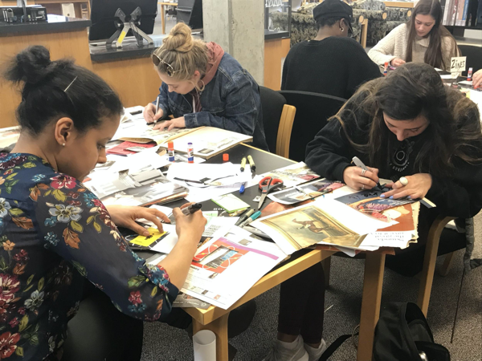
ZINE WORKSHOPS

Slide 9
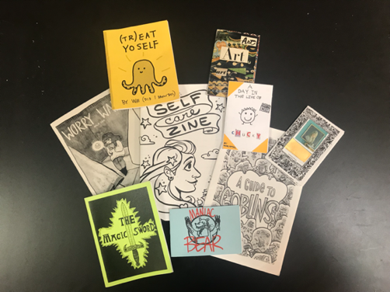
WHAT IS A ZINE?
Noncommercial
Nonprofessional
Small circulation
Self-published
Not created for profit
Associated with counter cultures and marginalized peoples
Handmade, often with a DIY or collage aesthetic
Use both text and image - either original or found/appropriated

Slide 10
In Person
Think-Pair-Share with zines from the collection
Short lecture in the history and aesthetics of zines
Students make their own zines

Slide 11
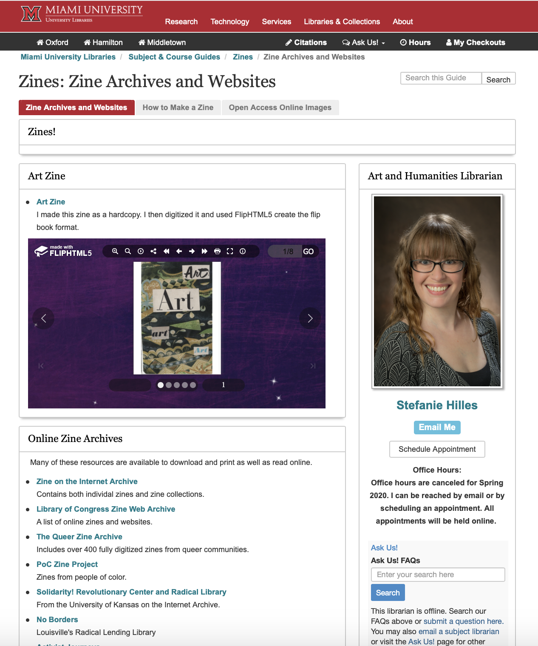
Zine LibGuide

Slide 12
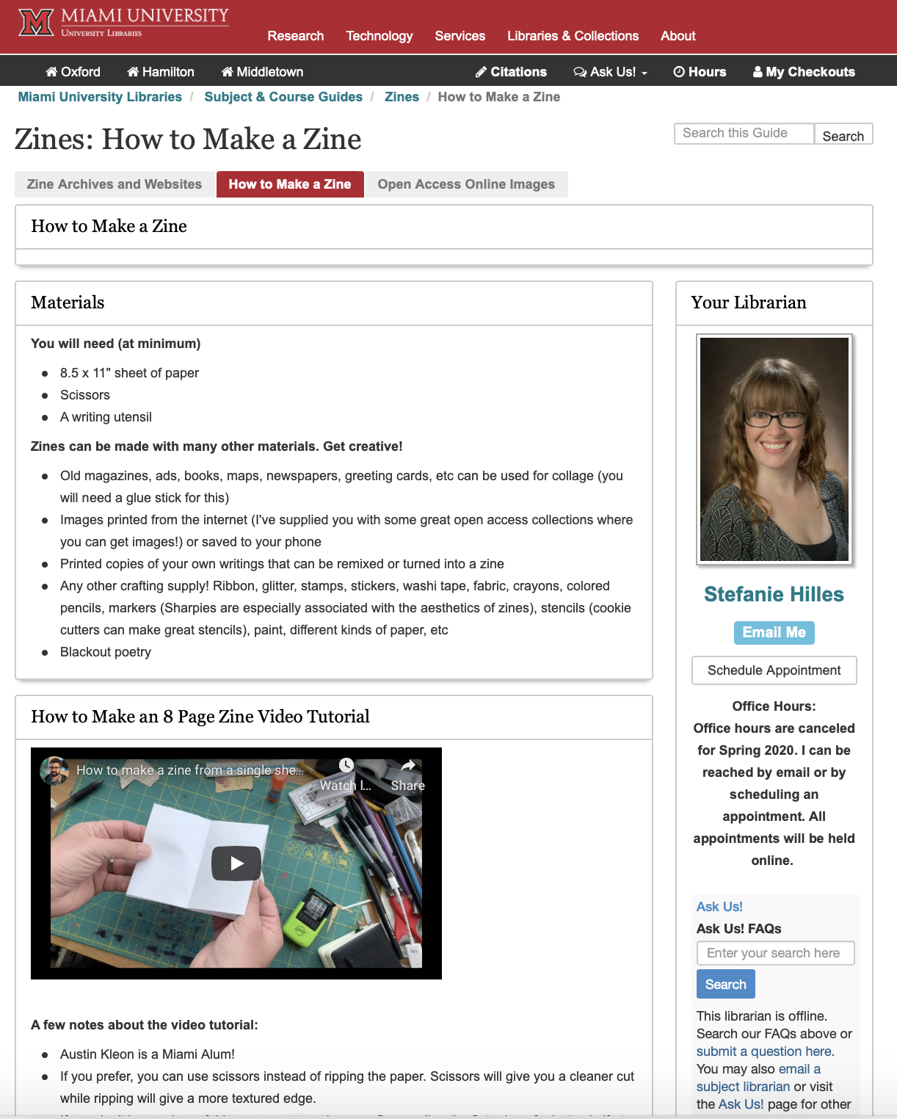
Zine LibGuide

Slide 13
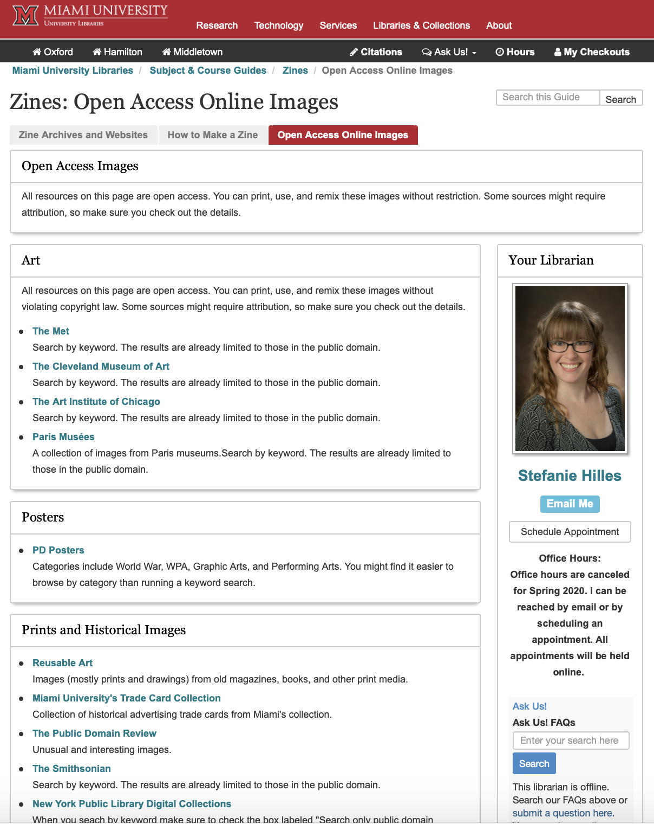
Zine Libguide

Slide 14
BEFORE AND AFTER
Asynchronous
In Person
Watch the introductory video
Visit the Archives and Website portion of the libguide and look at some zines from the online archives provided
Watch “A Brief History of Zines”
Refer back to the libguide for instructions and ideas on how to make their zine
Student make their own zines
Think-Pair-Share with zines from the collection
Short lecture in the history and aesthetics of zines
Students make their own zines

Slide 15
CHALLENGES
No access to the library’s zine collection
No think-pair-
share activity
Lack of collaboration and interactivity

Slide 16


Moving Forward
How can I foster more creative collaboration?

Slide 17
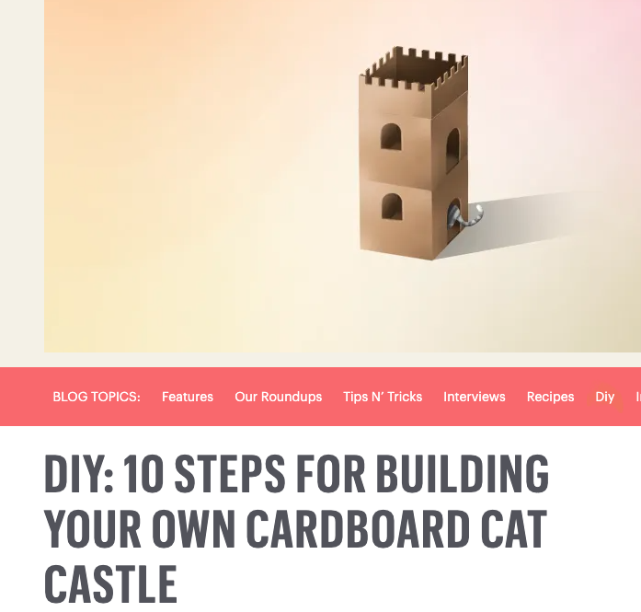
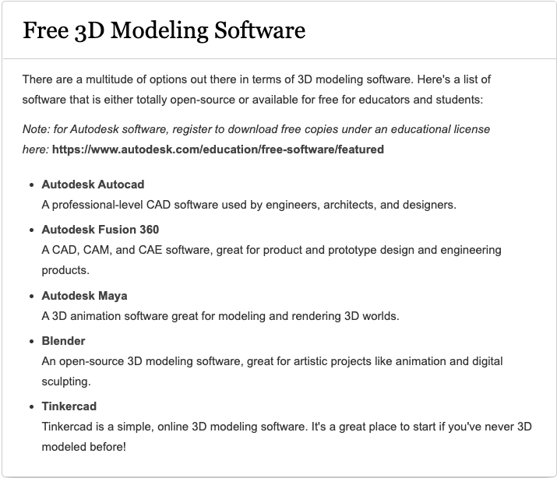
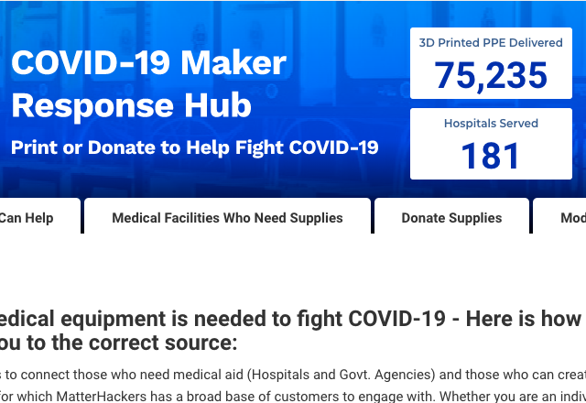
Making from Home LibGuide
At-Home Maker Projects
Online Tutorials
COVID-19 Make a Difference from Home

Slide 18
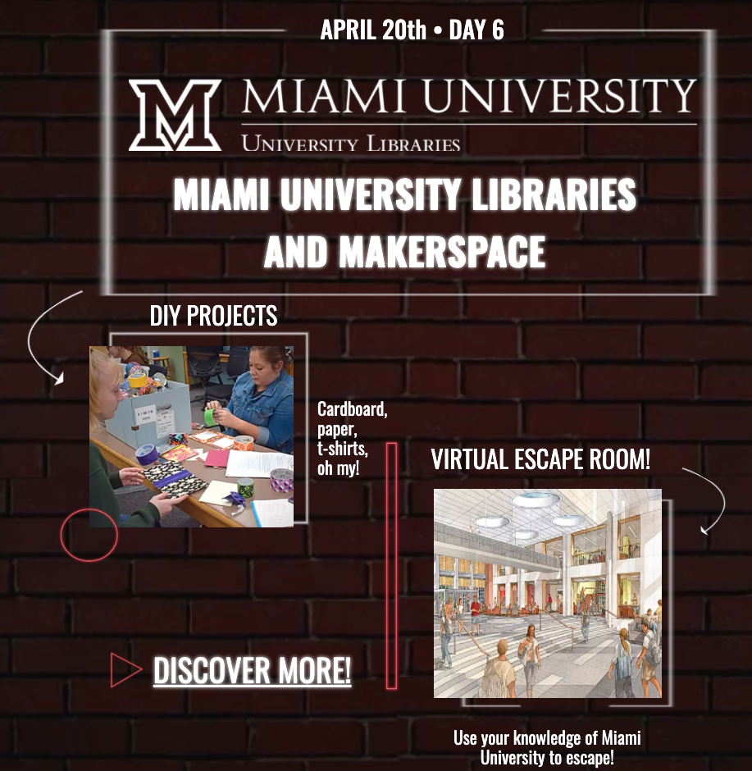
Creativity City
Innovation @Miami Libraries
Virtual Escape Room
Social media campaign

Slide 19
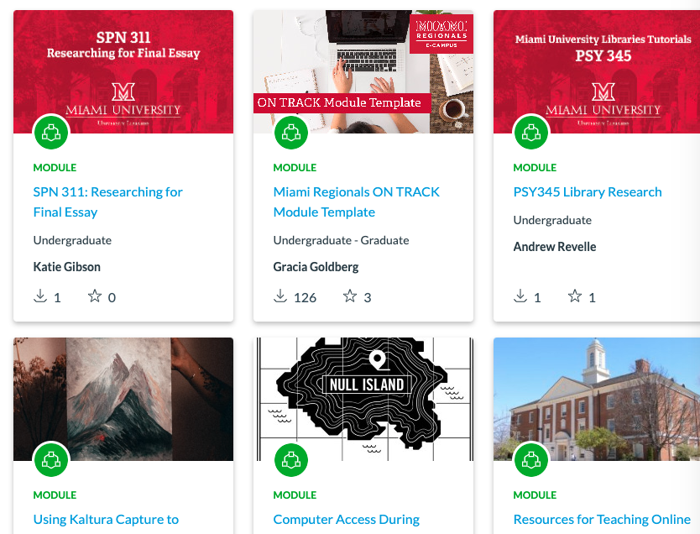
Canvas Modules
Videos
Tutorials
Quizzes

Slide 20
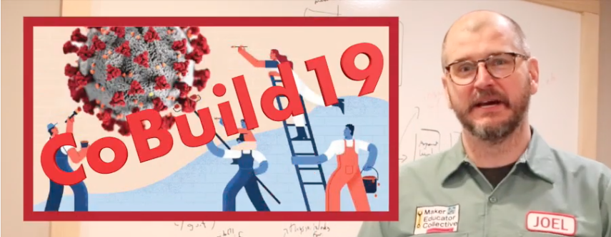
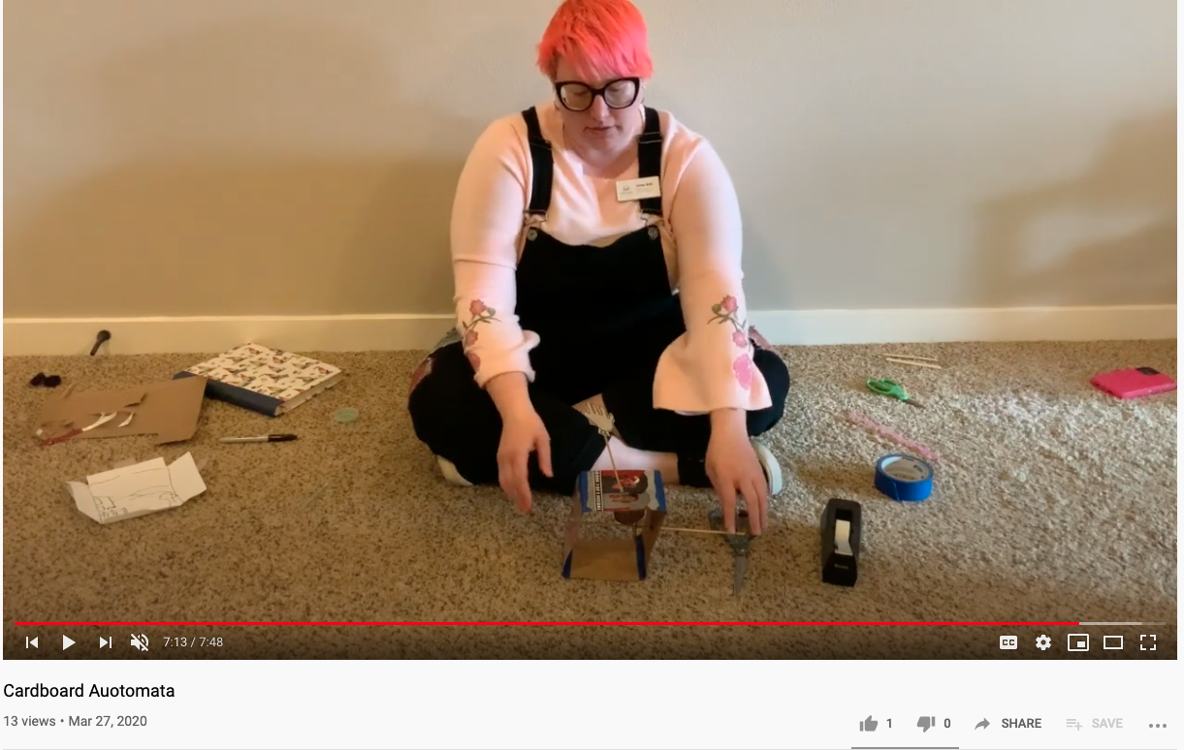
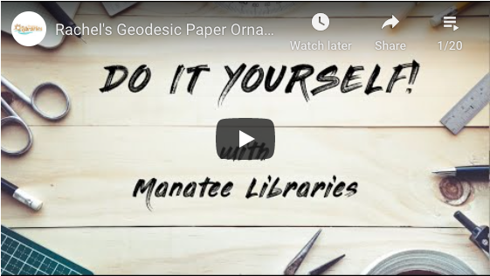
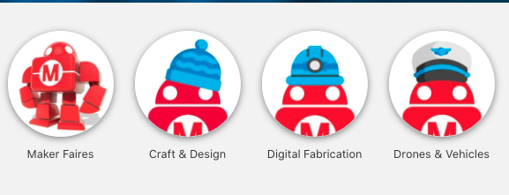
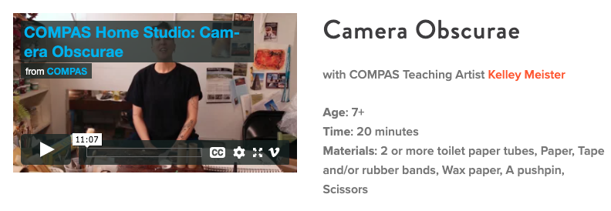

Videos · Tutorials · Collections
CoBuild 19
Maker Studio
Make At Home Projects
Fort Vancouver Libraries
Jamie Bair
Do it Yourself! Series
Manatee County Libraries
Rachel Suntop
02
03
Project Library
Make: Community
Arts Lesson Plans
COMPAS Home Studio
Maker Exchange
Corona Public Library

Slide 21
Synchronous

Slide 22
Moving Forward
With a HyFlex Instruction Model in Fall 2020

Slide 23
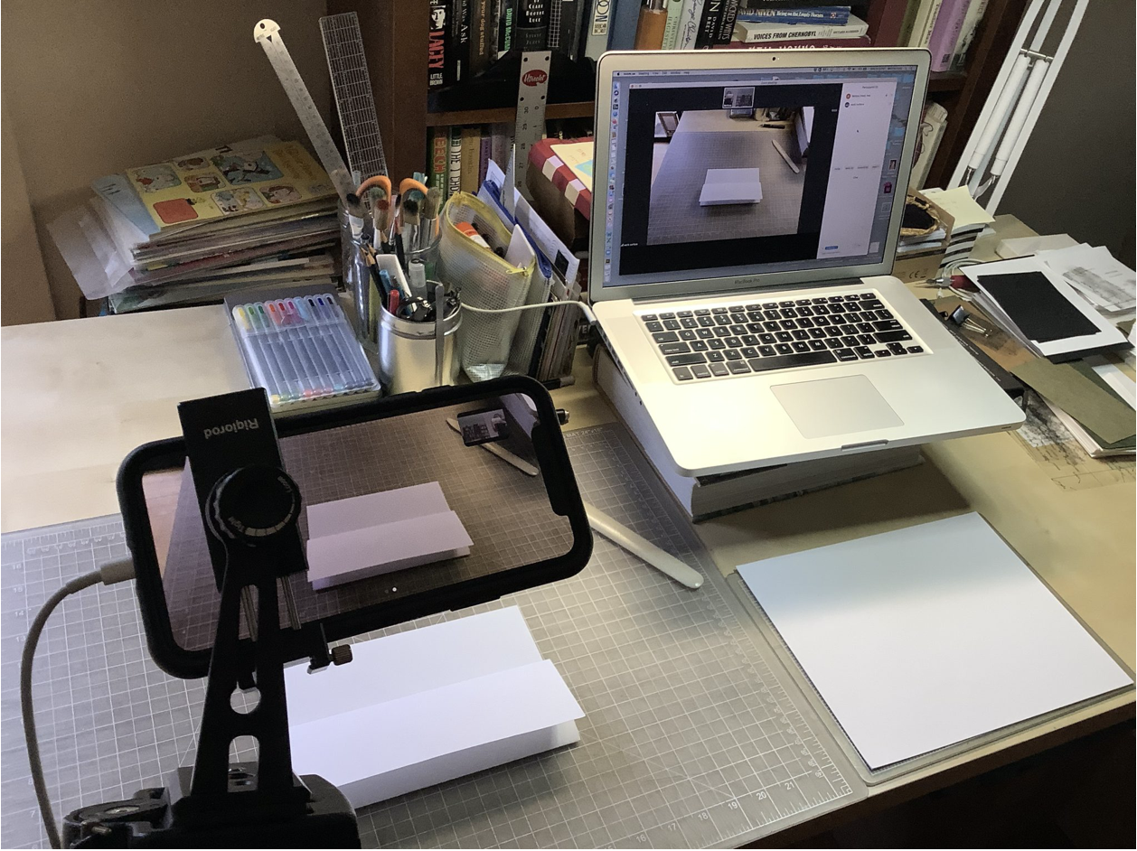
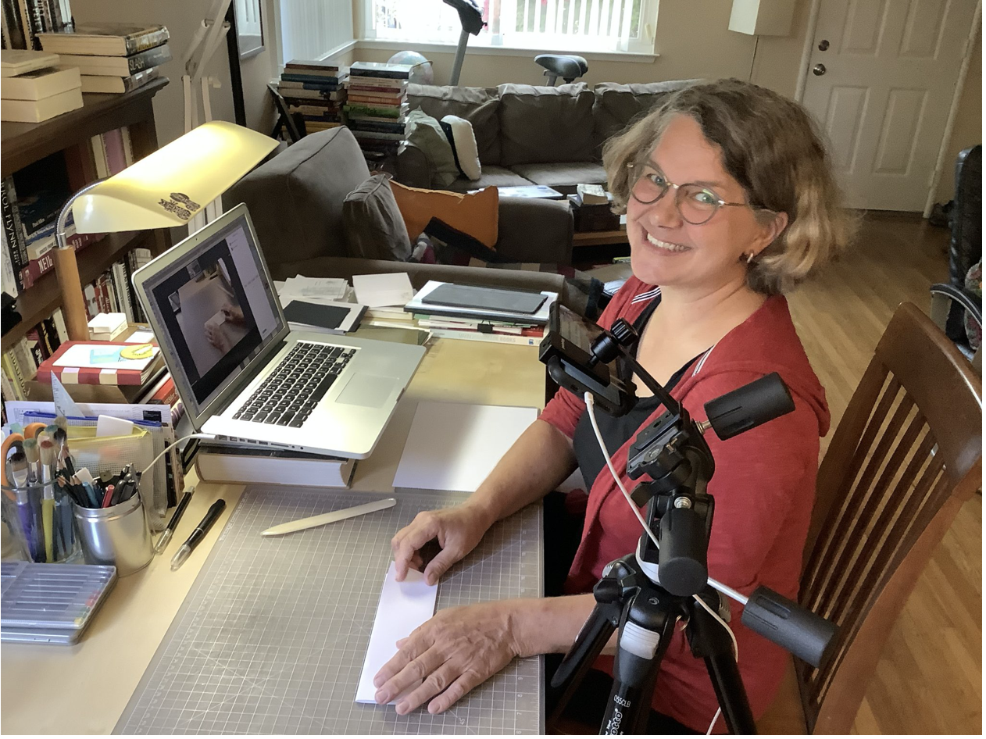
AT HOME DOC CAM
Pauly, B. (2020). At Home Doc Cam [Online image]. Bettina Pauly Bookart and Letterpress. http://blog.bettina-pauly.com/?page_id=1265
Pauly, B. (2020). At Home Doc Cam [Online image]. Bettina Pauly Bookart and Letterpress. http://blog.bettina-pauly.com/?page_id=1265

Slide 24
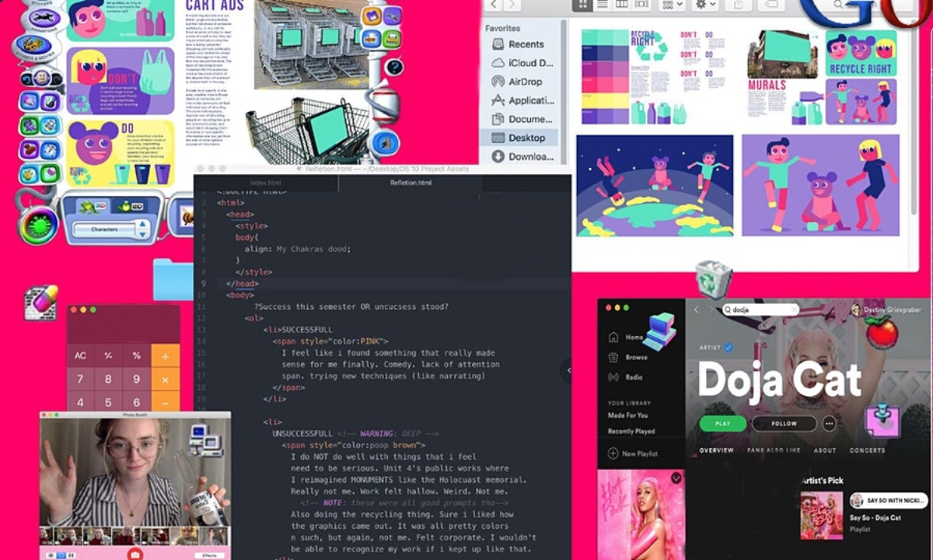
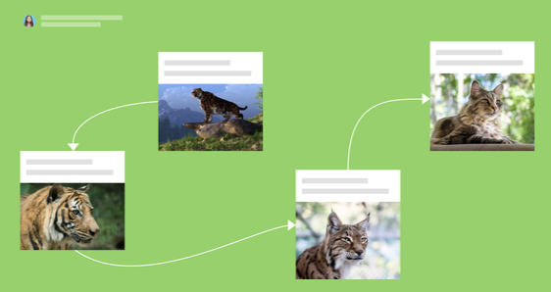
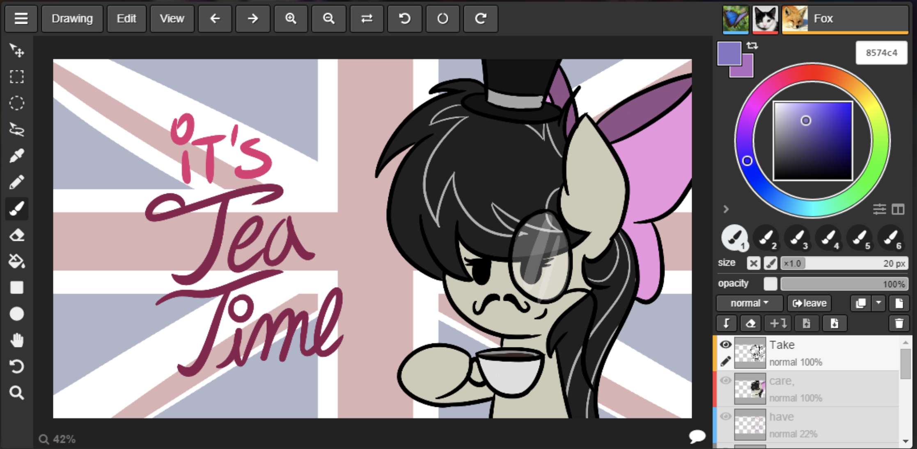
How can I foster more creative collaboration?
Zoom Zine
01
02
Padlet
03
Aggie
Queer. Archive. Work (2020). [Online image]. [Online image]. Eventbrite. https://www.eventbrite.com/e/screen-zine-workshop-at-queerarchivework-tickets-106451236514.
Padlet (2020). Canvas [Online image}. Padlet. https://padlet.com.
Aggie (2020). It’s Tea TIme [Online image].. Aggie.oi. https://aggie.io.

Slide 25
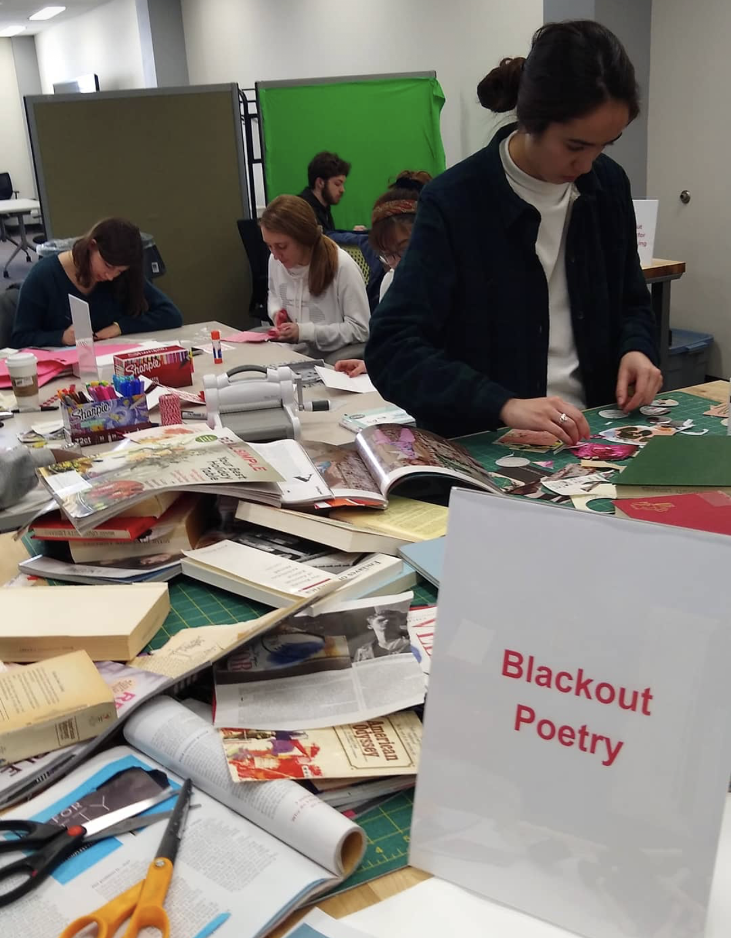
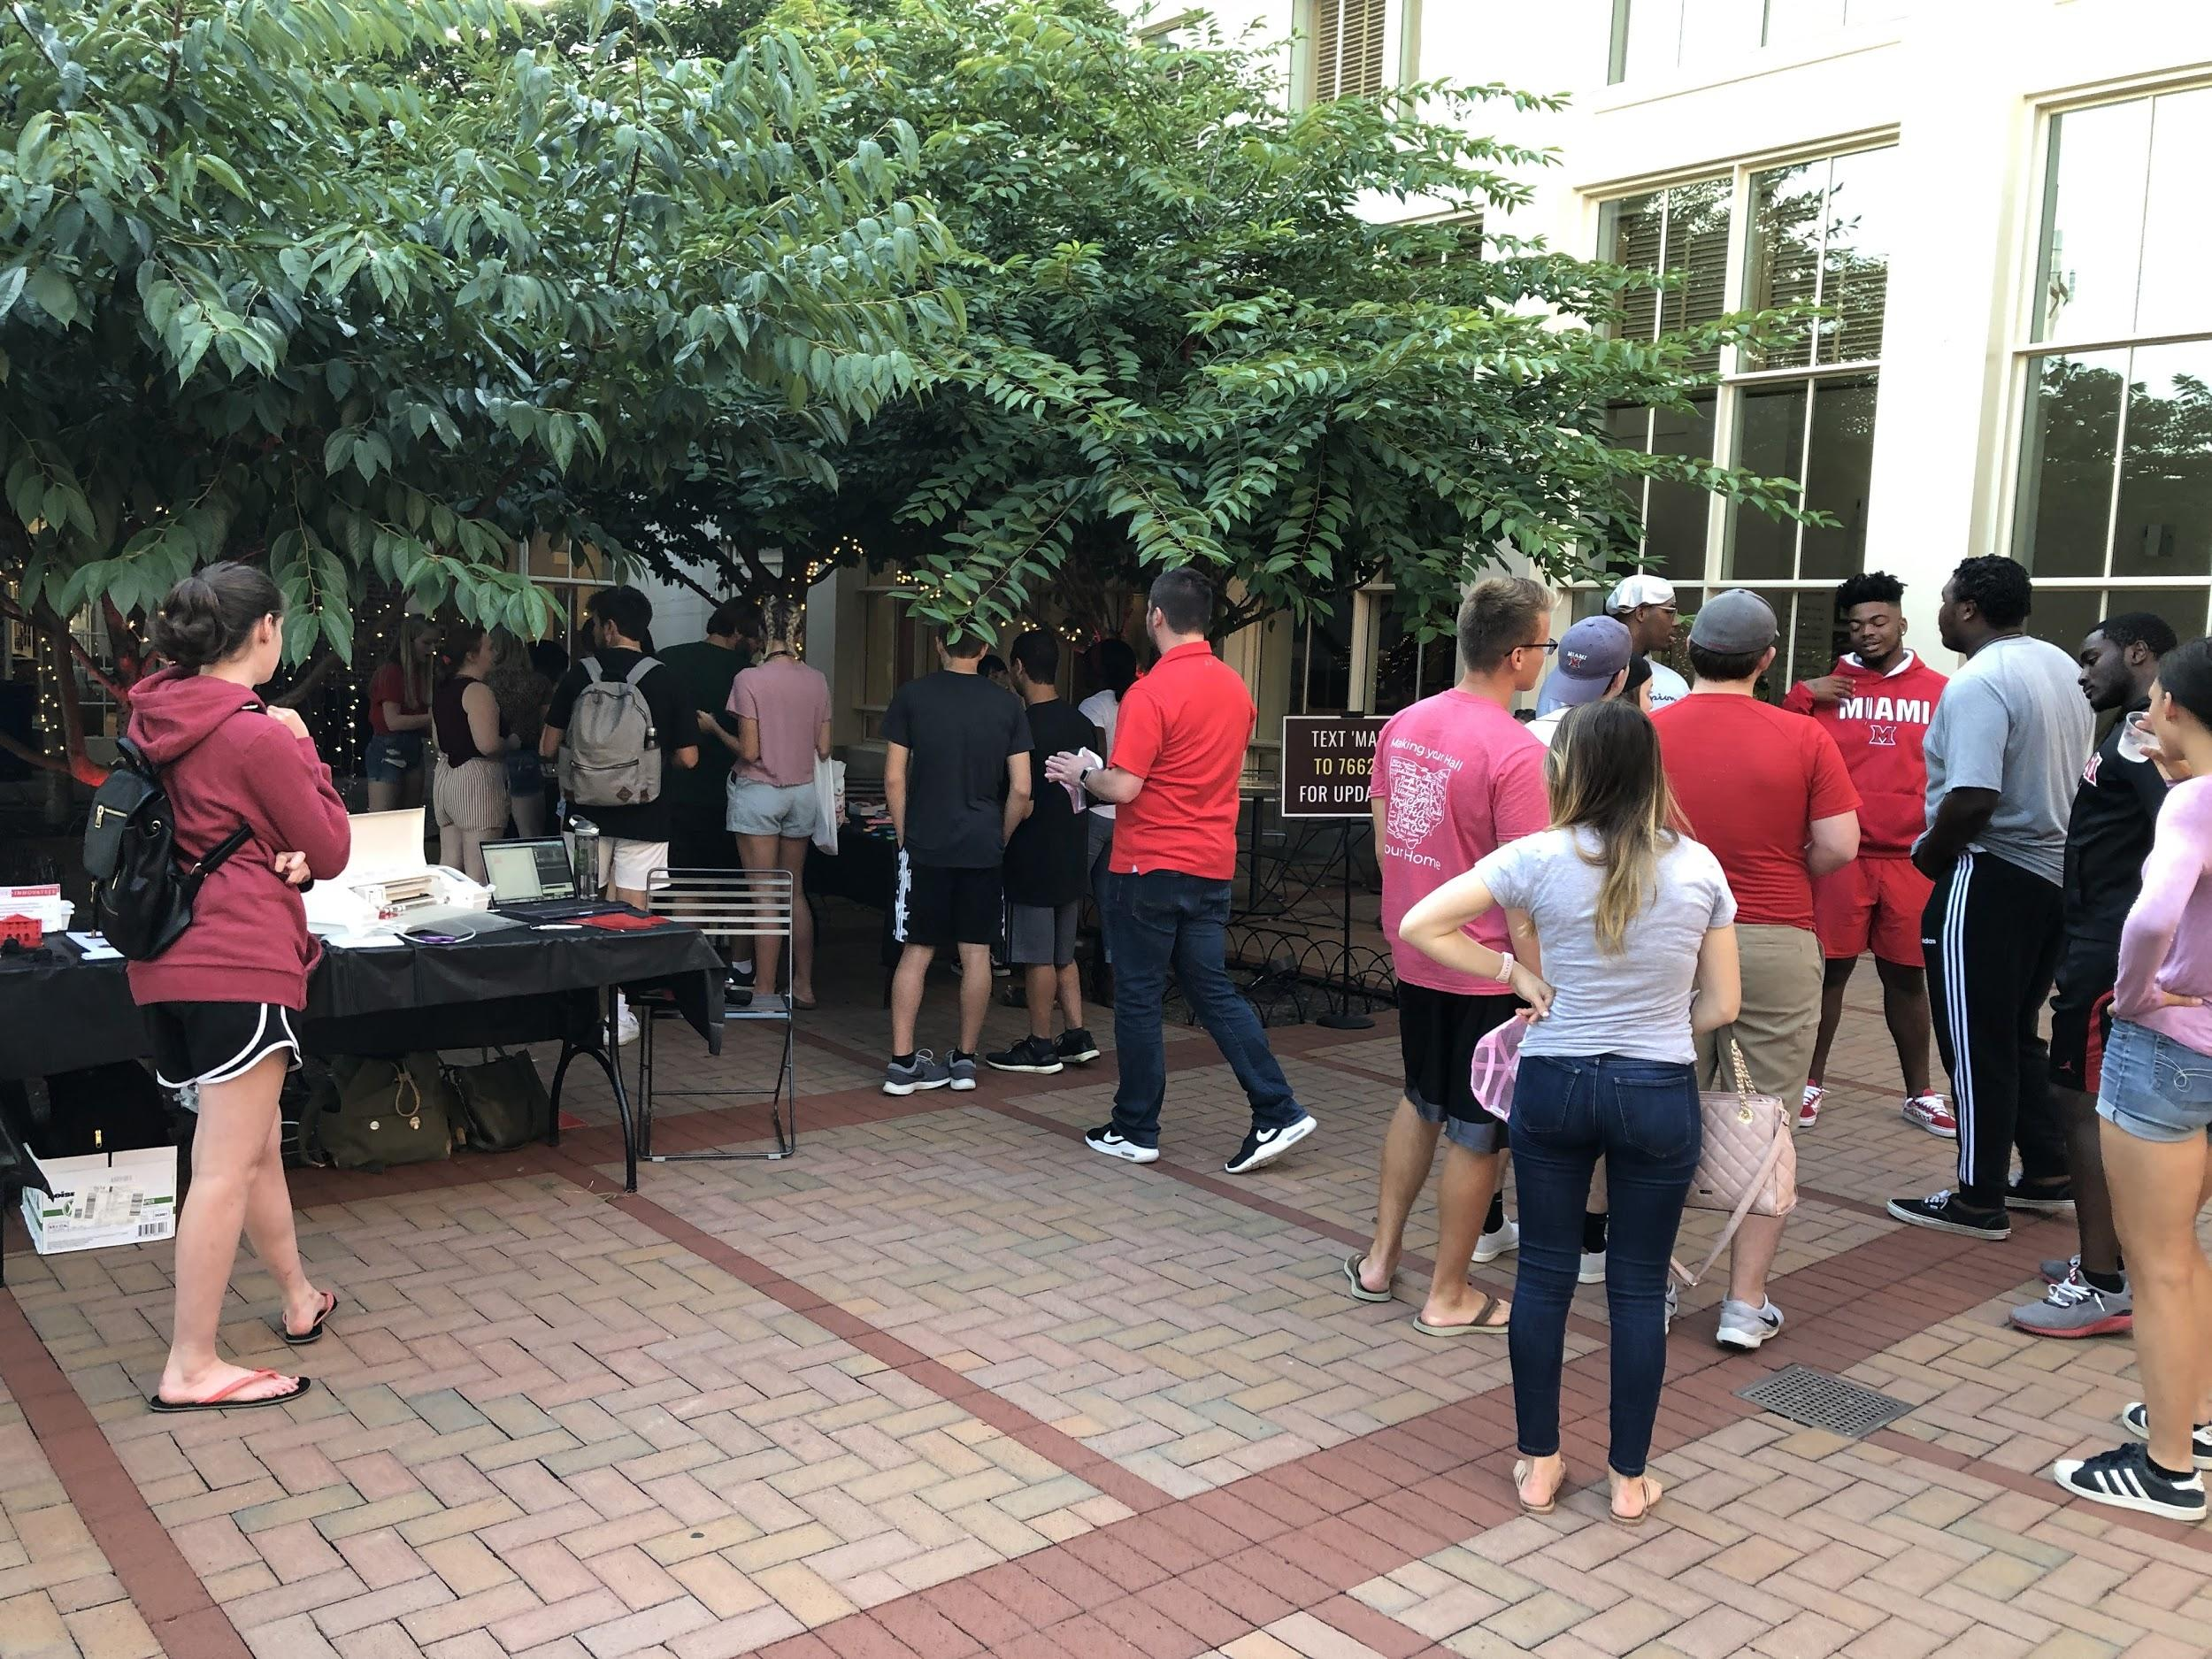
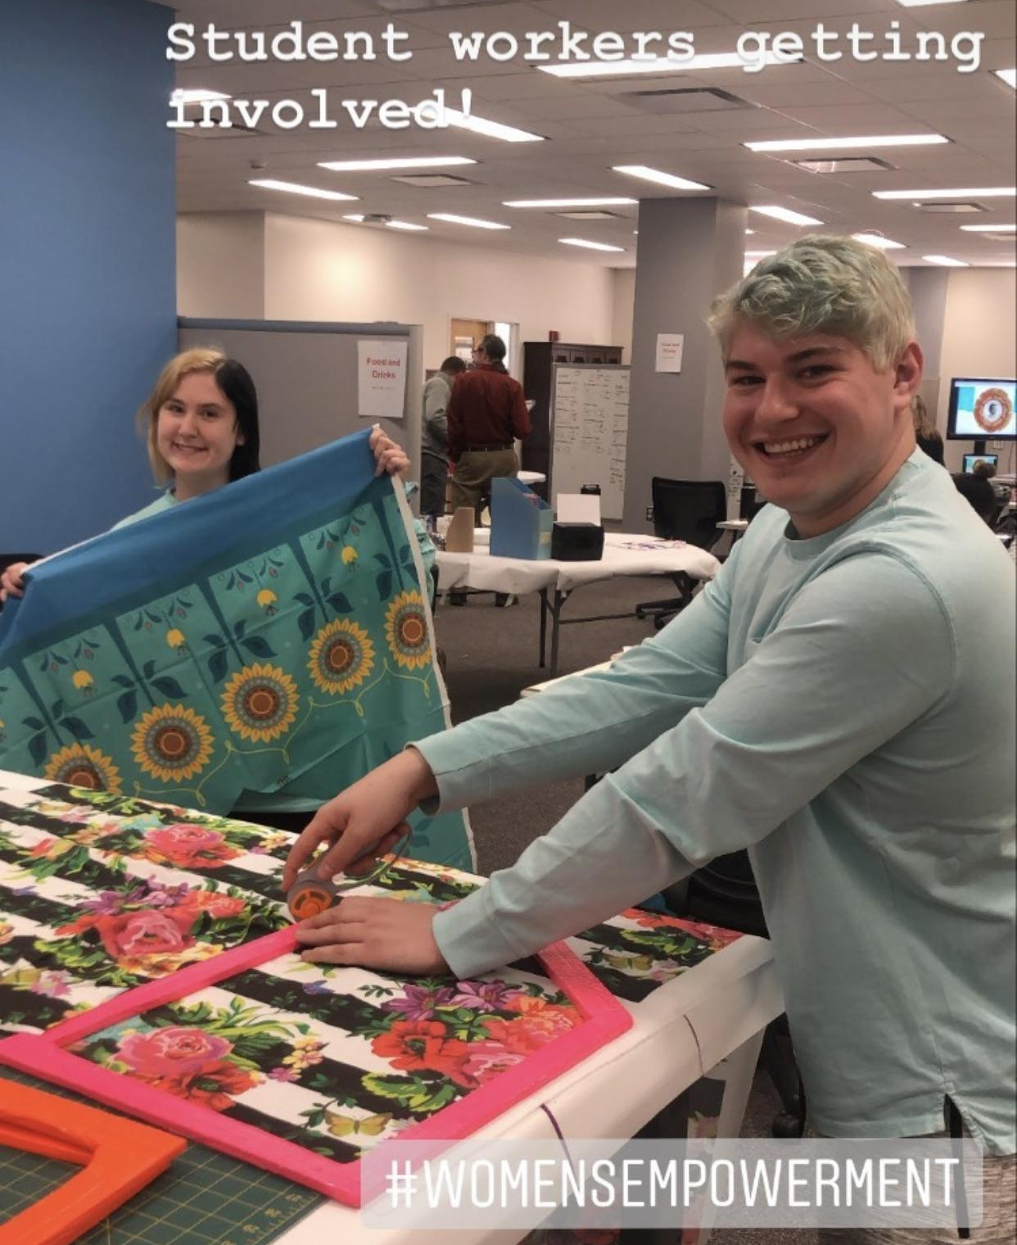
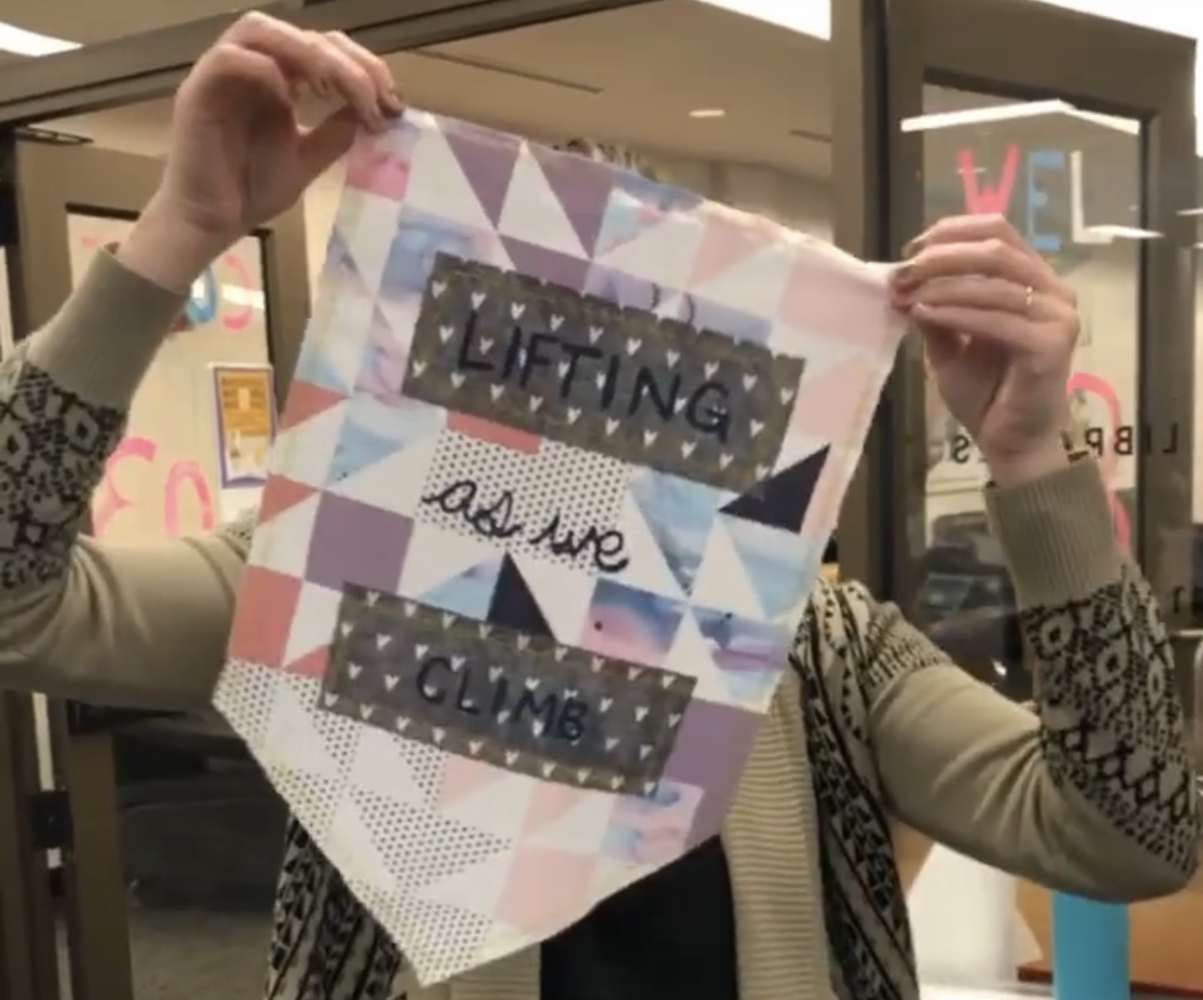
In-person Events
How do we recreate this virtually?
Collaborative
Inclusive
Fun
Casual

Slide 26
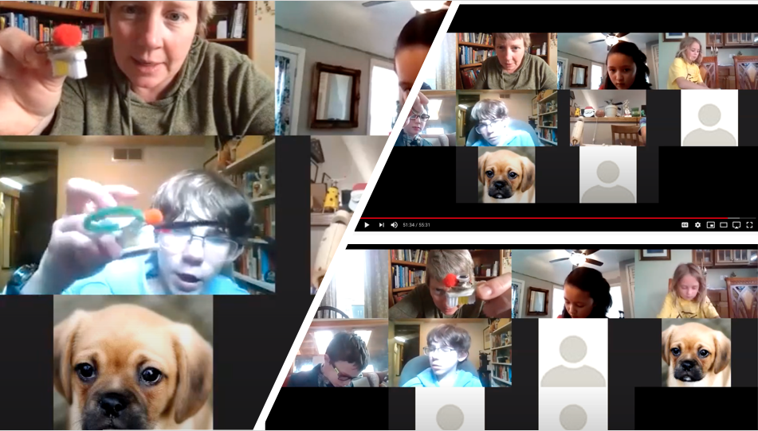
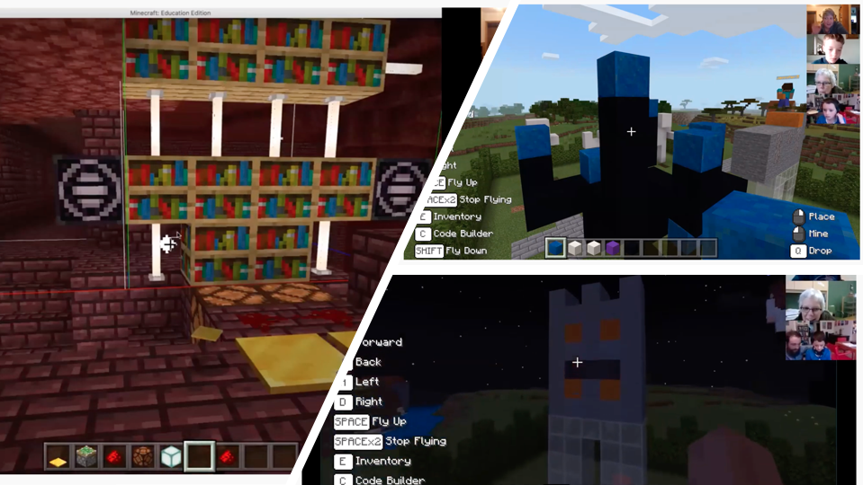
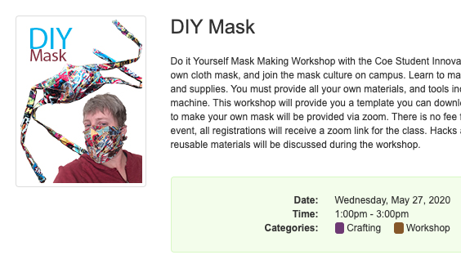
Synchronous Workshops
Live Zoom Sessions
Jane Crayton, Makerspace Coordinator
Coe Student Innovation Center - Makerspace
University of Wyoming
Virtual Minecraft Builds
DIY Mask Workshops

Slide 27
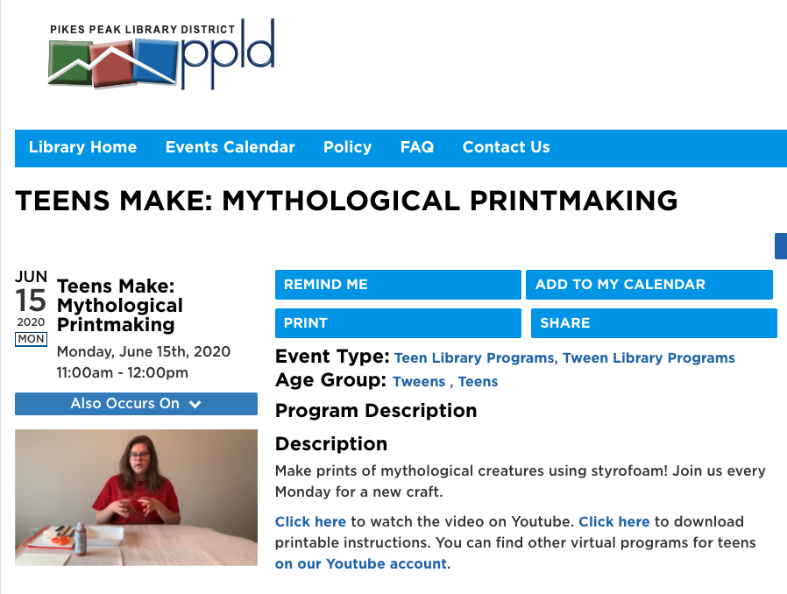
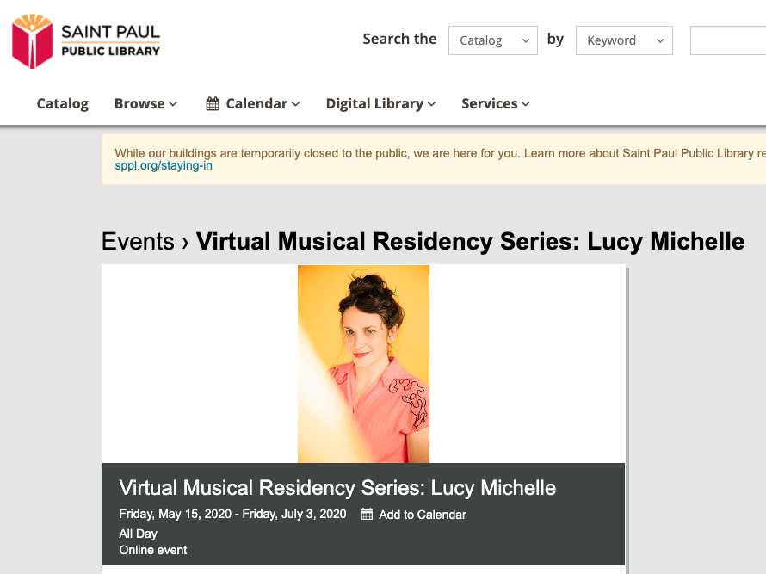
Synchronous Workshops
Public Libraries
Pikes Peak Library District
Saint Paul Public Library

Slide 28
LESSONS FROM EARLY ADOPTERS
FAIL FORWARD
STAY FLEXIBLE
WORK HARD FOR INCLUSION
In other words, don’t be afraid to jump in and try things out!
Moving our work online is new territory.
Don’t leave any students behind as we move online.

Slide 29
Thank you!
Questions?
Stefanie Hilles - hillessa@miamioh.edu
Sarah Nagle - pricesb@miamioh.edu; Tw: @SarahNagle10

