Slide 1

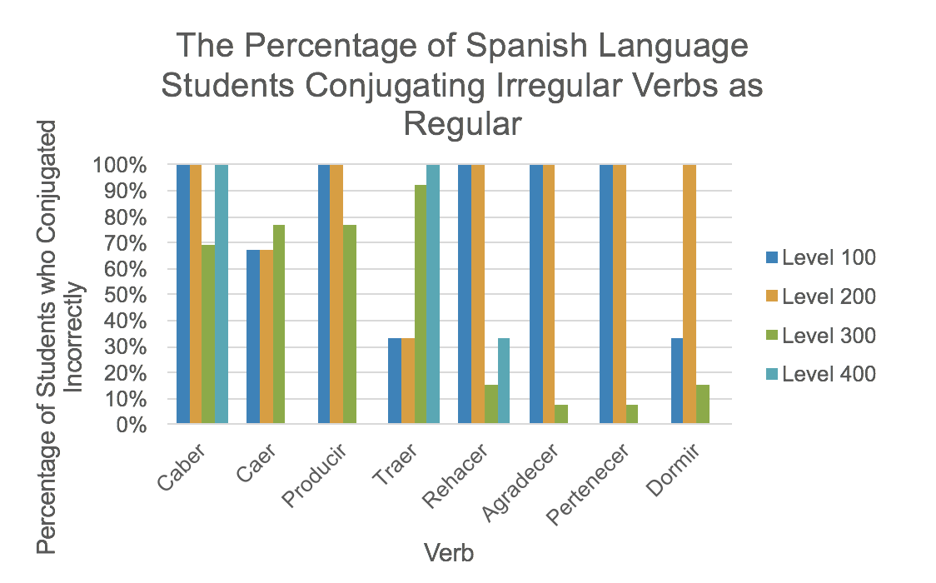
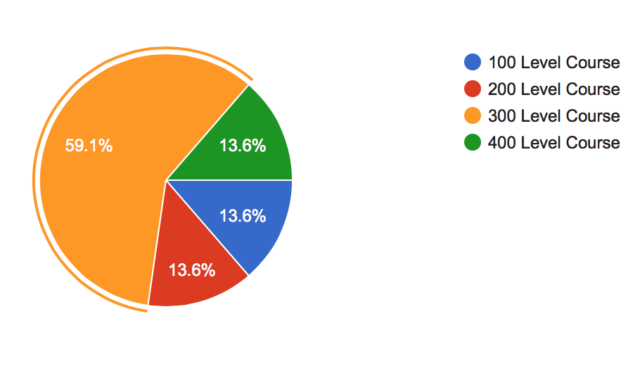
The Prevalence of Irregular Conjugations as Regular in Spanish Second Language Learners at Miami University
Alice Kitrys
kitrysak@miamioh.edu
Abstract
I investigated whether a higher course level of Spanish influences the conjugation of irregular verbs in a regularized form. For some verbs, it was found that as level of Spanish increased, the amount of incorrect conjugations decreased. However, for other verbs, no relationship between Spanish class level and incorrect conjugation was found.
Procedure
Miami students were asked to participate in a survey in which they were given 15 sentences in English. Participants were instructed to translate each sentence to Spanish using the provided verb. In order to keep the purpose of the study confidential, participants were asked to conjugate both regular and irregular verbs.
Future Research
To find out more about when irregular verbs are conjugated as regular, the following aspects could also be investigated:
Age at which students started speaking Spanish
Knowledge of other languages
Location or duration of study abroad
Interest in Spanish
Results
Purpose
The purpose of this study was to see whether Miami students learning Spanish as a second language shared similar speech patterns based on their course level.
Conclusions
It was found that for some irregular verbs such as producir, agradecer, and pertenecer, the prevalence of irregular conjugations as regular decreased with the increase of Spanish course level. However, for the verb caber, it was found that all levels of Spanish had difficulties with the correct conjugation. An interesting trend that was noticed was that the amount of incorrect conjugations of traer increased with an increase of Spanish course level. Due to these results, no significant pattern can be shown to predict whether Spanish experience, based on the level of Spanish course enrolled at Miami University, has an effect on conjugations of irregular verbs as regular.
Background
It was known that a longer duration of exposure to a language decreased incorrect conjugations of irregular verbs and that with practice, or formal instruction, it was more likely for L2 learners to conjugate irregular verbs in their correct form.
References
Birdsong, D., & Flege, J. E. (2001). Regular-irregular dissociations in L2 acquisition of English morphology. BUCLD 25: Proceedings of the 25th Annual Boston University Conference on Language Development (pp. 123-132). Boston, MA: Cascadilla Press.
Presson, N., Sagarra, N., MacWhinney, B., Kowalski, J. (2012). Compositional production in Spanish second language conjugation. Bilingualism: Language and Cognitions, 16(4), 808-828.
Yaden, B. (2007). The Processing and Representation of Verbal Inflection: Data from L1 and L2 Spanish. Hispania, 90(4), 795-808.
The Breakdown of Spanish Levels of Respondents
Limitations
Since this study was conducted online, there is a possibility that outside sources such as online translators, class notes, or dictionaries were used in formulating responses. It is also possible that participants may have lied about their Spanish experiences. Also, more than half of the respondents were from a 300 level course which may not have given accurate data when comparing between different levels of Spanish.
n=22

