Slide 1
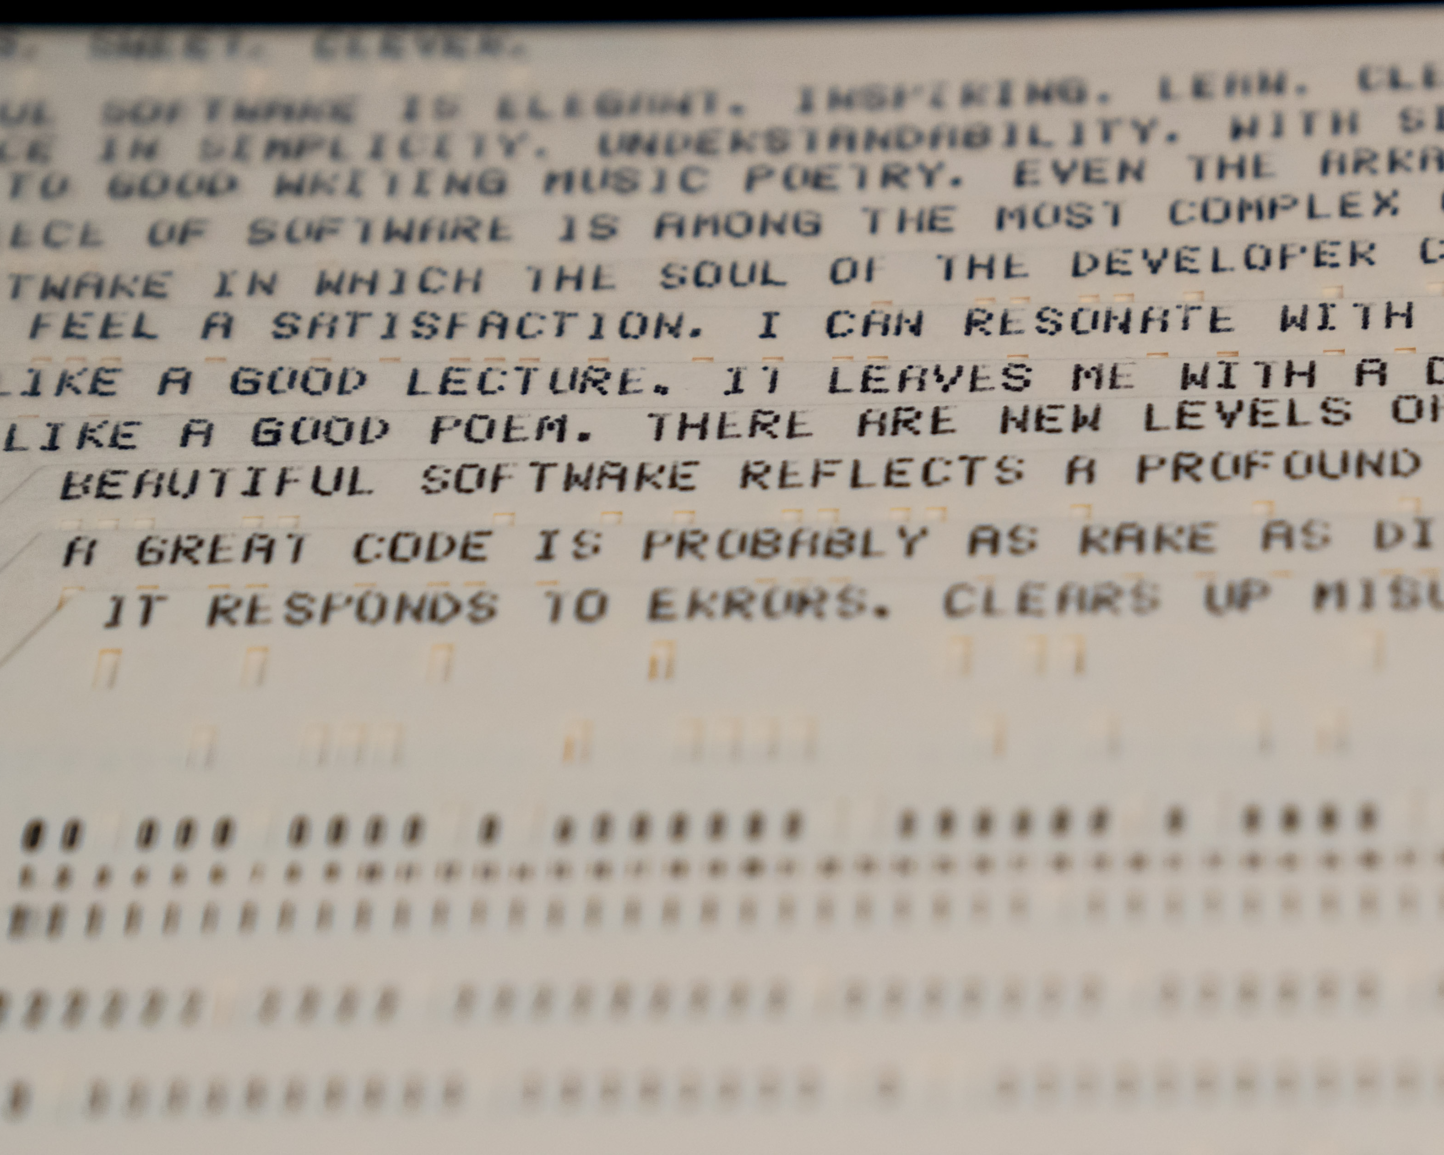
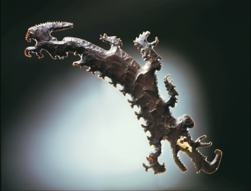
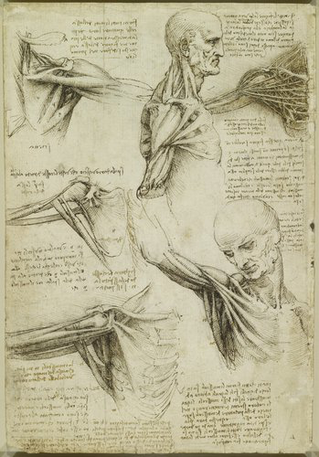
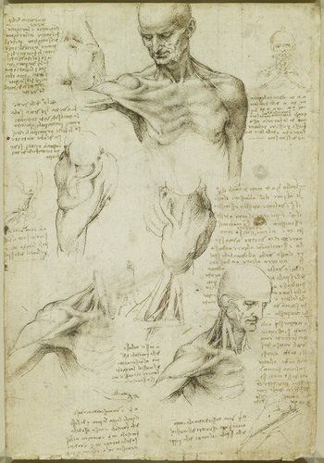
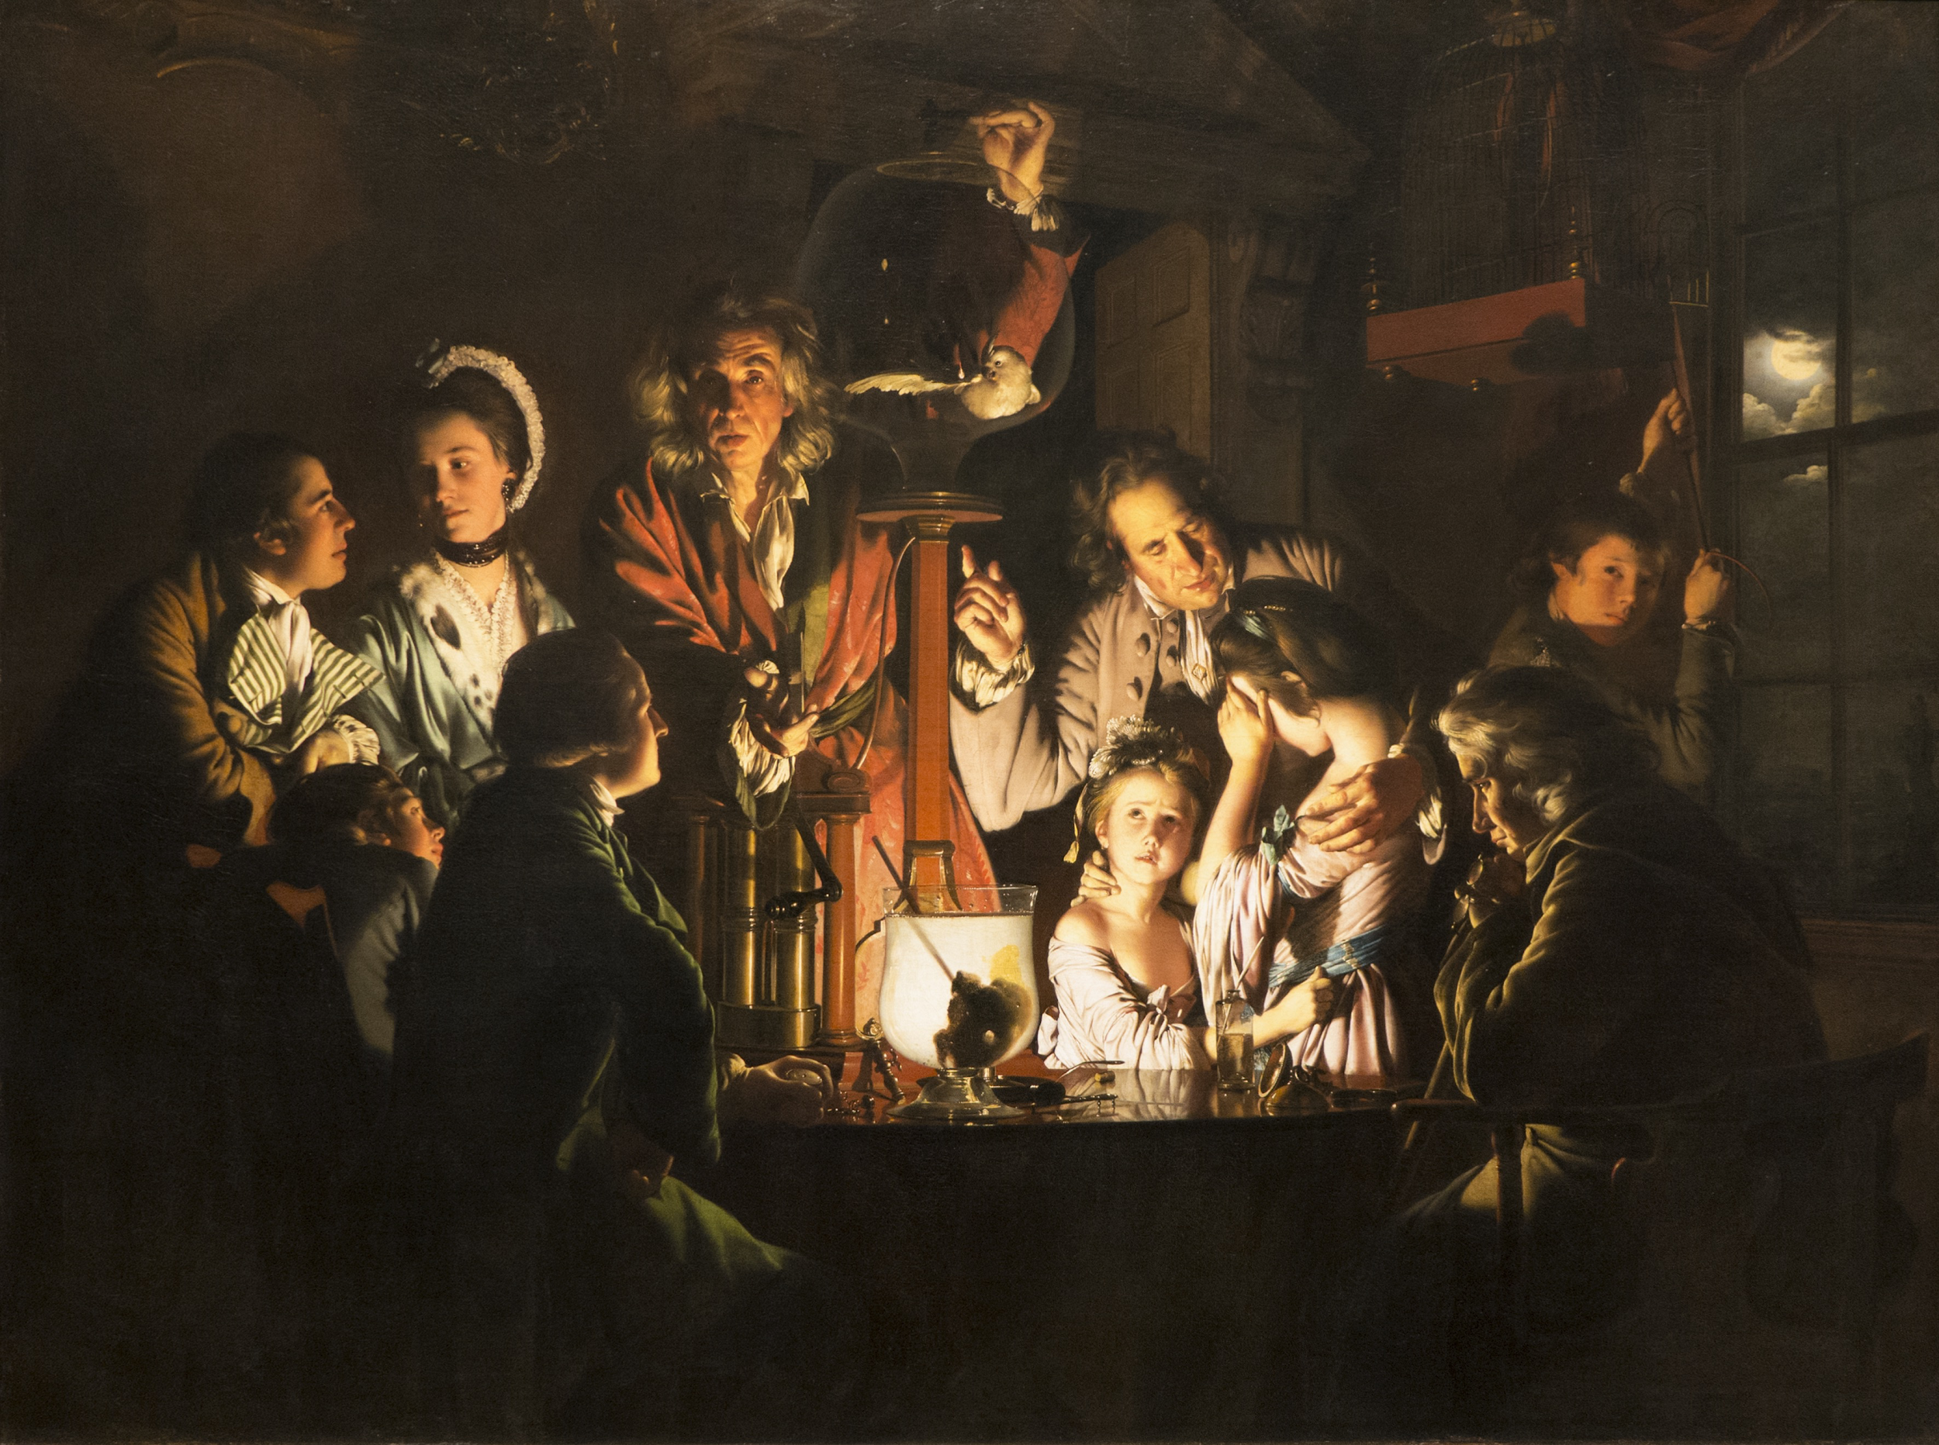
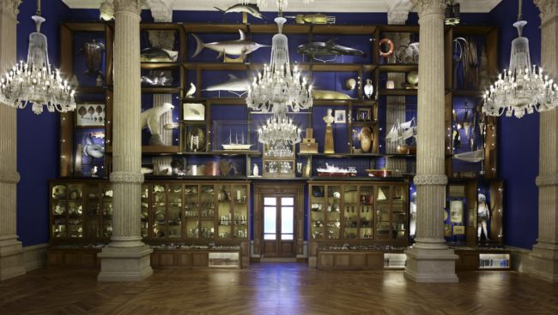
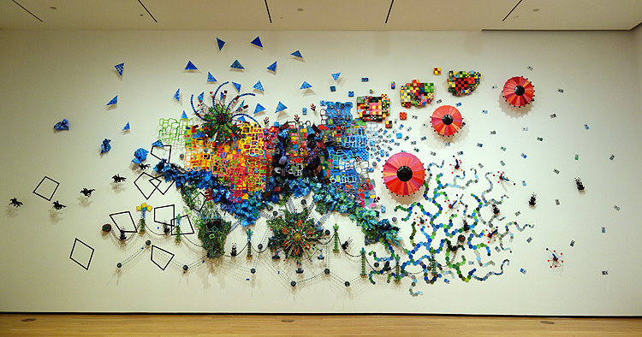
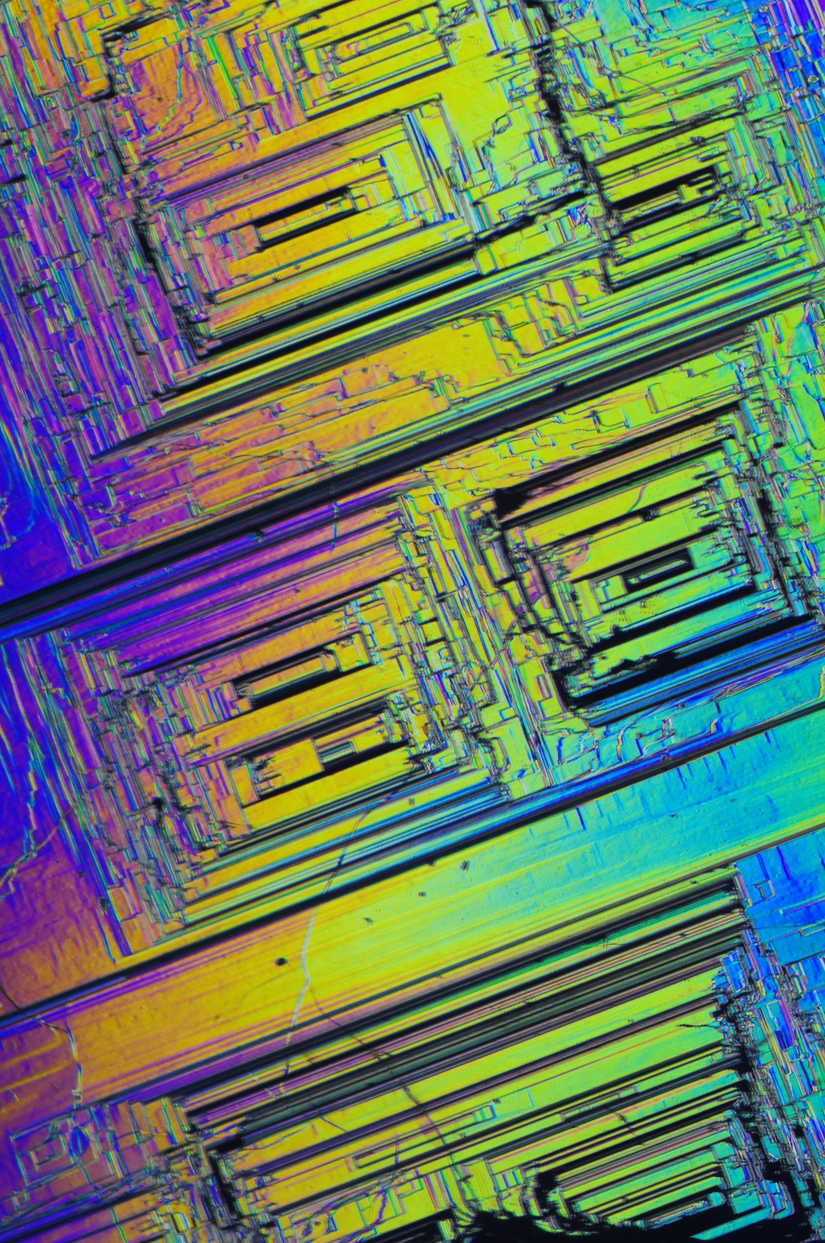
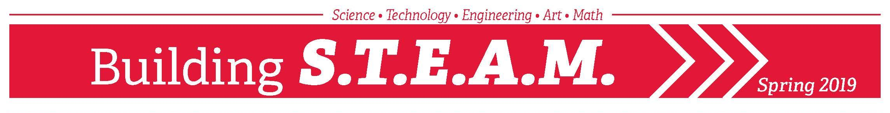
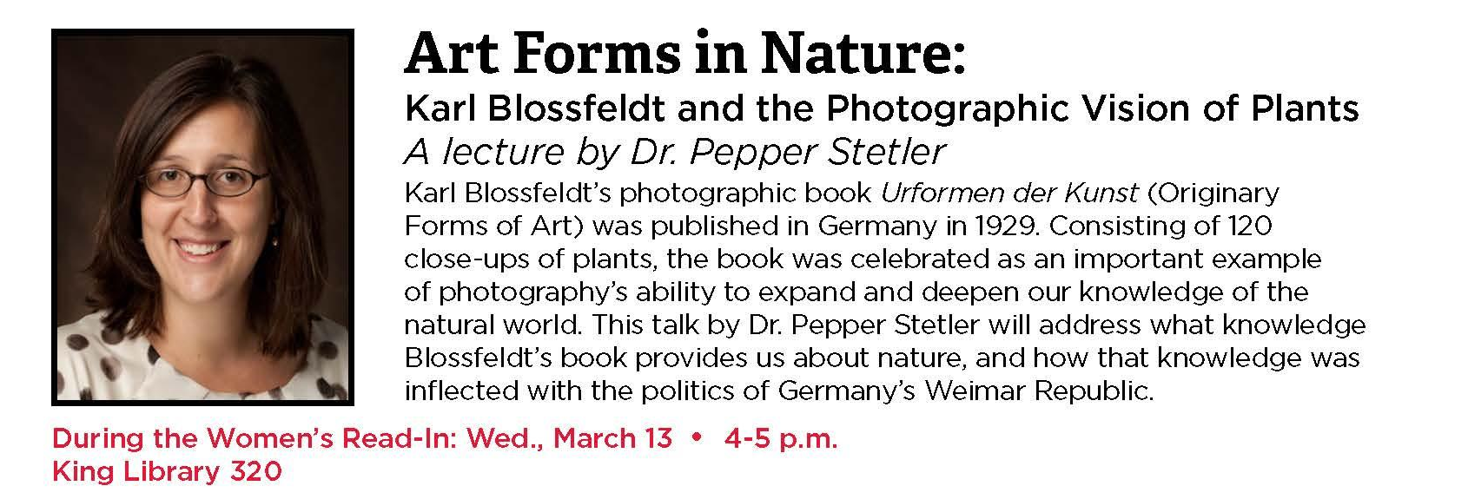
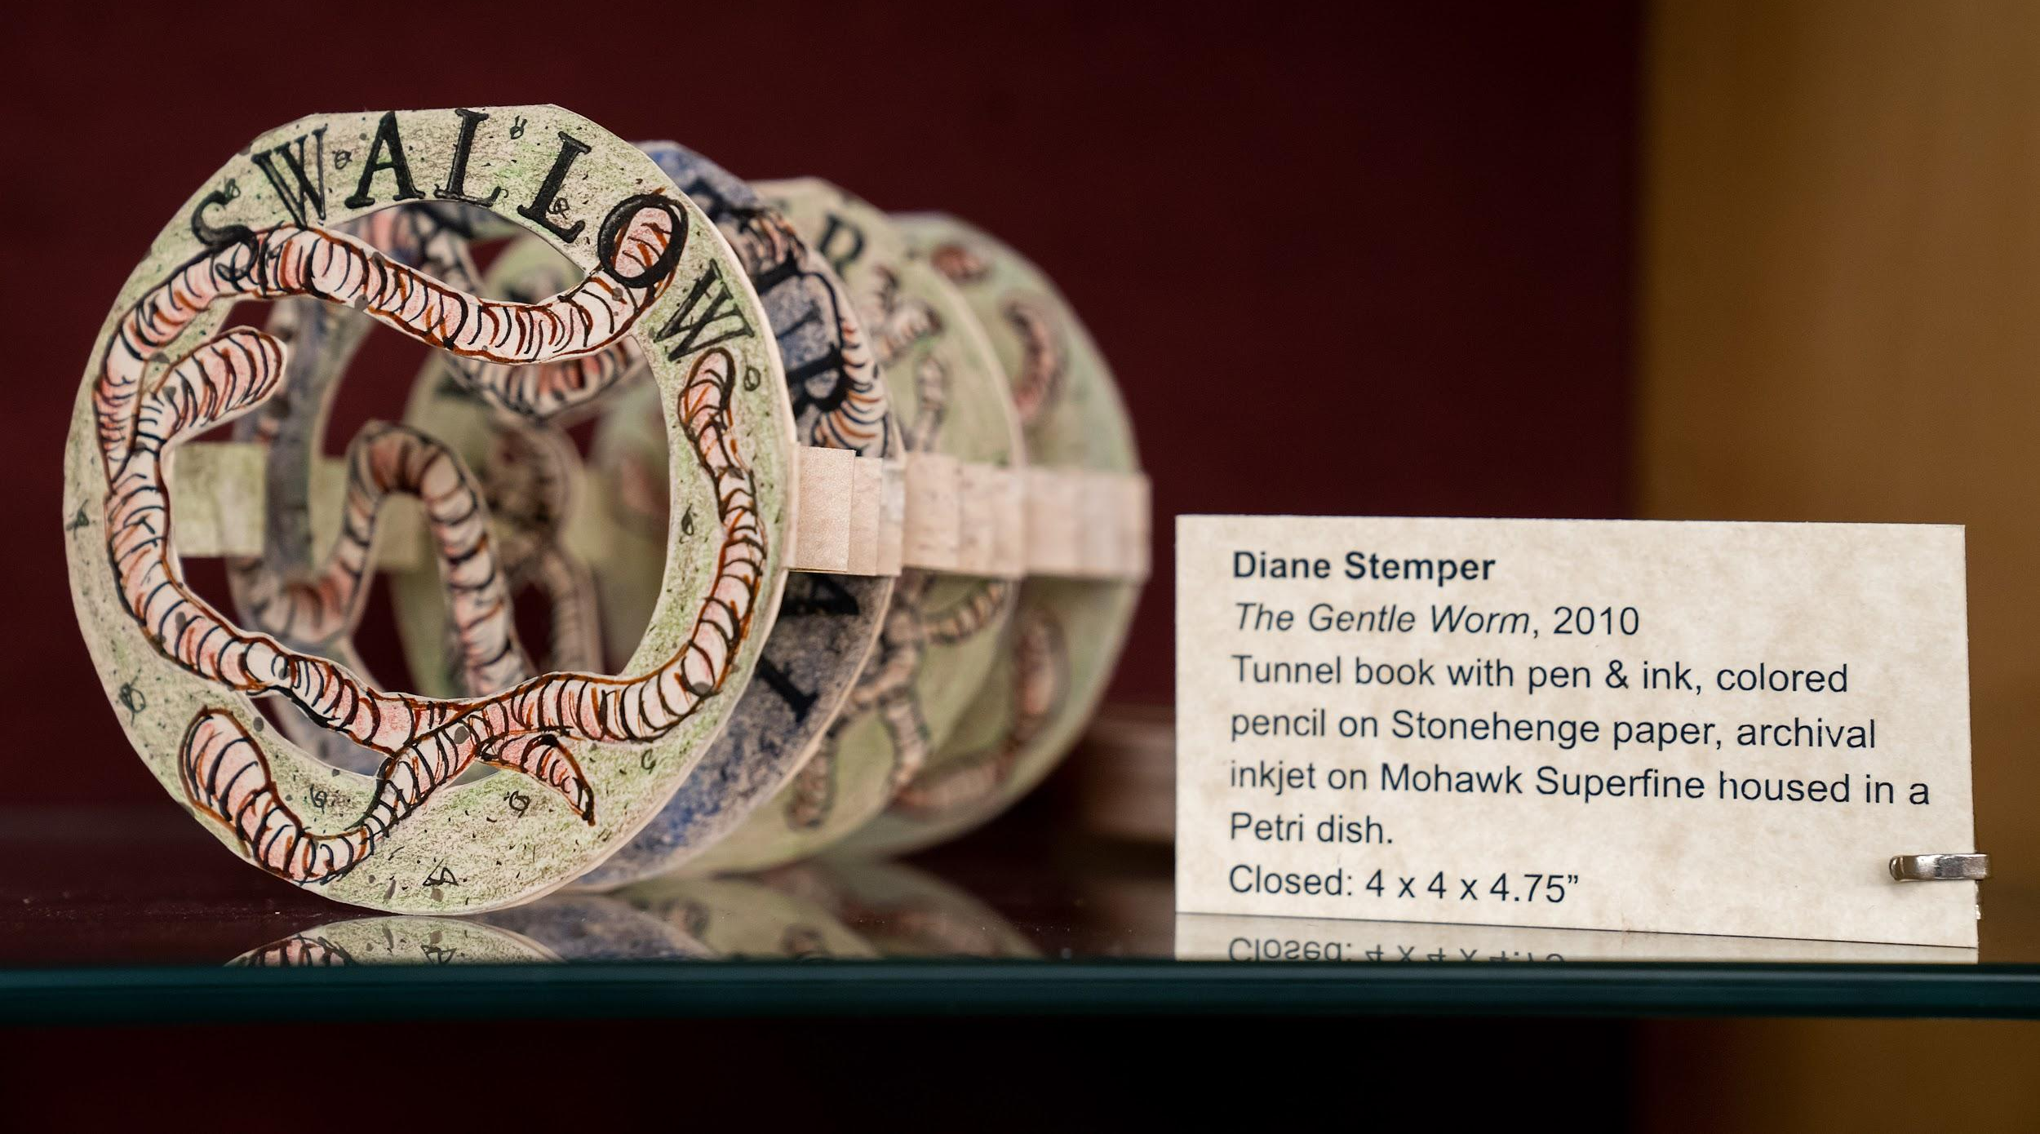
Building STEAM: Collaborative Outreach and Engagement with Art and Science in the Academic Library
Stefanie Hilles & Ginny Boehme, Miami University
Why is STEAM Important?
STEM researchers are increasingly reliant on creative methods to carry out studies, as well as creative media to present and promote their work¹
STEAM education acknowledges that the creation of an artistic end-product is just as valuable as traditional scientific output²
STEAM education is increasingly necessary for future career readiness, as it develops essential skills for a generation of students entering a workforce where, by 2030, it is expected that they will be working in jobs that do not yet exist³
Innovation, entrepreneurial thinking, and cross-disciplinary research, all of which are important elements of STEAM, are also key for student success⁴
¹Ashley H. Gess, “Steam Education: Separating Fact from Fiction,” Technology & Engineering Teacher 77, no. 3 (November 2017): 39–41.
²Ibid.
³Institute for the Future, “The Next Era of Human-Machine Partnerships,” 2017,
https://www.delltechnologies.com/content/dam/delltechnologies/assets/perspectives/2030/pdf/SR1940_IFTFforDellTechnologies_Human-Machine_070517_readerhigh-res.pdf.
⁴Strategic Planning Steering Committee, “Miami University’s Strategic Plan,” June 28, 2019.
Potential STEAM Partnerships
Special Collections / Archives
  Artists drawings in scientific texts
  Artists books about science
  Collections of scientific texts
  Scientific photography (or the science behind how photography works)
  Restoration/conservation
Community partners
  Local/regional artists
  Local schools
  Local artist groups and associations
Campus departments
  Campus museums
  Microscopy
  Data visualization
  Art and art history departments
  Intermedia/Interdisciplinary studies
  Architecture
  Biology
  First-year experience courses, independent studies
Makerspaces
  Potential for exhibitions of student work
  Projects that make art and through technology
Art and Science Through the Ages
Flint depicting a crocodile canoe, 600-900 CE. 9 ¾ x 16 ¼ x ¾”. Dallas Museum of Art, Texas. From Debra J. DeWitte et al. Gateways to Art. New York: Thames & Hudson, 2012. Plate 4.59.
Leonardo daVinci, Recto: The superficial anatomy of the shoulder and neck. Verso: The muscles of the shoulder c.1510-11, Pen and ink with wash, over black chalk, 11 ½ x 7 ⅘. Royal Collection Trust, London, England. From: The Royal Trust Collection, https://www.rct.uk (accessed October 15, 2019).
Joseph Wright of Derby, An Experiment on a Bird in the Air Pump, 1768. Oil on canvas, 6 x 8’. National Gallery, London, England. From Debra J. DeWitte et al. Gateways to Art. New York: Thames & Hudson, 2012. Plate 4.62.
Mark Dion, Oceanomania, 2011. Installation, 59 x 32 ⅘”. Oceanographic Museum of Monaco. From: Art in America, https://www.artinamericamagazine.com/news-features/news/oceanomania-mark-dion/ (accessed October 15, 2019).
Nathalie Miebach, Sibling Rivalry, 2016. Installation, 28 x 15 x 1’, Akron Art Museum, Akron, Ohio. From Nathalie Miebach, http://nathaliemiebach.com/ (accessed October 15, 2019).
Our STEAM Series
Stakeholder Collaborations and Takeaways
Survey your campus and community -- there will be connections to leverage, with unexpected links between art and science
Examine your collections – what do you have that you can showcase? E.g. cuneiform tablets to discuss archaeological processes and techniques, medieval manuscripts to focus on the science behind paint mixing
Be prepared for disappointment -- not everything you come up with will be popular!
Potential outcomes include: exhibitions, lectures, makers events, class projects
3 lectures
2 exhibitions
1 series

