Slide 1
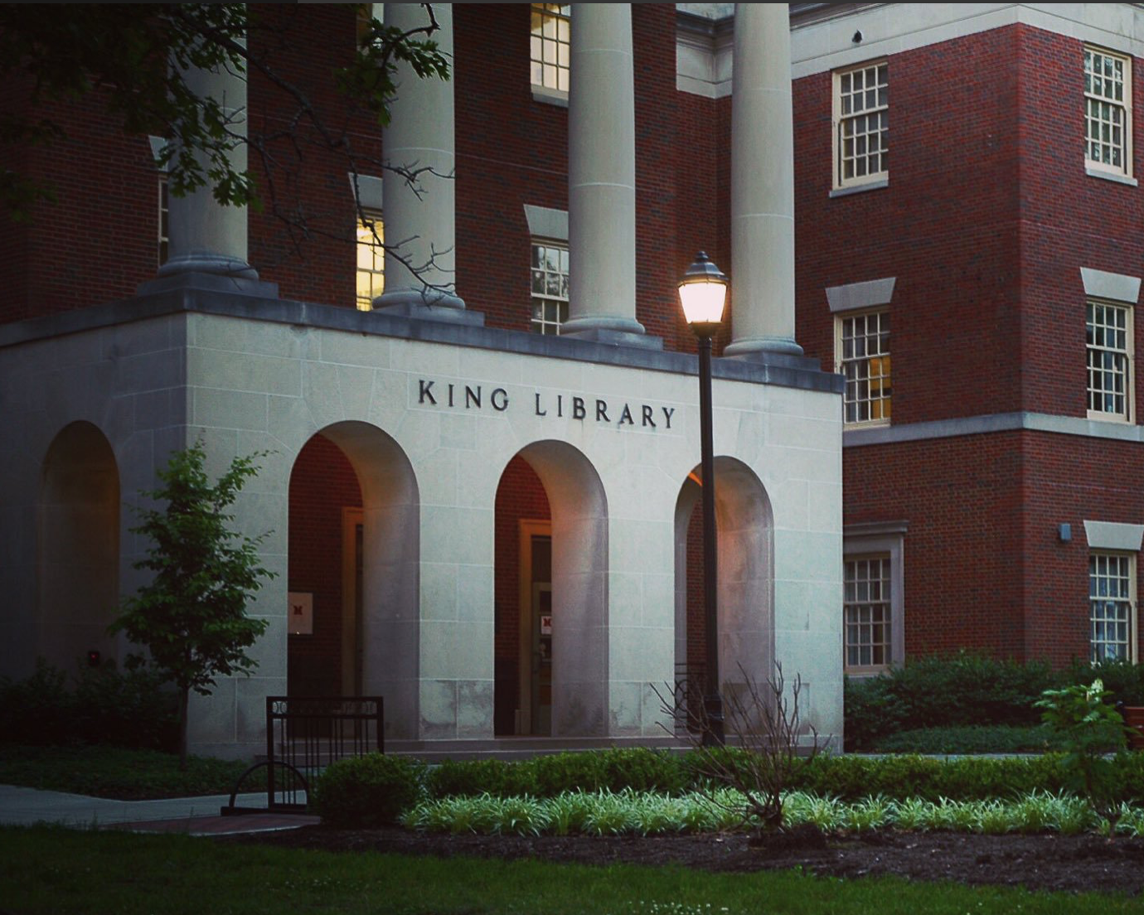
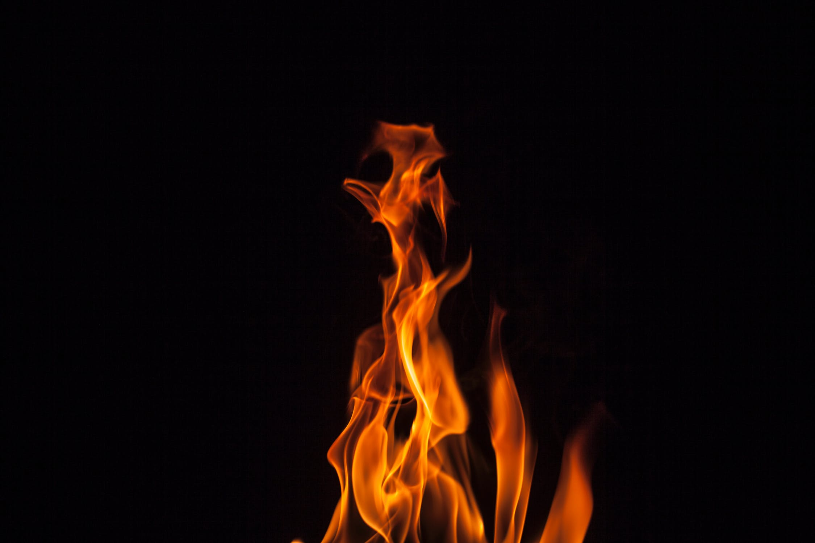
First Year Research Experience (FYRE) and Miami University Libraries
Ginny Boehme & Nate Floyd
Course
Creating Museum Exhibits
Students
Creative, driven students of any background or major
Topics
Universal design
Exhibit design
Writing for various formats and audiences
Building empathy
Librarian role
How research differs across disciplines and projects
Evaluating and identifying research needs for a given task
How to find, evaluate, and synthesize information
FYRE at Miami University
Miami's Office of Research for Undergraduates sponsors the First Year Research Experience (FYRE) Program. Over 600 Miami students have participated in the program since 2009. FYRE aims to jumpstart student involvement in research and inquiry at the very start of their college experience. The program allows students to establish meaningful relationships with Miami faculty, graduate students and their peers outside of the traditional classroom setting.
Course
Investigating Academic And Career Success
Students
Bridges Scholars
Topics
Sense of belonging
Mentorship
Leadership
Success in STEM fields
Librarian role
Providing orientation and overview of relevant university resources
How to design and conduct research
Locating and retrieving source material for research projects
Benefits of FYRE-Library Collaboration
Shared responsibility
Exploration of differing viewpoints
Exposure to different areas of expertise

