Slide 1


Faculty-librarian partnerships within a course-based first-year research experience program
Ginny Boehme, Science Librarian
Miami University

Slide 2
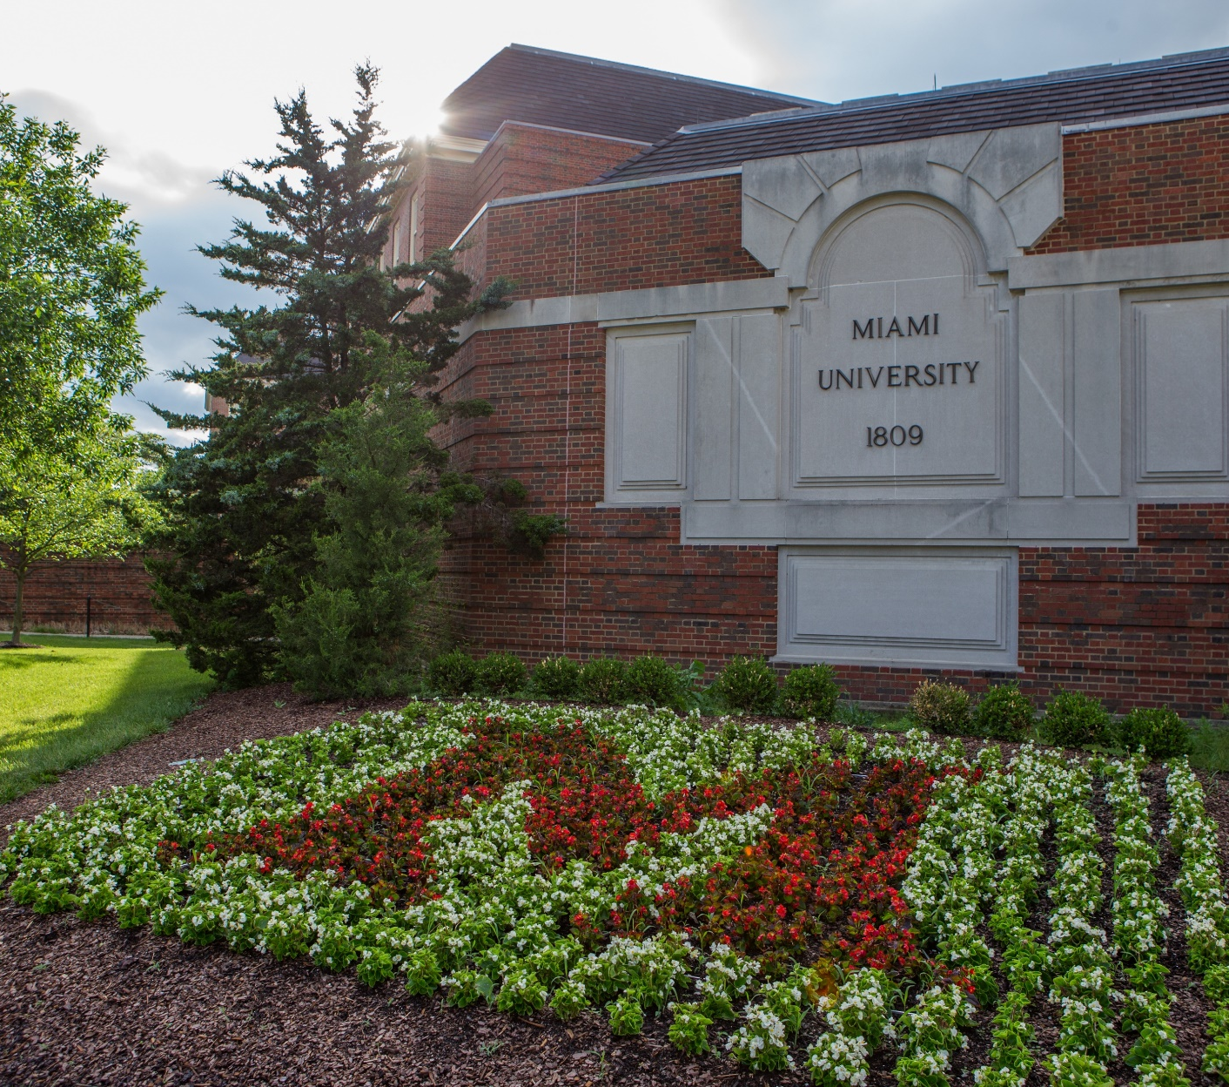
Miami: A Public Ivy
Main campus: Oxford, OH
FTE: 20,000
  17,500 undergraduate
  2,500 graduate
Focus: Liberal Arts education
Pride: 3rd in undergraduate teaching (in USA)
Issue: ~16% of undergraduates participate in research
Image courtesy: Miami University, Scott Kissell

Slide 3


A brief history of FYRE
ca. 2008
FLC investigates STEM diversity
ca. 2013
Librarian-led FYRE project
fall 2018
First semester with librarian as co-instructor
ca. 2009
Birth of FYRE
ca. 2016
Course-based FYRE format emerges

Slide 4
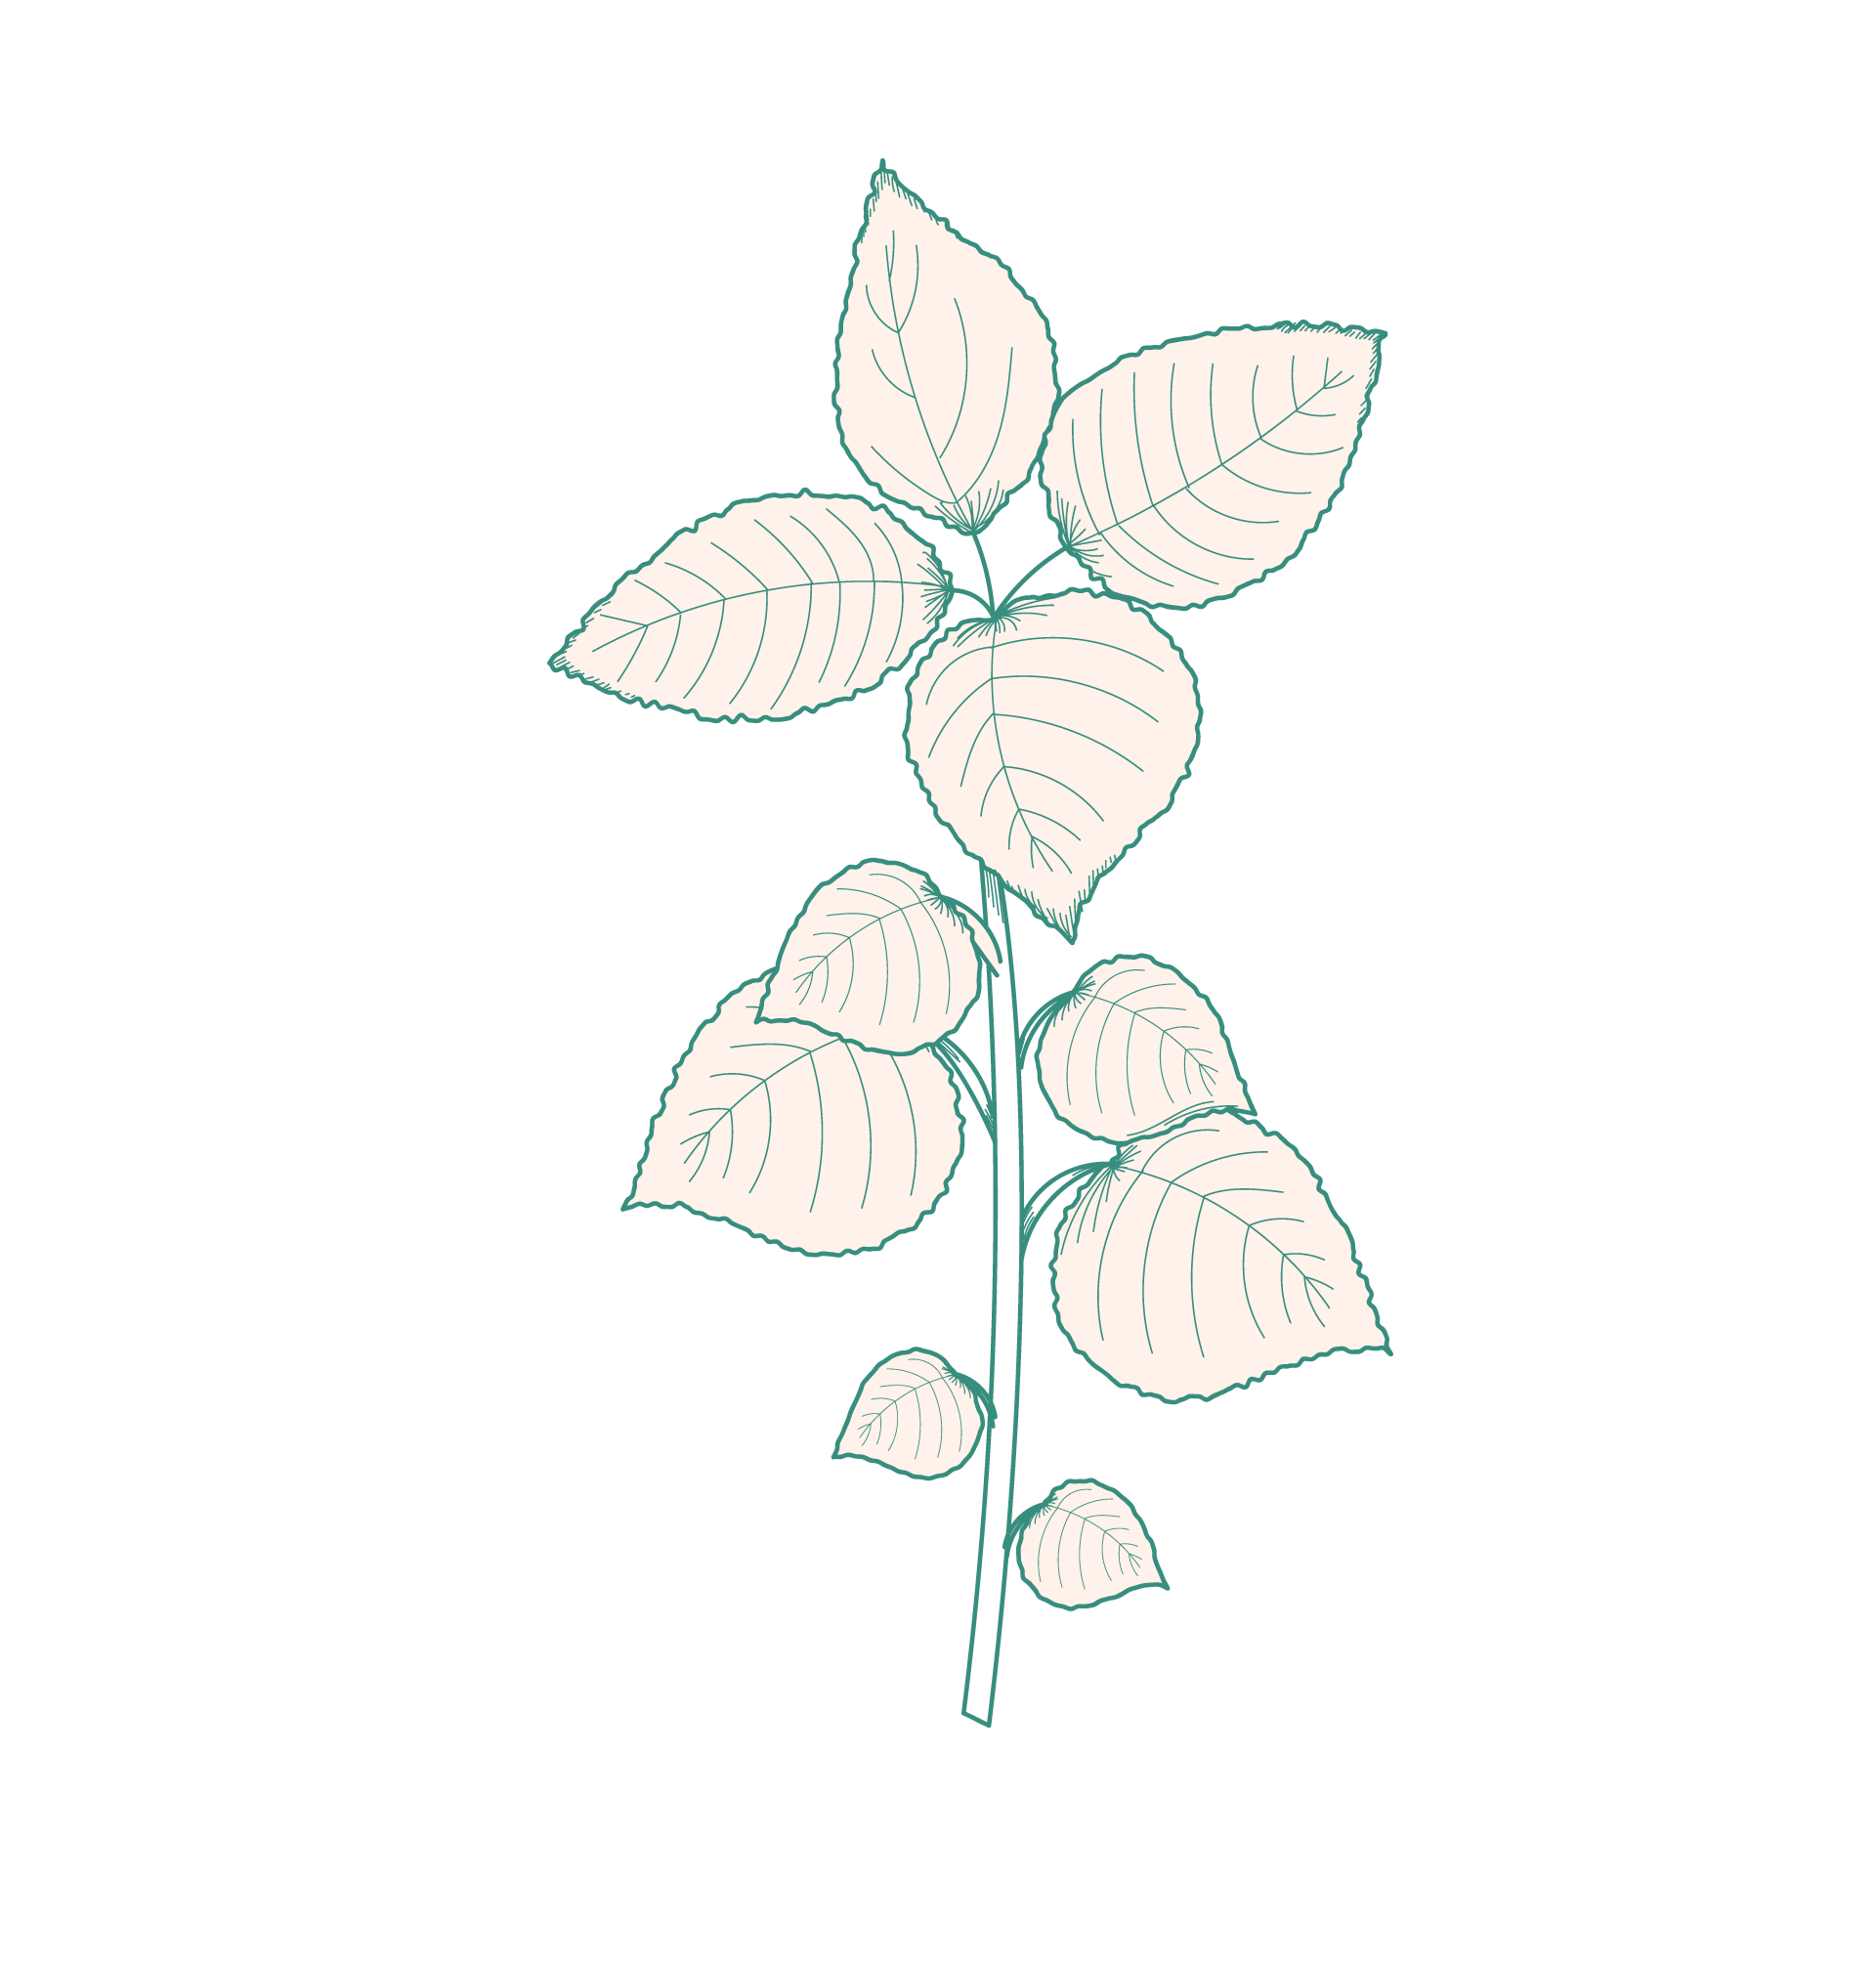

2018-2019
2019-2020
One librarian
One FYRE course
Three librarians
Three FYRE courses

Slide 5





Creating Museum Exhibits
Our FYRE course

Slide 6
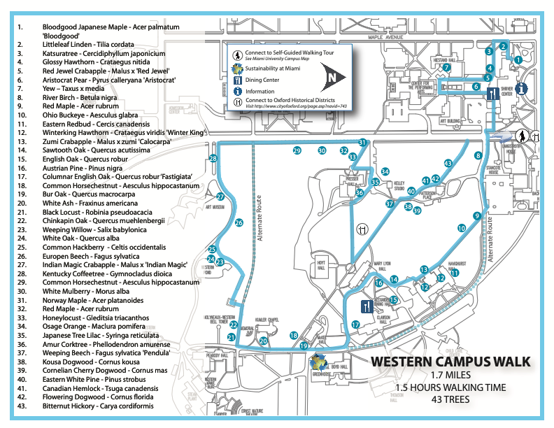
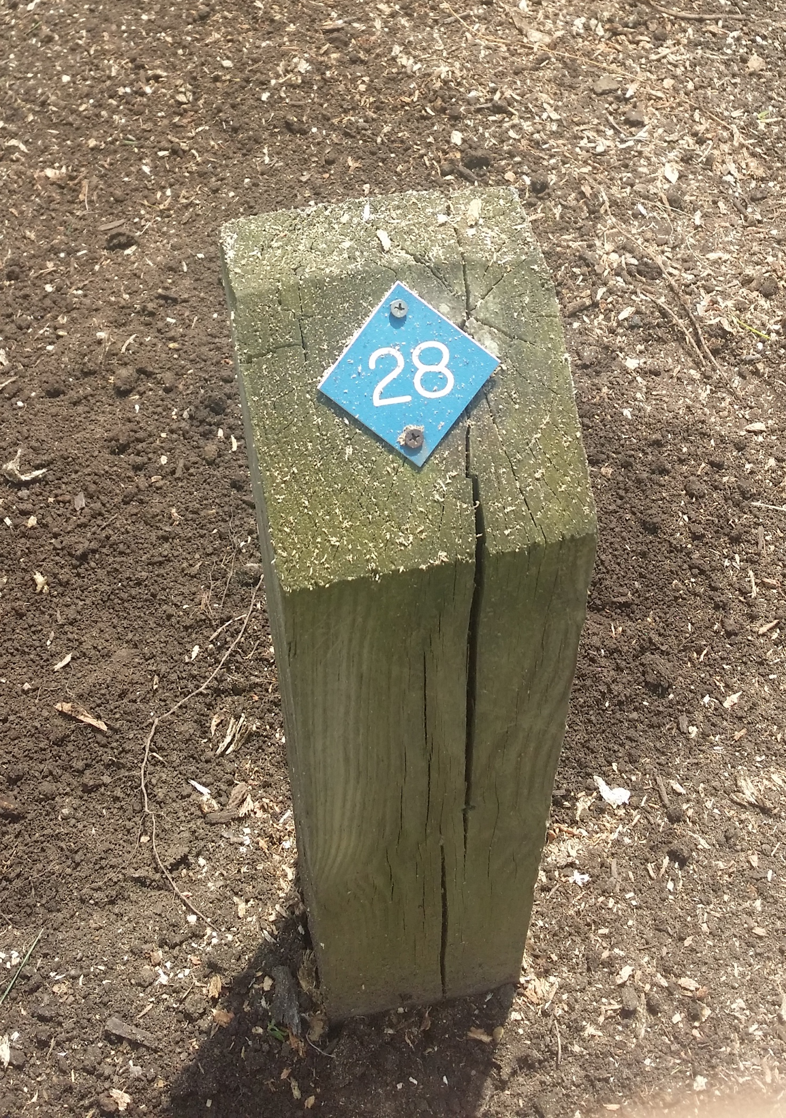
Exhibit Refresh:
“Tree Walks”
Inaccessible
Uninformative
Outdated
Image courtesy: Steve Sullivan
Image courtesy: Miami University

Slide 7
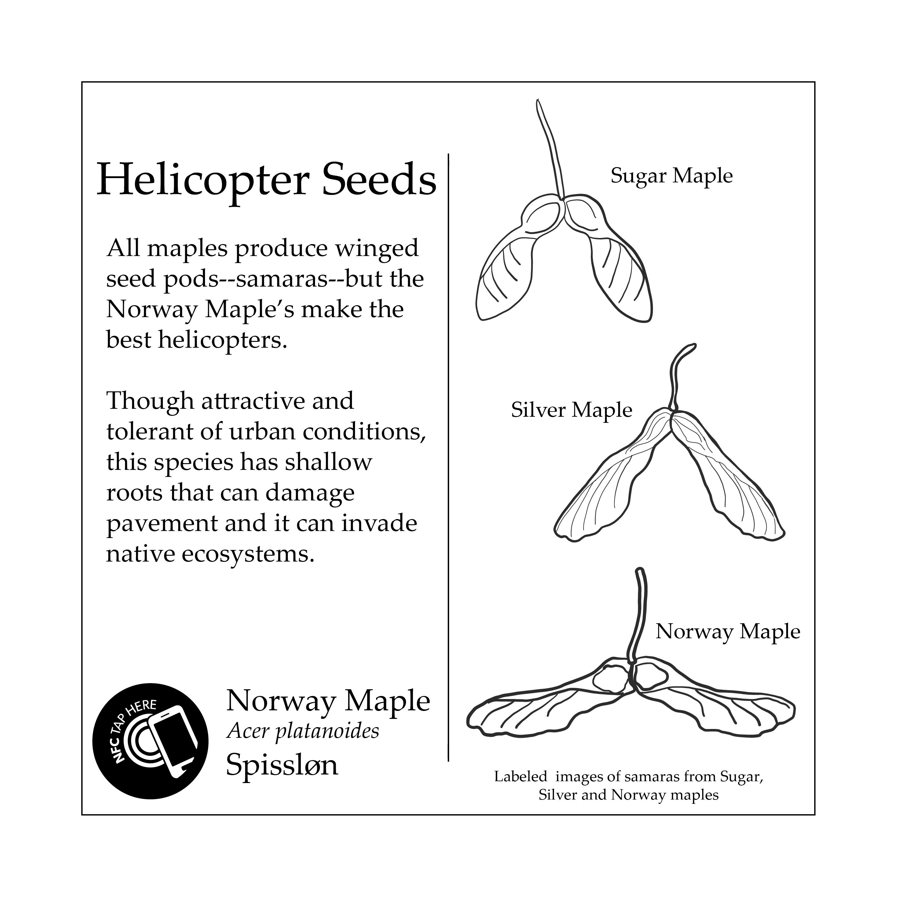
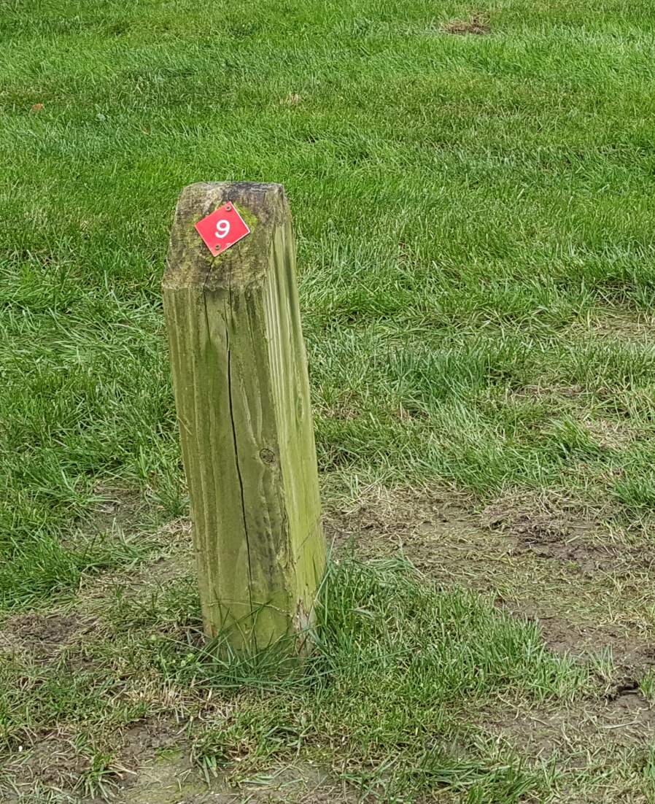
Image courtesy: Steve Sullivan

Slide 8
Instructor Roles
Faculty (Steve) taught… | Librarian (me) taught… | Both of us…
Subject matter (in this case, botany/dendrology) | How research differs across disciplines & projects | Taught project management & collaboration skills
Exhibit design, incl. universal design principles | Evaluating & identifying research needs for different tasks | Designed & graded assignments & exams
Communicating for different audiences | Locating, evaluating, & synthesizing information | Mentored & advised students

Slide 9
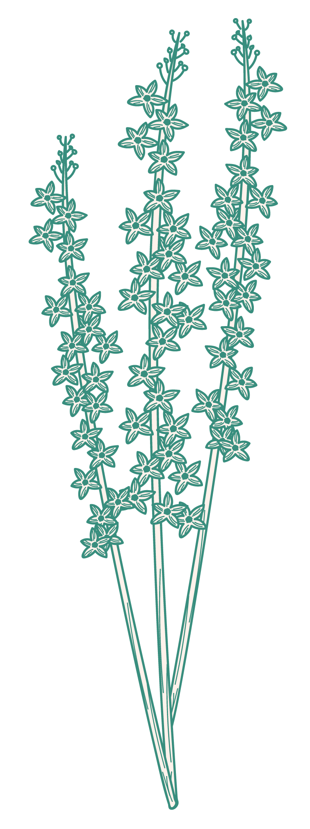
Challenges
Time constraints
Funding
Scalability & sustainability

Slide 10
Benefits
Exposure to and exploration of differing viewpoints & expertise
Content tailored to students
Increased visibility of the library
Scaffolded information literacy skills

Slide 11
So what does the future hold? We’re not sure…
No librarians currently slated to co-teach in fall 2020…
…but our last cohort will continue our work.
Several faculty have shown interest in creating new FYRE courses…
…but low enrollment may force cancellations.
Some exploration of different formats…
…which may be necessary with COVID-related restrictions.

Slide 12
THANK YOU!
I’d love to answer any and all questions. Please don’t hesitate to reach out:
boehmemv@miamioh.edu
ACKNOWLEDGEMENTS
Miami University (MU) Libraries
MU Hefner Museum of Natural History
MU Office of Research for Undergraduates
Council for Undergraduate Research
presentation template & graphics by Slidesgo, Flaticon, & Freepik

